Slide 1
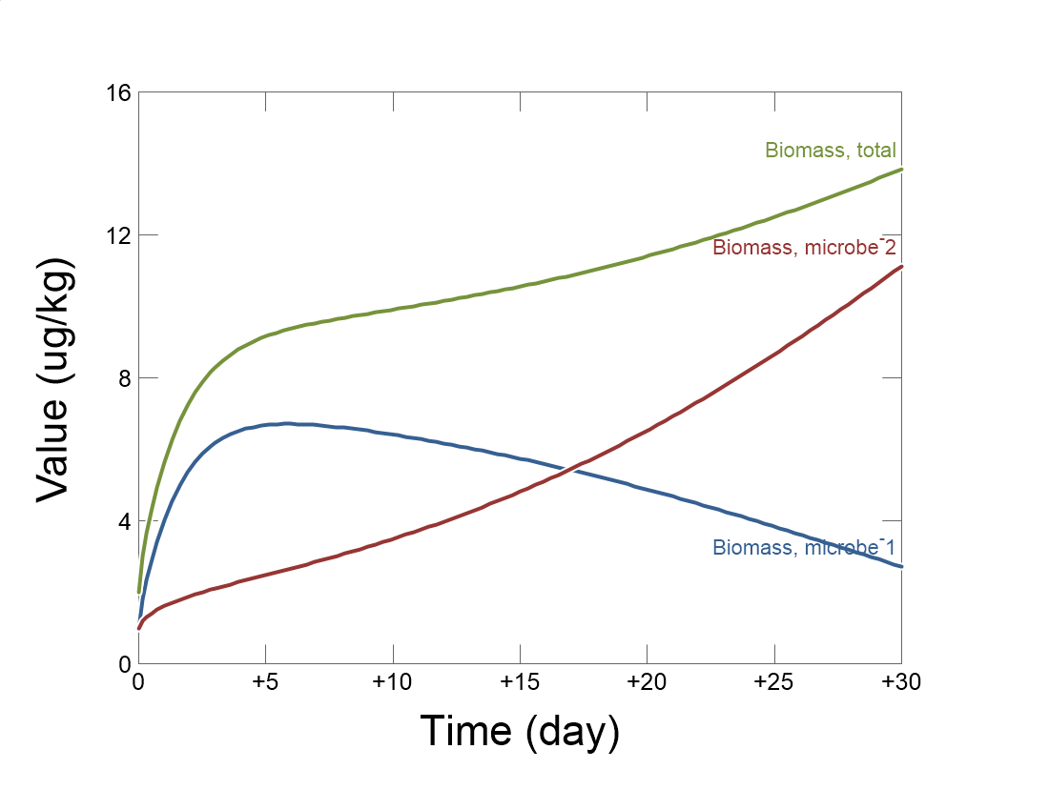

Slide 2
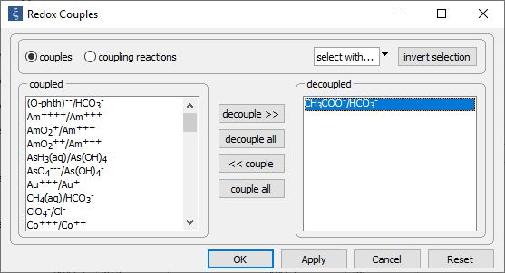
Config →
Redox couples…
Decouple redox pairs for electron donating and accepting half reactions

Slide 3
Set the initial fluid composition on the Basis pane.
Initial fluid contains acetate and is in contact with O₂ and CO₂ in the atmosphere
Set the simulation’s duration

Slide 4
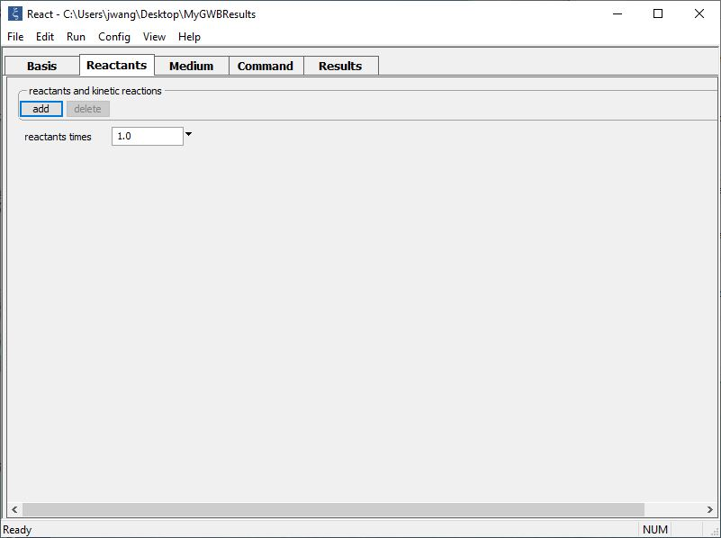
Set up kinetic rate laws for two microbial strains on the Reactants pane.
add → Kinetic →
Microbial reaction
add → Kinetic →
Microbial reaction
In this example, we also set buffers and supply additional substrate to the system

Slide 5
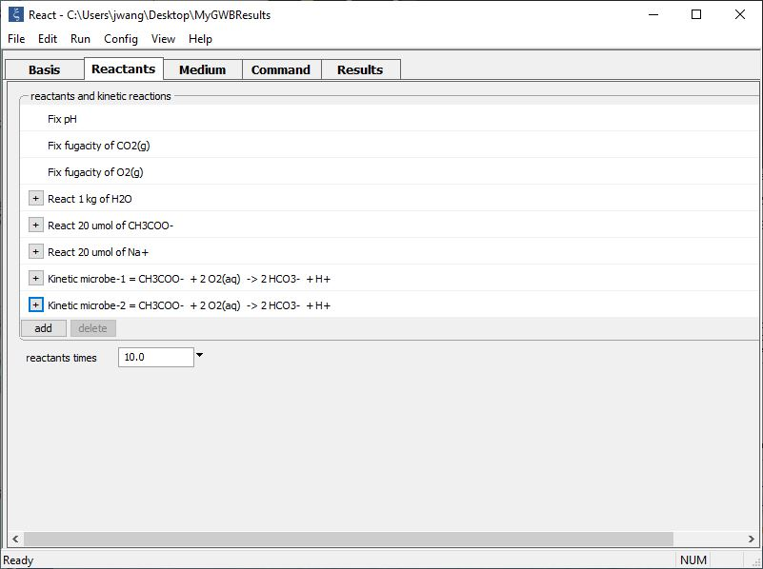
Supply kinetic parameters
Buffer values
Supply additional substrate
Click to expand and supply kinetic parameters for each microbe

Slide 6
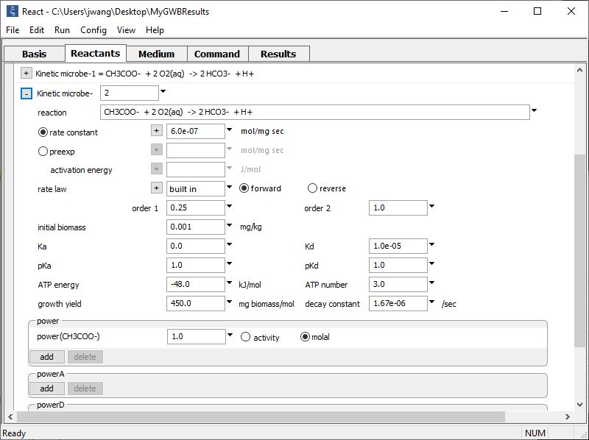
Supply kinetic parameters
Identify each microbial population with a label and reaction.
Microbes can compete for common substrates or catalyze different reactions.
In this example, two different strains, (one fast, the other efficient) growing in a chemostat catalyze the same reaction. They differ in their kinetic and growth parameters.

Slide 7
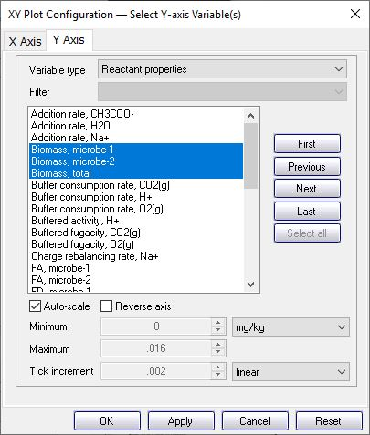
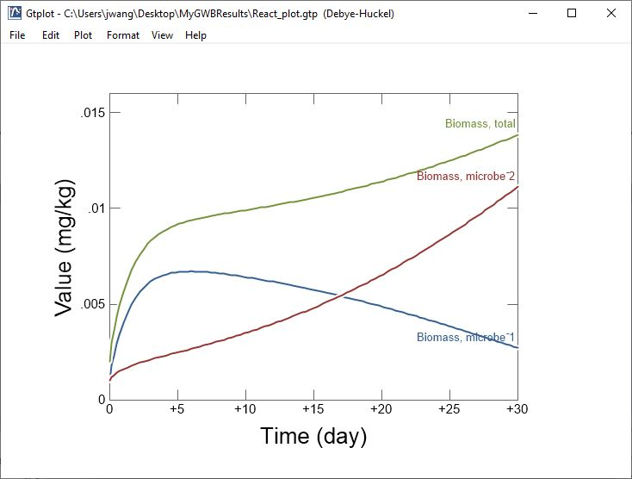
The rapidly metabolizing strain grows fastest initially, but with time is replaced by the more efficient strain.

