Slide 1
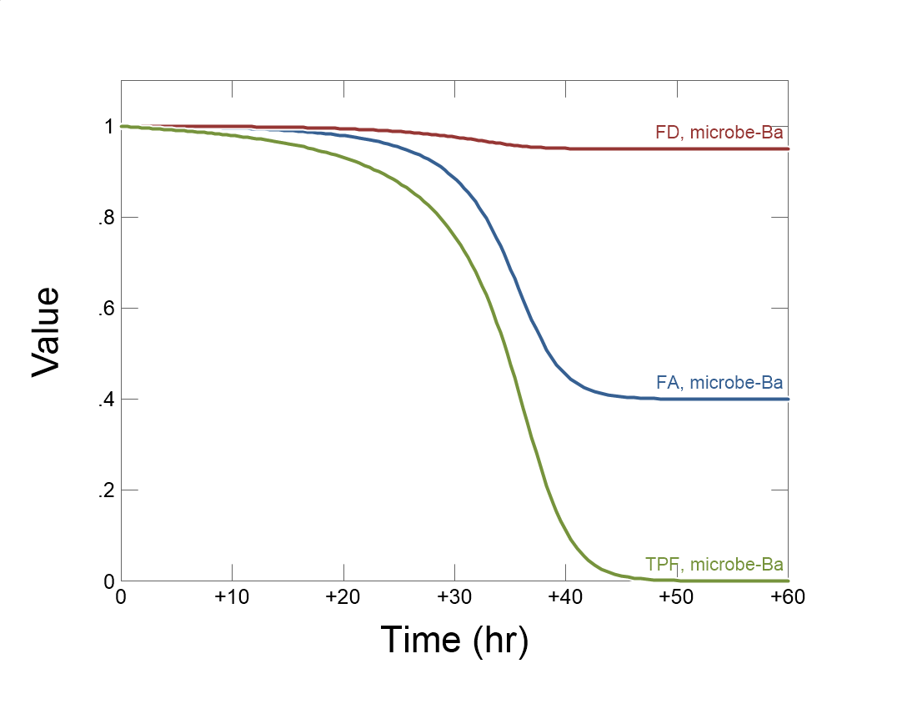

Slide 2
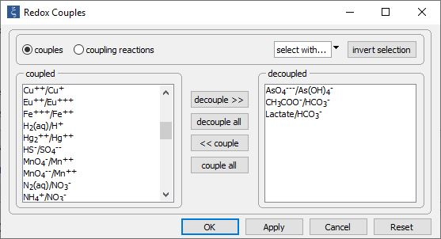
Config →
Redox couples…
Decouple redox pairs for electron donating and accepting half reactions

Slide 3
Set the initial fluid composition on the Basis pane.
Define initial fluid composition, including electron donor and acceptor and small amounts of reaction products.
Set the simulation’s duration

Slide 4
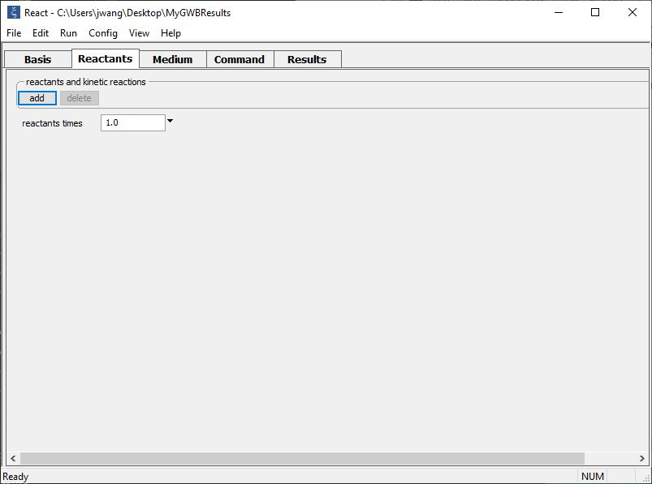
Buffer pH and set up a kinetic rate law on the Reactants pane.
add → Fixed → pH
add → Kinetic →
Microbial reaction

Slide 5
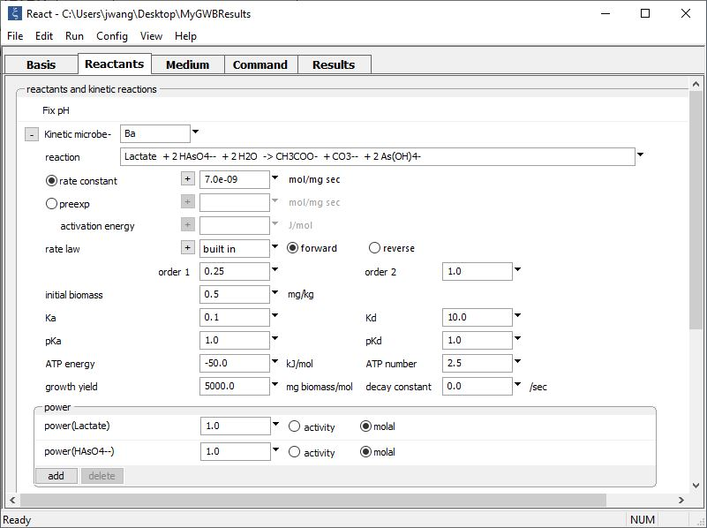
pH buffered to initial value
Supply kinetic parameters
Type out redox reaction catalyzed by the microbe
Enter thermodynamic constraints including ATP energy, ATP number, and reaction order.

Slide 6
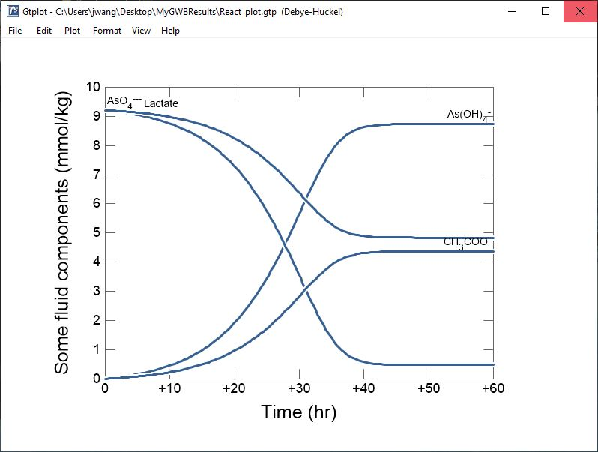
Reaction halts after 40 hours despite the presence of appreciable substrate concentrations.

Slide 7
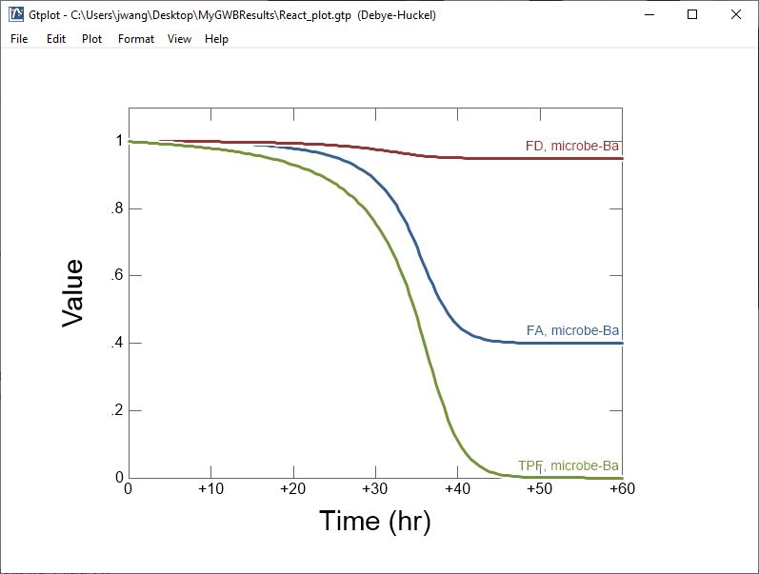
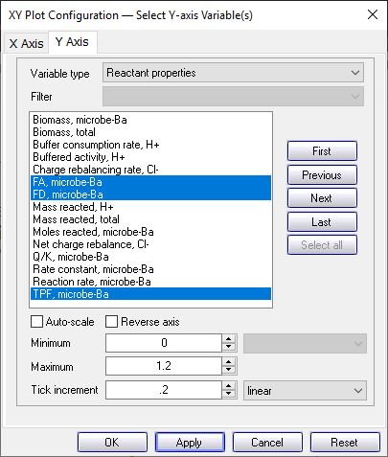
Reaction proceeds uninhibited initially but rate slows primarily due to thermodynamic limitations.

