Slide 2
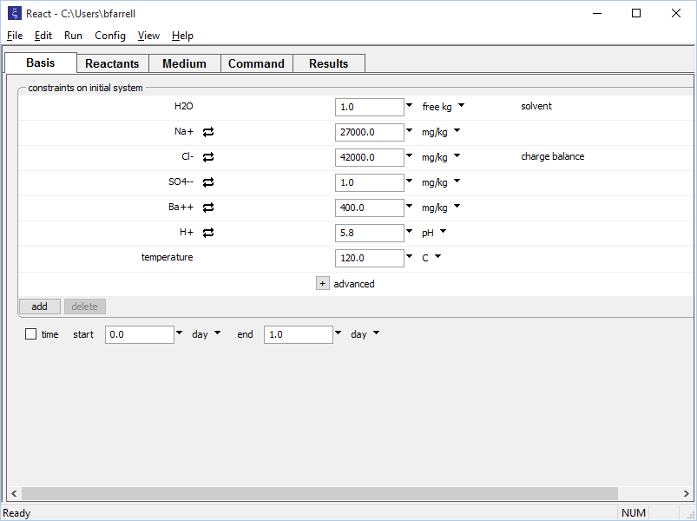
Set the composition of the first fluid on the Basis pane, then equilibrate it.
Fluid 1:
High Ba⁺⁺, low SO₄⁻⁻
Run → Go equilibrates the fluid

Slide 3
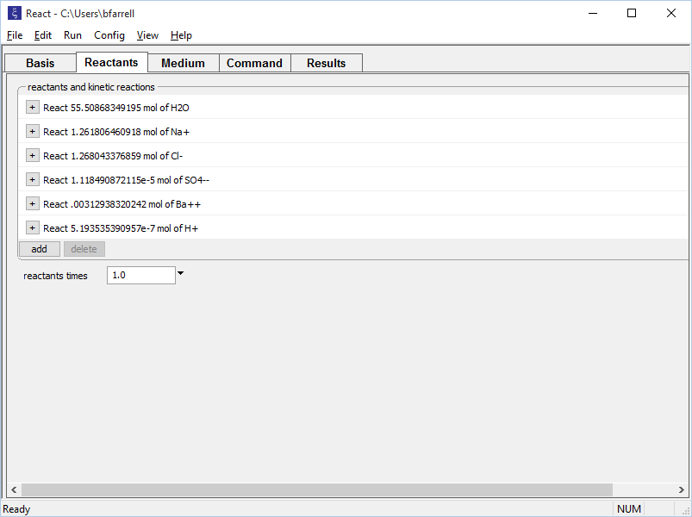
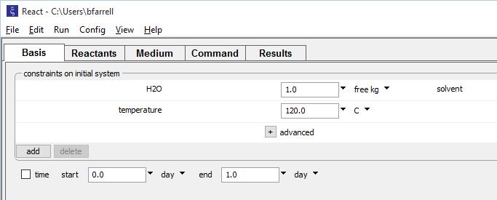
Run → Pickup → Reactants → Fluid moves the equilibrated fluid to the Reactants pane and vacates the Basis pane
The Ba⁺⁺-rich fluid can now be mixed with a new fluid.

Slide 4

Set the composition of the second fluid on the vacated Basis pane.
Fluid 2:
Low Ba⁺⁺, high SO₄⁻⁻

Slide 5
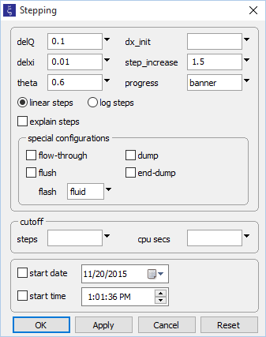
Go to Config → Stepping… to implement a flash model. A flash model mixes two fluids in every possible mixing fraction.
flash: off → fluid
Run → Go
mixes the fluids

Slide 6
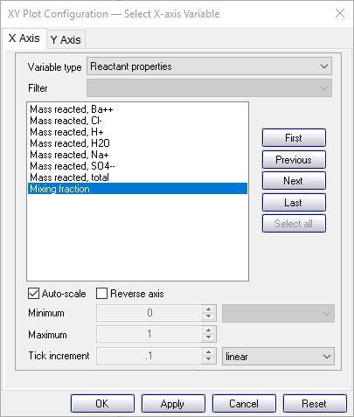
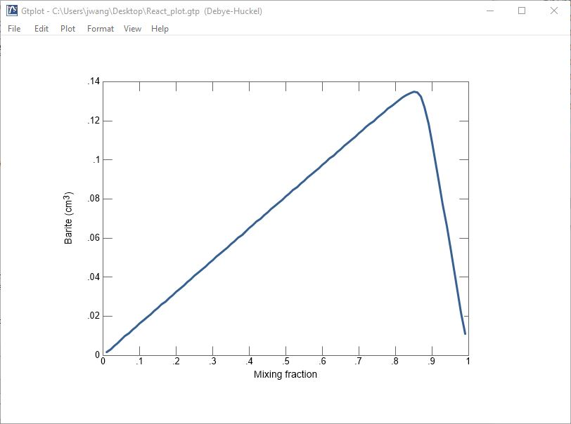
Barite does not precipitate from either end-member fluid, but forms extensively in mixture
Fluid 2:
Low Ba⁺⁺, high SO₄⁻⁻
Fluid 1:
High Ba⁺⁺, low SO₄⁻⁻

Slide 7
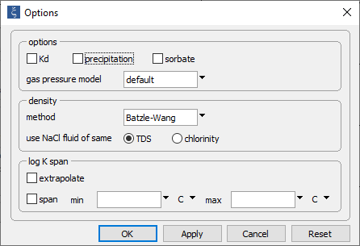
Go to Config → Options… to disable mineral precipitation.
Uncheck “precipitation”
Run → Go
mixes the fluids

Slide 8
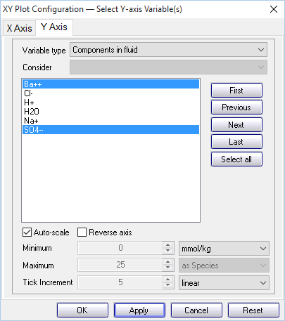
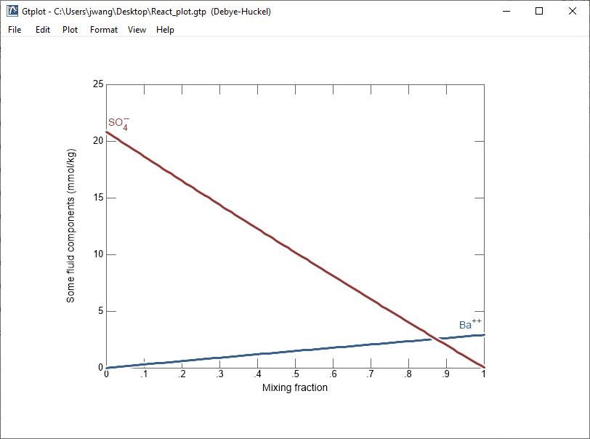
Component concentrations demonstrate (semi)conservative mixing behavior when precipitation is disabled.
Fluid 2:
Low Ba⁺⁺, high SO₄⁻⁻
Fluid 1:
High Ba⁺⁺, low SO₄⁻⁻

Slide 9
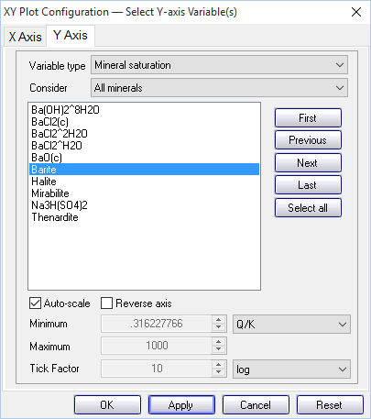
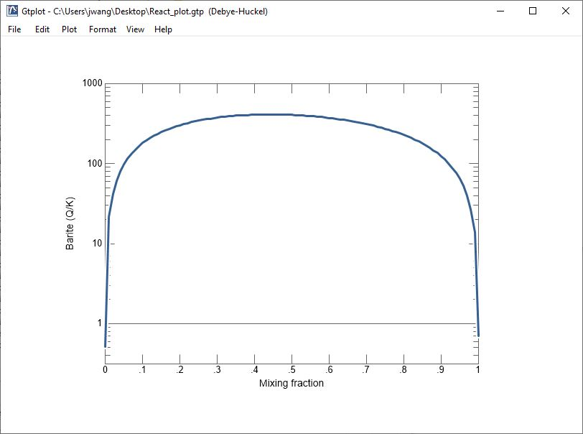
Barite is undersaturated in end-member fluids, oversaturated in mixture.
Fluid 2:
Low Ba⁺⁺, high SO₄⁻⁻
Fluid 1:
High Ba⁺⁺, low SO₄⁻⁻

