Slide 2
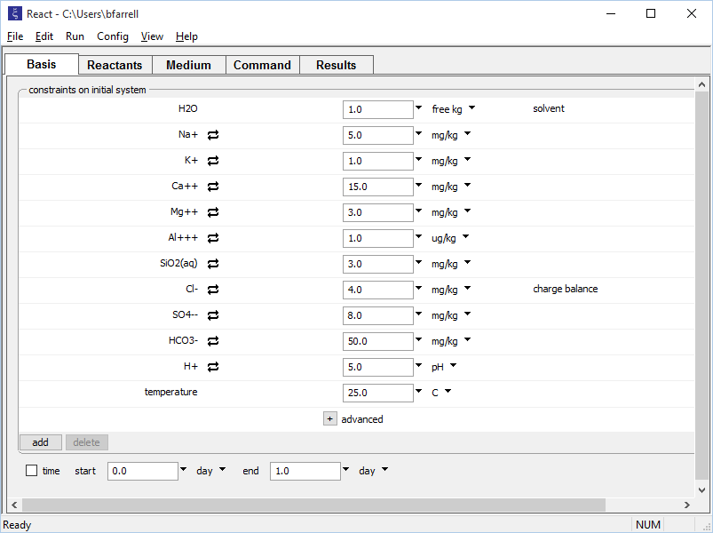
Set the initial fluid composition on the Basis pane.
Dilute fluid, pH 5
Click to add components to the fluid.

Slide 3
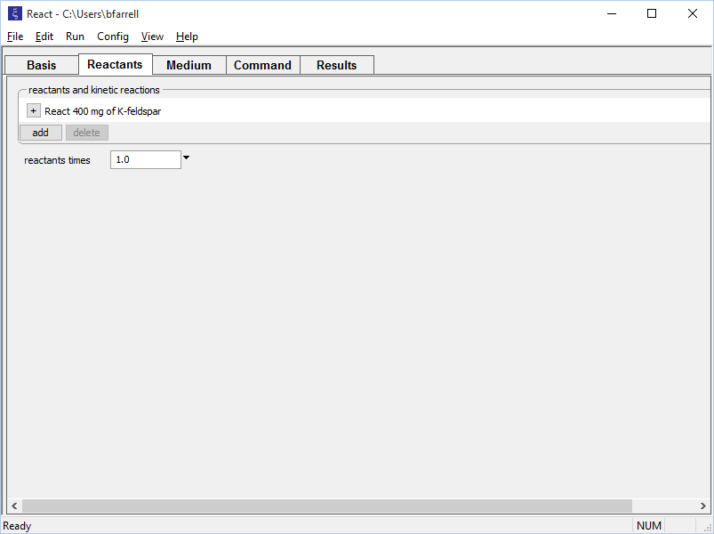
Set up a titration path on the Reactants pane.
400 mg of K-feldspar will gradually be added to the fluid defined on the Basis pane
add → Simple → Mineral… → K-feldspar

Slide 4
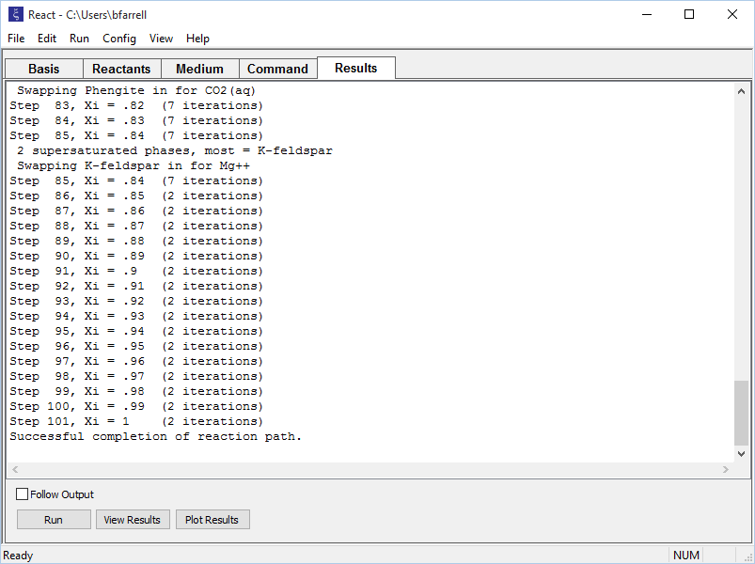
On the Results pane, click Run to execute the calculation.
Open text file
Plot results with Gtplot

Slide 5
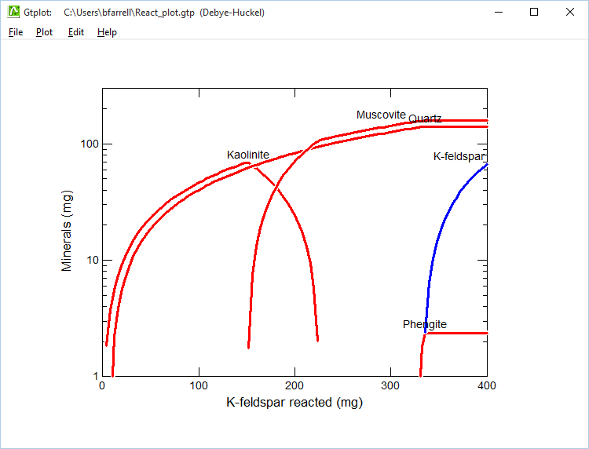
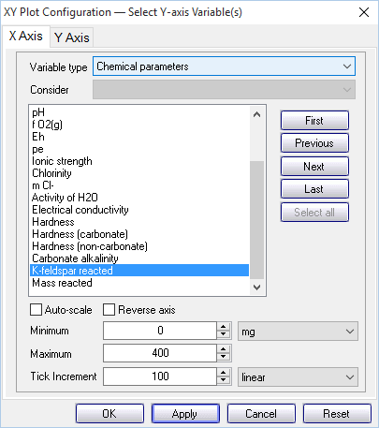
K-feldspar (initially undersaturated) is added to the fluid and dissolves. New minerals precipitate until K-feldspar reaches equilibrium and begins to accumulate in solution.
Look in the “Chemical parameters” to plot as a function of reactant added

