Slide 1
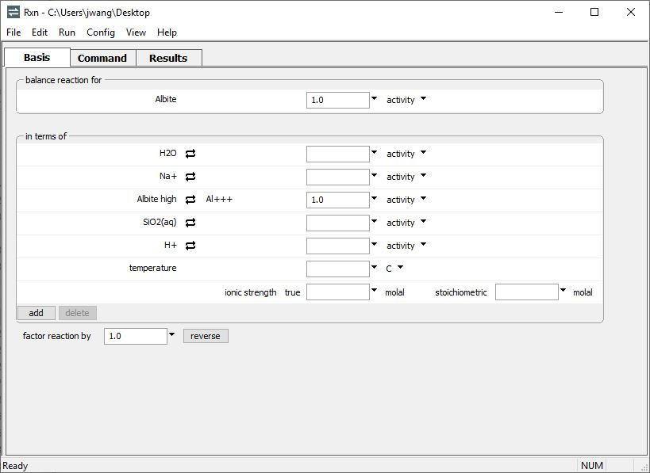
Polymorphs

Slide 2
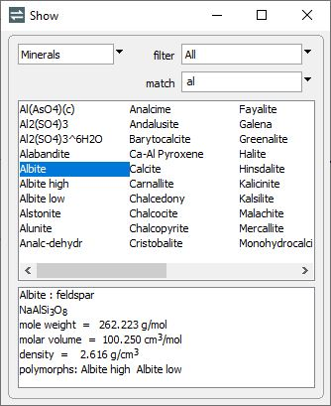
The Show dialog gives you information about the species in a thermo dataset, including the polymorphs of minerals.
Config → Show…
Choose the type of species here.
Begin typing the species’ name to find it faster.
“Albite high” and “Albite low” are two polymorphs of Albite.

Slide 3
Choose a mineral to appear on the left side of a reaction…
… and swap its polymorph into the right side of the reaction

Slide 4
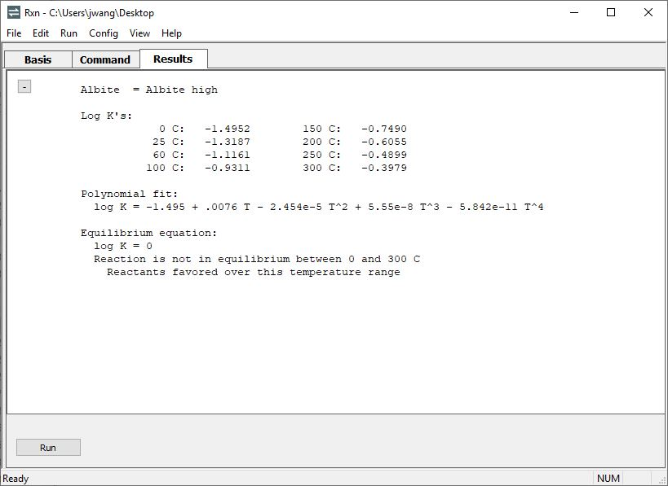
Rxn’s ability to calculate equilibrium temperatures can be used for determining which of a mineral’s polymorphs is stable.
High albite is the unstable form from 0 to 300 °C.

