Slide 1
400
-
HSO
4
300
Pyrite
Some species (mmolal)
200
Balancing reactions
+
+
H
FeCl
100
Hematite
SO
--
4
+++
O
(aq)
Fe
0
2
0
200
400
600
800
O
(aq) reacted (mmolal)
2

Slide 2
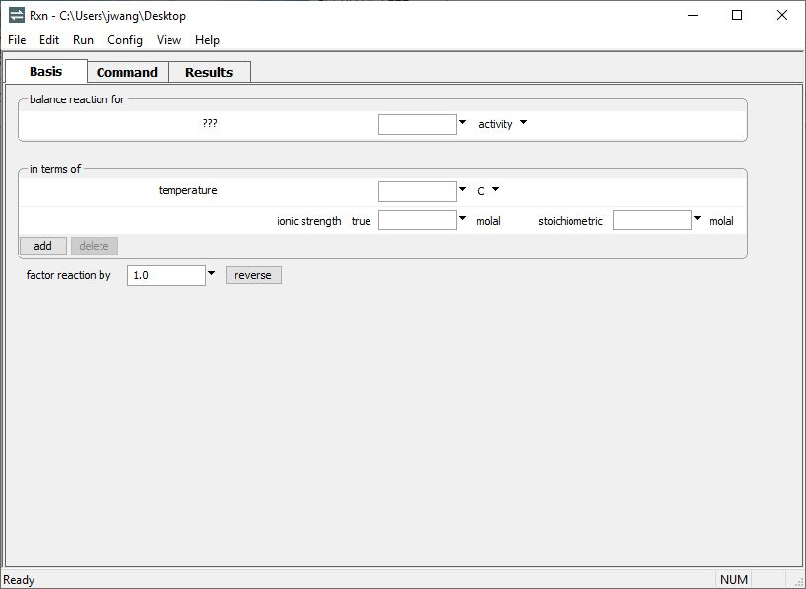
Start by choosing a species to appear on the left side of the reaction.
Click ??? → choose Aqueous…, Mineral…, or Gas… → select a species from the list

Slide 3
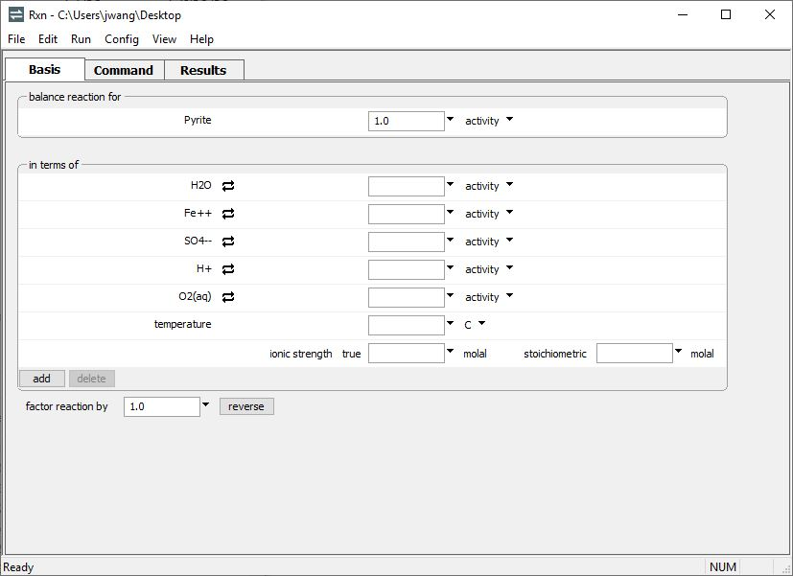
Pyrite selected
Rxn will automatically add species to create a balanced reaction.
Run → Go
balances the reaction

Slide 4
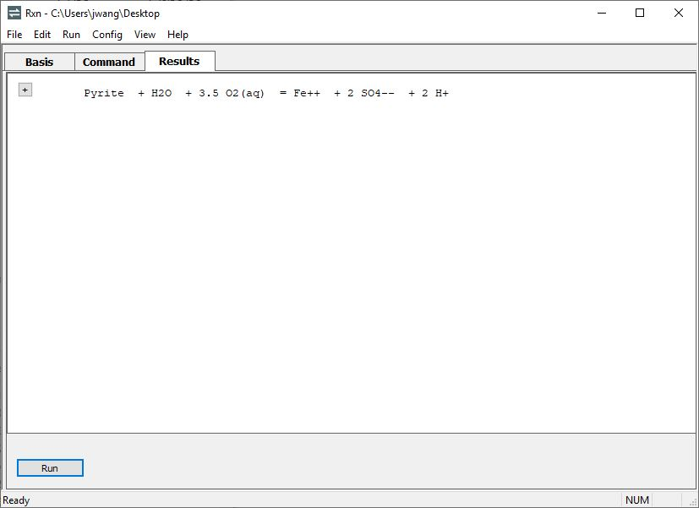
Move to the Results pane.
Rxn writes a reaction with Pyrite on the left side, balanced by the default basis species
Return to the Basis pane to recast the reaction in any form

Slide 5
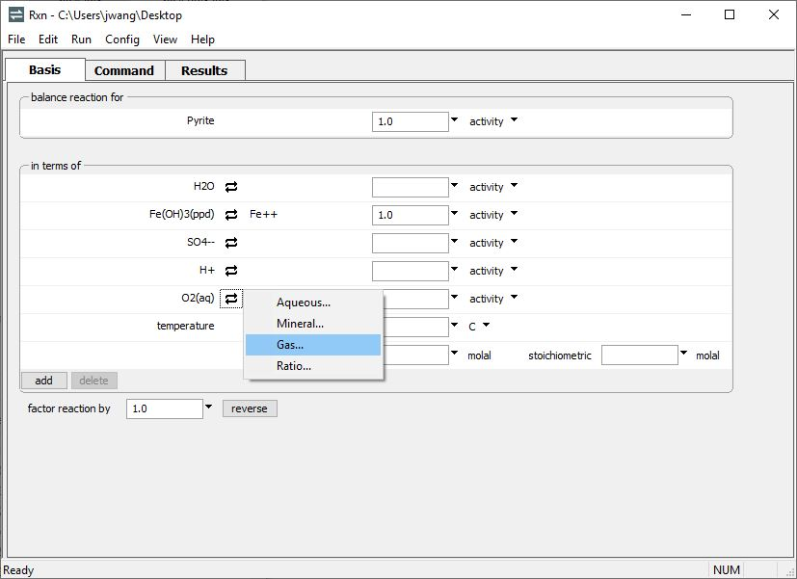
Recast the reaction by performing basis swaps. Click
to swap out an entry, then choose a species to replace it
Fe(OH)₃(ppd) has been swapped in for Fe⁺⁺
Swap O₂(g) in for O₂(aq)
Run → Go
rebalances the reaction

Slide 6
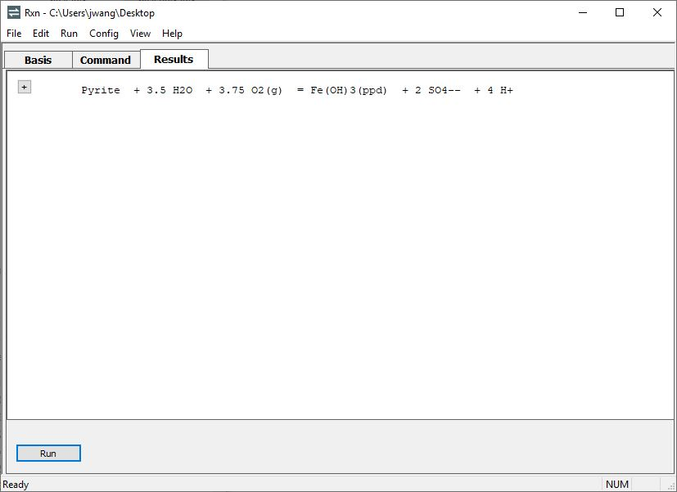
The reaction is automatically rebalanced in terms of a ferric iron mineral and O₂(g).

