Slide 1
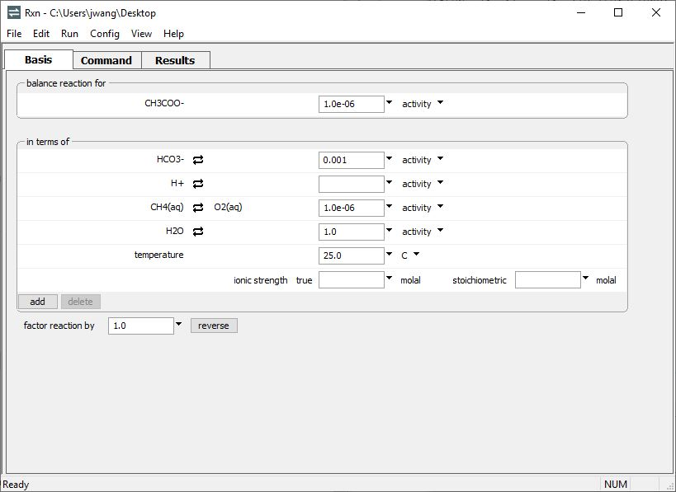
Free energy change

Slide 2
Add species to the Basis pane in Rxn to write a balanced reaction.
Constrain the activity of species in the reaction.
Assume mmol/kg levels of bicarbonate, μmol/kg levels of acetate and methane.
Set temperature

Slide 3
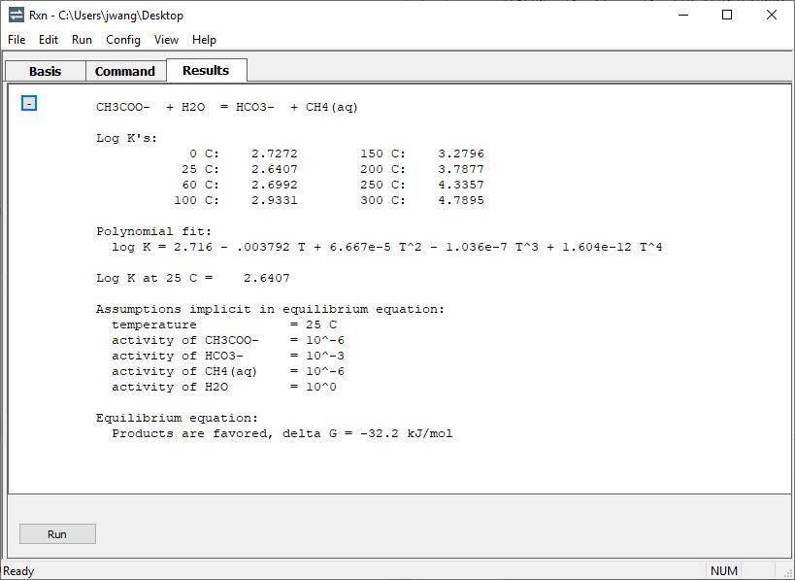
Move to the Results pane.
If the reaction is constrained such that the reactants or products are favored thermodynamically, Rxn will calculate the free energy change of reaction.
For the dismutation of acetate at 25 °C, there is a modest thermodynamic drive for the reaction to proceed forward.

