Slide 1
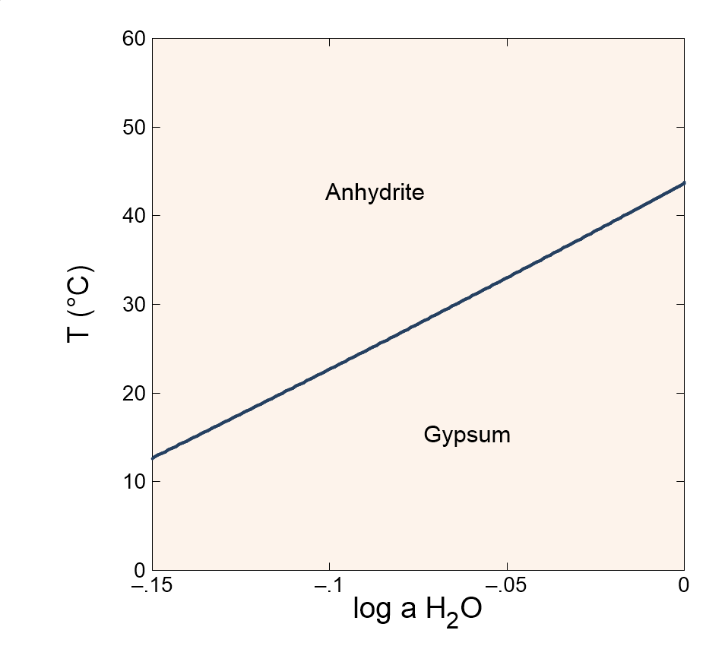

Slide 2
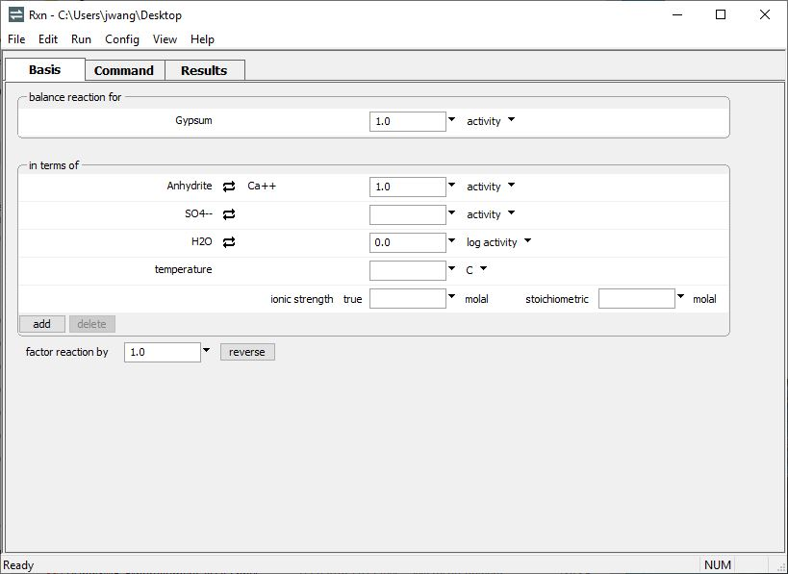
You can use Rxn to calculate the temperature at which a reaction is in equilibrium.
Reaction for the dehydration of gypsum
Constrain the activity of species in the reaction.
Do not set temperature
Run → Go
calculates the equilibrium temperature

Slide 3
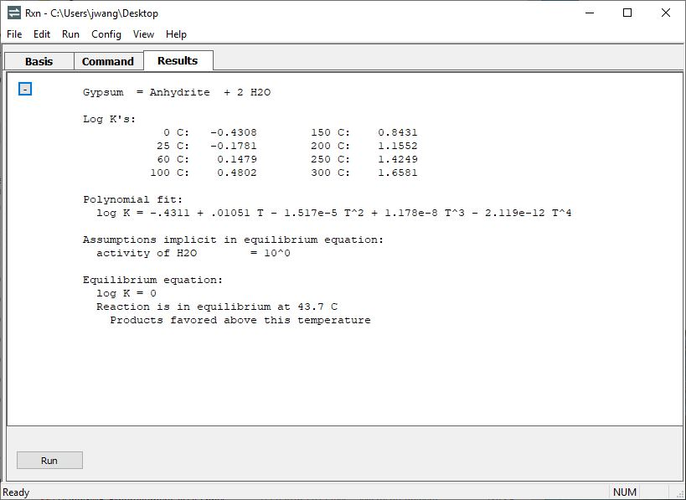
In a dilute solution the water activity is close to 1
The dehydrated mineral is more stable above 43.7°C, the equilibrium temperature.
Return to the Basis pane to alter your system constraints

Slide 4

Change your constraints to see how the equilibrium temperature is affected.
Lower the water activity to model equilibrium in a brine.

Slide 5
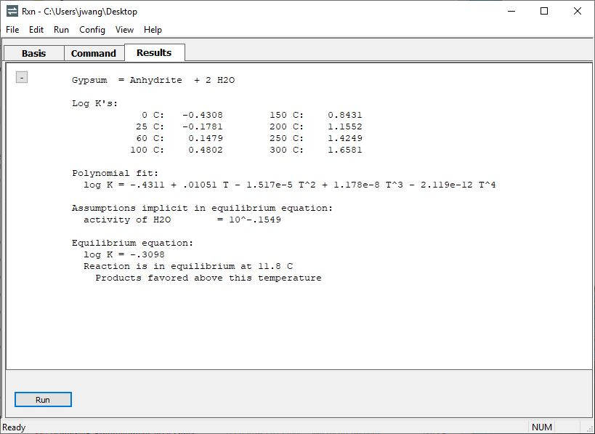
Anhydrite is more stable over a larger temperature range in the brine.

