Slide 1
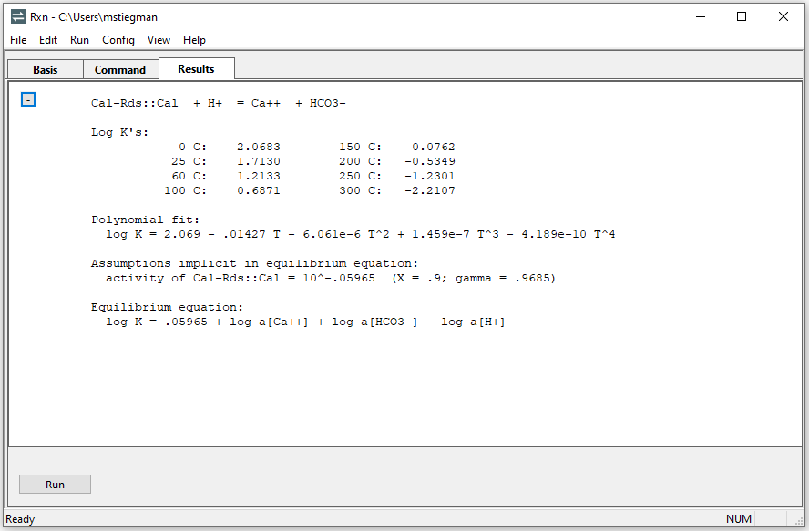
Solid Solutions

Slide 2

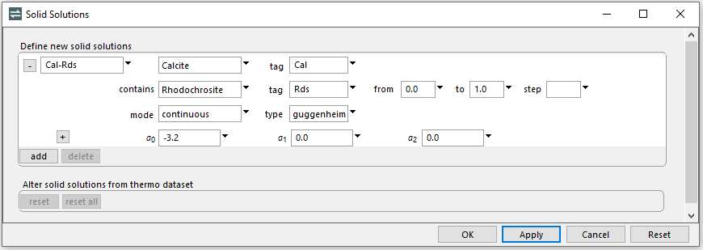
Config → Solid Solutions
Assign a name, end members, and tags (abbreviations)
Set “continuous” and activity model to “Guggenheim” with a0 at -3.2
GWB can define solid solutions as varying continuously or as a sequence of discrete tranches

Slide 3
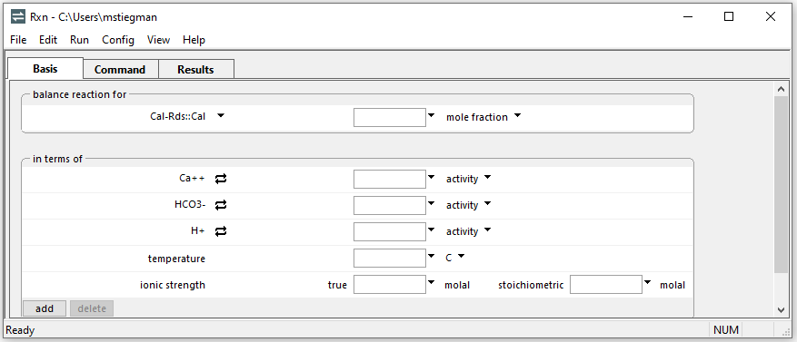
To figure the equilibrium equation for the dissolution reaction of the calcite end member:
???→ End member → Cal-Rds::Cal
Run → Go

Slide 4
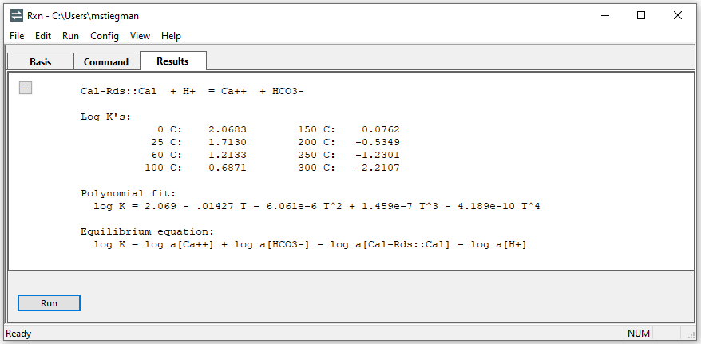
Log K values are the same as pure calcite
Equilibrium equation includes log activity of solid solution end member

Slide 5
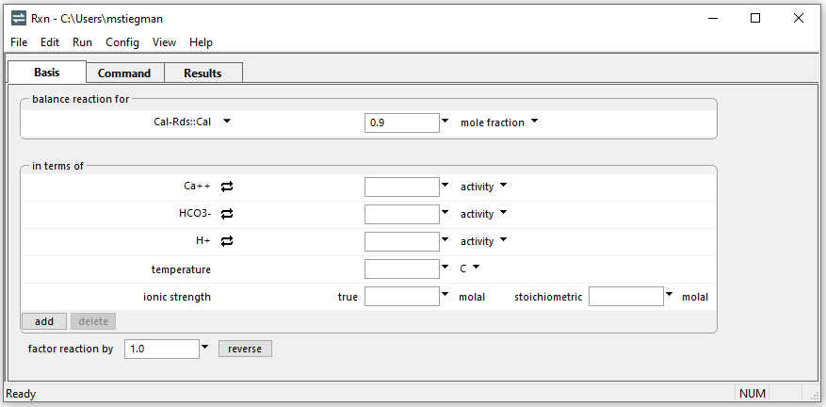
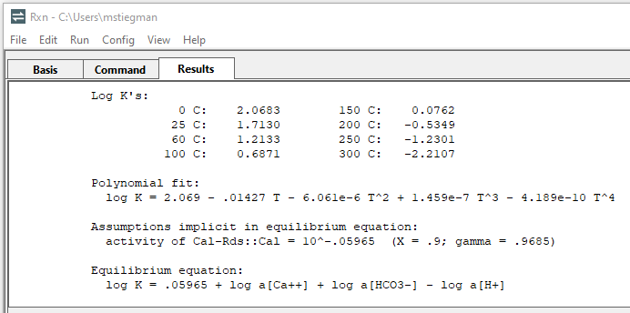
Set mole fraction to evaluate activity
Activity coefficient
Log activity

Slide 6
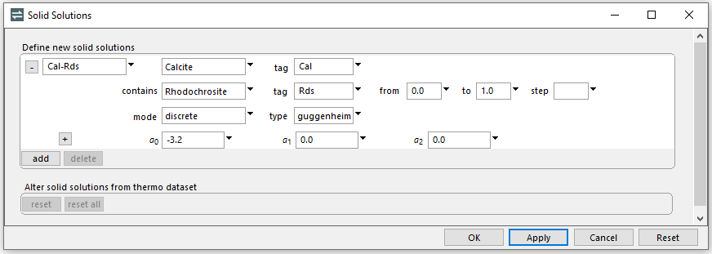
Dissolution of discrete-composition solid solution tranche
Change mode to discrete
Rxn generates discrete tranches from X_{Rds} = 0 to 1, incremented by step (default 1/20th compositional range)

Slide 7
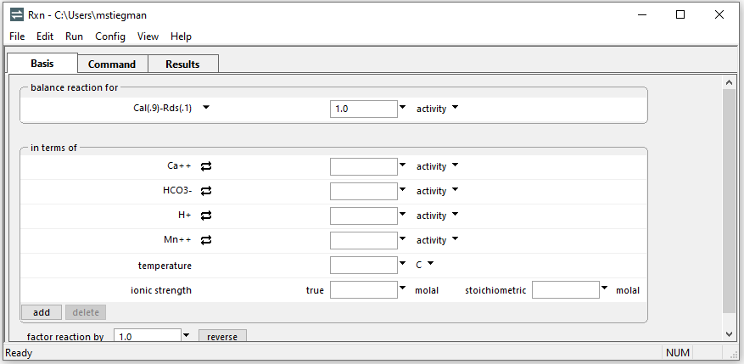
Select tranche: ???→ Mineral → Cal(.9)-Rds(.1)
Run → Go

Slide 8

Equilibrium equation for discrete solid solution
Specified tranche’s dissolution reaction
Log K values reflect activity coefficients for specified composition

