Slide 2
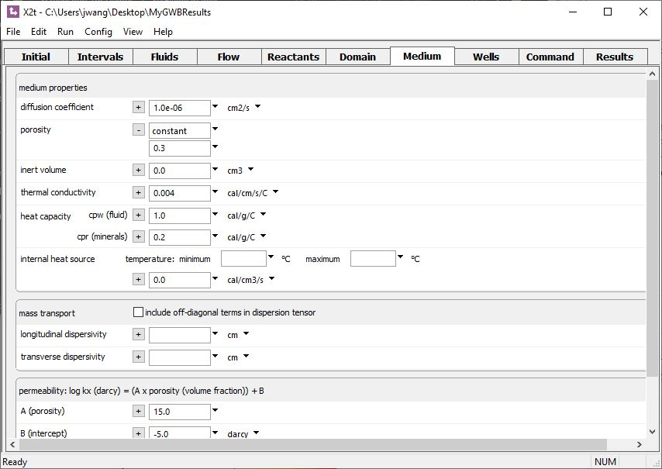
Field variables are constant in space (homogeneous) by default.
Click + to expand, then to select options.
Porosity is 30% throughout the domain.

Slide 3
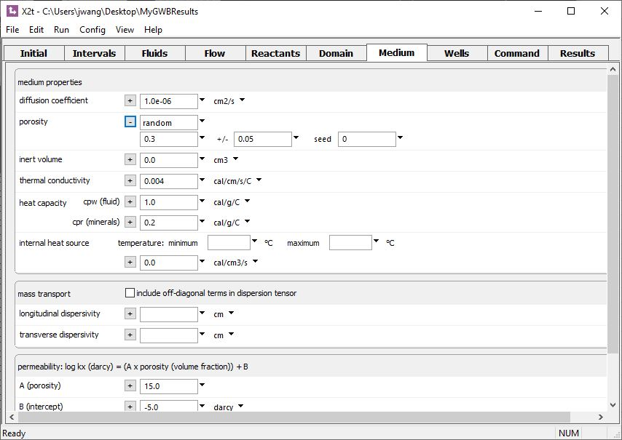
Random field
Porosity varies about a mean of 30% with a standard deviation of 5%.

Slide 4
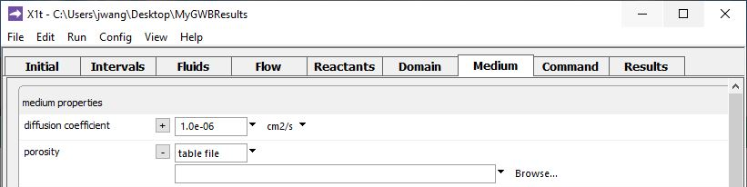
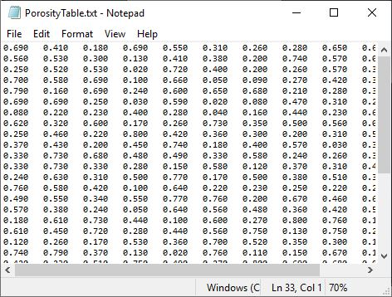
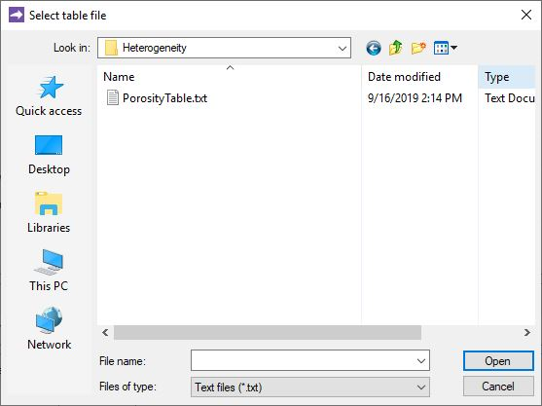
Supply values node-by-node from a table dataset.
Read in values from .txt file.
Click Browse…

Slide 5
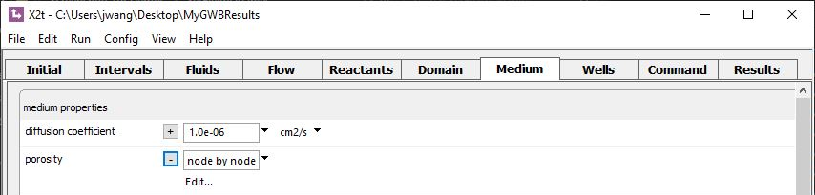
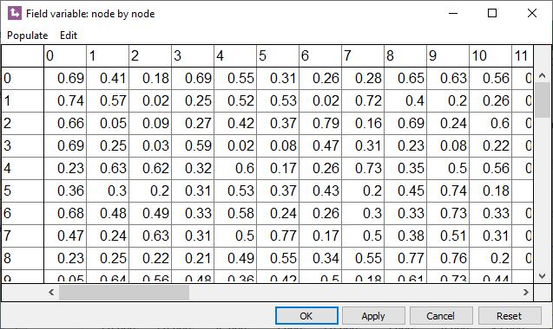
Enter values into a node-by-node editor.
Click Edit…
Nx columns
Type or paste values for each nodal block into an editor.
Ny rows

Slide 6
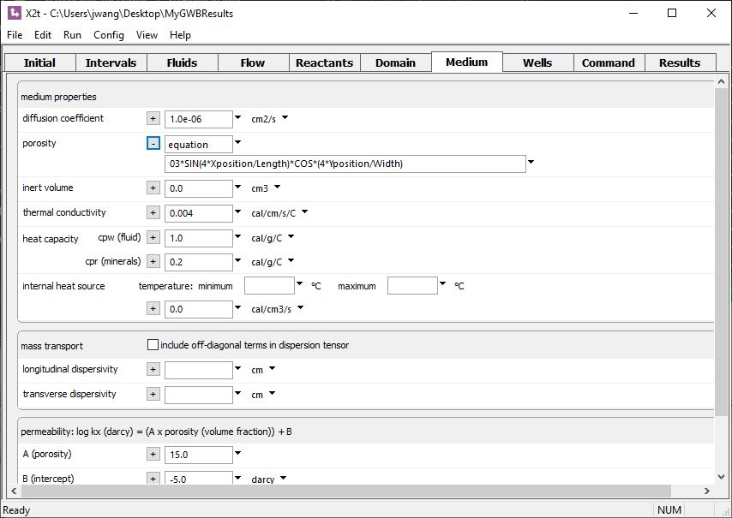
Type in a simple expression.
Porosity varies periodically over the domain according to a trigonometric function.

Slide 7
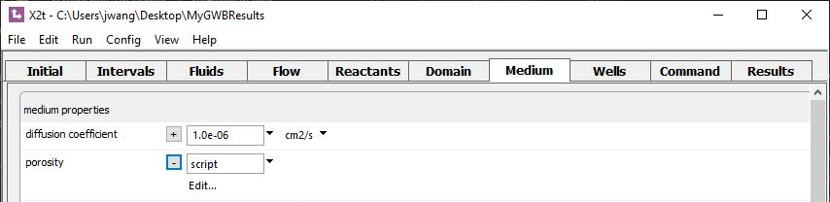
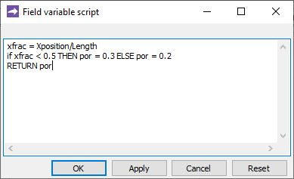
Type the BASIC script into an editor
Click Edit…
Porosity on the left half of the domain is 30%, and on the right half is 20%.

Slide 8
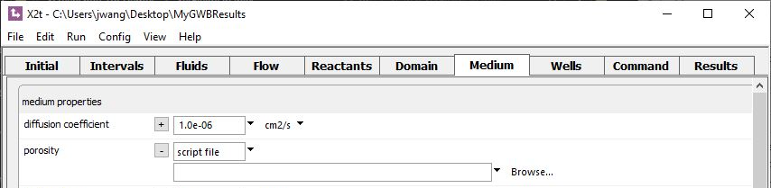
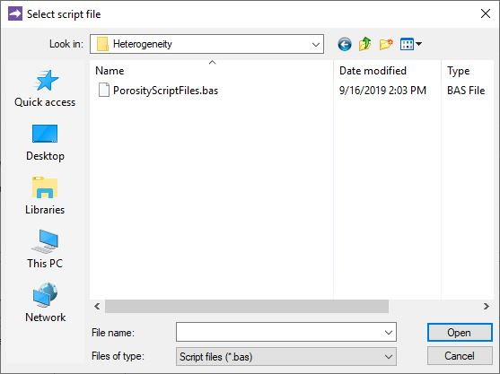
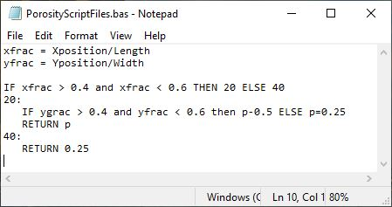
Prepare a script in the BASIC language, save as a .bas file.
Click Browse…
.bas script file
Porosity is 50% in the center of the domain, 25% everywhere else.

Slide 9

Write and compile a C++ function for maximum flexibility
Click Browse…

Slide 10
Your function for field variables can utilize internal parameters and syntax listed in the GWB Reaction Modeling Guide (RMG) and the GWB Reactive Transport Modeling Guide (RTMG).
Method for setting Field variables | BASIC language syntax (RMG Table 5.3) | Internal parameters (RTMG Table A.1)
Constant value
Random field
Table file
Node editor
Equation |  | ✓
Script | ✓ | ✓
Script file | ✓ | ✓
Compiled function |  | ✓
For details, see “Custom Rate Laws” in the GWB Reaction Modeling Guide and “Heterogeneity” in the GWB Reactive Transport Modeling Guide.

Slide 11
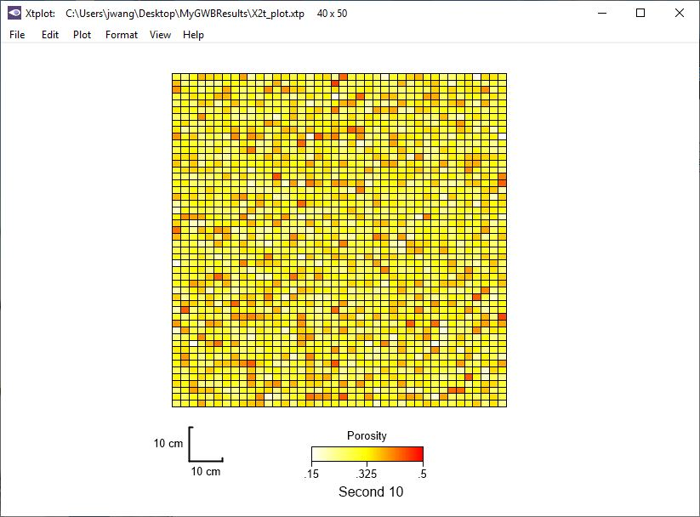
Porosity has been set as a random variable.

