Slide 2
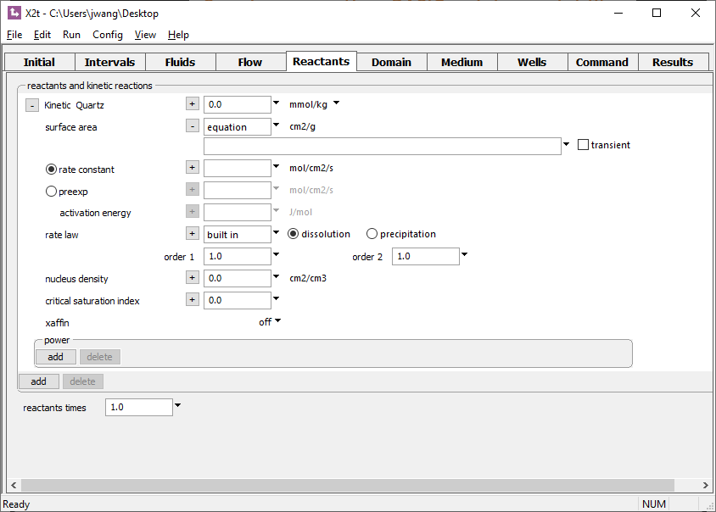
Supply an equation, BASIC script or script file, or a C/C++ function to describe how transient field variables vary in space and time.
Click + to expand, then to select options.
Field variables by default hold steady throughout a run. Check to evaluate at each time step.

Slide 3
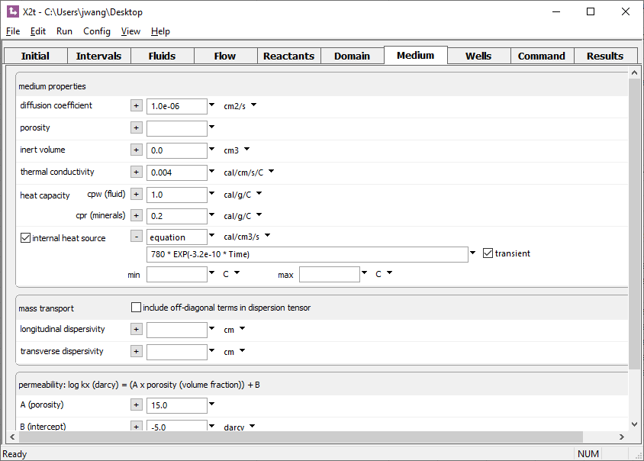
Type in a simple expression.
The function sets a heat source in the domain that decays exponentially with time.

Slide 4
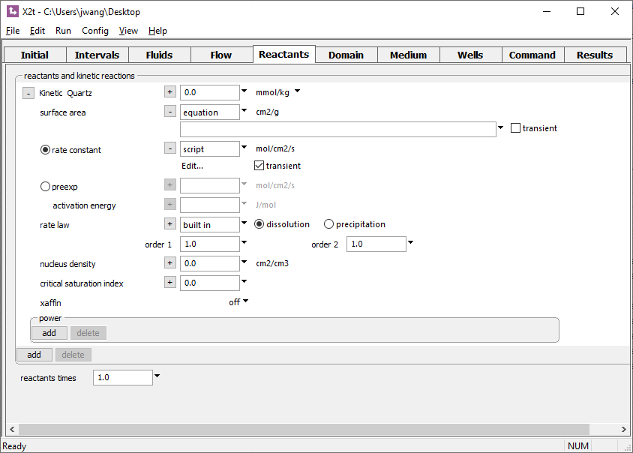
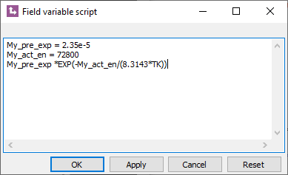
You can type the BASIC script into an editor
Click Edit…
The script mimics the Arrhenius equation by evaluating the user-supplied expression for the rate constant at each time step.

Slide 5
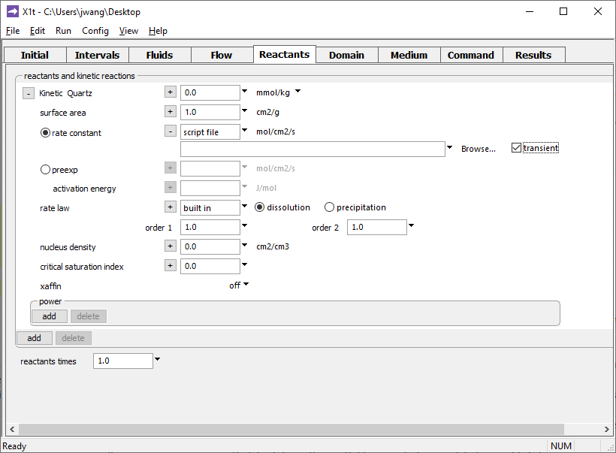
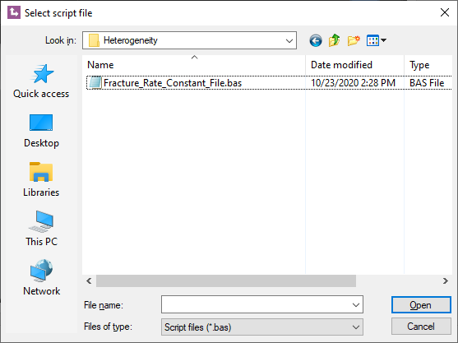
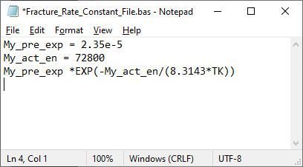
Prepare a script in the BASIC language, save as a .bas file.
Click Browse…
.bas script file
The script mimics the Arrhenius equation by evaluating the user-supplied expression for the rate constant at each time step.

Slide 6
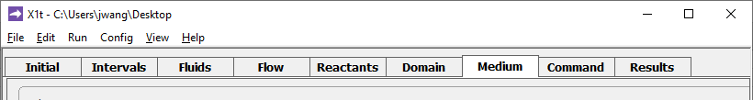
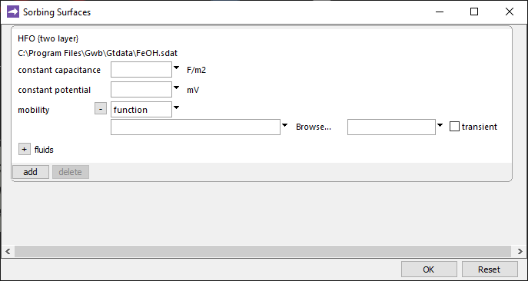
Config →
Sorbing Surfaces…
Colloid mobility is a transient field variable.
Write and compile a C++ function for maximum flexibility
Mobility can range from 0 (immobile) to 1 (fully mobile).
Mobility might depend on ionic strength, pH, surface charge, etc.

Slide 7
Your function for transient field variables can utilize internal parameters and syntax listed in the GWB Reaction Modeling Guide (RMG) and the GWB Reactive Transport Modeling Guide (RTMG).
Method for setting Transient field variables | BASIC language syntax (RMG Table 5.3) | Internal parameters (RTMG Table A.1)
Equation |  | ✓
Script | ✓ | ✓
Script file | ✓ | ✓
Compiled function |  | ✓
For details, see “Custom Rate Laws” in the GWB Reaction Modeling Guide and “Heterogeneity” in the GWB Reactive Transport Modeling Guide.

