Slide 1
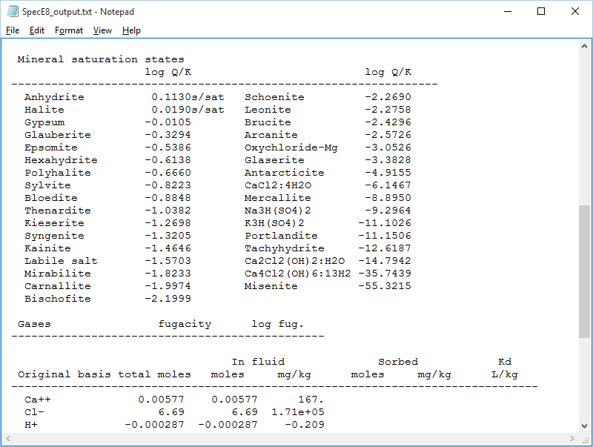
Pitzer equations

Slide 2
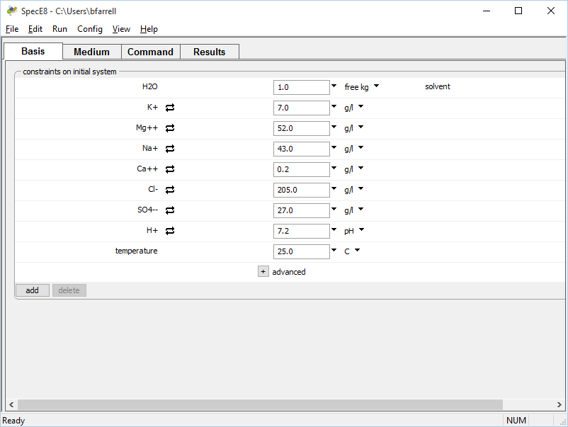
The GWB’s default thermo dataset, thermo.tdat, uses an extended form of the Debye-Huckel equation for activity coefficient calculations.
This fluid was sampled from an evaporite bed
The method becomes less accurate as ionic strength increases.

Slide 3
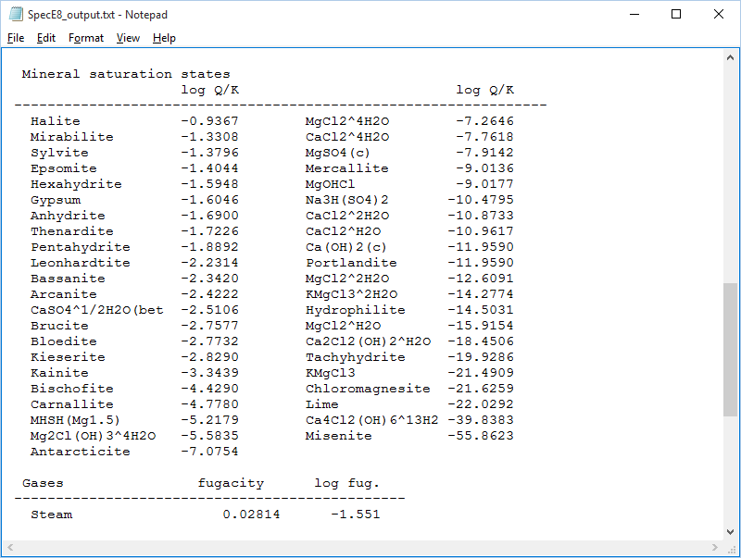
Results calculated using thermo.tdat
Field evidence suggests Halite and Anhydrite are in equilibrium with the fluid, in contrast to calculations.

Slide 4
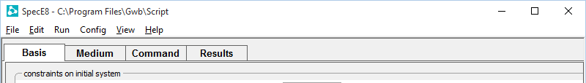
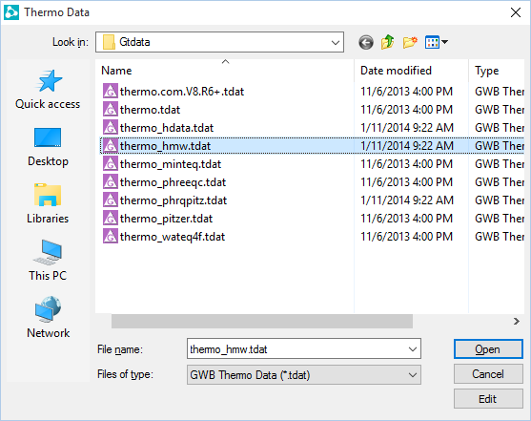
Thermo datasets utilizing the Pitzer equations are designed for application at high ionic strength.
File → Open →
Thermo Data…
thermo_hmw.tdat is the Harvie-Moller-Weare formalism of the Pitzer equations.

Slide 5
Results calculated using thermo_hmw.tdat
In the new calculation, Anhydrite and Halite appear very close to being in equilibrium with the fluid, reflecting the success of the Pitzer equations in highly saline fluids.

