Slide 2
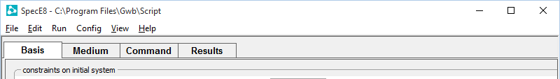
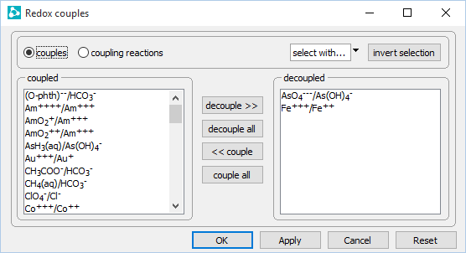
Config →
Redox Couples…
Disable redox coupling between As(V) and As(III), Fe(III) and Fe(II)

Slide 3
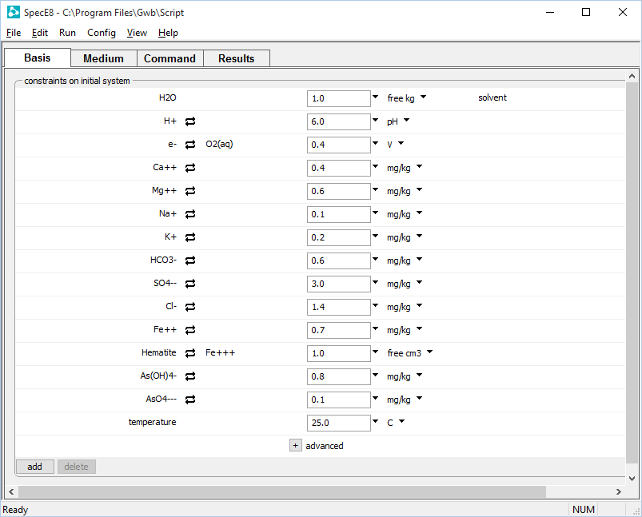
Eh controls redox potential of coupled redox pairs.
HCO₃⁻ will be distributed between inorganic carbon, methane, and acetate
SO₄⁻⁻ will be distributed between sulfate and sulfide
Equilibrium not reached between decoupled redox pairs
Fe(III) constrained separately from Fe(II); As(V) from As(III).

Slide 4
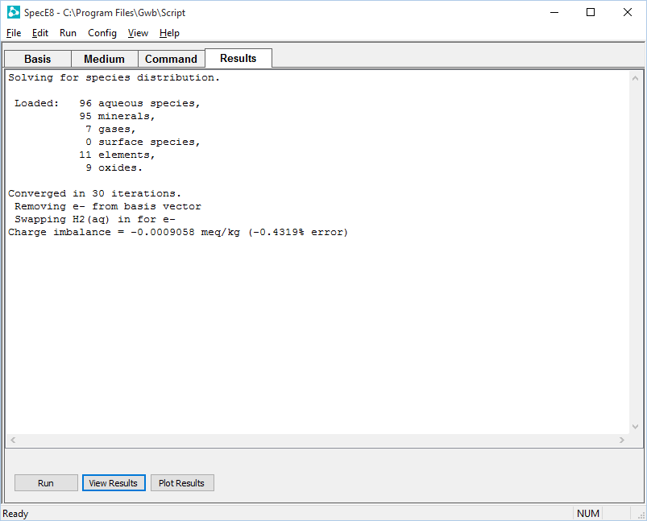
On the Results pane, click Run to execute the calculation.
Open text file
Plot results with Gtplot

Slide 5
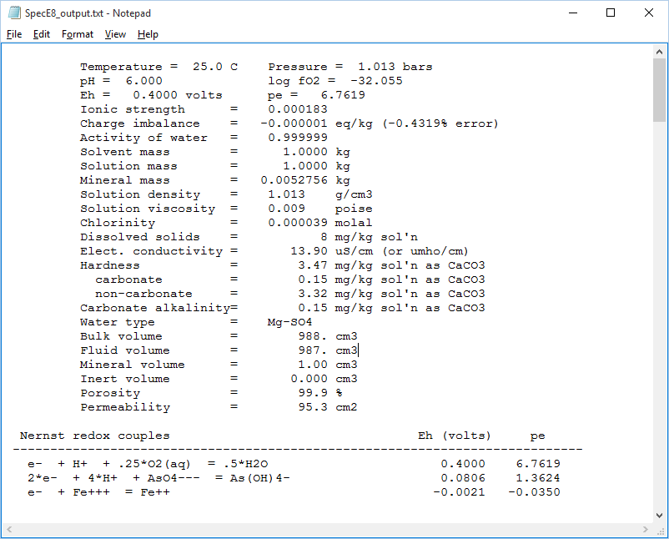
“View Results” opens text file
System Eh matches the constraint set on the Basis pane
System Eh is followed by Nernst Eh calculated for decoupled redox pairs

Slide 6
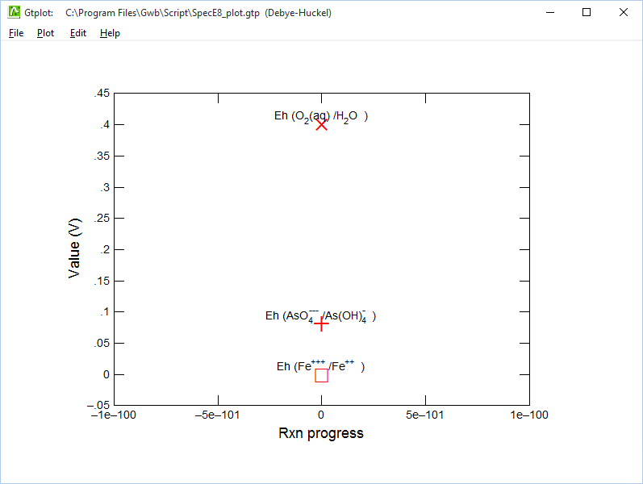
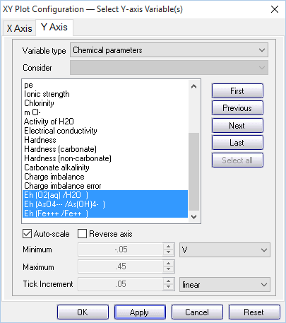
“Plot Results” opens Gtplot
Select “Chemical parameters” for the “Variable type”
Widely varying Eh values indicate system has not reached redox equilibrium
Select Nernstian Eh values

