Slide 1
Quartz
,
1
Tridymite
Chalcedony
Ÿ
œ
Cristobalite
Saturation, some minerals (Q/K)
+
.1
Amrph^
silica
›
.01
5
6
7
8
pH

Slide 2
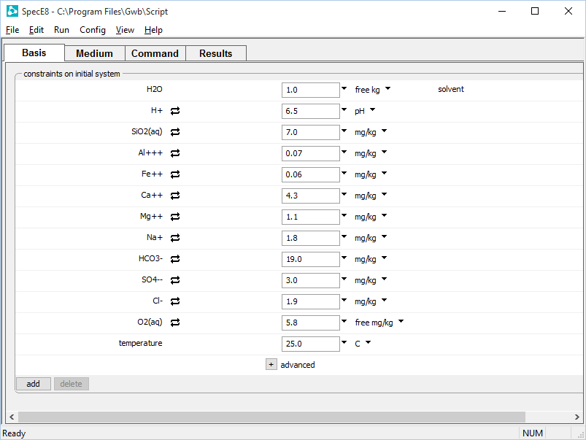
Enter your fluid composition on the Basis pane
Set dissolved concentrations in units of your choice
Set temperature of your system
Click to add new entries

Slide 3
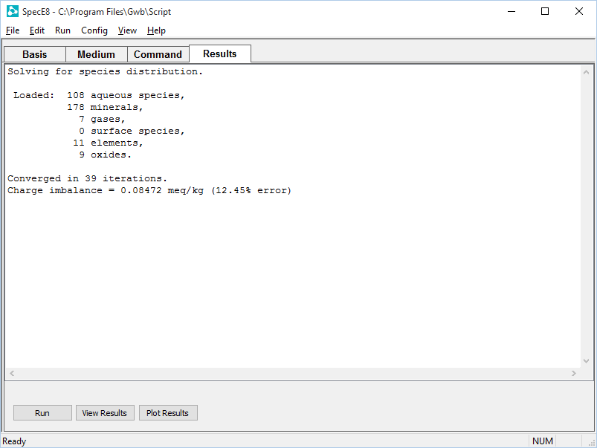
On the Results pane, click Run to execute the calculation.
Open text file
Plot results with Gtplot

Slide 4
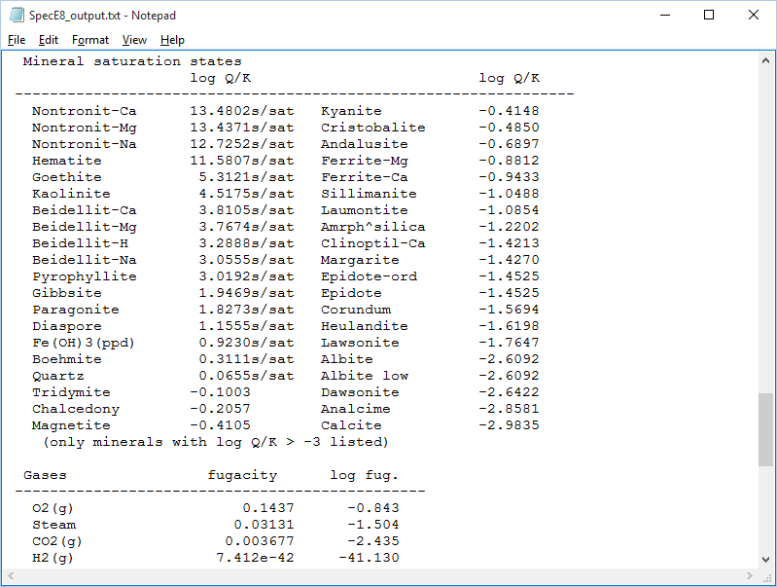
“View Results” opens text file
Oversaturated minerals
Undersaturated minerals

Slide 5
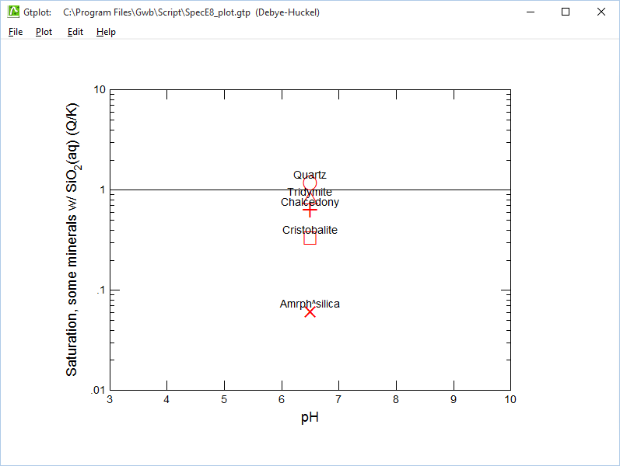
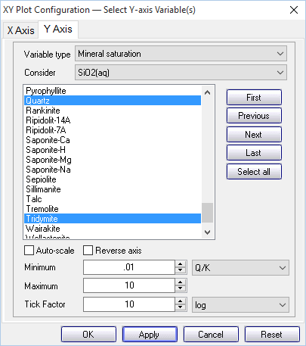
“Plot Results” opens Gtplot
Set X and Y axes
Set “Variable type” to “Mineral saturation”
Only consider minerals with silica

Slide 6
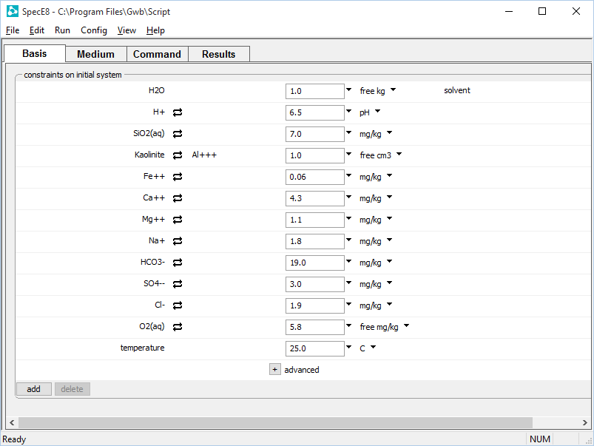
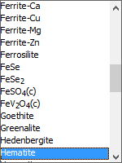
You can set your fluid in equilibrium with one or more minerals by swapping them into the basis
Kaolinite swapped in for Al+++
Set an arbitrary mass or volume
Swap Hematite in for Fe++
Rerun your model to figure the new equilibrium state

Slide 7
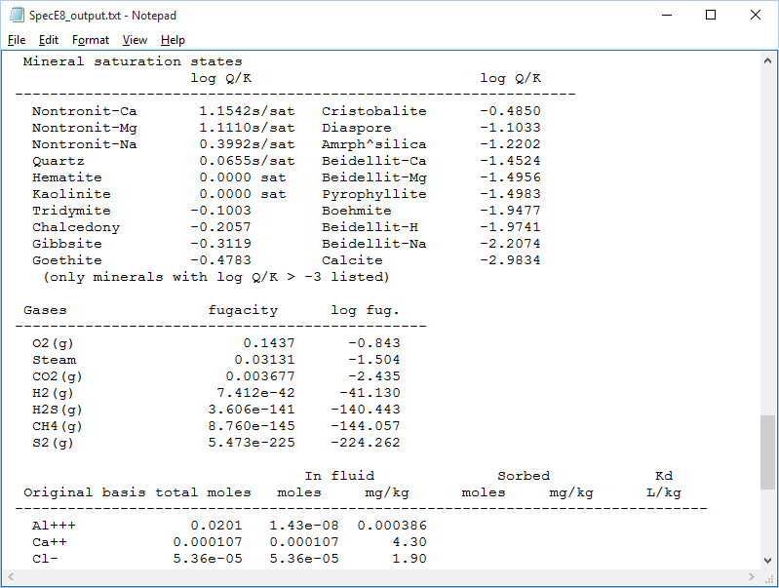
The new fluid is distinct from the previously defined fluid.
We set our new fluid in equilibrium with Hematite and Kaolinite, so their saturation indices should be 0

