Slide 1
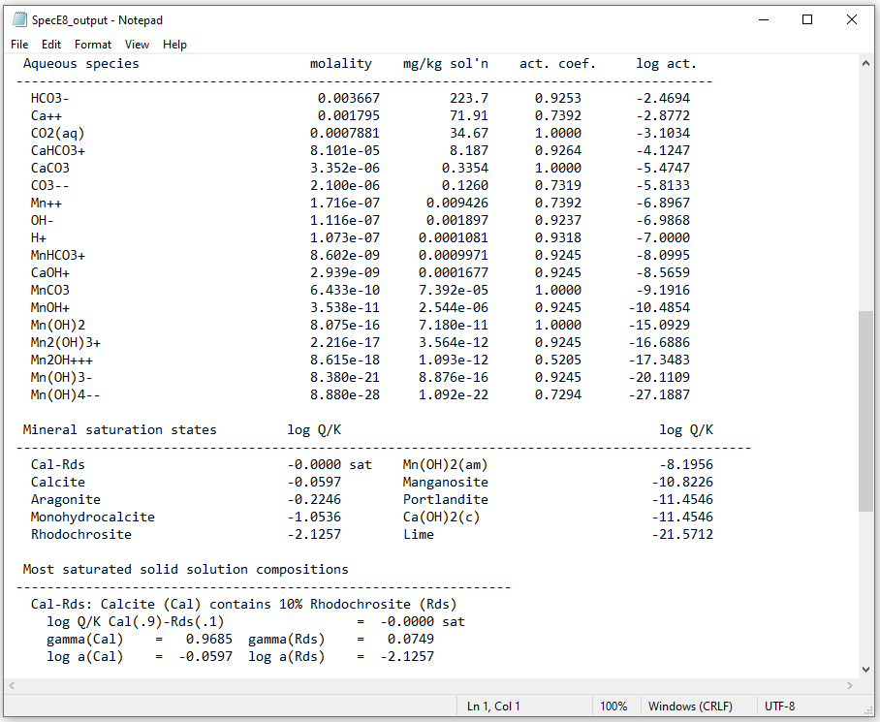
Solid Solutions

Slide 2
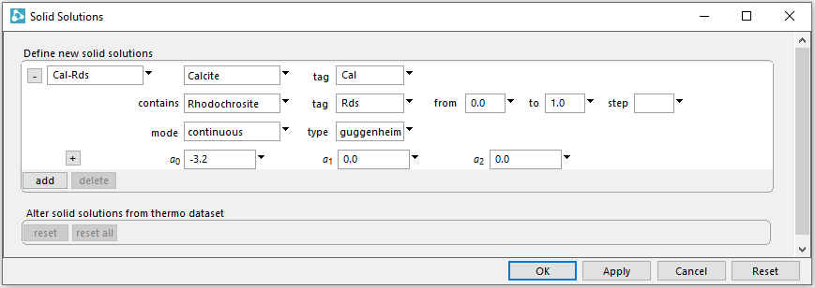
Config → Solid Solutions
Choose a name for the solid solution, define end members, and give them tags
Set activity model to continuous and type to Guggenheim with “a0” at -3.2

Slide 3
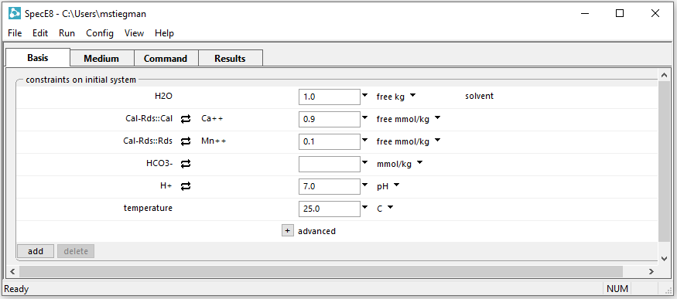
Defining a fluid in equilibrium with a solid solution
Swap both end members into the basis and set free masses (constrains mole fraction)
Run → Go

Slide 4
Includes solid solutions and end members in the system with saturation states, compositions, and activities
Solid Solution and fluid are in equilibrium, so the solution’s saturation index is zero
End member activity coefficients and log activities

