Slide 2
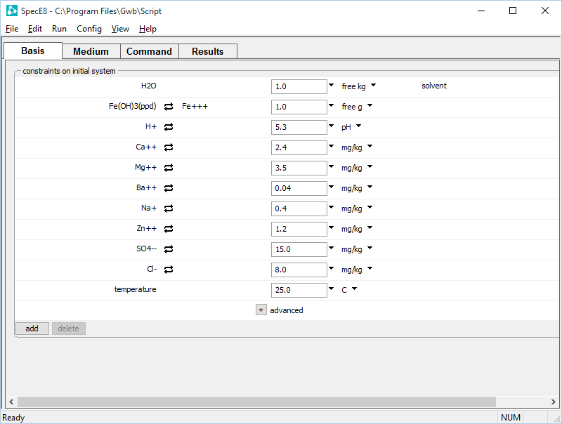
Set the fluid composition and mass of sorbing minerals on the Basis pane.
The number of surface sites is proportional to the sorbing mineral’s mass
Swap sorbing mineral into the basis

Slide 3
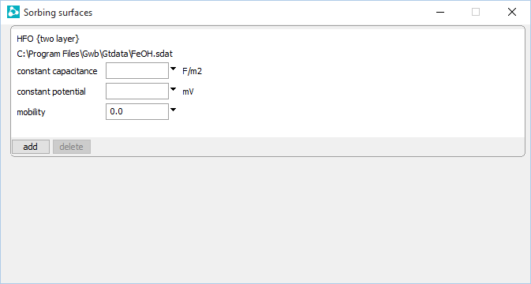
File → Open →
Sorbing Surfaces…
Surface complexation dataset for hydrous ferric oxide.
You can add any number of sorbing surfaces.

Slide 4
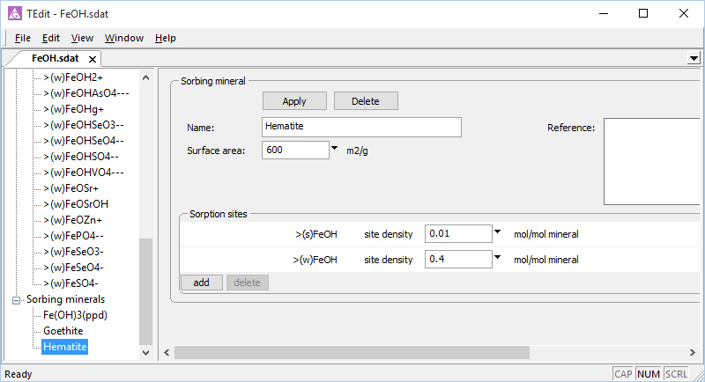
You can view the loaded dataset of surface reactions in TEdit
File → View →
…\FeOH.sdat
Surface complexes in the dataset
Hematite surface site density
The sorbing minerals contain the surface sites

Slide 5
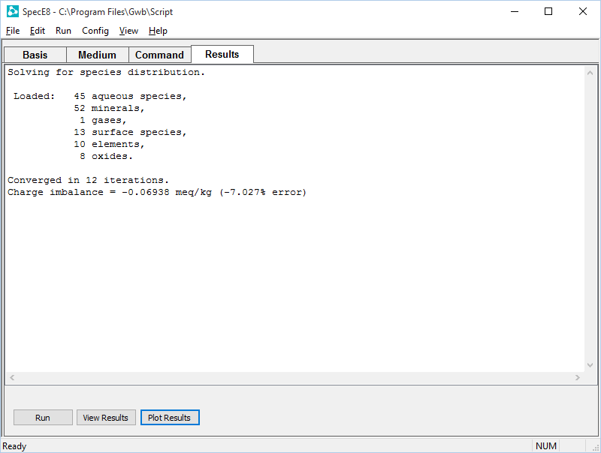
On the Results pane, click Run to execute the calculation.
Open text file
Plot results with Gtplot

Slide 6
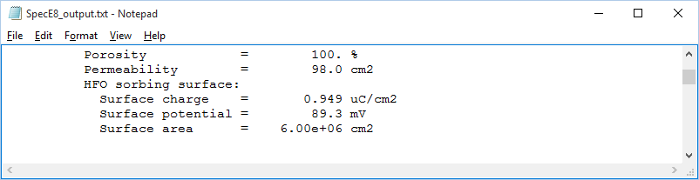
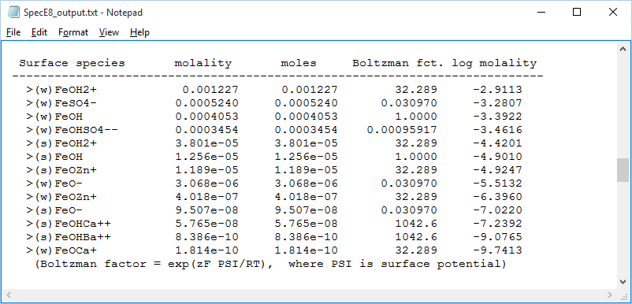
“View Results” opens text file
Calculated surface charge, surface potential, and surface area
Concentrations of surface complexes
Boltzman factors describe the magnitude of electrostatic corrections
System Eh is followed by Nernst Eh calculated for decoupled redox pairs

Slide 7
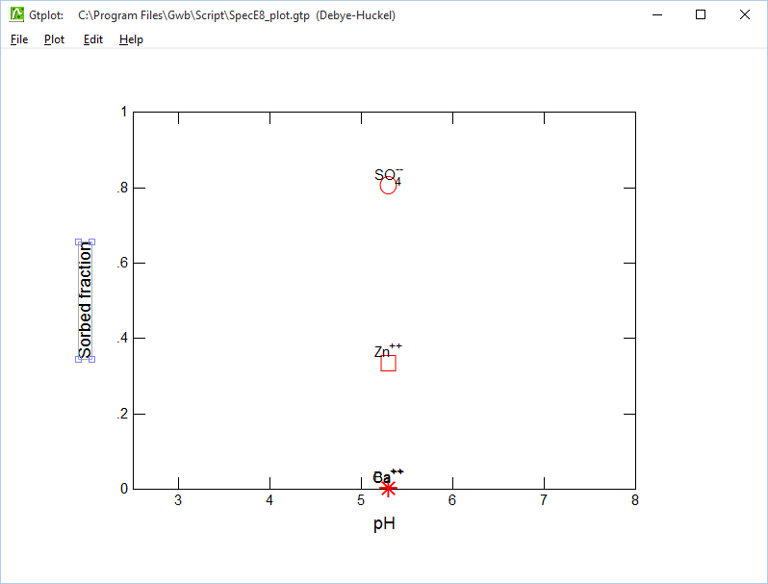
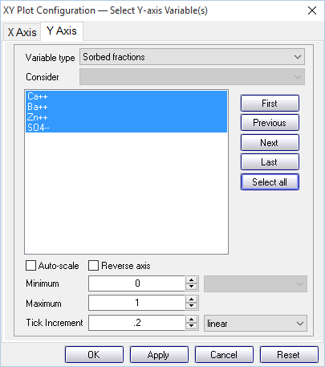
“Plot Results” opens Gtplot
Select “Sorbed fractions” for the “Variable type”
The anion SO₄⁻⁻ is strongly sorbed at pH 5.3, but not the cations.
Select Nernstian Eh values

