Slide 1
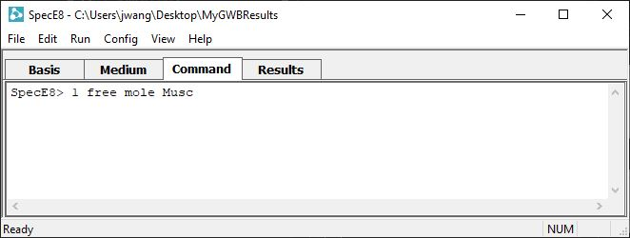
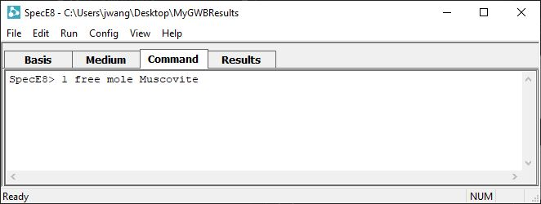
Spelling Completion

Slide 2
A number of helpful features are available when working from the Command pane
Touch the Tab key when you have typed enough characters to identify the name of a chemical or mineral completely.
The app will complete the name for you. Hit Enter to trigger the command.

Slide 3
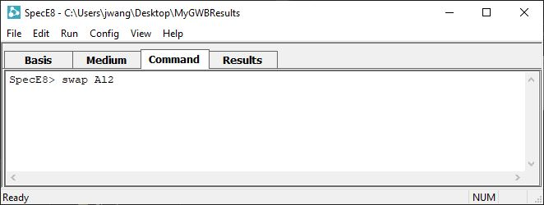
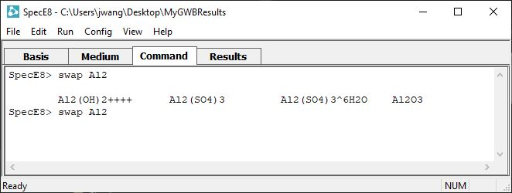
If the app can’t identify a unique name, touch Tab repeatedly to cycle through the options, or touch Ctrl+D to show all possible completions...
… then finish typing the command.

