Slide 1
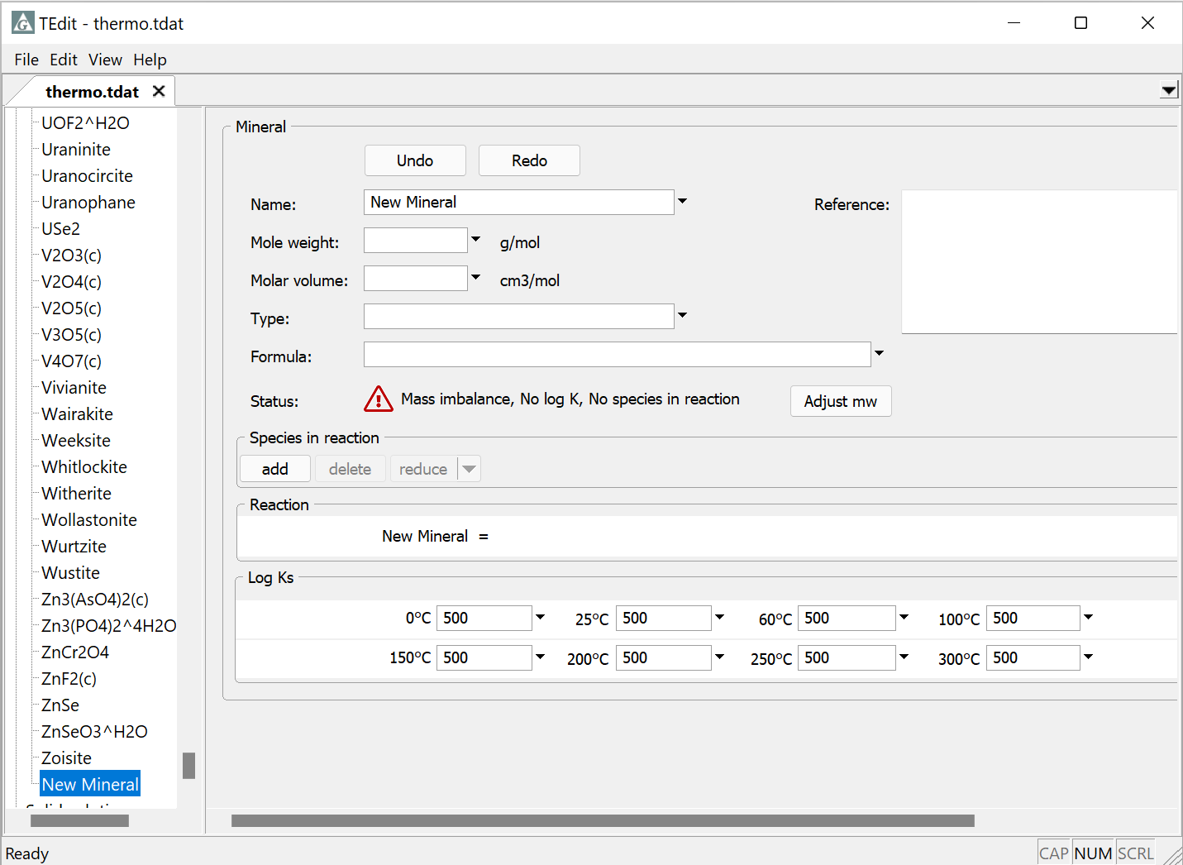
Add and delete entries

Slide 2
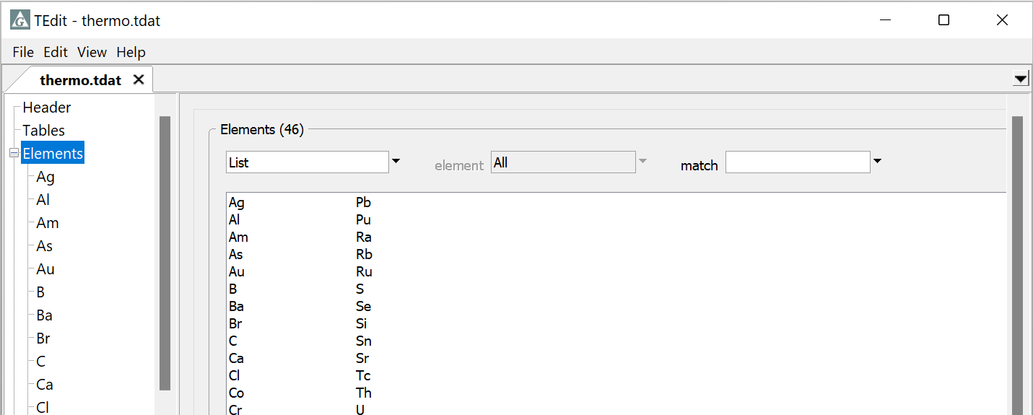
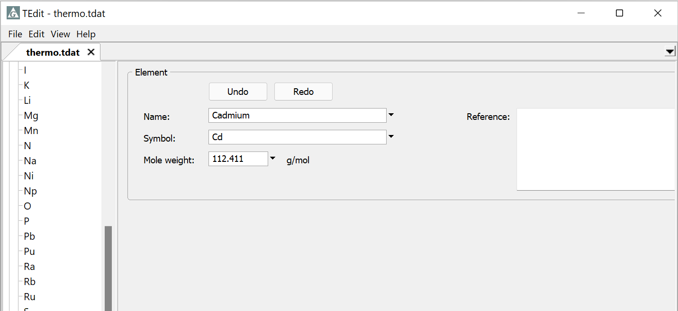
Start by adding any elements you need to your thermo dataset
Right-click → Add
Enter the new element’s name, symbol, and molecular weight

Slide 3
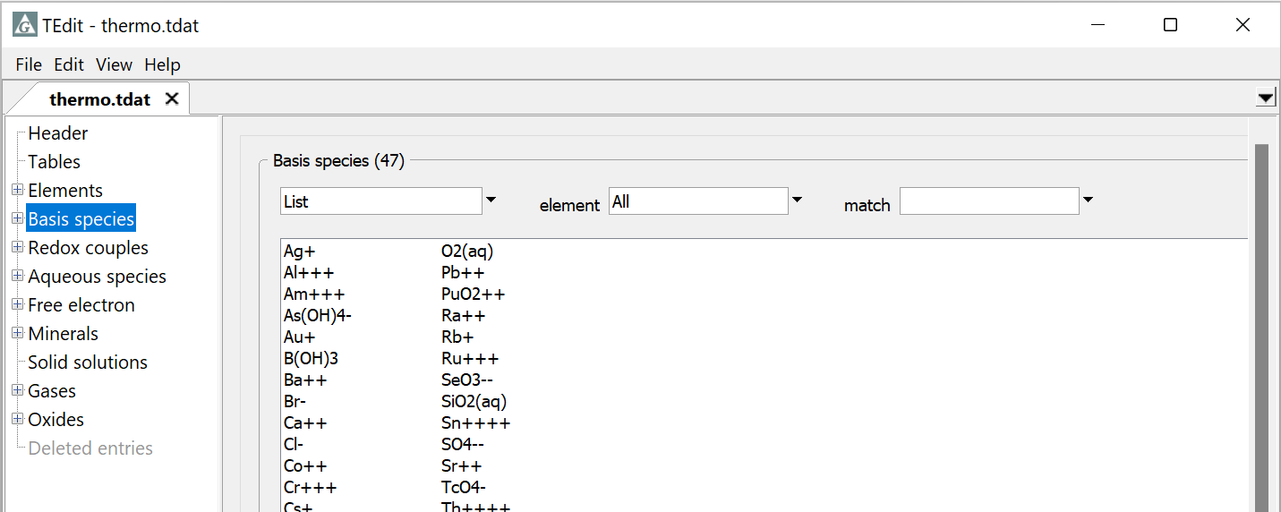
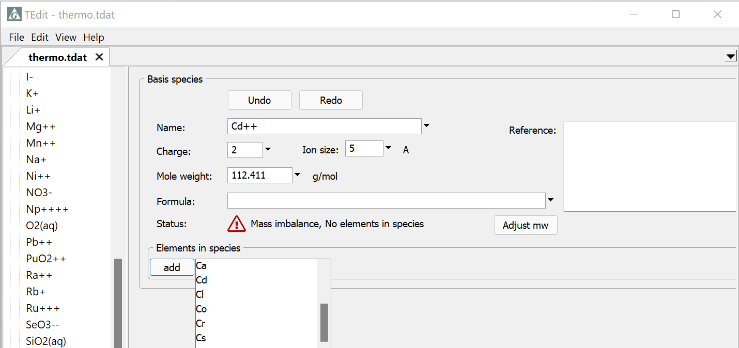
Add new Basis species
Right-click → Add
Specify a reference
Supply the properties of new Basis species
For Cd⁺⁺, select the element Cd and set its coefficient to 1

Slide 4
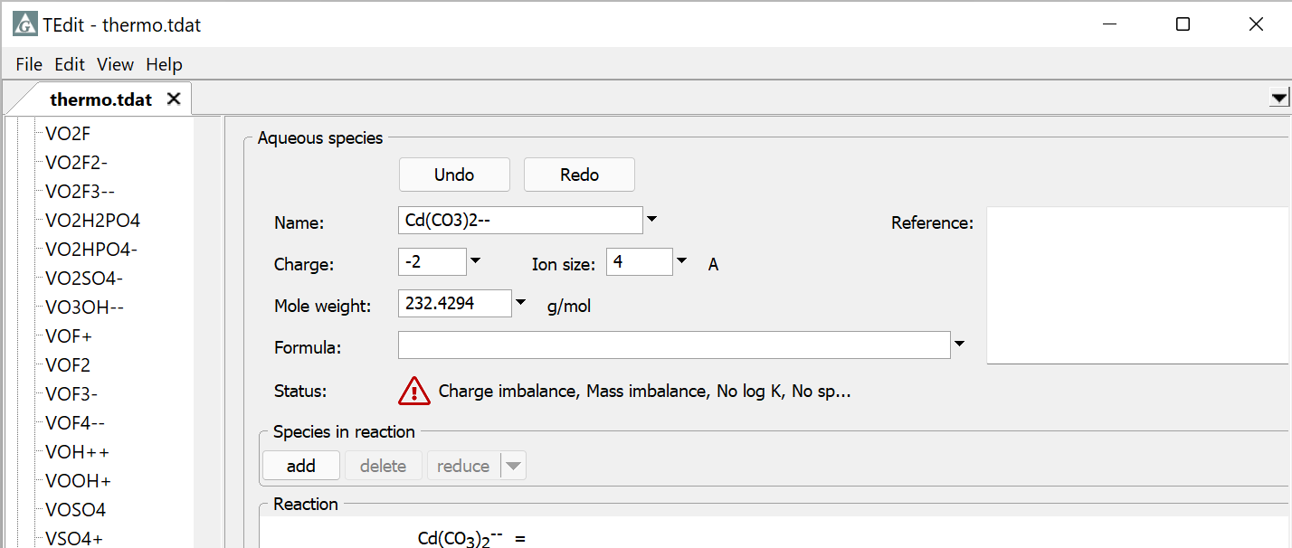
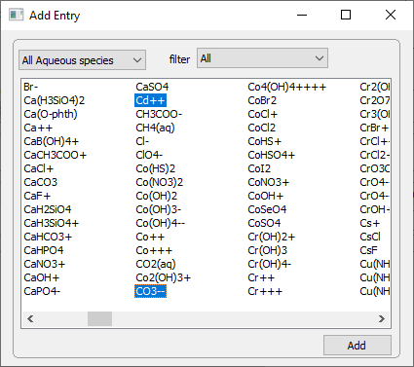
New Redox couples, Aqueous species, Minerals, and Gases require a reaction and log K
Show short list of basis & redox species, all aqueous species, minerals, or gases
Select species and click Add
-hold “Ctrl” for multi-select
-Double-click, “Enter” also add
-Type to find species

Slide 5
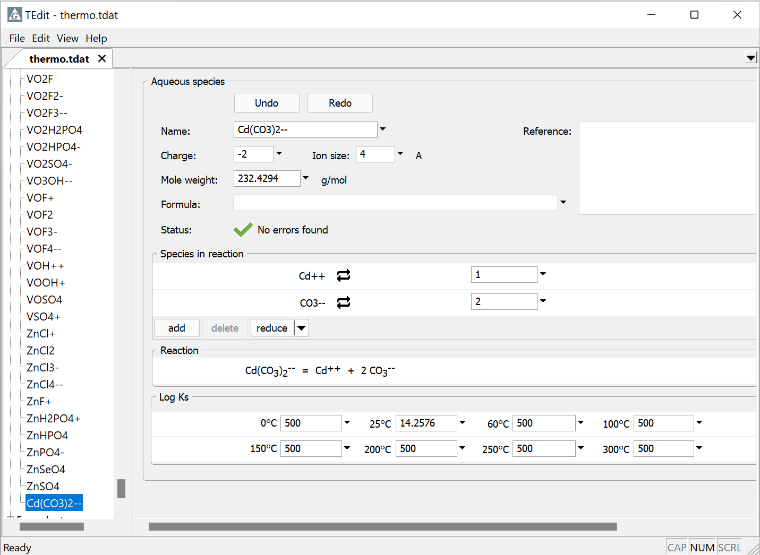
Reactions can be written in terms of any species in the dataset
Fill in stoichiometric coefficients
Supply reaction’s log K at the principal temperatures
Log K = 500
indicates no data

Slide 6
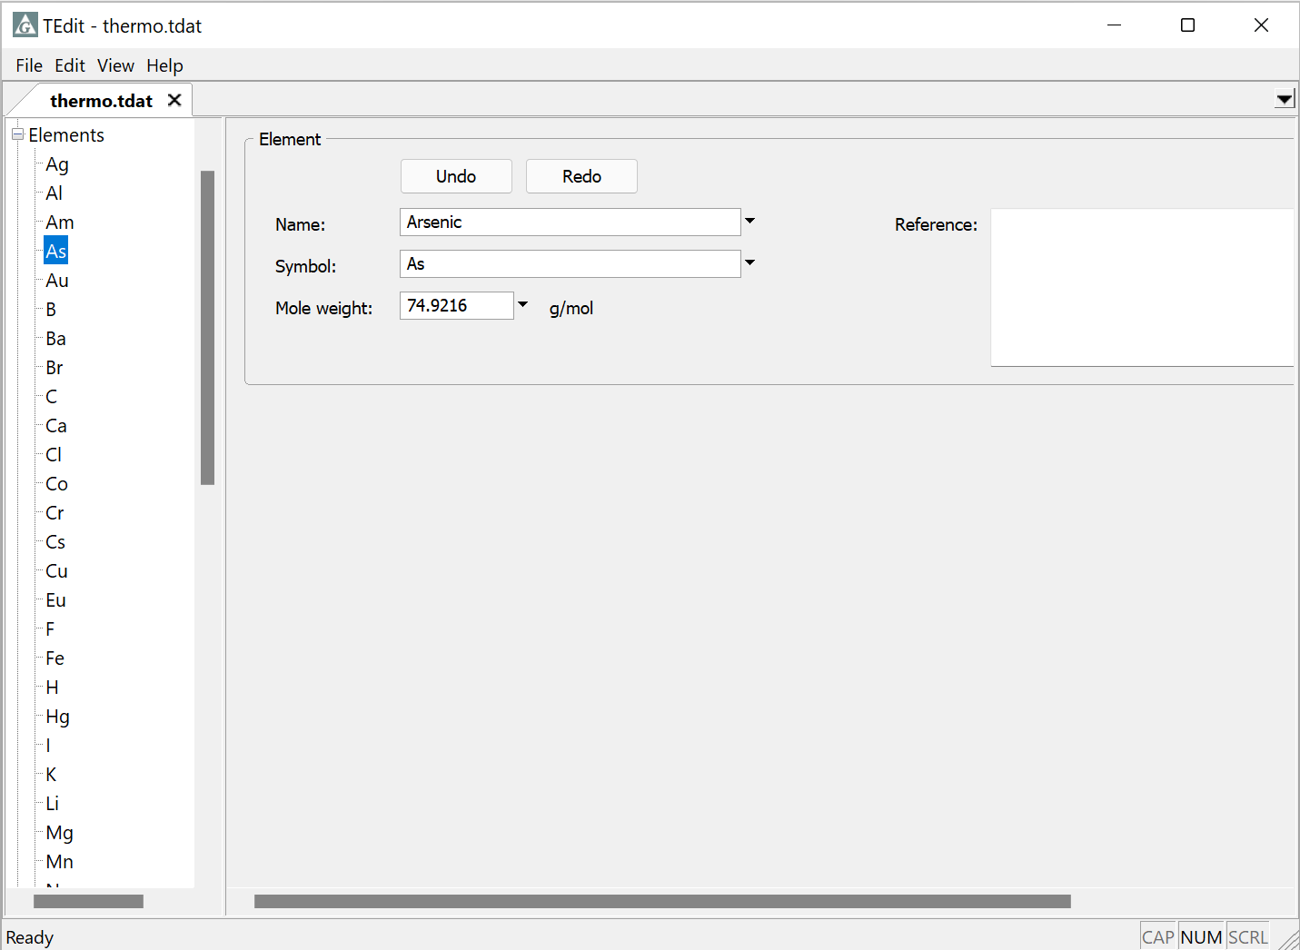
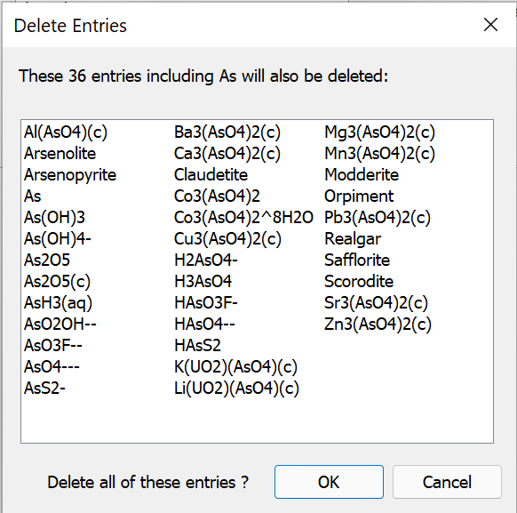
You can delete elements or species from a dataset. All dependent species will also be deleted.
Right-click → Delete
Alternatively, use Extract to keep selected entries, and discard the rest

Slide 7
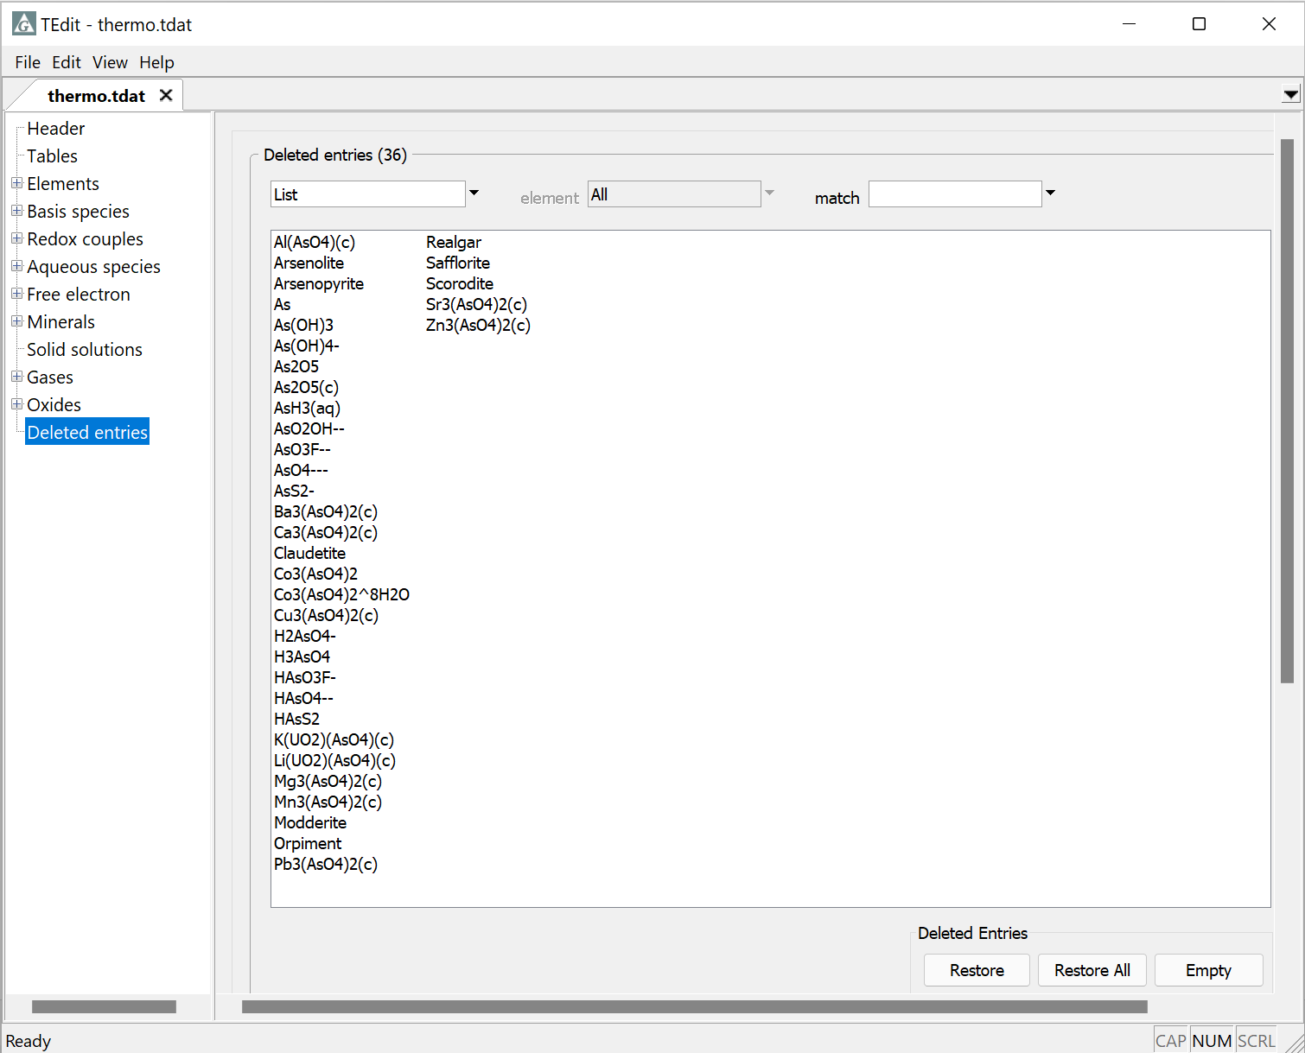
You can recover deleted entries while the dataset remains open
Go to Deleted entries on the tree
Restore all or only selected entries

Slide 8
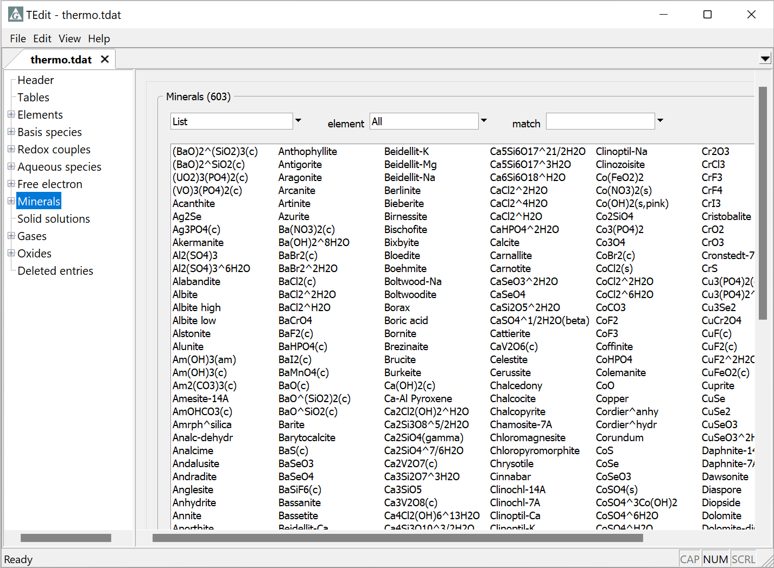
Save your changes by going to File → Save As… or File → Save

