Slide 1
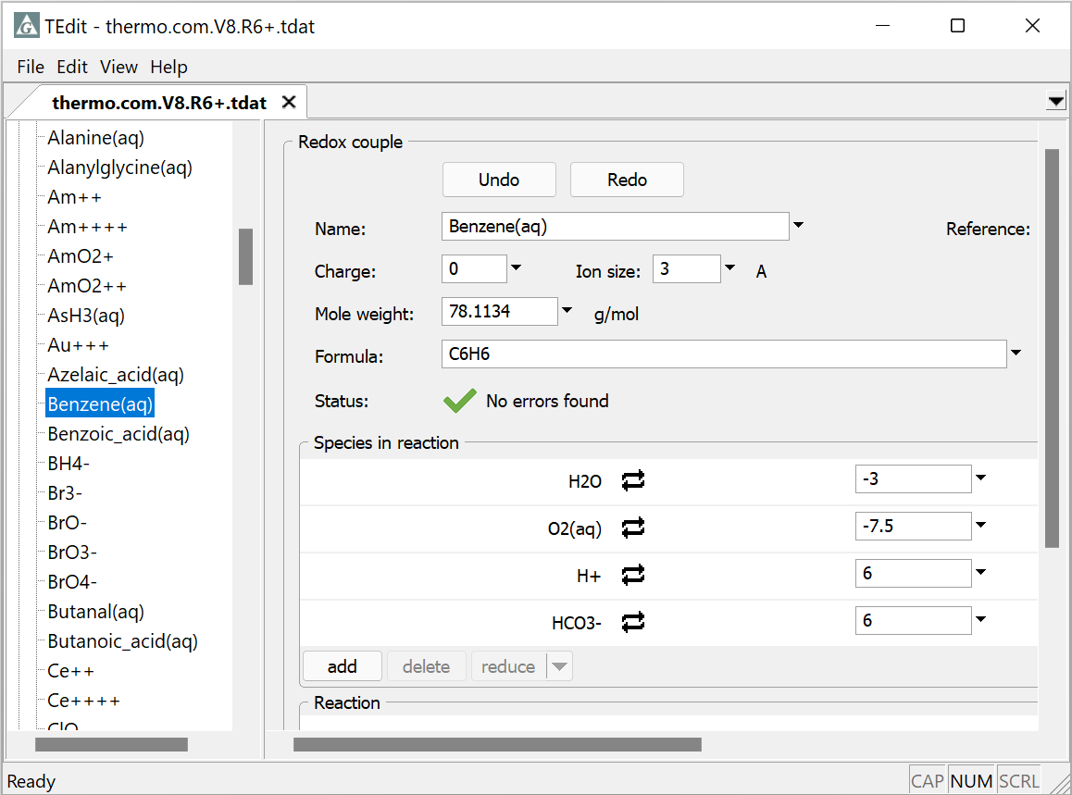
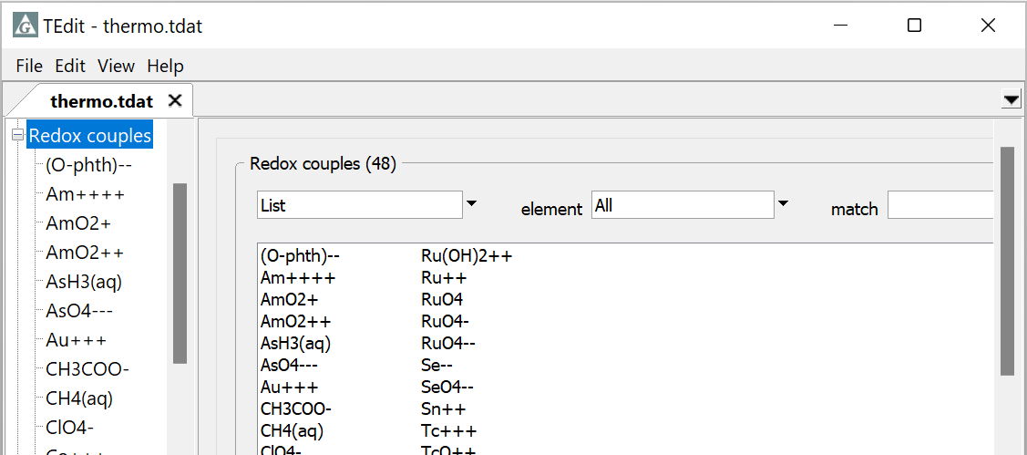
Transfer thermo data

Slide 2
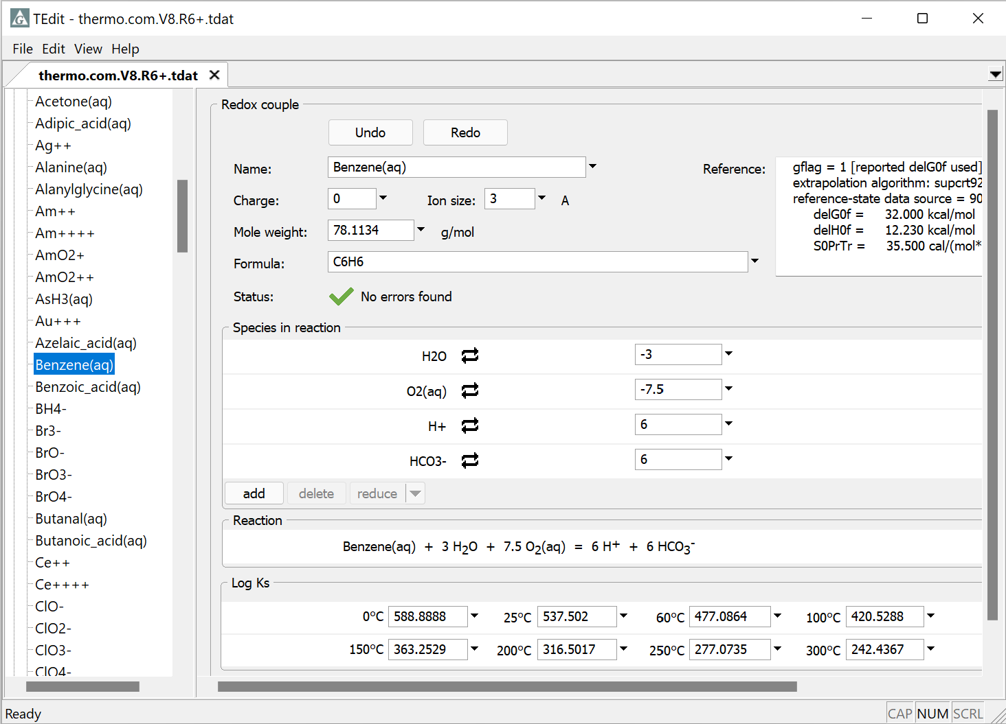
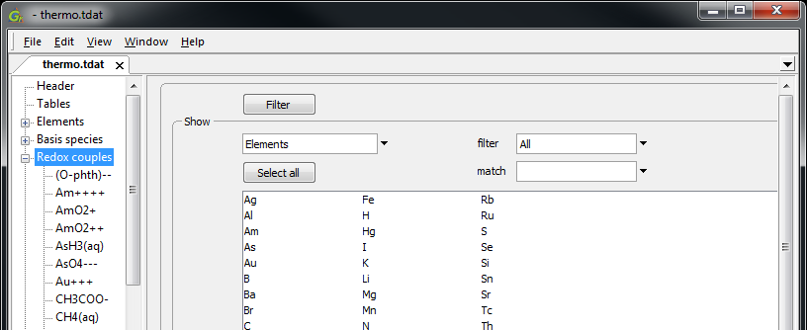

You can use TEdit to copy entries from one thermo dataset (the source) into another (the target).
Open both datasets in TEdit and select the entry or entries you’d like to copy. To select multiple entries, hold down “Ctrl” and left-click.

Slide 3
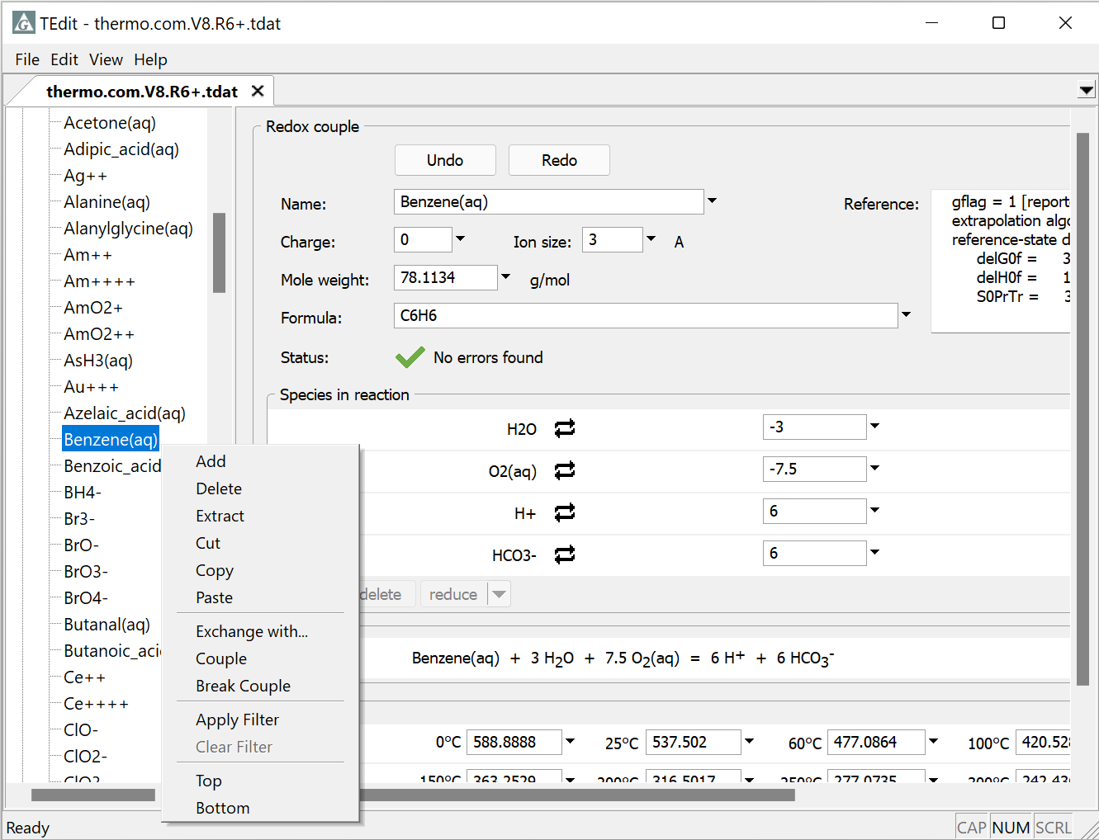
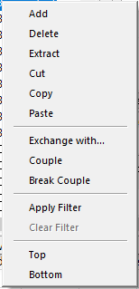
Copy from the source (thermo.com.V8.R6+.tdat)
Edit → Copy
Or, right-click → Copy
Benzene’s properties, reaction, and log Ks will be copied

Slide 4
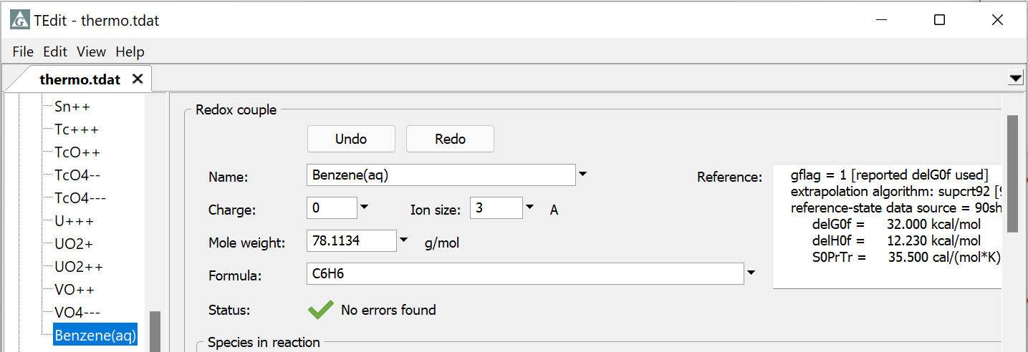
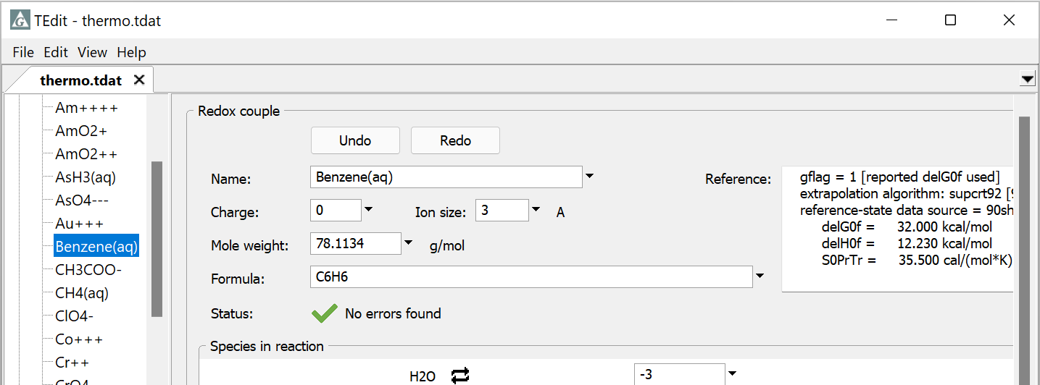
Paste into the target (thermo.tdat)…
Edit → Paste
New entry pasted at the end of the appropriate section
Alternatively, right-click on desired location in tree structure and paste.

Slide 5
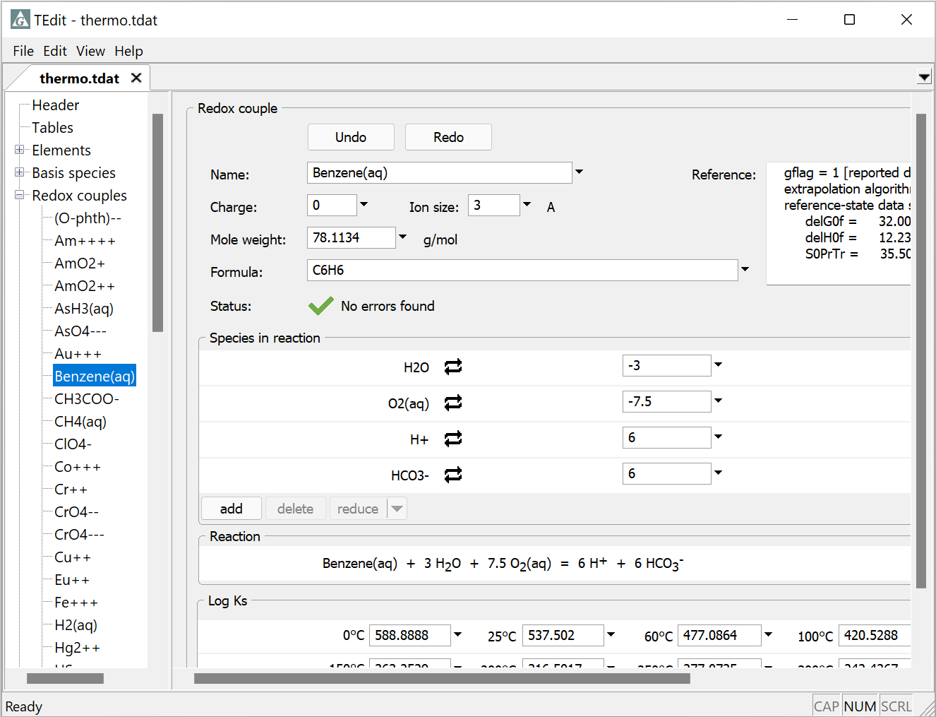
Save as a new dataset (thermo+benzene.tdat)
File → Save As… → thermo+benzene.tdat

Slide 6
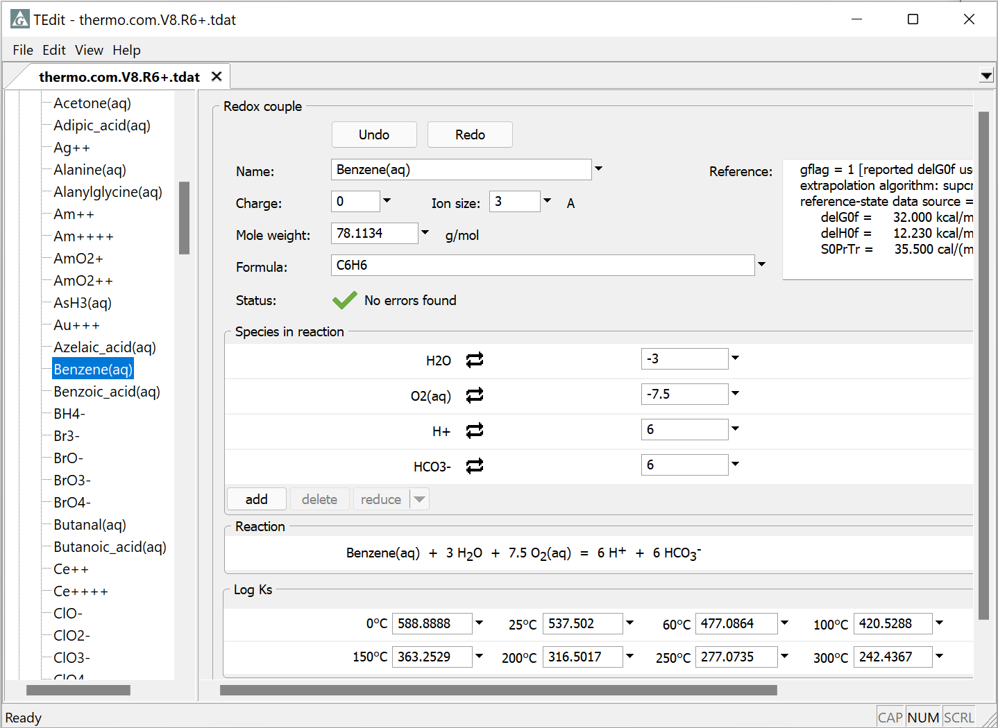
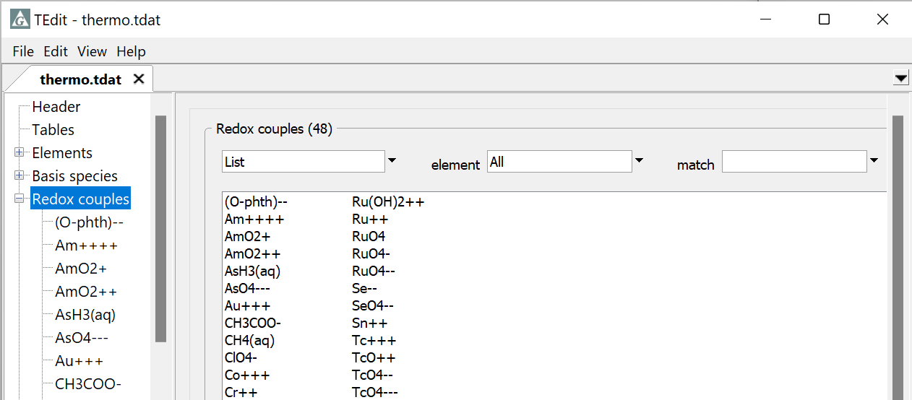
You can also use drag and drop to transfer entries to other datasets.
Left-drag into the target dataset and release.

Slide 7
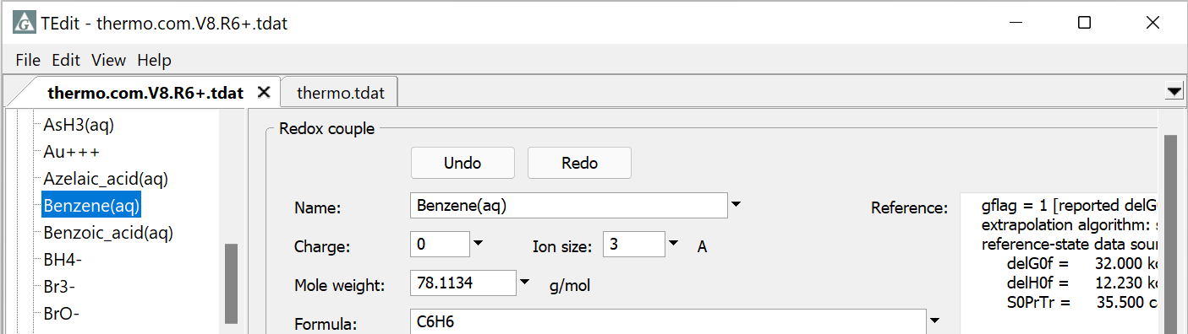
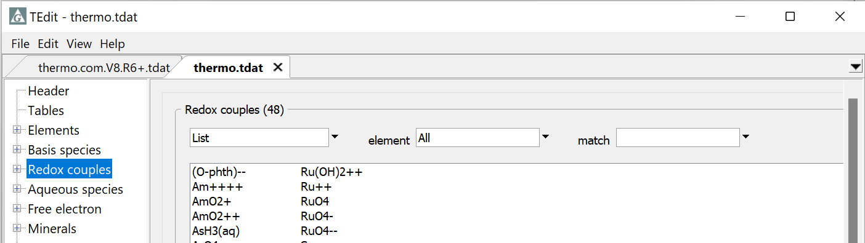
If both datasets are open in the same window, just hover over a tab as you left-drag to change the focus...
... then release below the tab to drop the entry into the target dataset.

