Slide 1
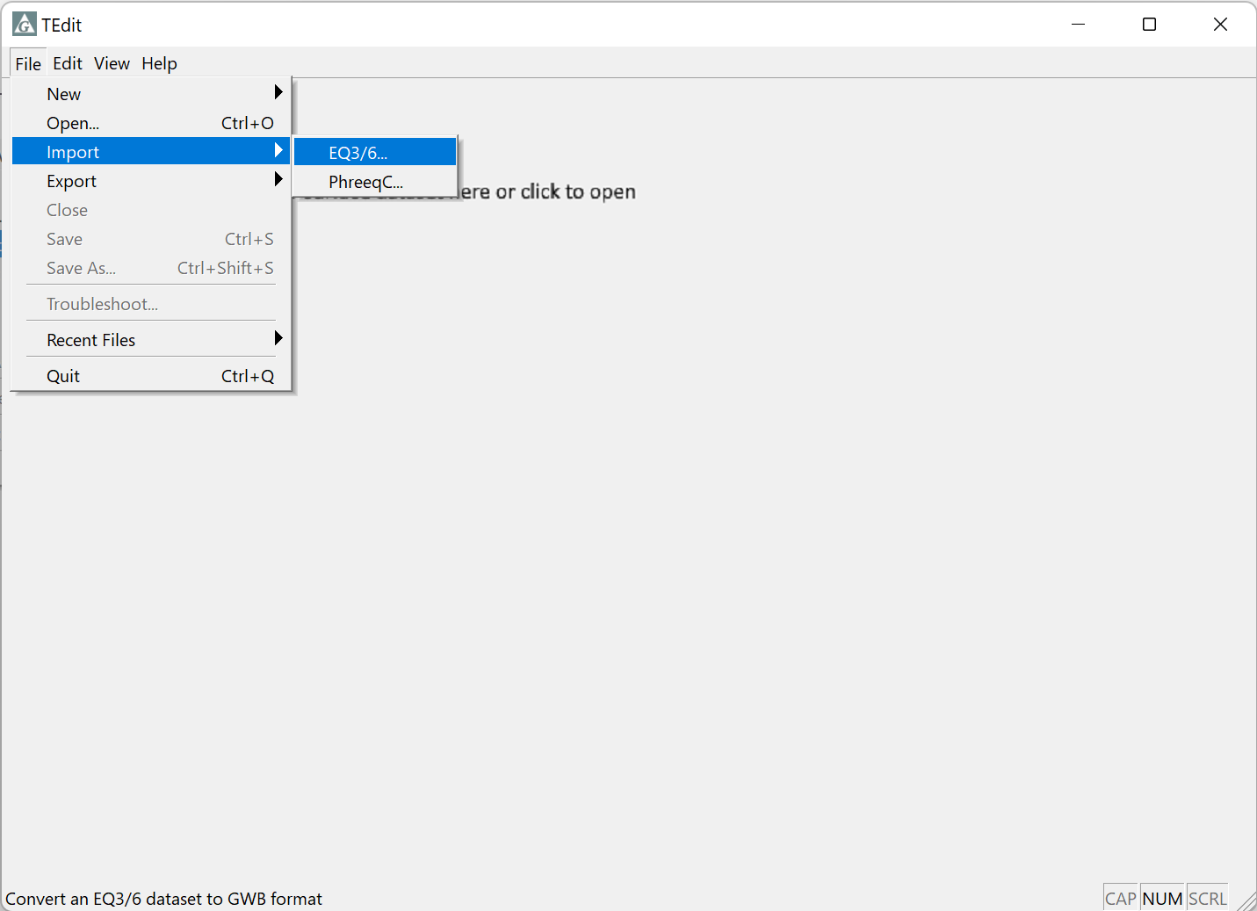
Import and export EQ3/6 datasets

Slide 2
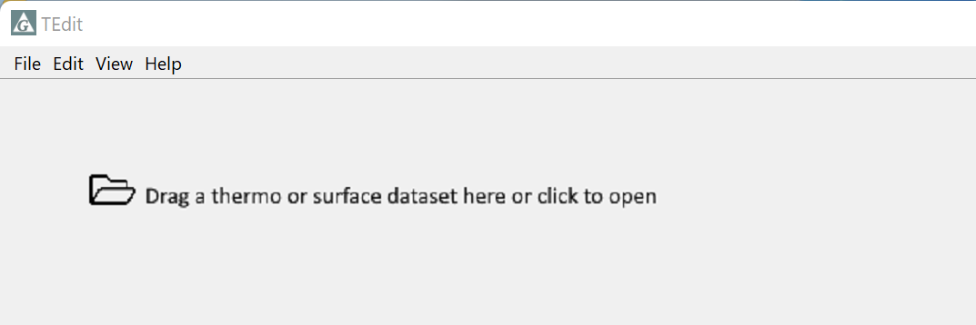
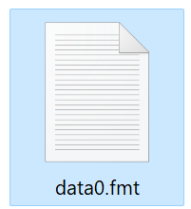

Drag and drop an EQ3/6 dataset into TEdit
Or, in TEdit go to File → Import → EQ3/6…
New GWB dataset (.tdat) saves automatically to the same location as your EQ3/6 dataset

Slide 3
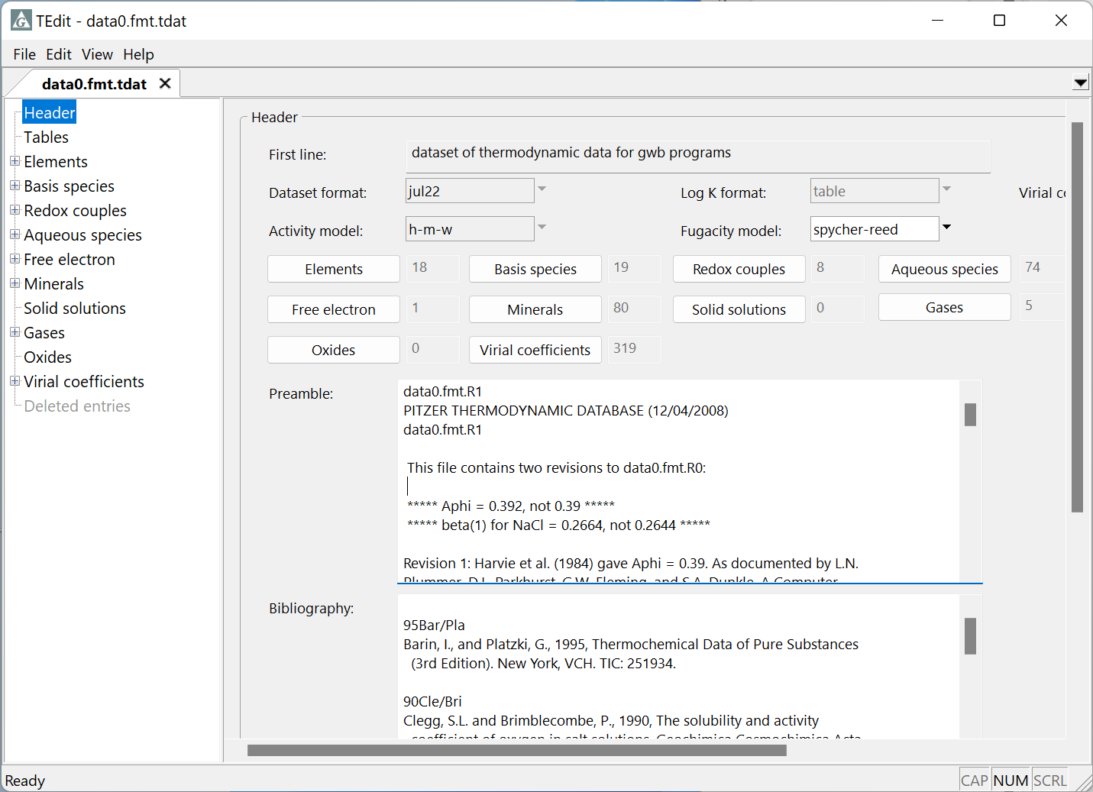
View new GWB dataset in TEdit
Text block from the top of the original dataset is preserved in the “Preamble”
Reference block preserved in the “Bibliography” section

Slide 4
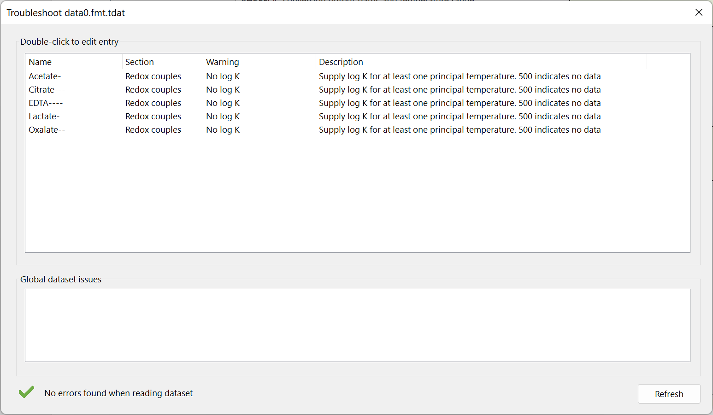
Troubleshoot dialog shows any errors found in the new dataset
Double-click to go to entry. Correct errors in dataset before use.

Slide 5
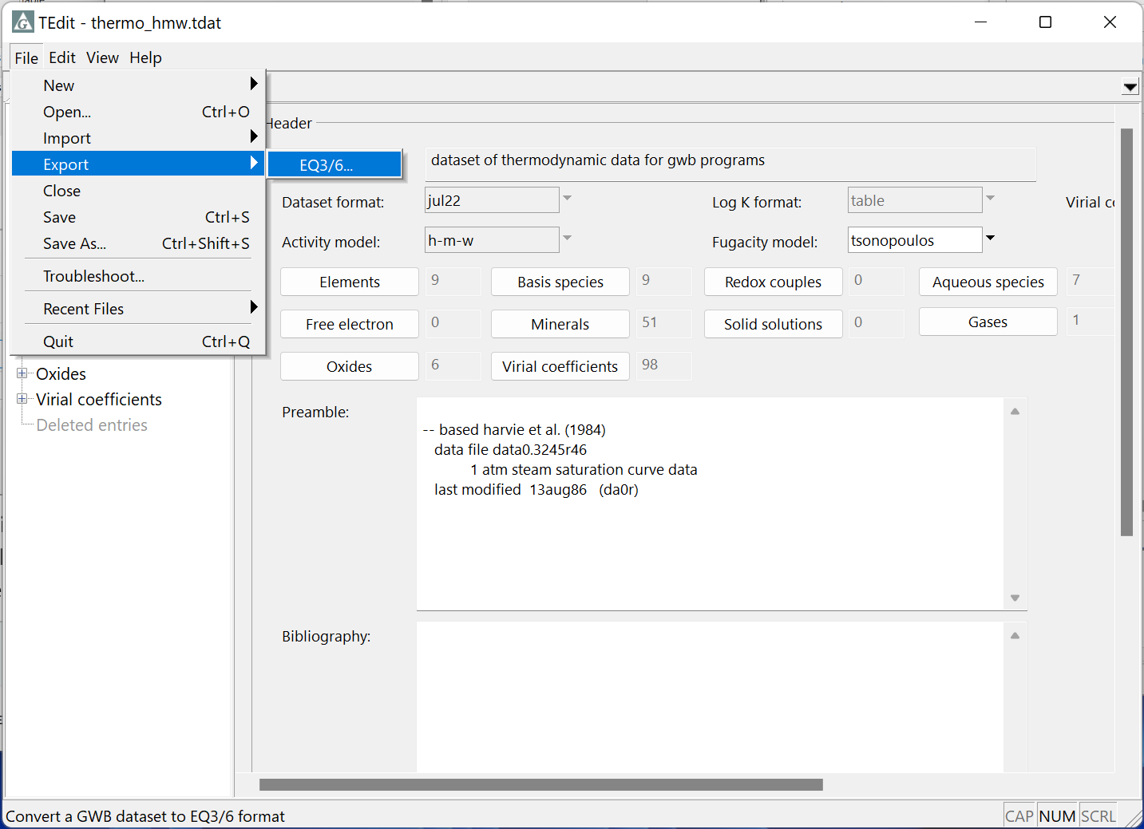
Export GWB datasets to use with the EQ3/6 software
Go to File → Export → EQ3/6…

Slide 6
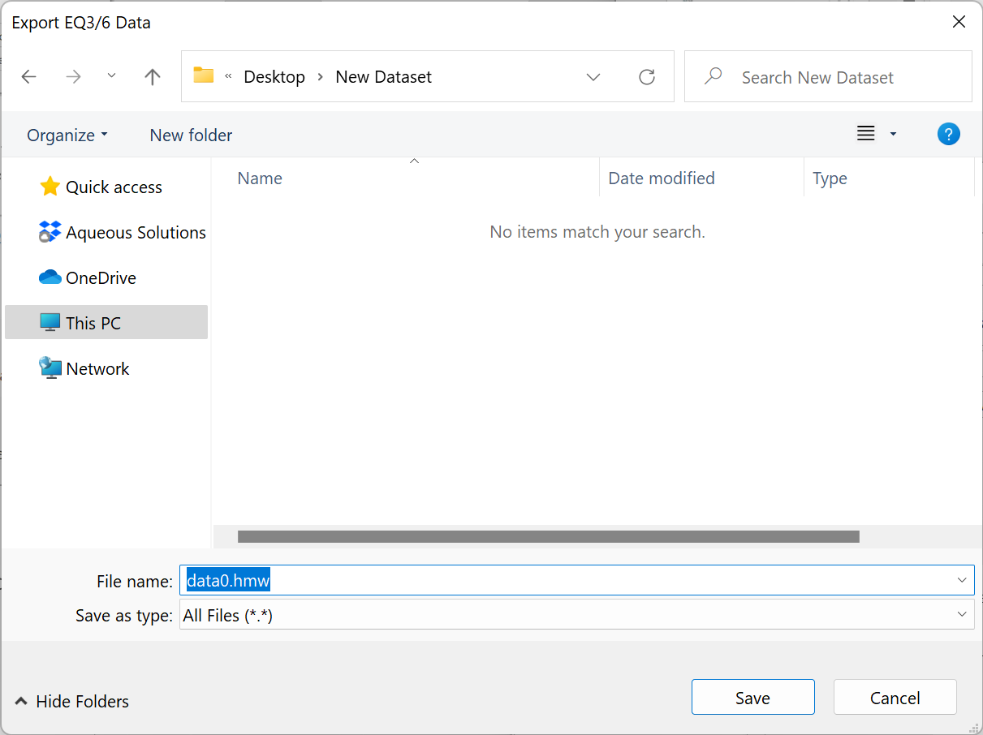
Browse to the directory where you wish to save your dataset
Supply the new dataset with a file name

Slide 7
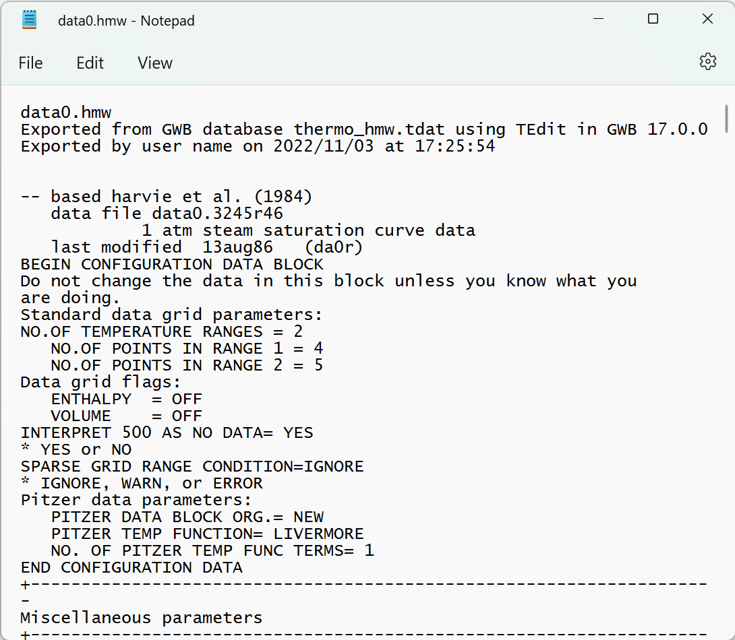
View EQ3/6 dataset in a text editor
Original GWB dataset, time and date of the conversion, and username

