Slide 1
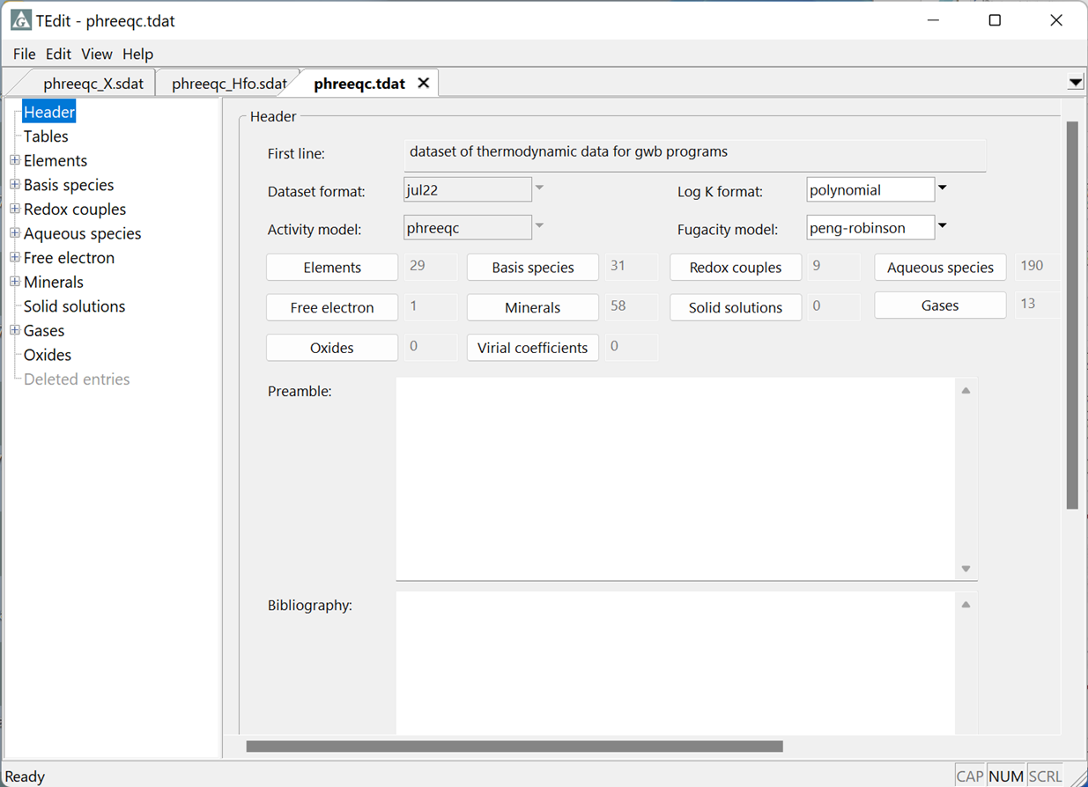
Import PhreeqC datasets

Slide 2
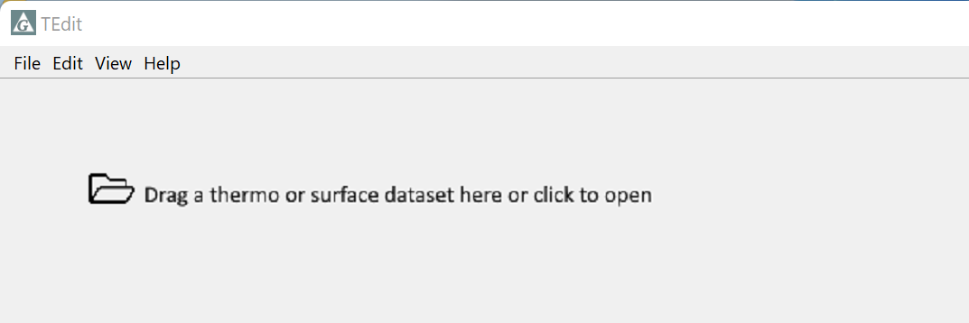
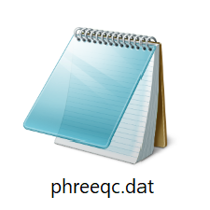
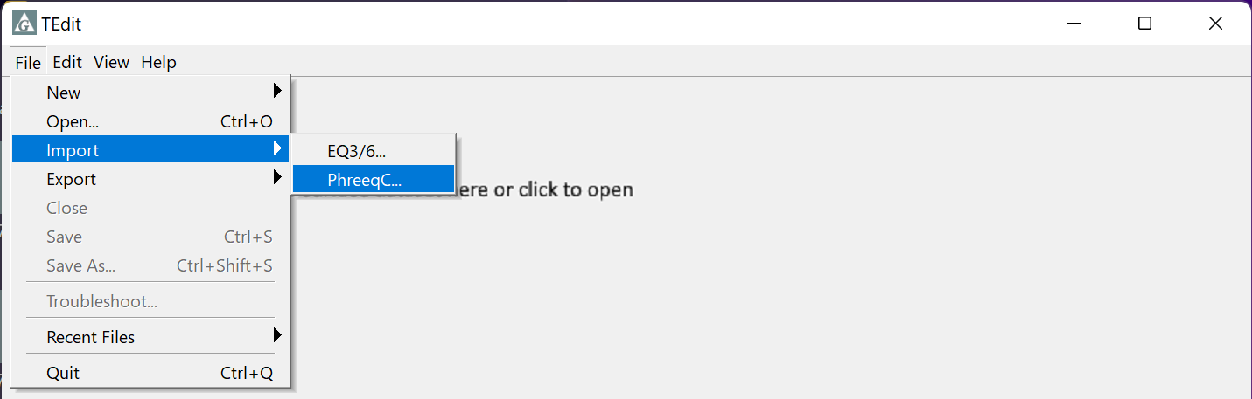
Drag and drop a PhreeqC dataset into TEdit
Or, in TEdit go to File → Import → PhreeqC…

Slide 3
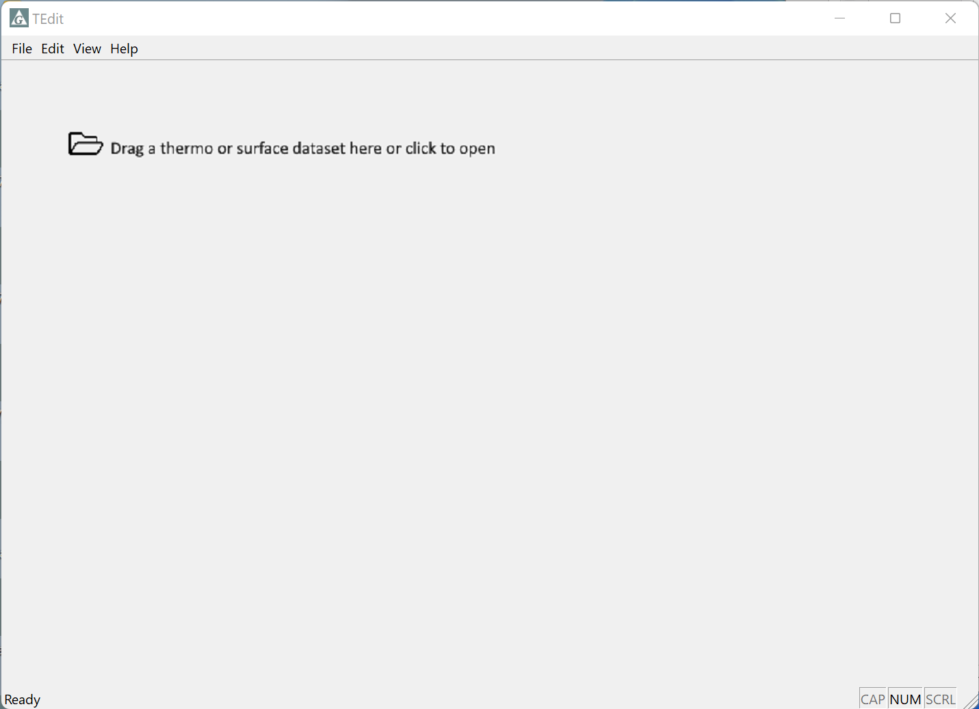
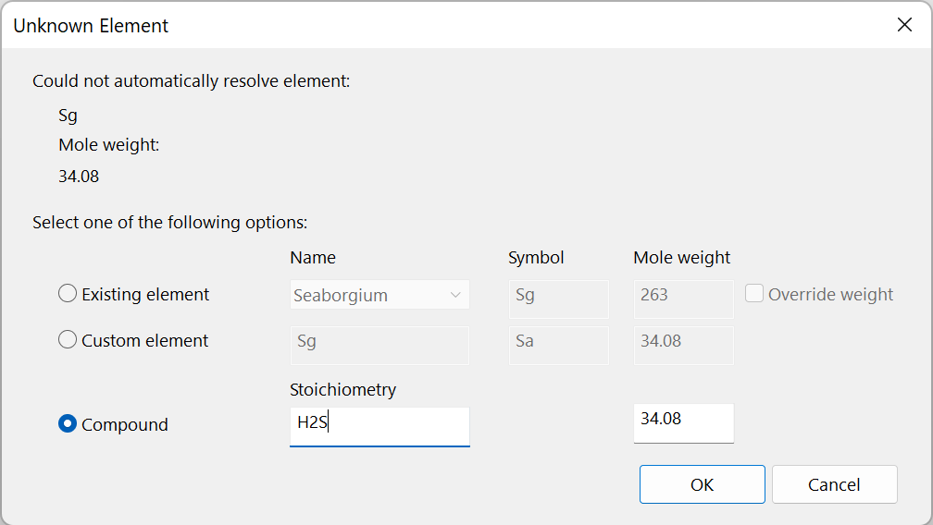
Correct fictive elements if any are found in the PhreeqC dataset
Use an existing element, create a fictive element, or supply the elemental composition of a compound
If you import file “phreeqc.dat”, “Sg” is really H₂S
Click “OK” to proceed

Slide 4
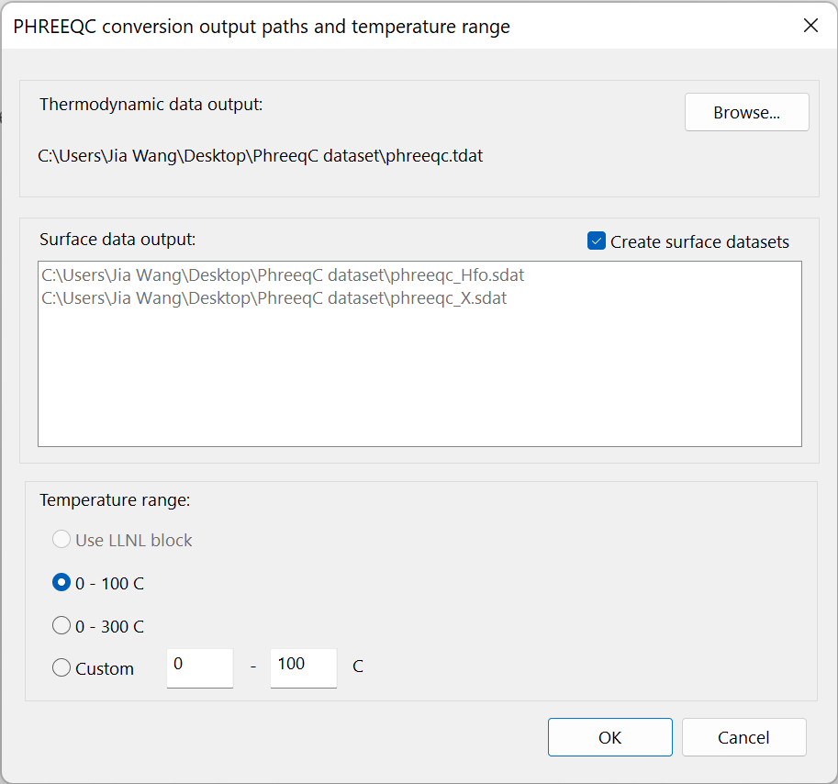
Choose where to save the dataset
Check box to create associated surface datasets
Specify an appropriate temperature range for the dataset
Click OK to finish

Slide 5
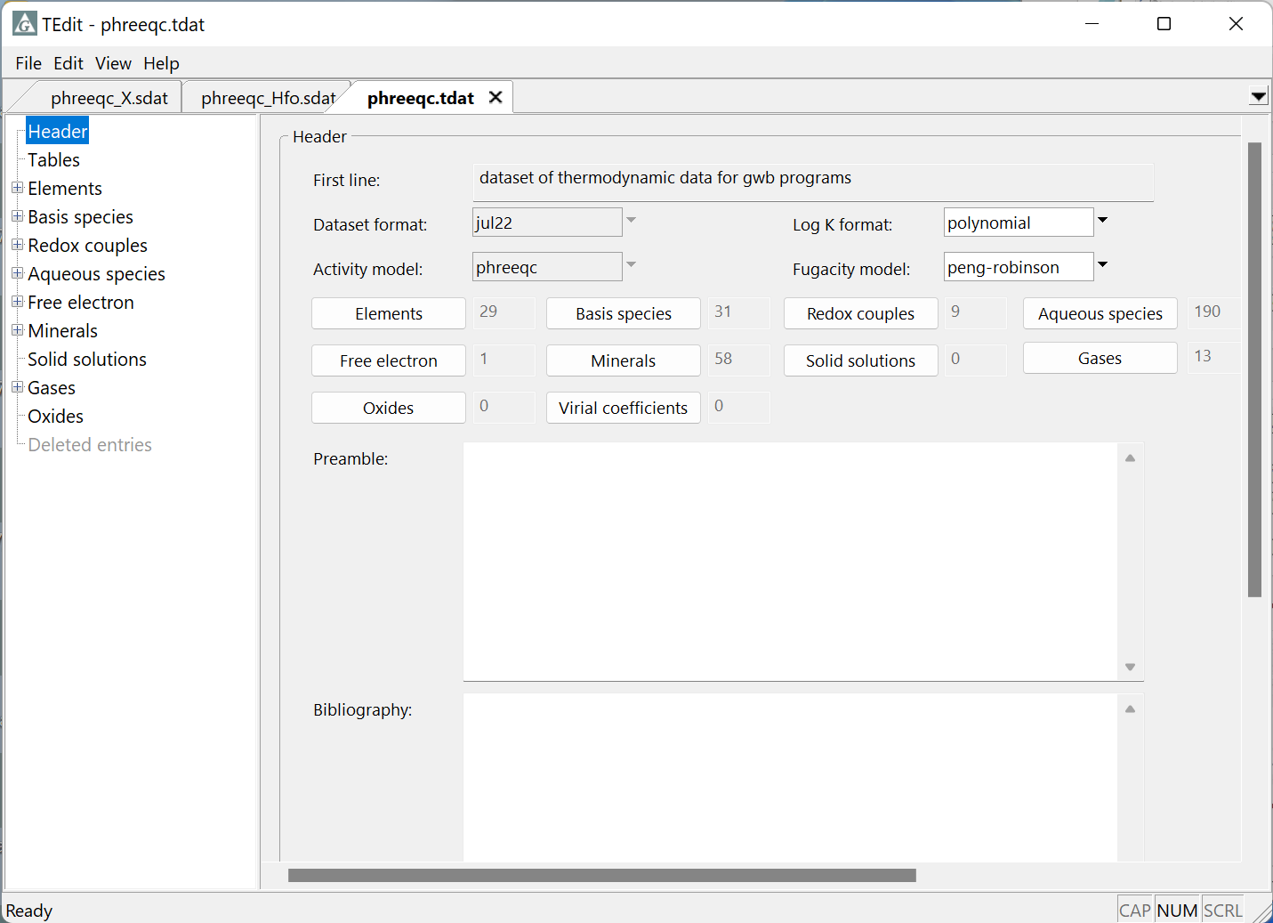
View your new GWB dataset(s) in TEdit

