Slide 1
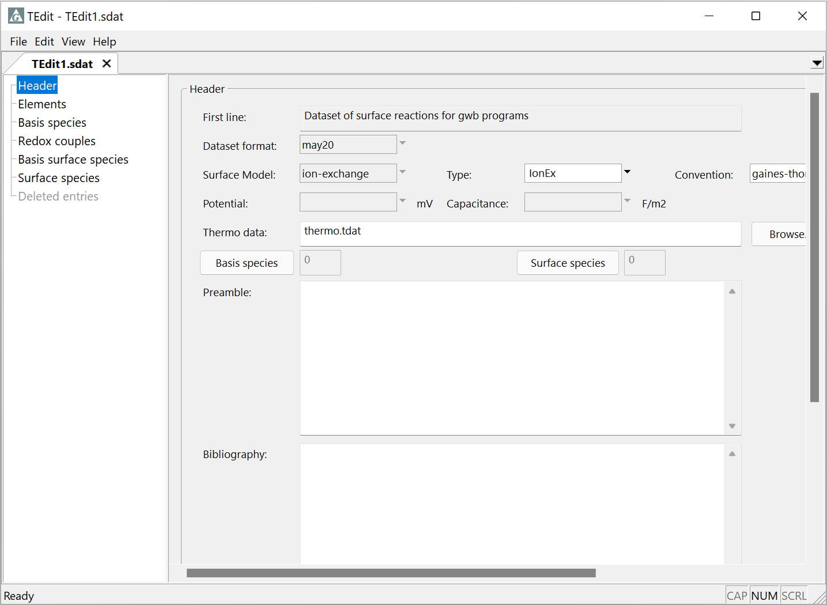
Ion Exchange

Slide 2
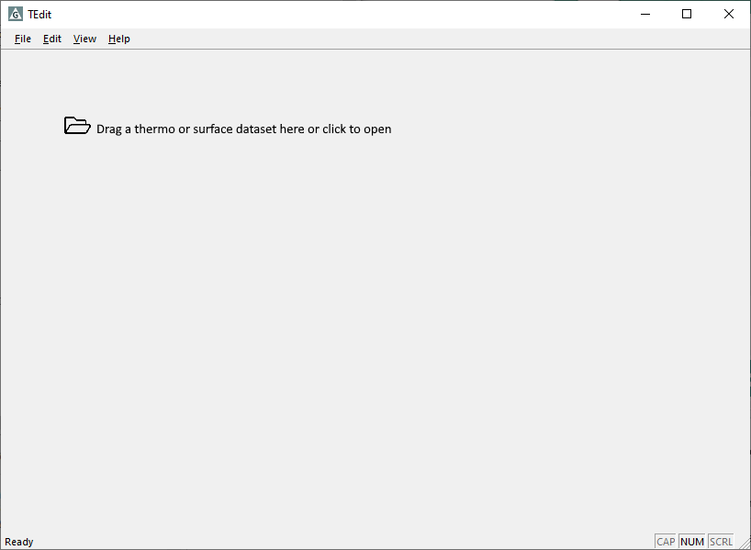
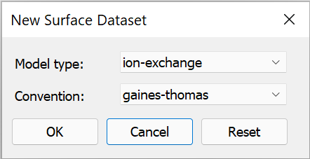
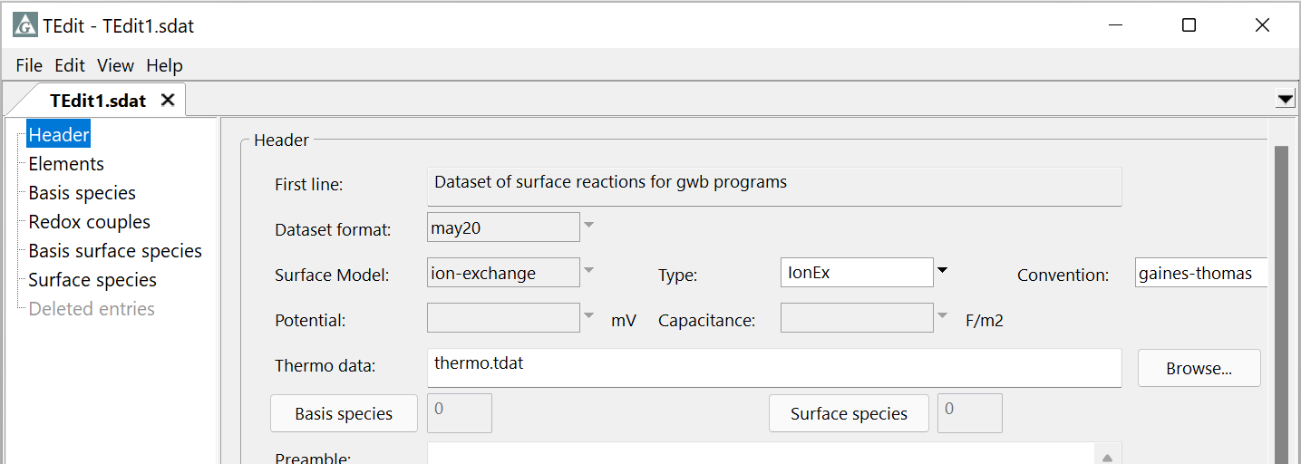
Ion exchange activity conventions include Gaines-Thomas, Vanselow, and Gapon
File → New → Sorbing Surfaces…
Set model type to ion-exchange, convention to gaines-thomas
In the Gaines-Thomas convention, the activity of the sorbed ion is its equivalent fraction of the sorbing sites
Aqueous species are drawn from a thermo dataset to create surface reactions

Slide 3
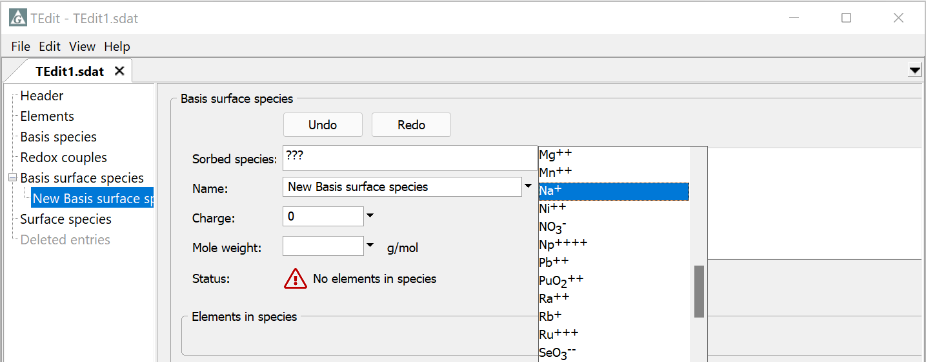
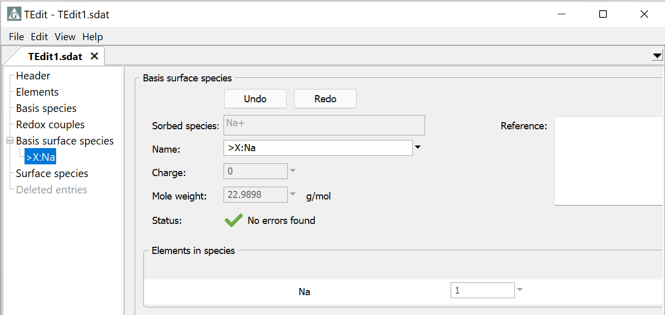
Choose a basis species from the list, typically an abundant monovalent cation or anion
Basis… → Na⁺
Right-click → Add
TEdit automatically fills in all entries

Slide 4
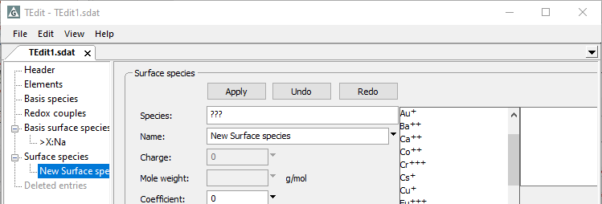
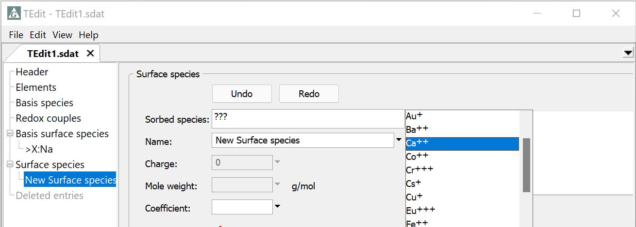
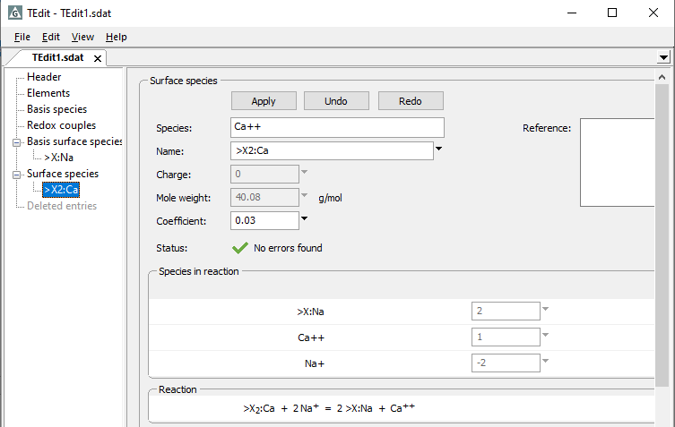
Choose any basis, redox, or aqueous species to create exchange reactions
Basis… → Ca⁺⁺
Right click → add
TEdit automatically fills in all entries except the selectivity coefficient, which you supply
Exchange reaction automatically written using Gaines-Thomas convention

Slide 5
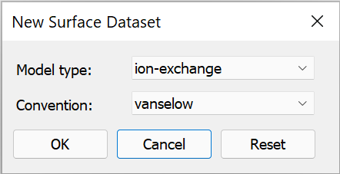
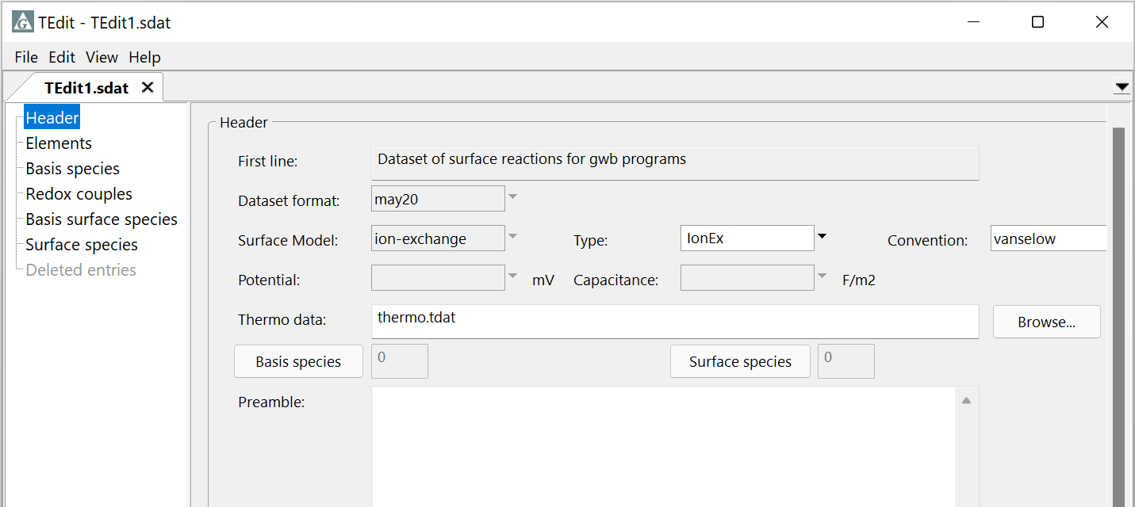
Vanselow convention
File → New → Sorbing Surfaces…
Set model type to ion-exchange and convention to vanselow
The Vanselow convention is like Gaines-Thomas, except that the sorbed ion activity is the molar fraction of the sorbing sites

Slide 6
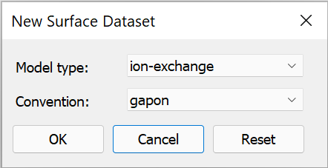
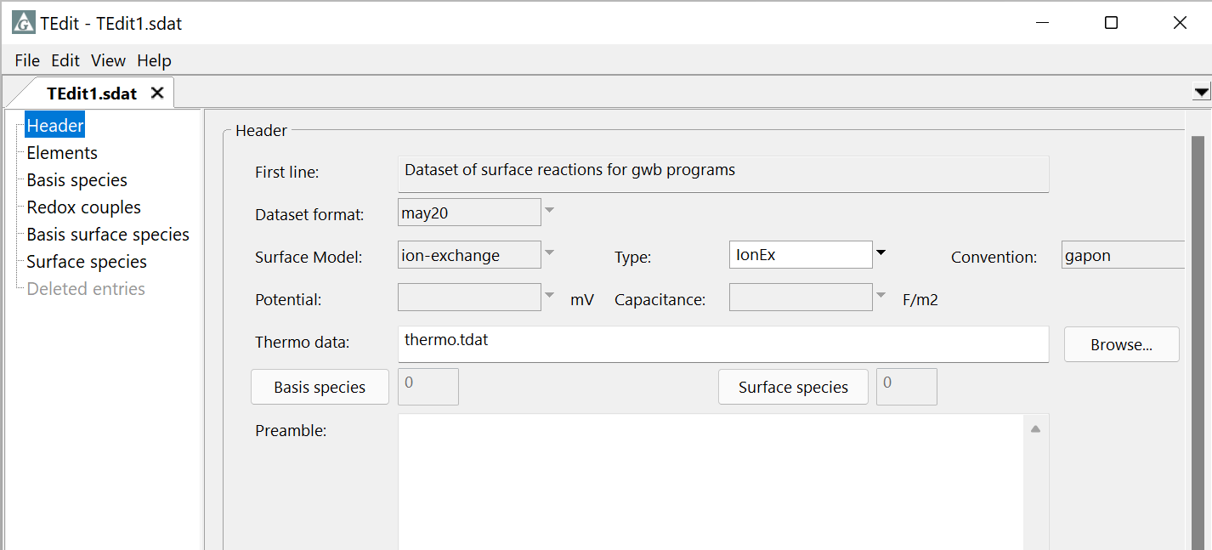
In the Gapon convention, you balance reactions on the sites rather than on the ions
File → New → Sorbing Surfaces…
Set model type to ion-exchange and convention to gapon
The sorbed ion activities can be expressed as equivalents or molar fractions

Slide 7
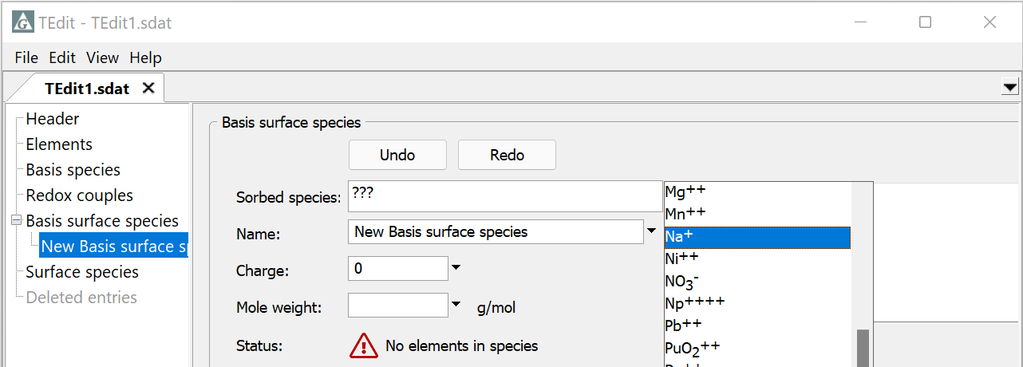
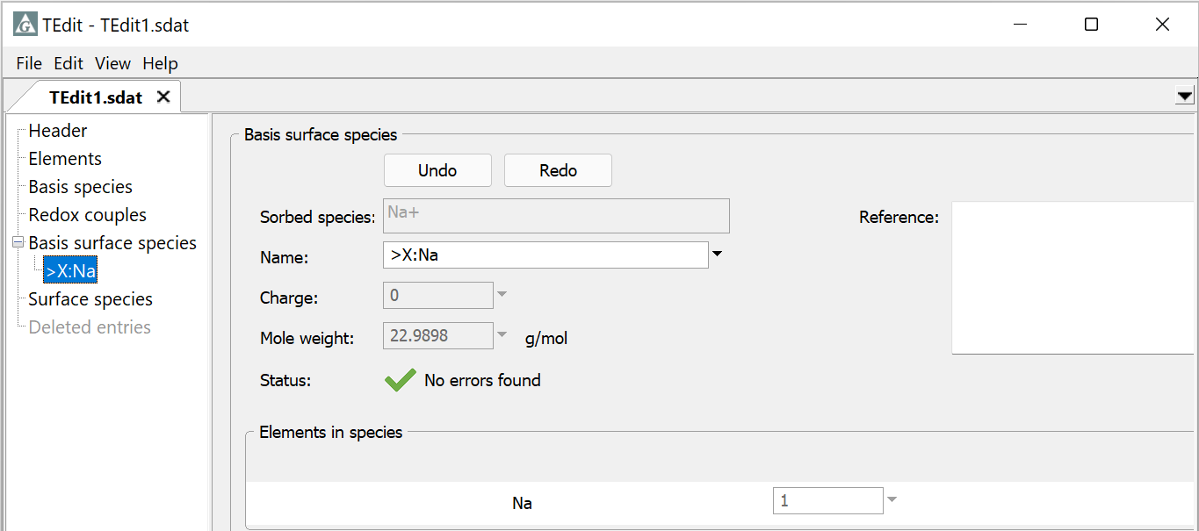
Choose a basis species from the list, typically an abundant monovalent cation or anion
Basis… → Na⁺
Right-click → Add
TEdit automatically fills in all entries

Slide 8
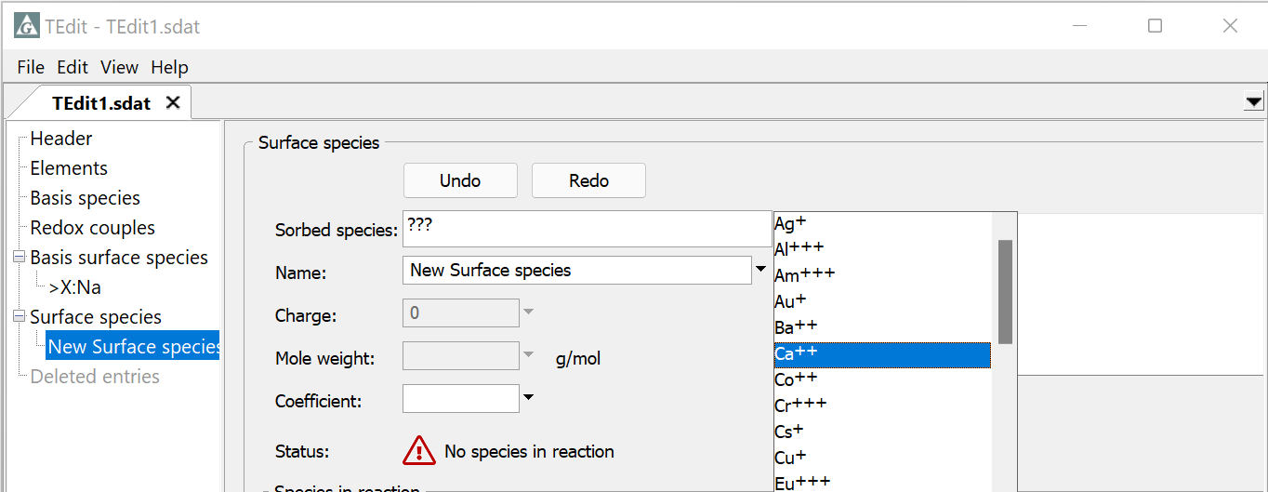
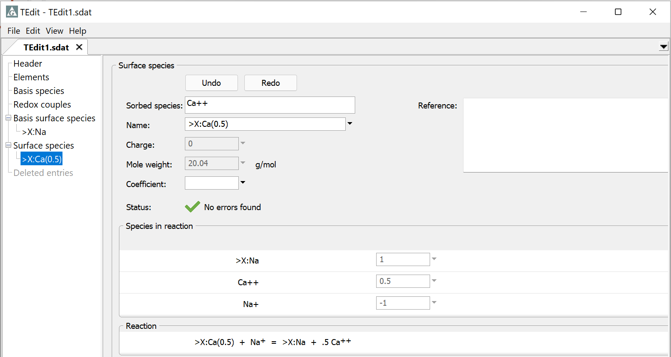
Choose any basis, redox, or aqueous species to create exchange reactions
Basis… → Ca⁺⁺
Right click → Add
TEdit automatically fills in all entries except the selectivity coefficient, which you supply
Exchange reaction automatically written using Gapon convention

