Slide 1
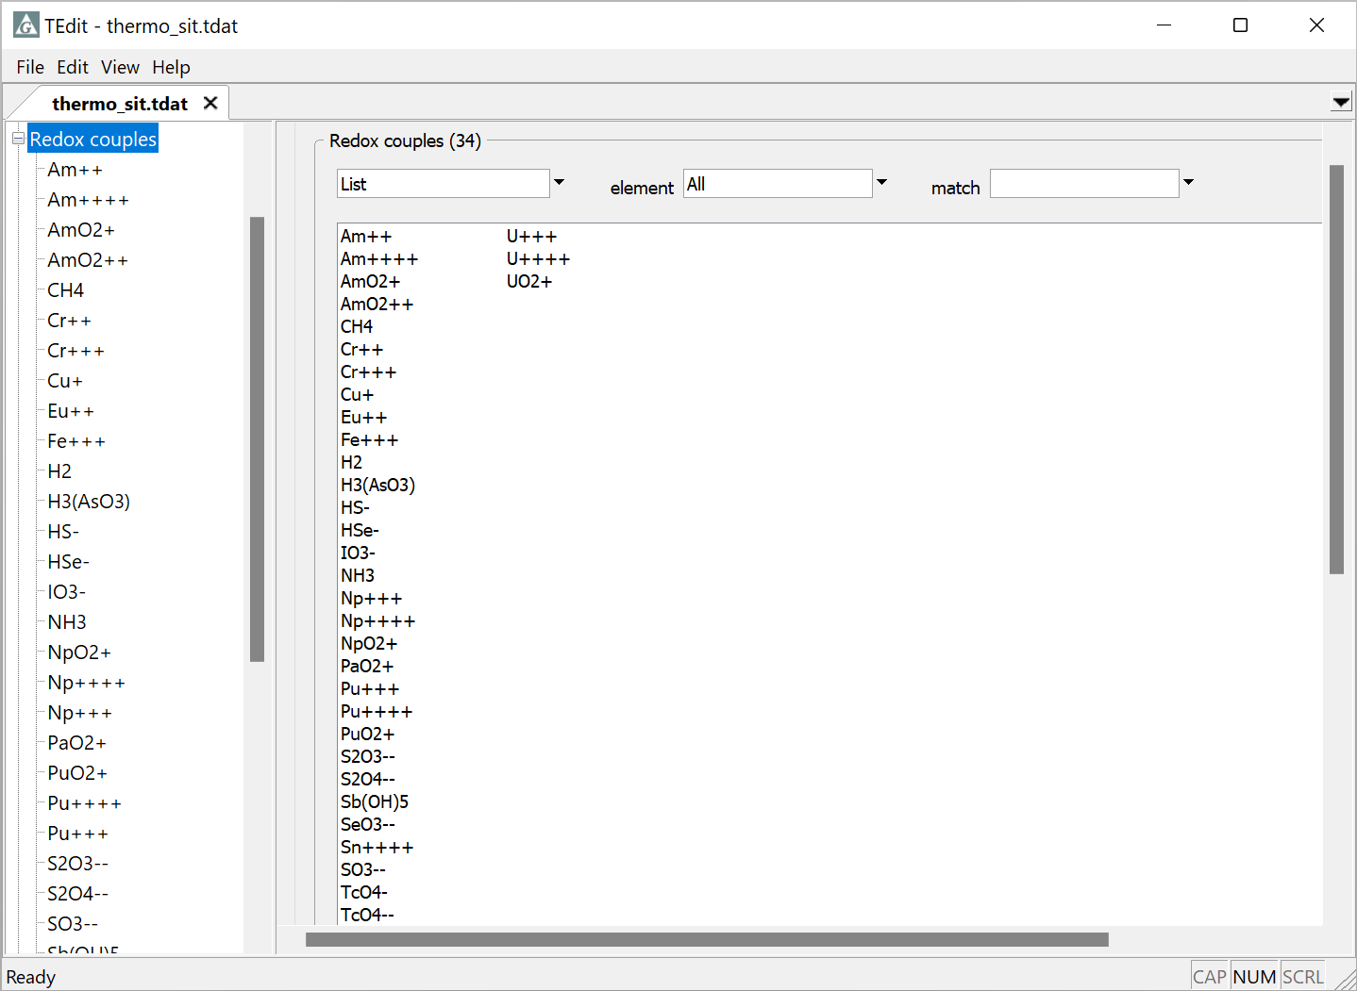
Making and breaking redox couples

Slide 2
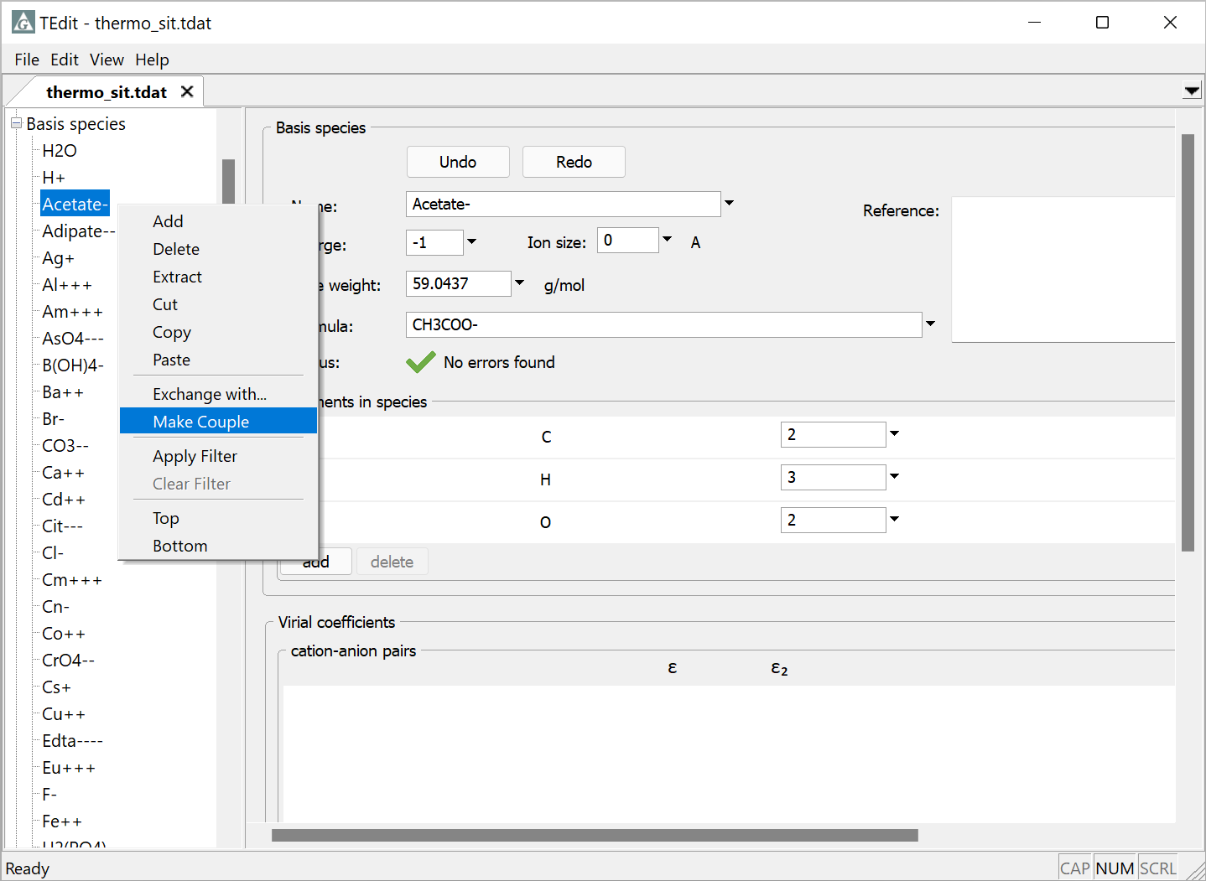
You can change a basis species into a redox couple
Right-click on the desired basis species and select Make Couple

Slide 3
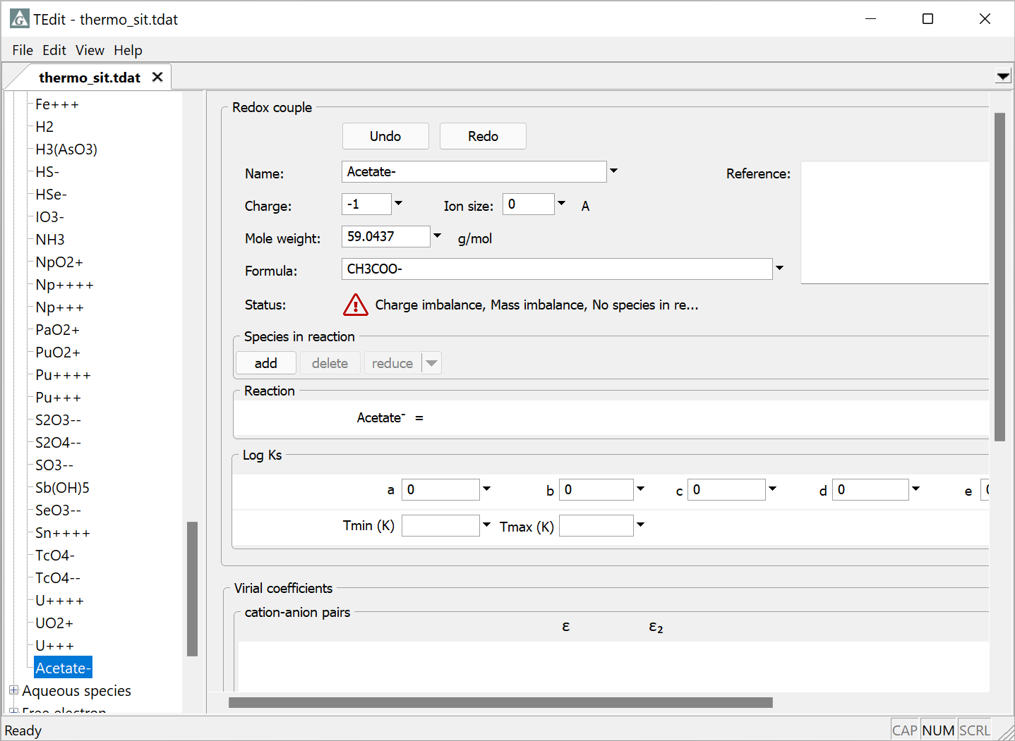
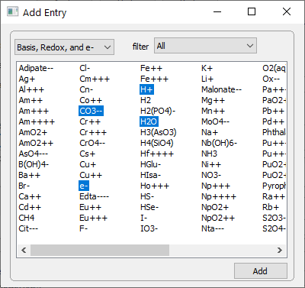
Fill in the template for the new redox coupling reaction
Information from previously filled entry
Add species in reaction

Slide 4
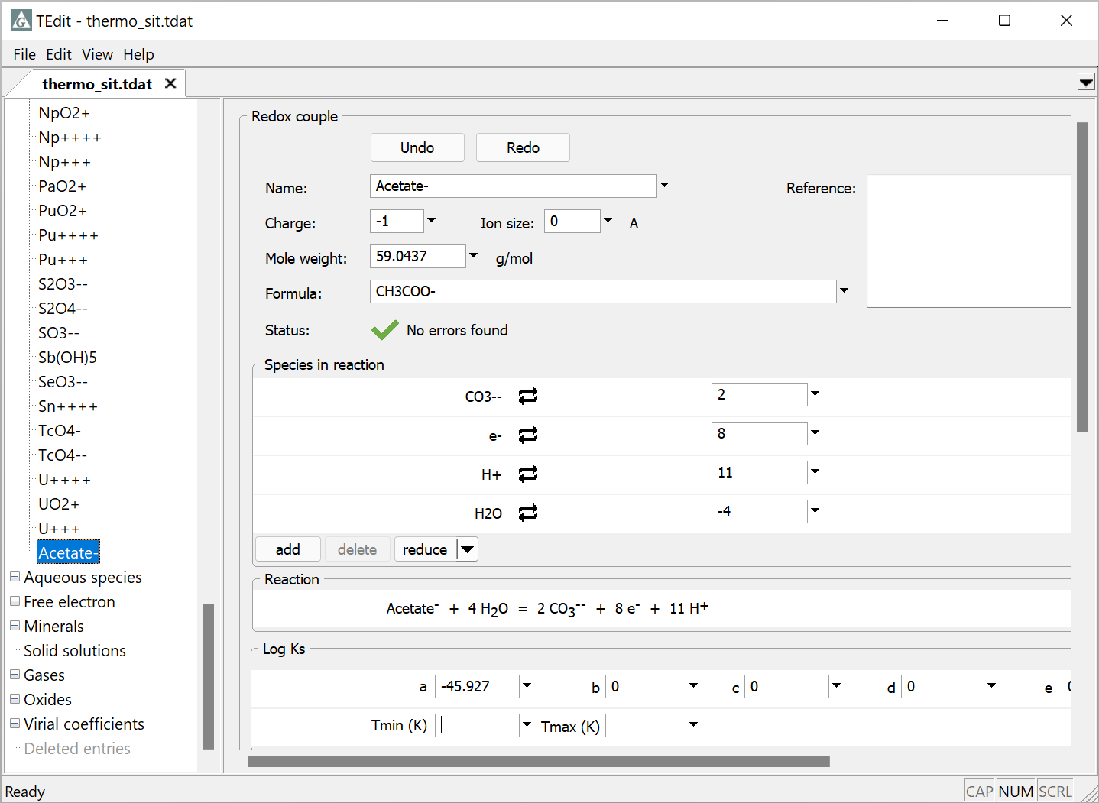
Supply stoichiometric coefficients
Negative coefficients indicate species is on the left-hand side of the equation
Supply Log Ks or polynomial coefficients

Slide 5

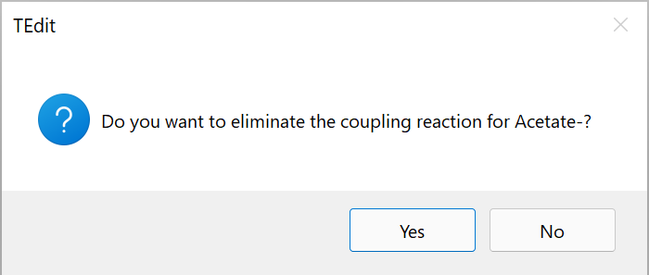
You can also change a redox species to a basis species, if the coupling reaction is not useful
Right-click and select Break Couple
Select Yes to break the coupling reaction and move the redox species to the basis species section

Slide 6
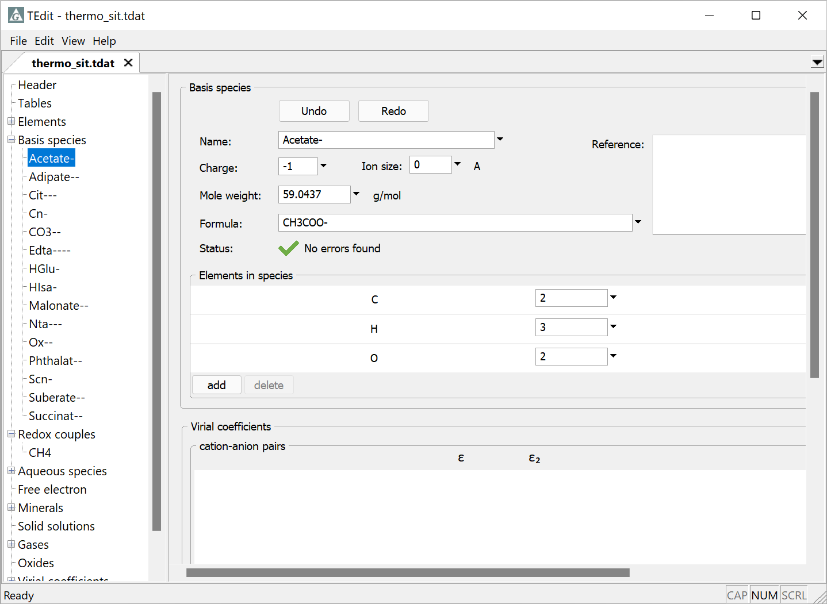
Acetate- is now a basis species

