Slide 1
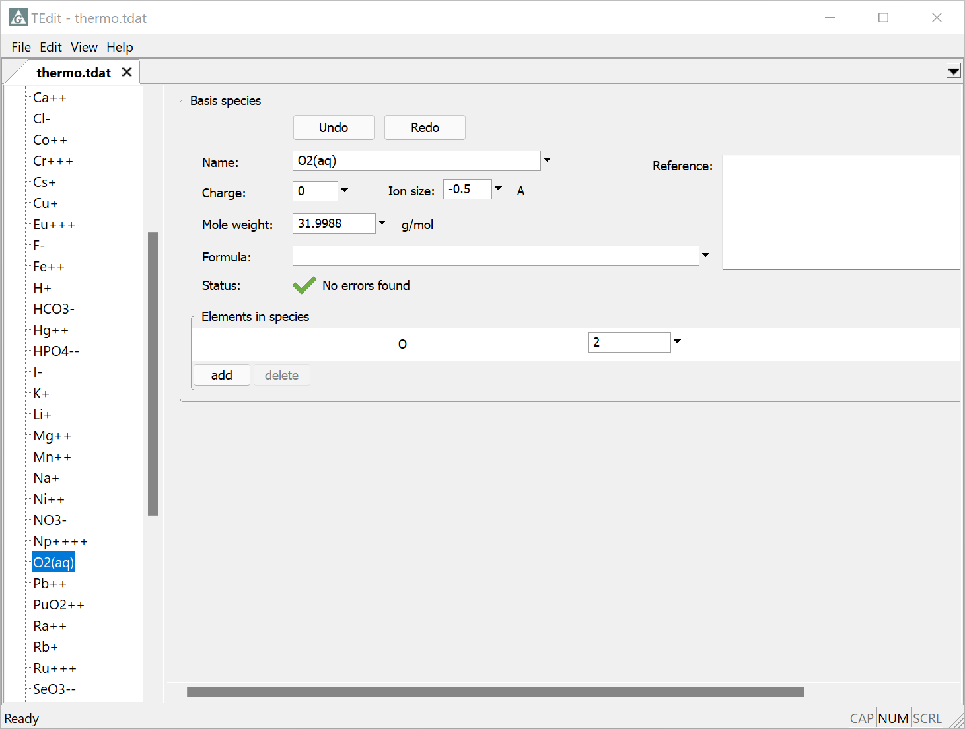
Redox pivots

Slide 2
Databases treating redox reactions must include O₂(aq) or H₂(aq) in the list of Basis Species. This species is the “redox pivot”.
O₂(aq) is the redox pivot in thermo.tdat

Slide 3
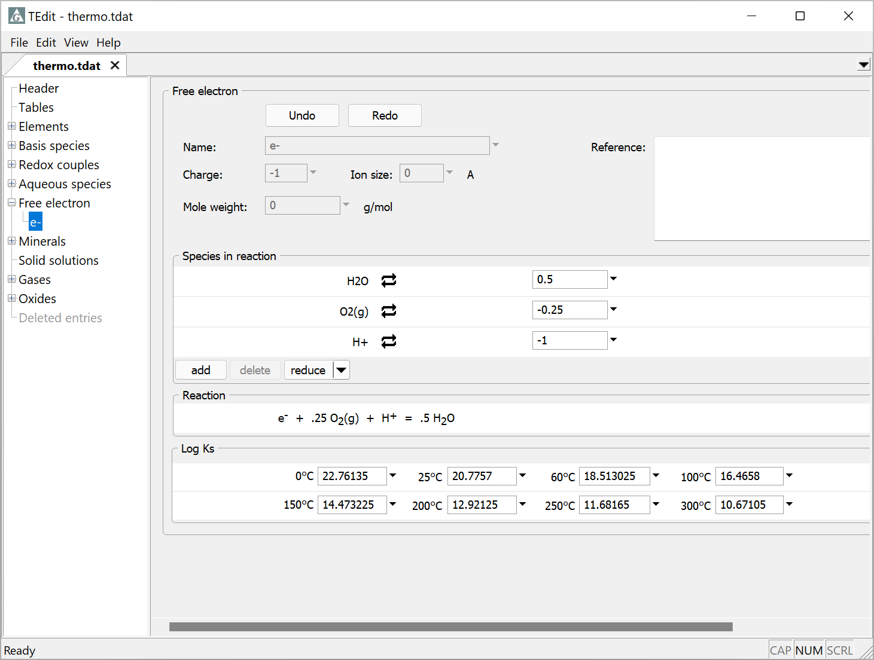
The reaction for the “free electron” is written in terms of O₂(aq) or H₂(aq), or their gaseous forms.
Here the electron is balanced in terms of O₂(g)

Slide 4
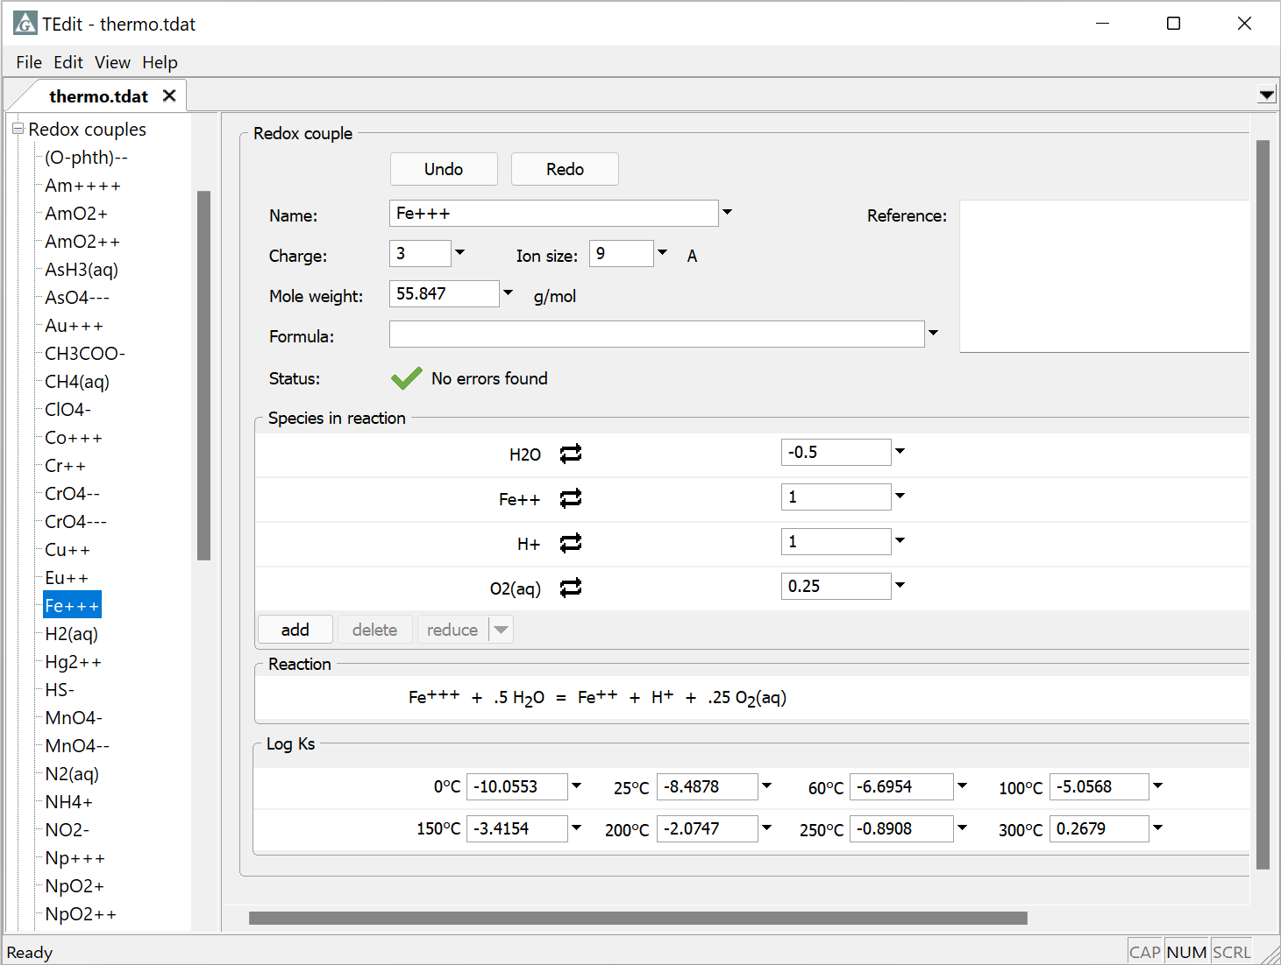
Redox coupling reactions can be balanced in a flexible manner.
Balance in terms of O₂(aq), O₂(g), H₂(aq), H₂(g), or the e⁻
Fe⁺⁺⁺, H₂(aq), etc. are redox species

Slide 5
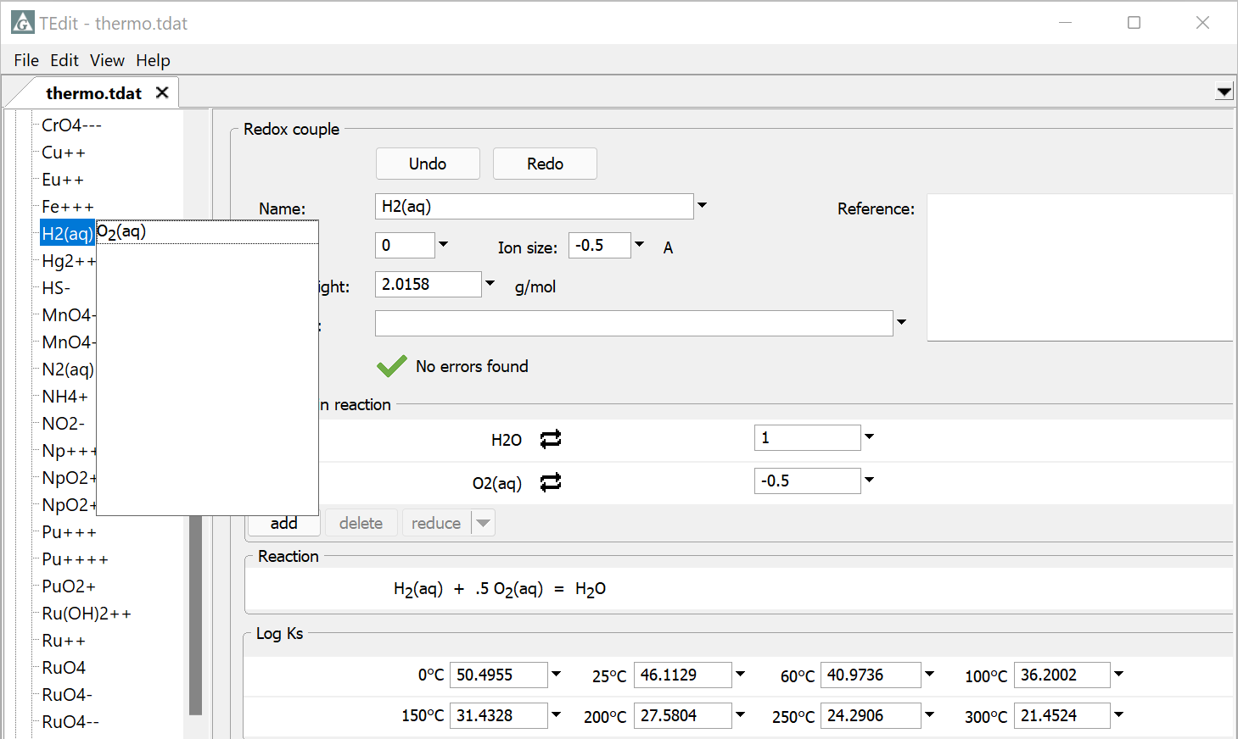
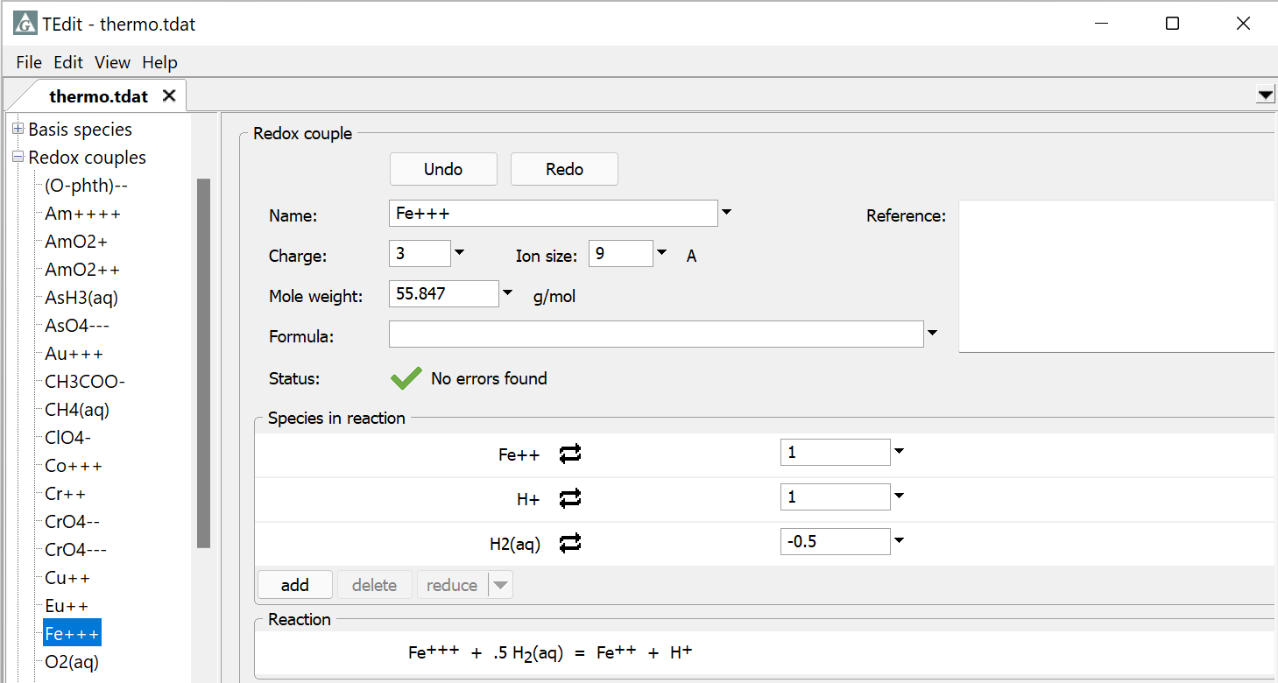
You can change the redox pivot by exchanging O₂(aq) with H₂(aq).
Exchange the positions of O₂(aq) and H₂(aq)
After the exchange, reaction is balanced with H₂(aq), Fe²⁺, and H⁺.

