Slide 1
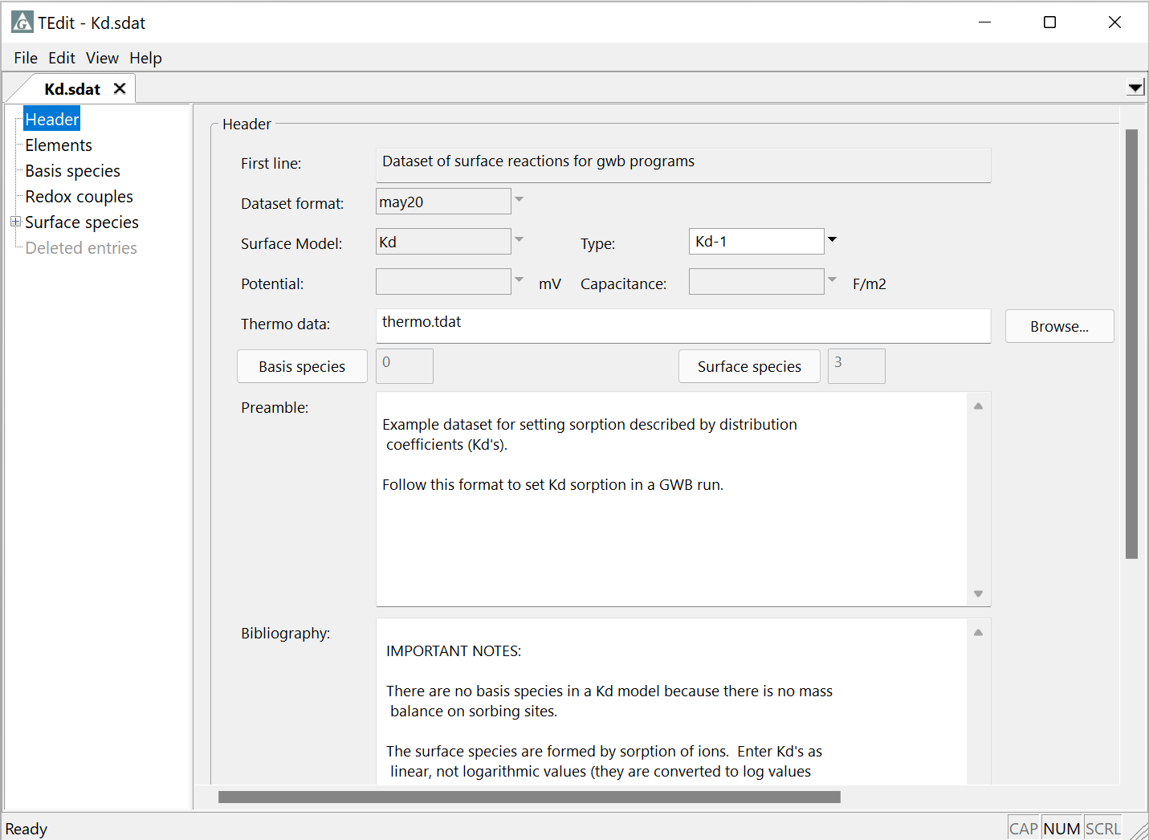
K_{d}, Freundlich, and Langmuir isotherms

Slide 2
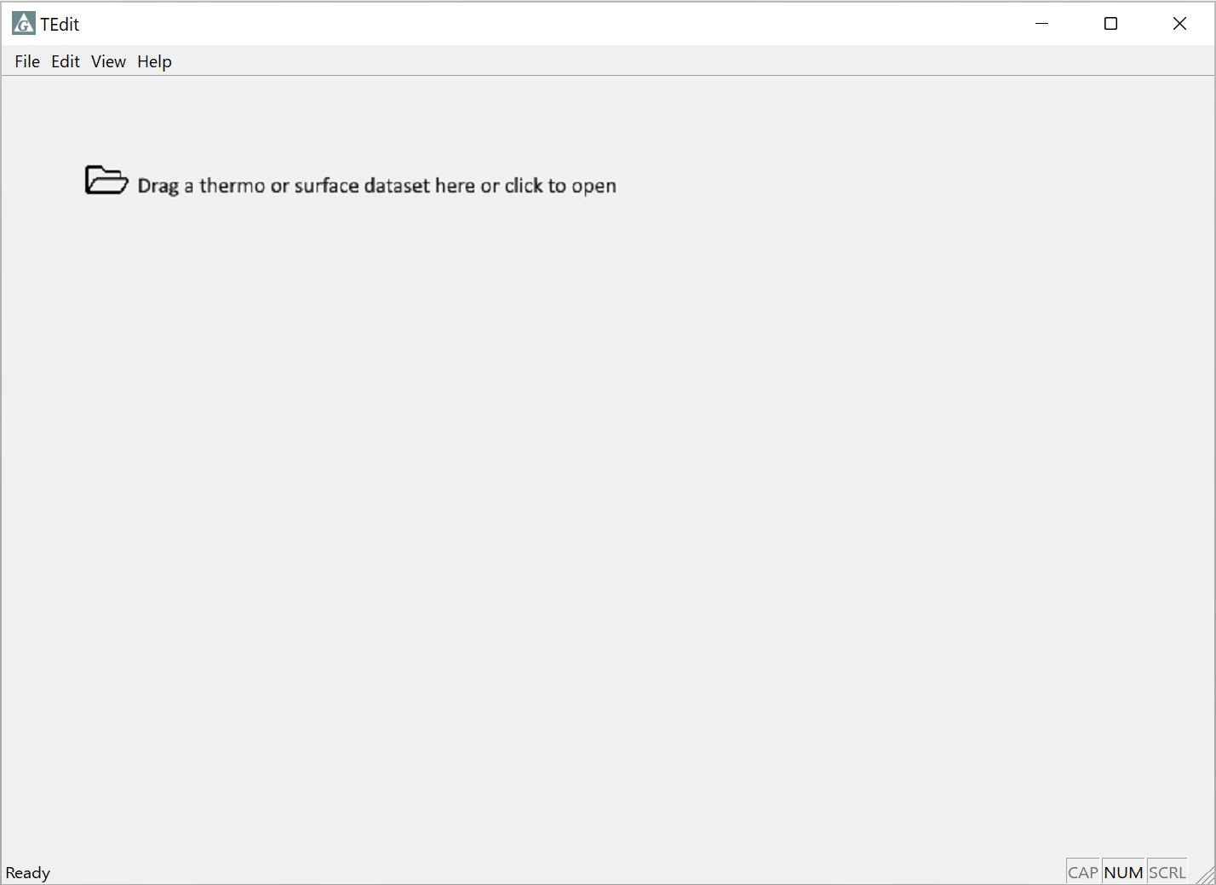
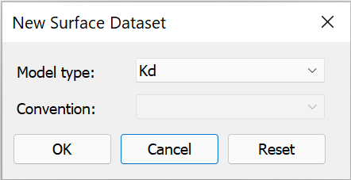
Creating a reaction Kd surface dataset
File → New → Sorbing Surfaces…
Select Kd from pulldown

Slide 3
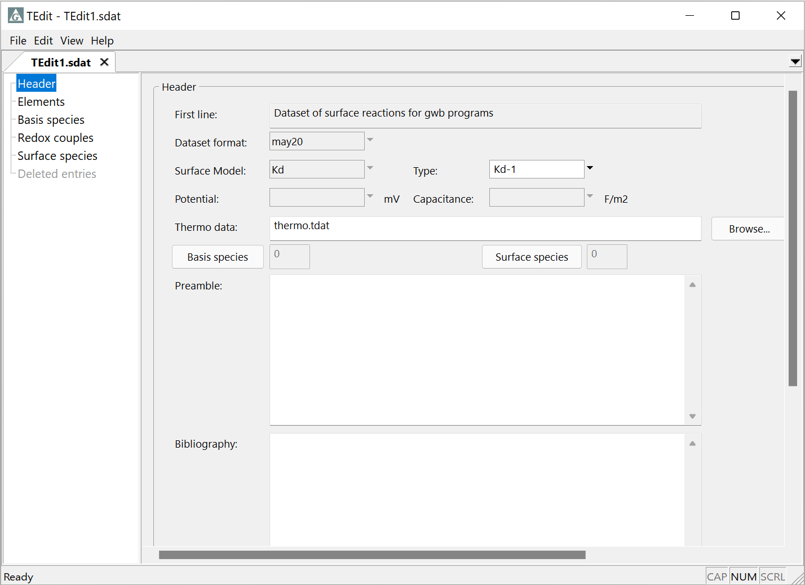
Creating a reaction Kd surface dataset
Enter a unique identifier for the sorbing surface
Pull aqueous species from this thermo dataset

Slide 4
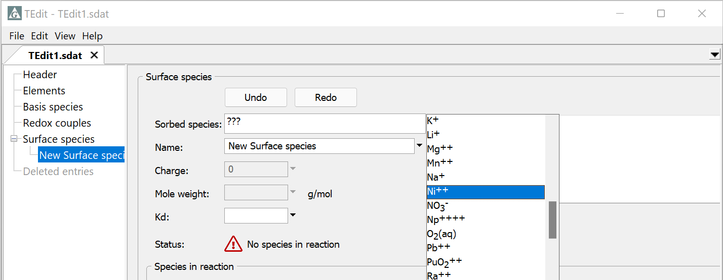
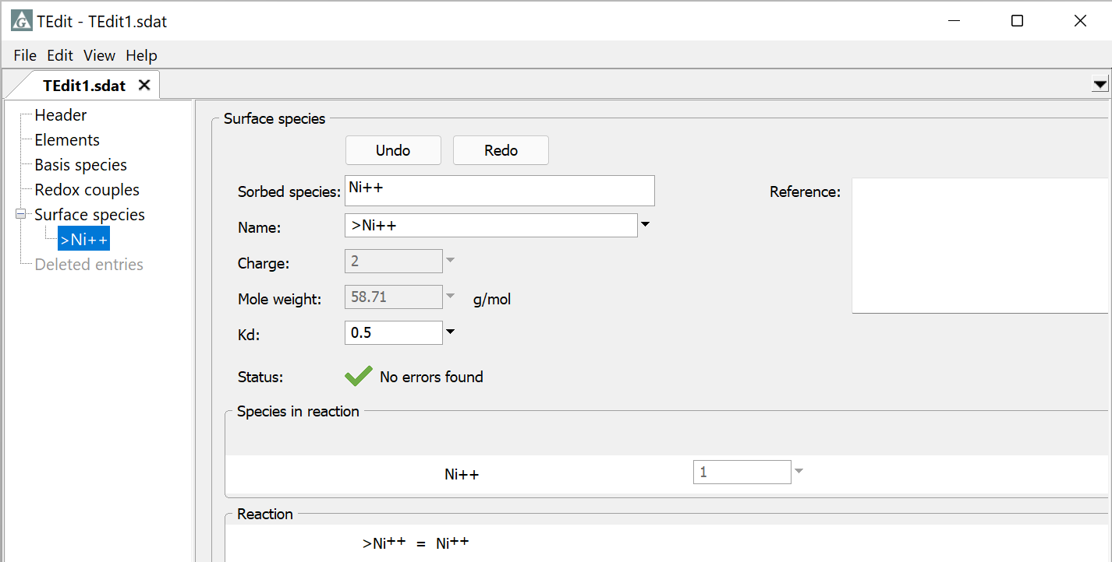
Choose a basis, redox, or aqueous species from the list
Basis… → Ni⁺⁺
Right-click → Add
Ni⁺⁺ properties taken from thermo dataset automatically
Supply a reaction K_{d}

Slide 5
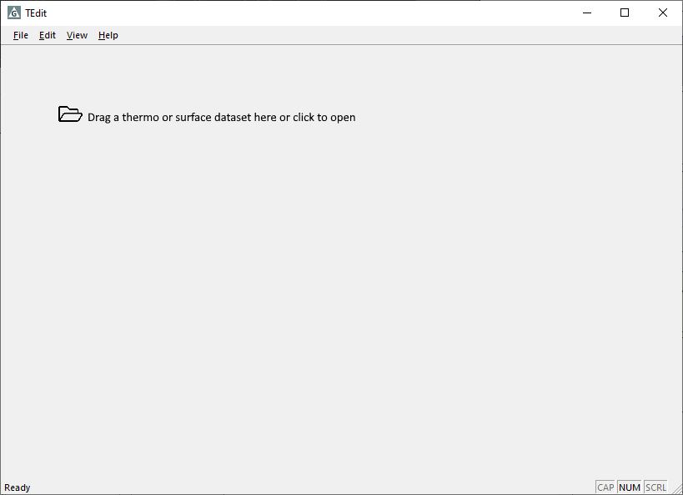
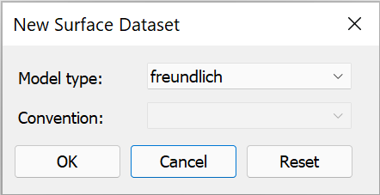
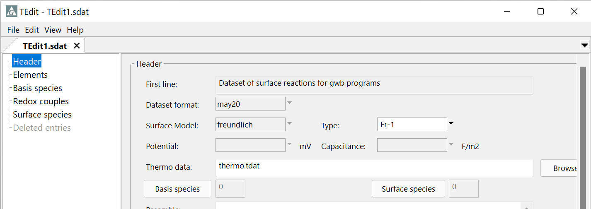
Creating a new Freundlich surface dataset
File → New → Sorbing Surfaces…
Select Freundlich from pulldown

Slide 6
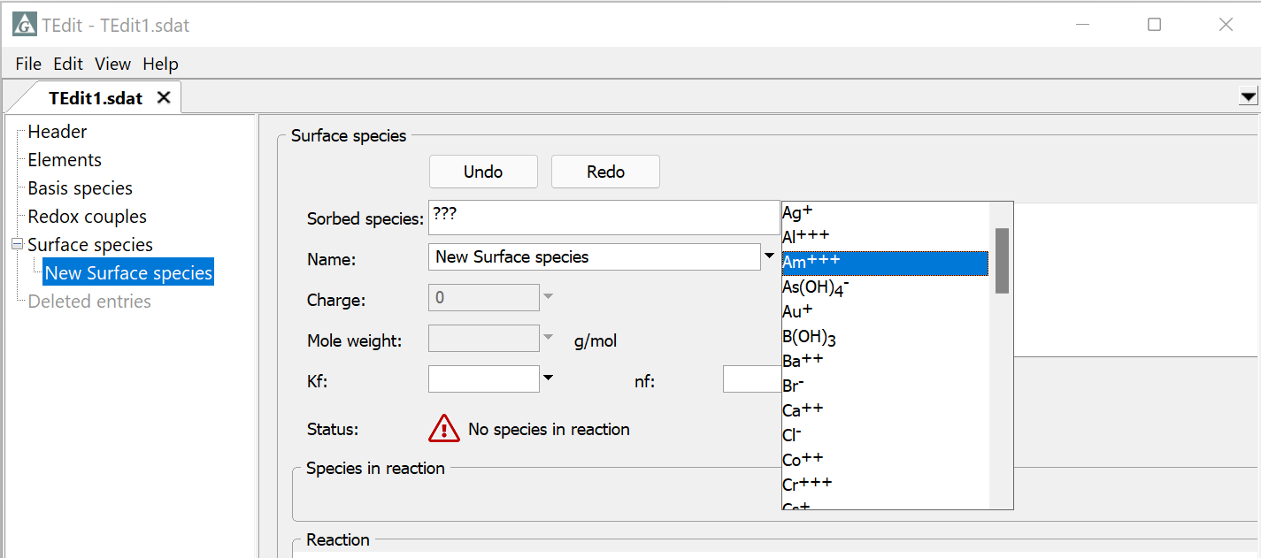
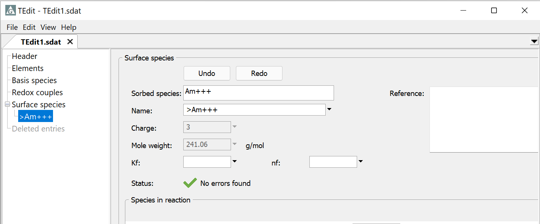
Basis… → Am⁺⁺⁺
Right-click → Add
Am⁺⁺⁺ properties taken from thermo dataset automatically
Supply a reaction K_{f} and n_{f}

Slide 7
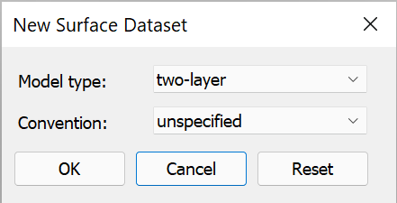
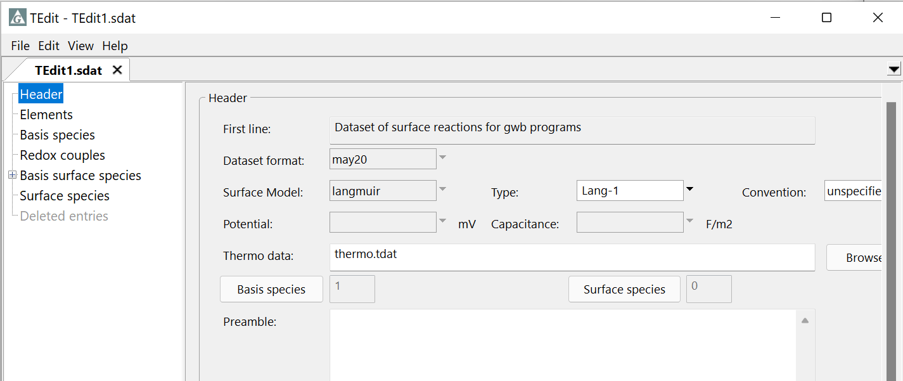
Creating a new Langmuir surface dataset
File → New → Sorbing Surfaces…
Select Langmuir from pulldown

Slide 8
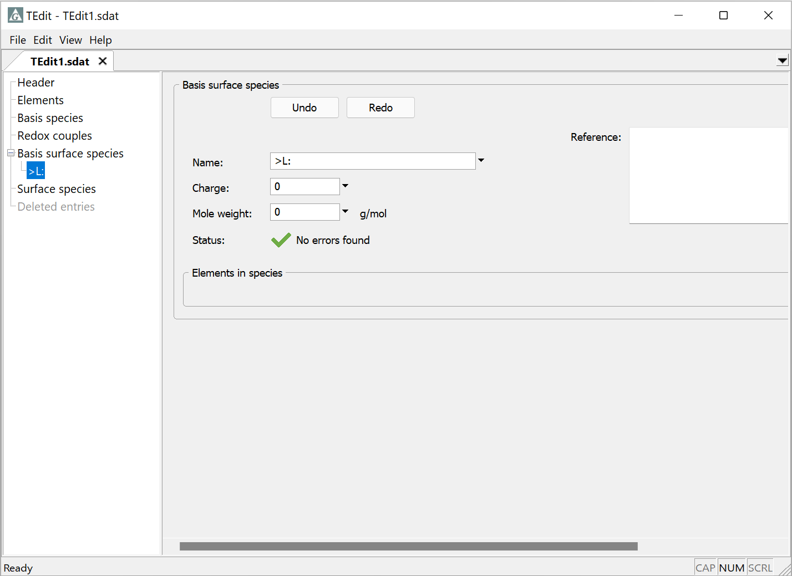
Langmuir datasets have one uncomplexed site, >L:
You can edit its name if you’d like to consider multiple Langmuir datasets simultaneously.

Slide 9
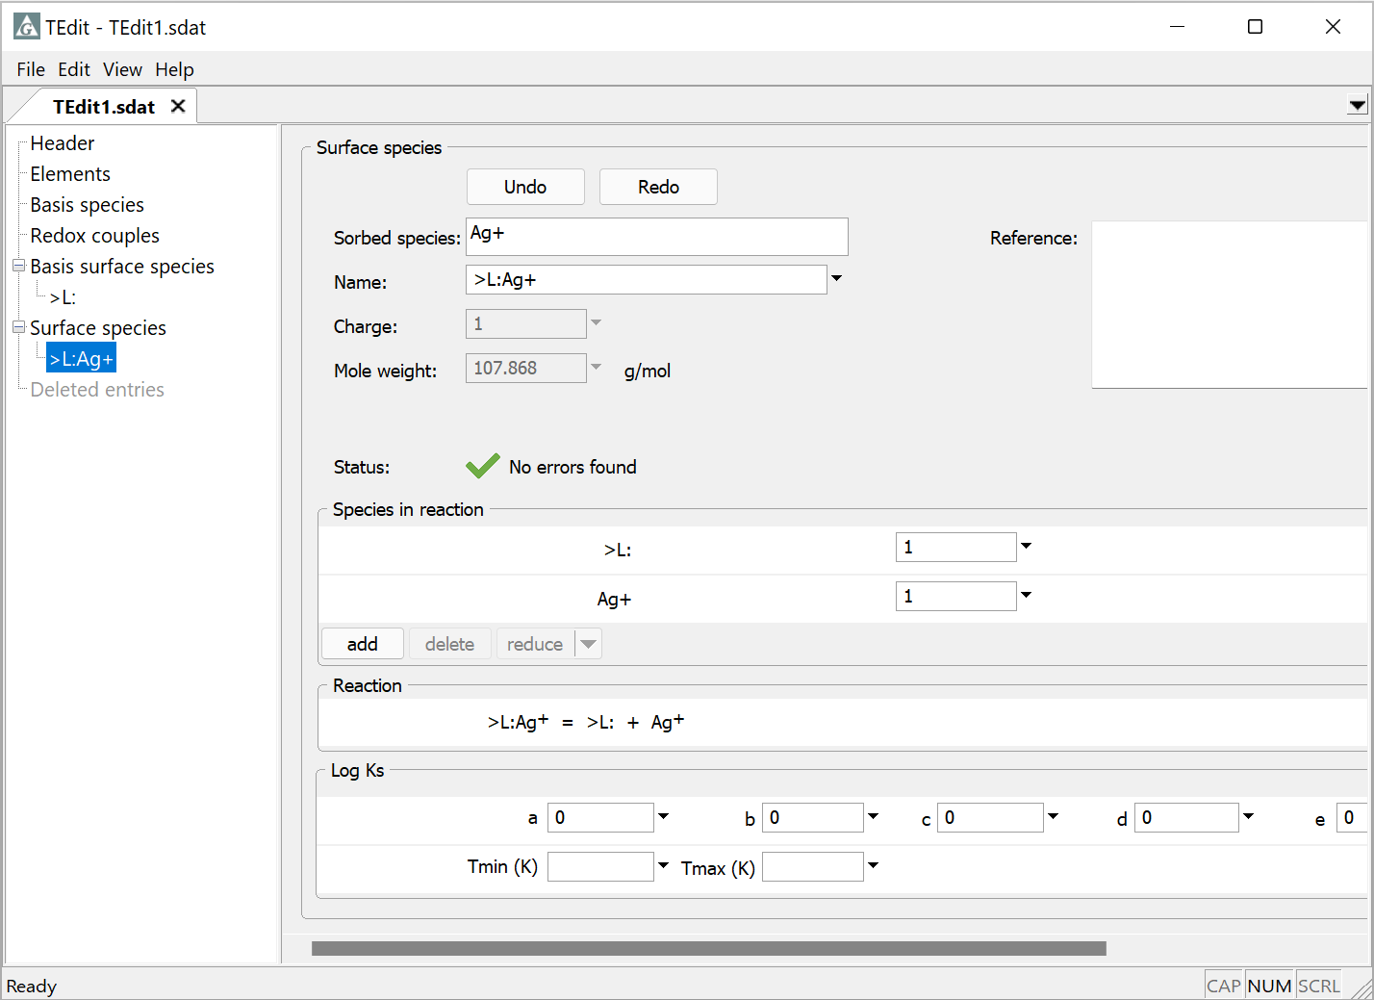
Choose sorbing ion as before
In GWB 2021 and newer releases, set a polynomial temperature expansion for the equilibrium constant; “a” is the log K value at 25°C.

