Slide 1
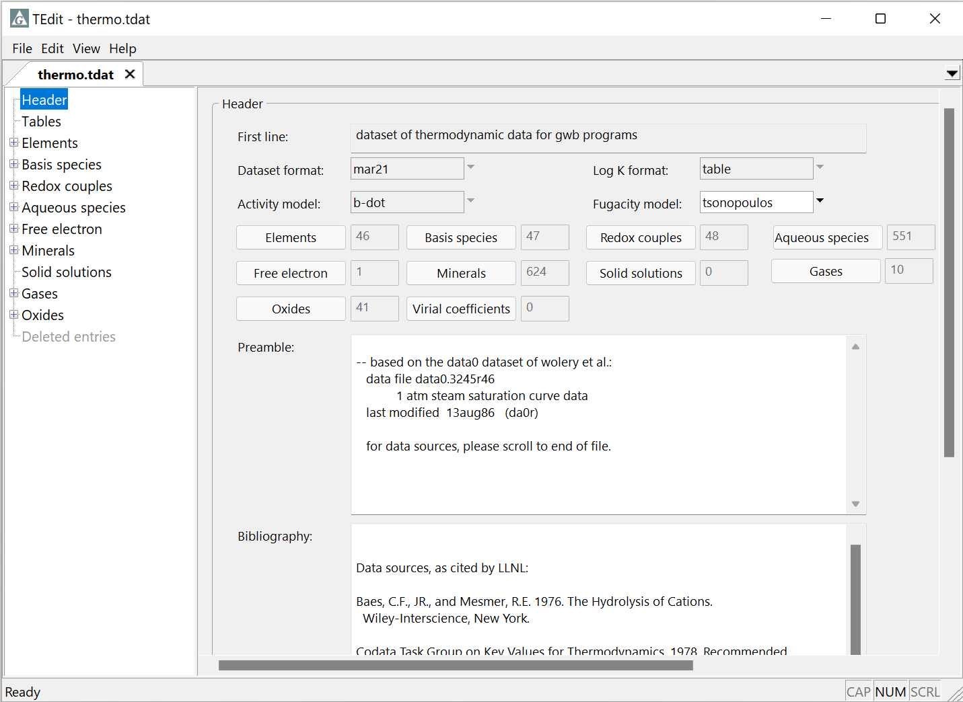
Summary panes
and Filtering

Slide 2
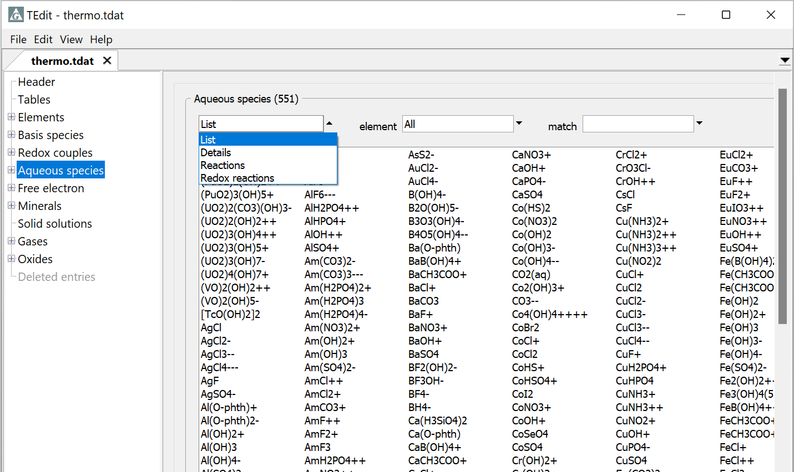
Click on a section header to view a summary of its contents
Choose view: species, their properties, reactions, …
Limit entries by element
Show entries matching the text entered
Double-click to Open an entry, or right-click to Add, Delete, Extract, Cut, Copy, or Paste

Slide 3
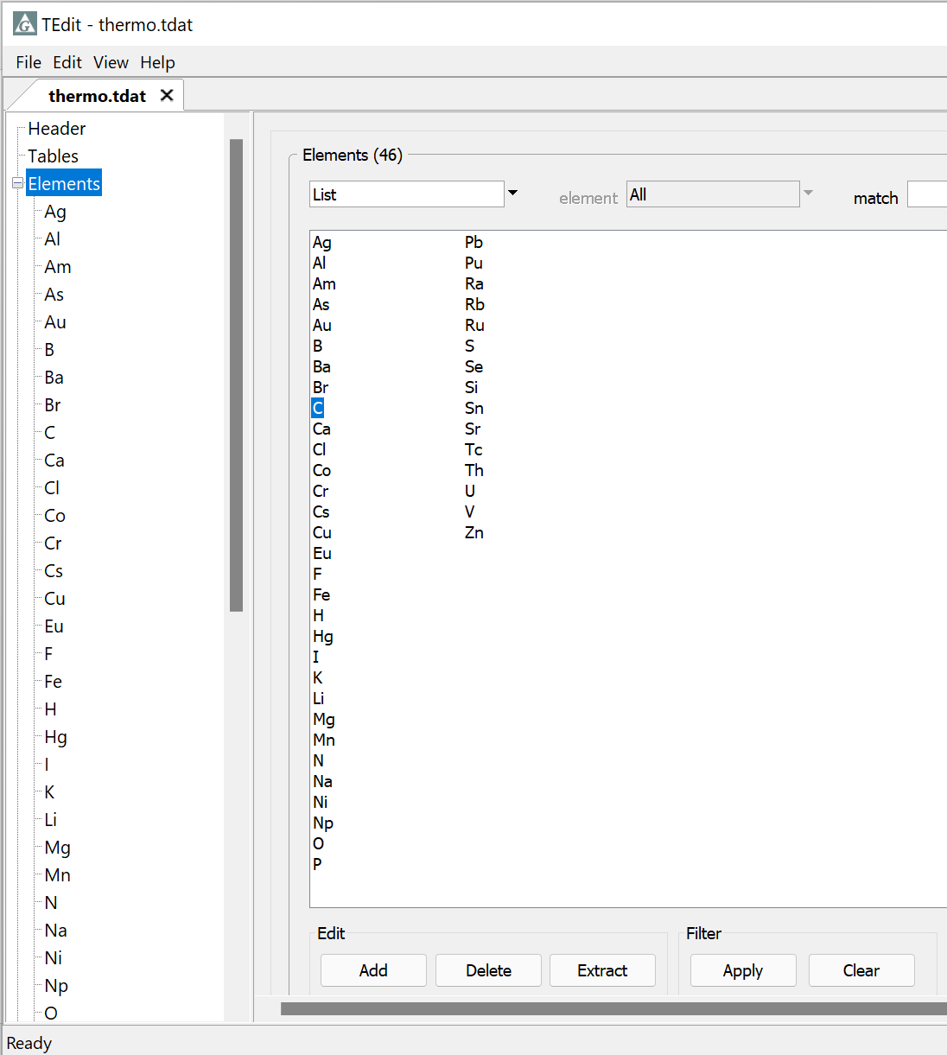
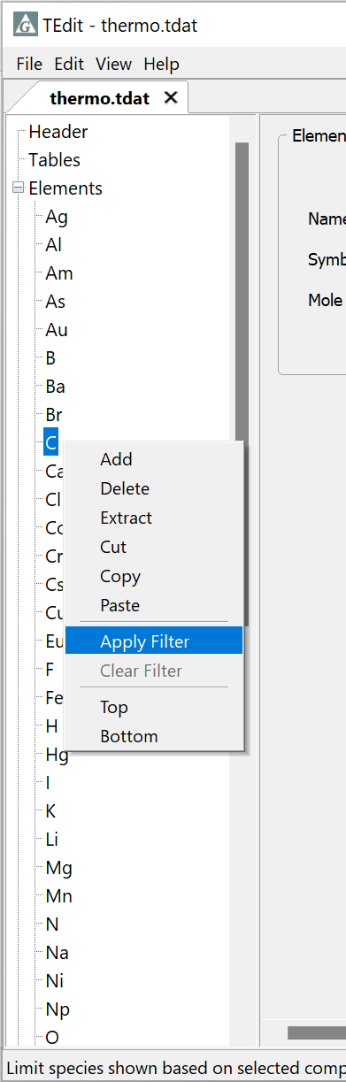
You can filter by element or species. Control from section header or from the tree structure
To show only entries containing carbon, select C, then click Apply under Filter
Or, right-click on C on the tree, then select Apply Filter

Slide 4
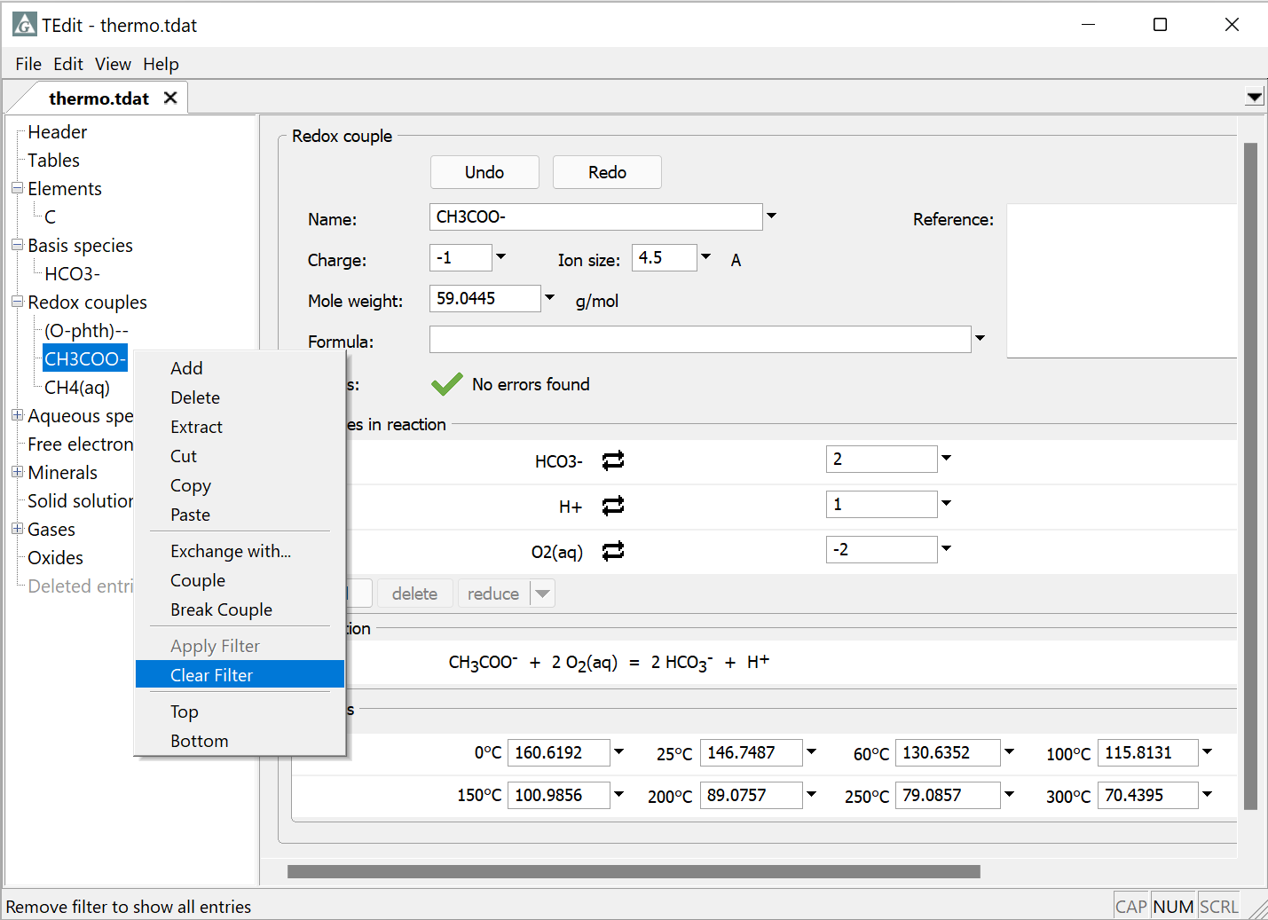
Tree structure only showing species with carbon
Clear Filter from any right-click menu

Slide 5
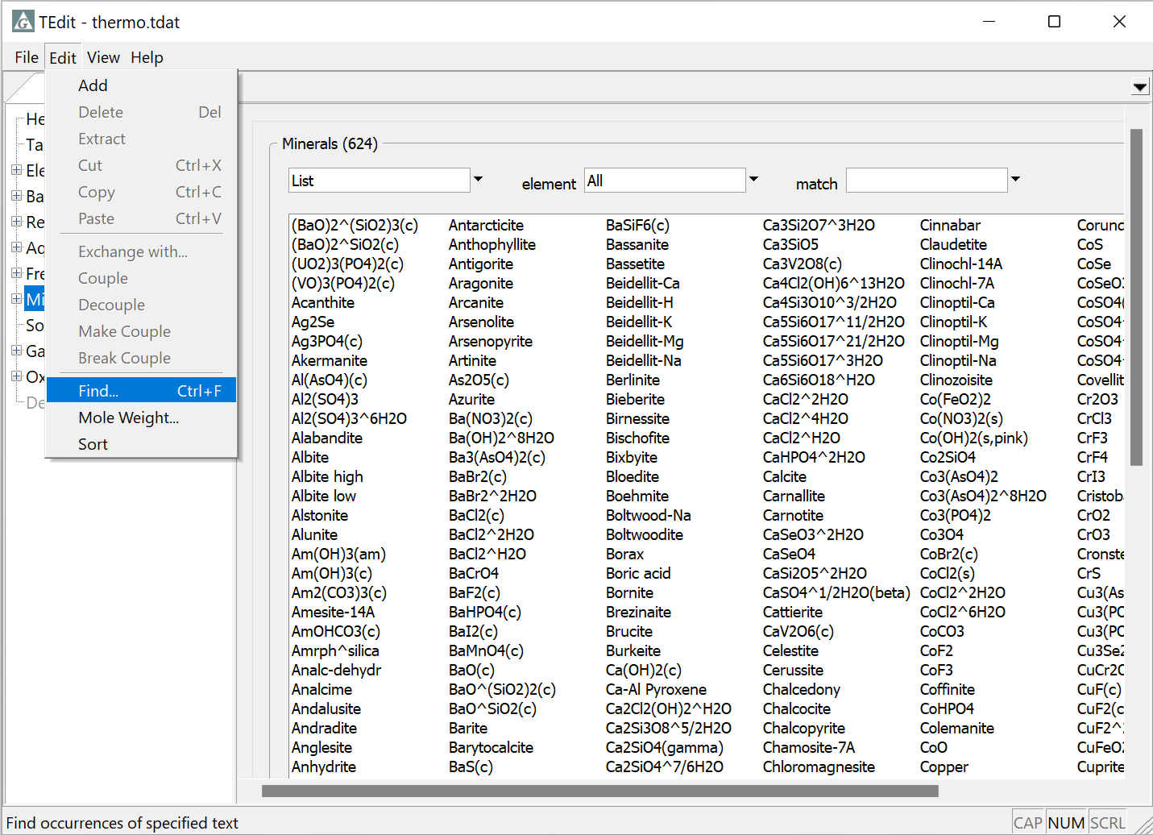
Search entries in dataset.
Edit → Find…

Slide 6
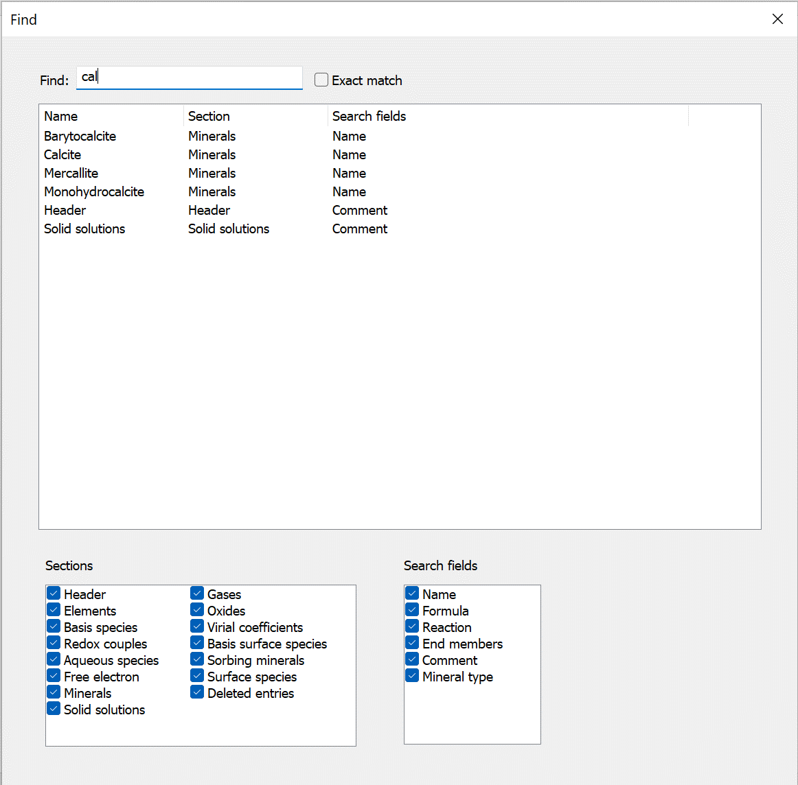
Search entries
Select sections to search
Select fields to search

