Slide 1
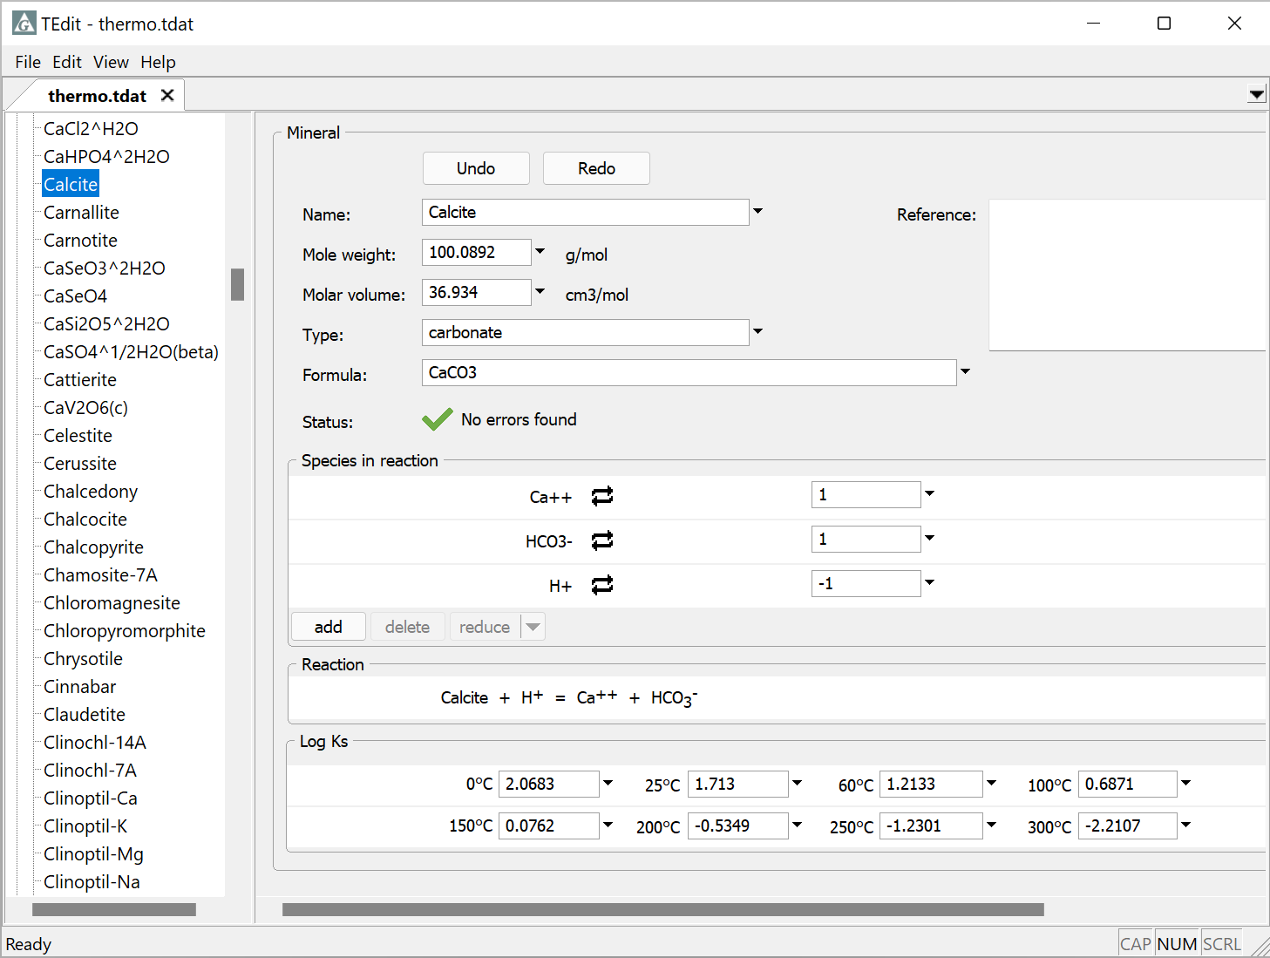
Swapping reactions

Slide 2
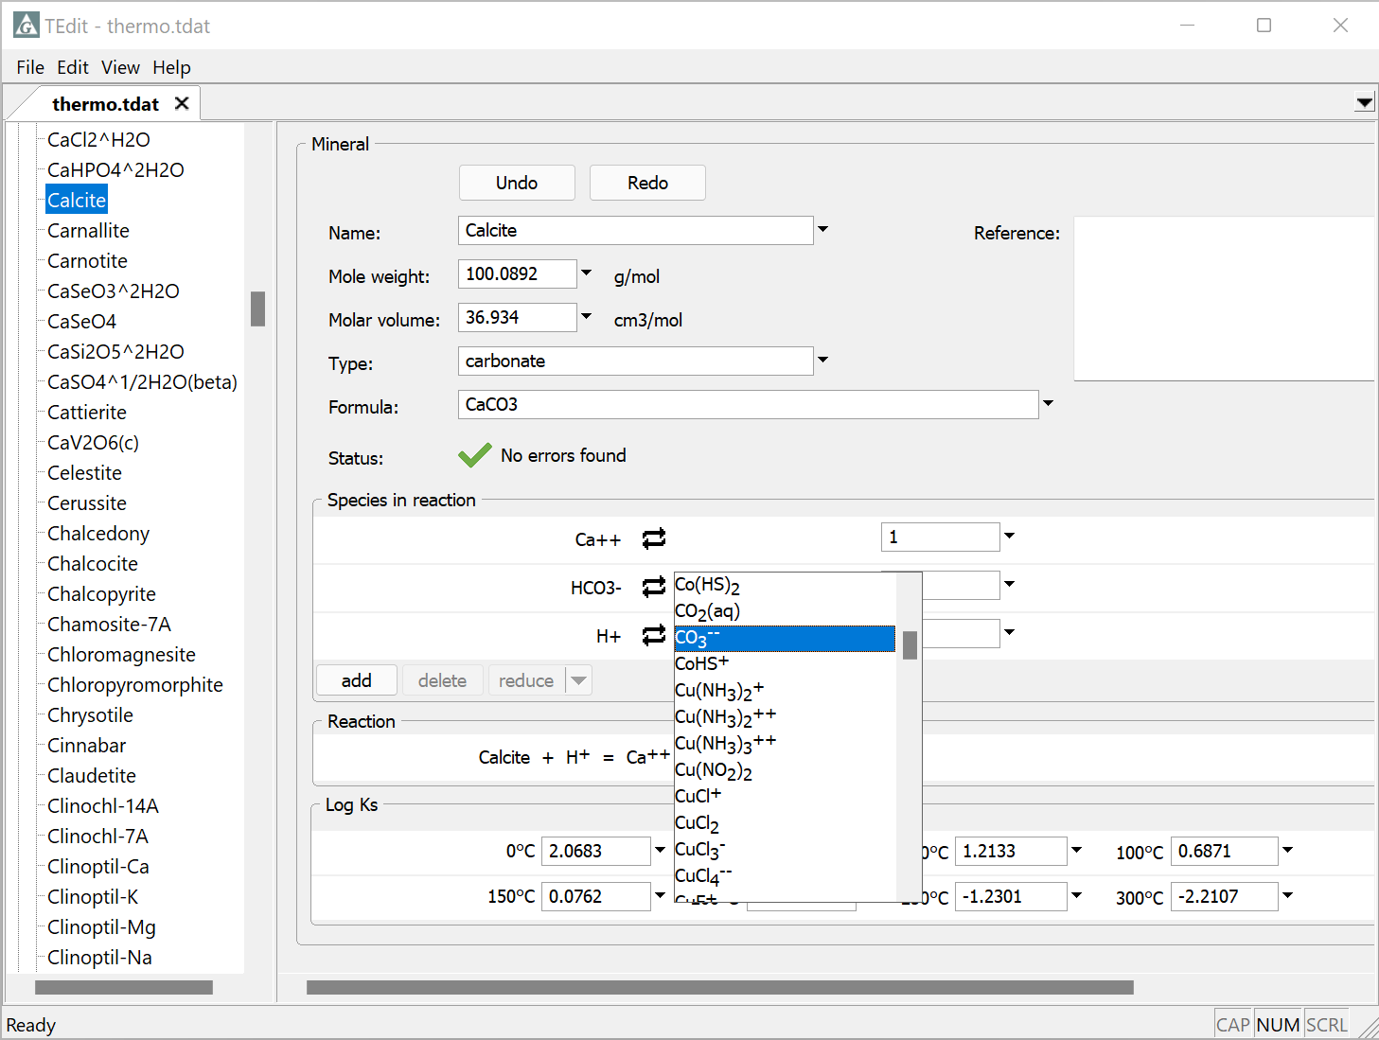
Use swaps to rebalance reactions and recalculate log Ks in TEdit
Rebalance the mineral calcite in terms of carbonate ion, using swapping in TEdit
Click on the swap button
Select Aqueous species… and select CO₃⁻⁻

Slide 3
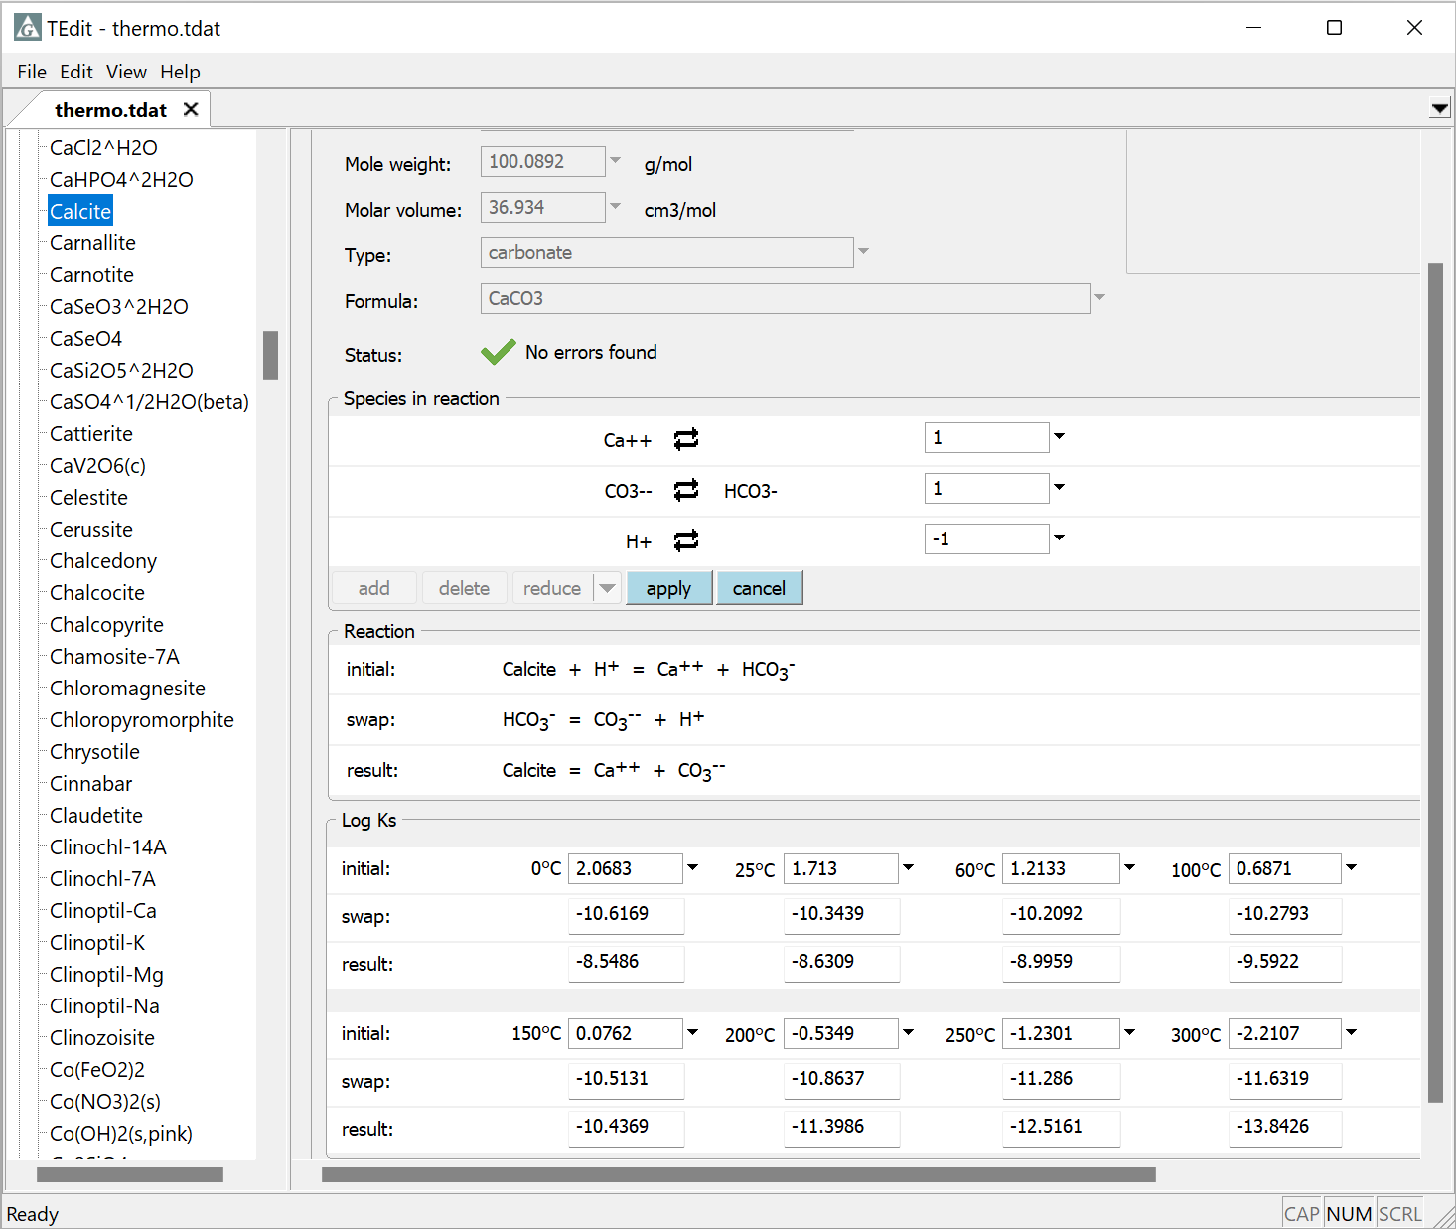
apply to save new reaction
Initial reaction before swap
Reaction that’s being swapped in
Log Ks are automatically recast for the new reaction
Resulting reaction

Slide 4
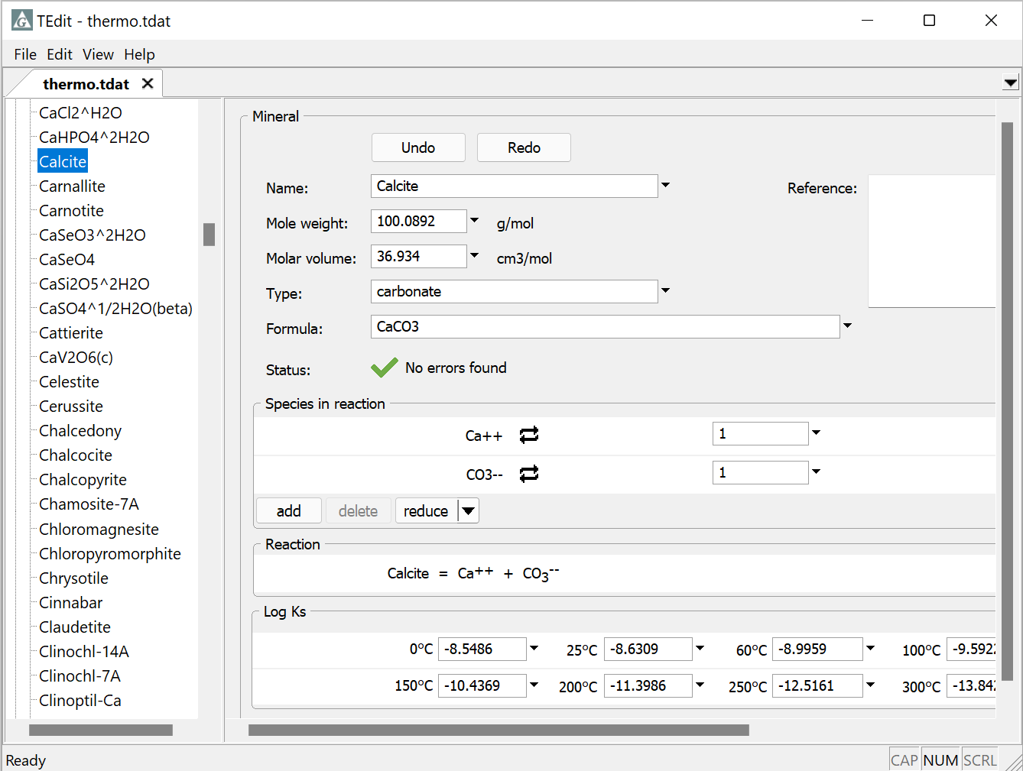
Final reaction
Final log Ks

