Slide 1
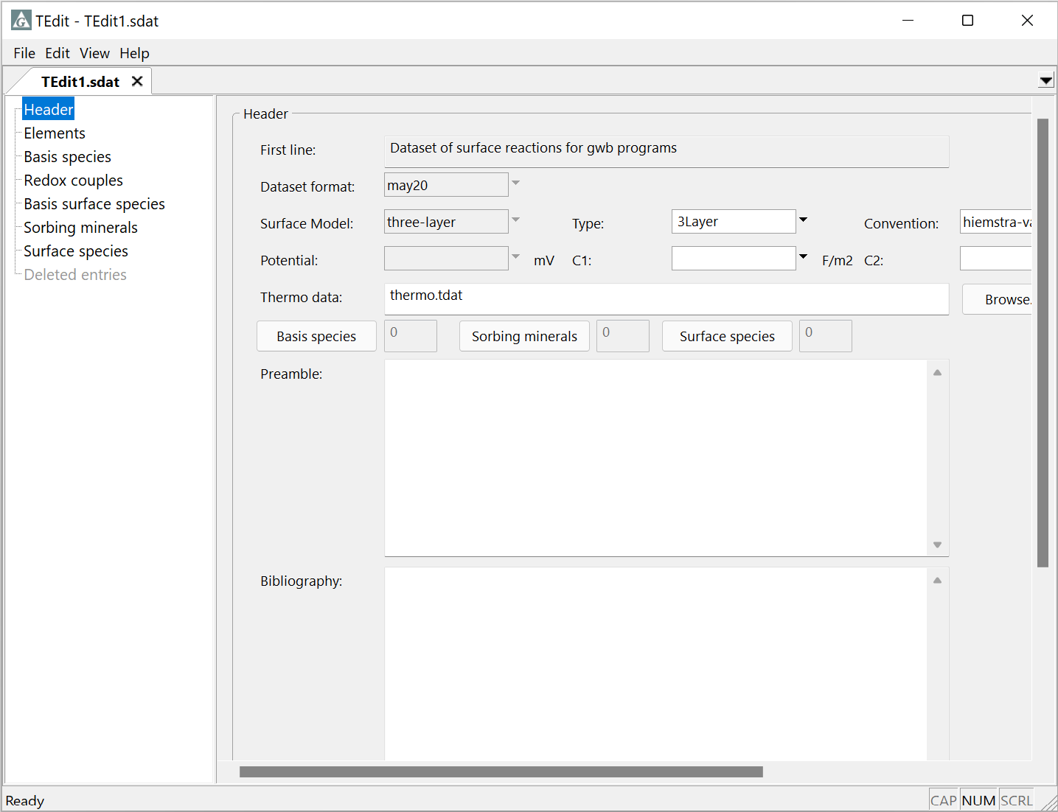
Three-layer and
CD-MUSIC datasets

Slide 2
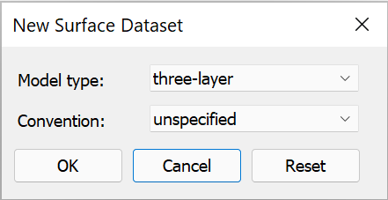
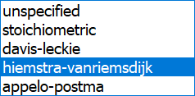
File → New → Sorbing Surfaces…
Choose the three-layer or CD-MUSIC model.
Choose a convention for polydentate complexation, if desired. CD-MUSIC is typically used with Hiemstra-Van Riemsdijk or Appelo-Postma, for example.

Slide 3
Three-layer and CD-MUSIC datasets are similar to those for the two-layer model
Supply capacitance values C₁ and C₂ for your surface

Slide 4
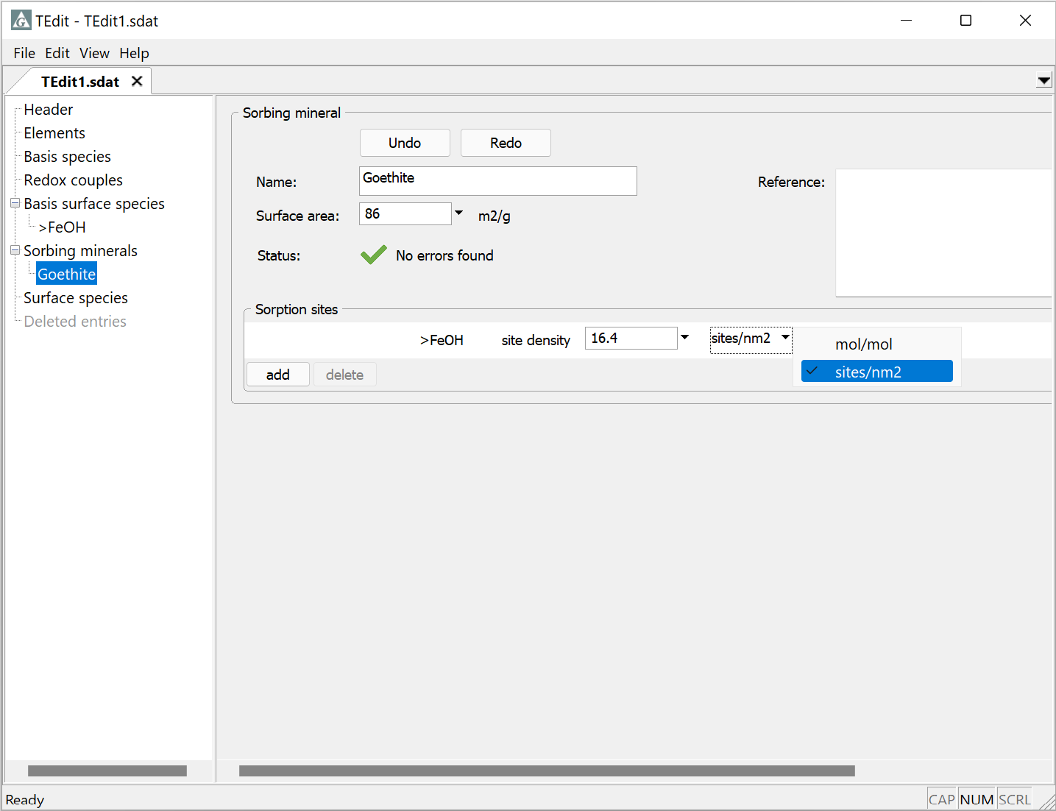
Associate surface sites with minerals from a thermo dataset and set their site density
Goethite selected from list of minerals in thermo dataset.
Right-click → Add
Each sorbing mineral can contain one or more of the sorbing sites (the surface basis species)
Enter site density in moles/mole mineral or sites/nm²

Slide 5
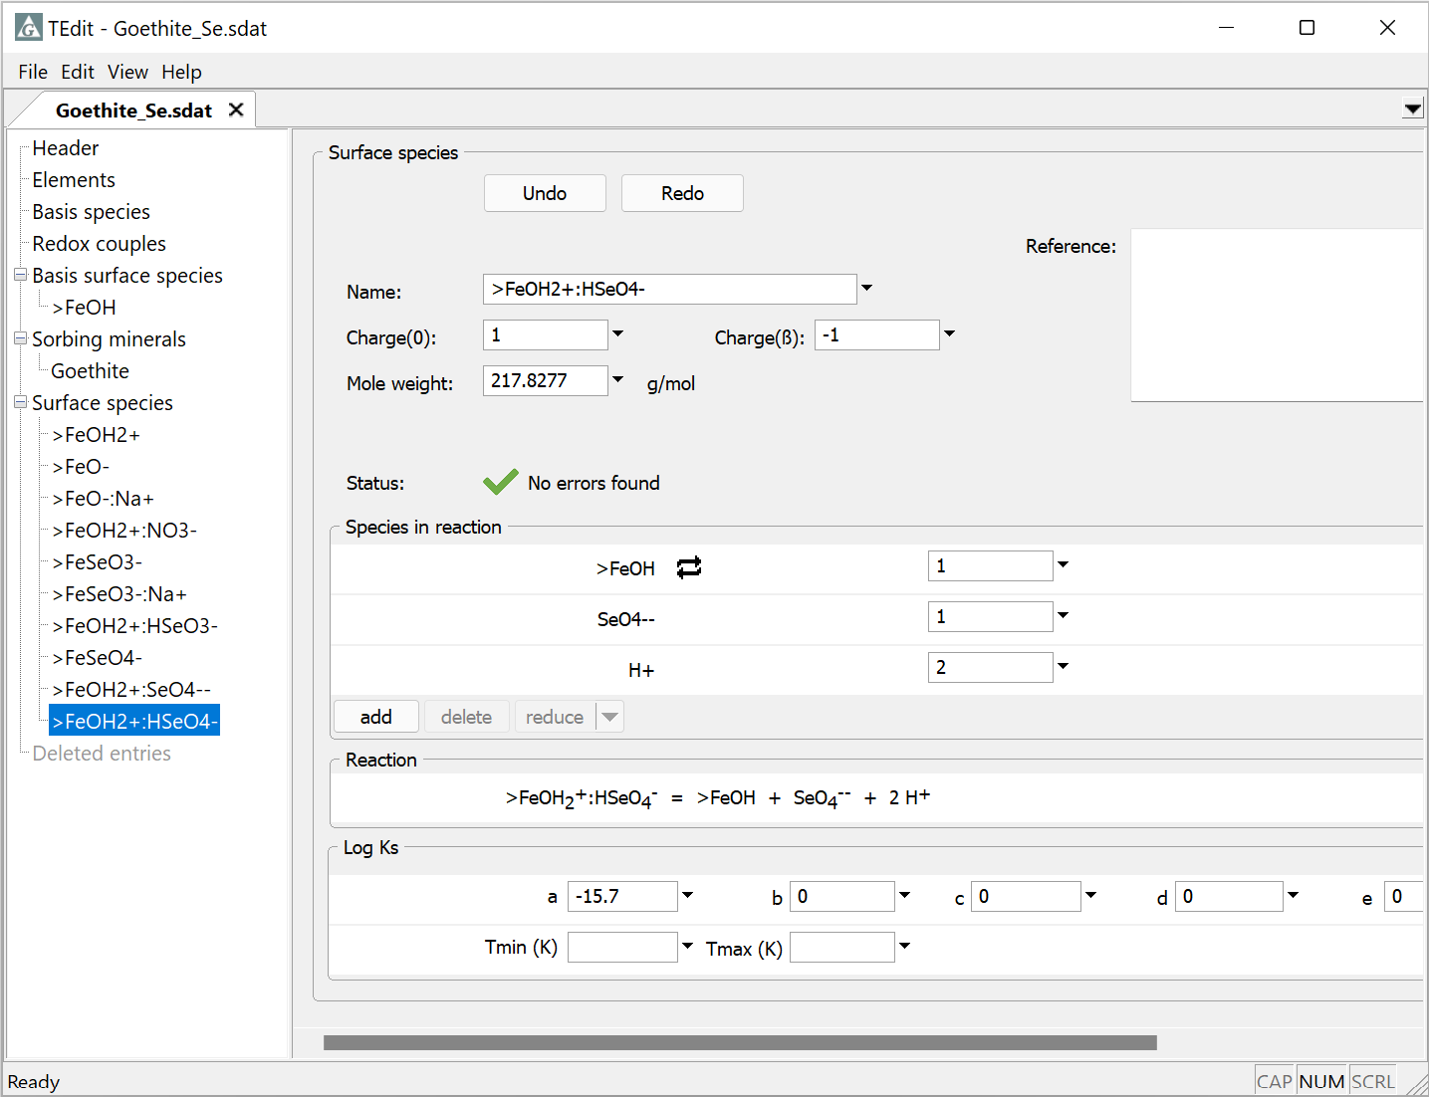
In the three-layer model, set charge of surface species on multiple planes
Selenate complex
Charge on the 0 and β planes
0 plane charge decreases by 1
β plane charge increases by 1

Slide 6
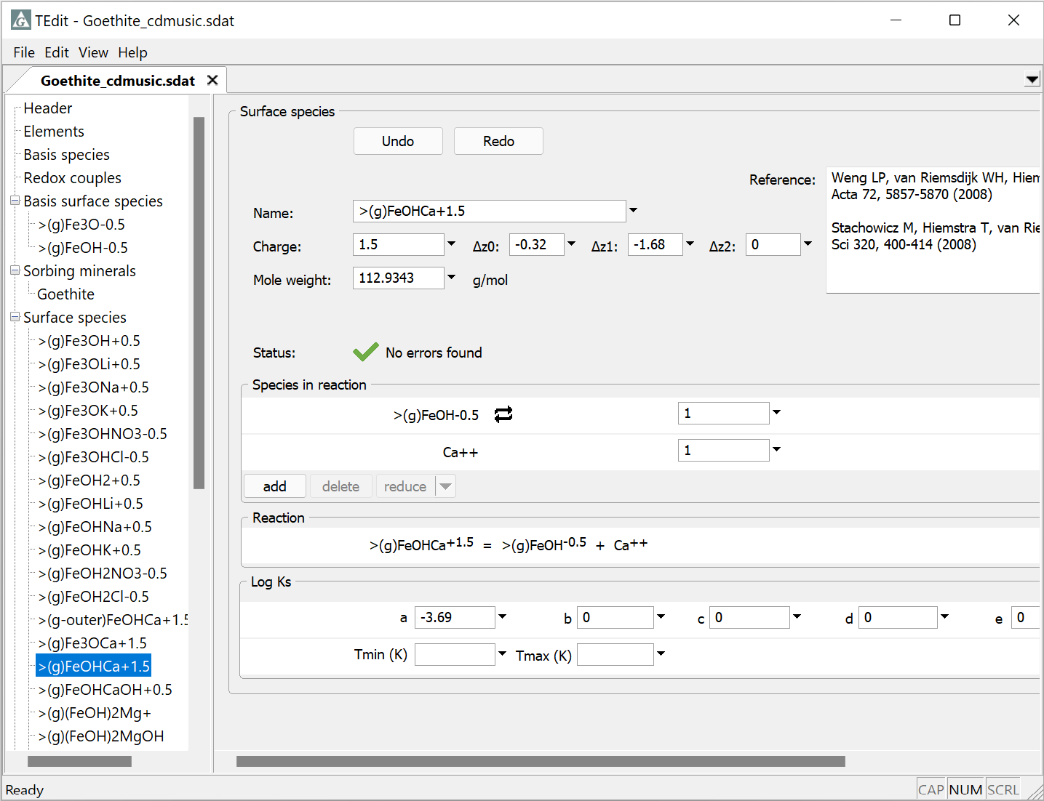
In the CD-MUSIC model, set total charge of surface species and change in charge on each plane
Charge distribution from complex dissociation
0 plane charge decreases by .32, β plane decreases by 1.68, and d plane is unchanged
Uncomplexed site commonly has fractional charge

