Slide 1
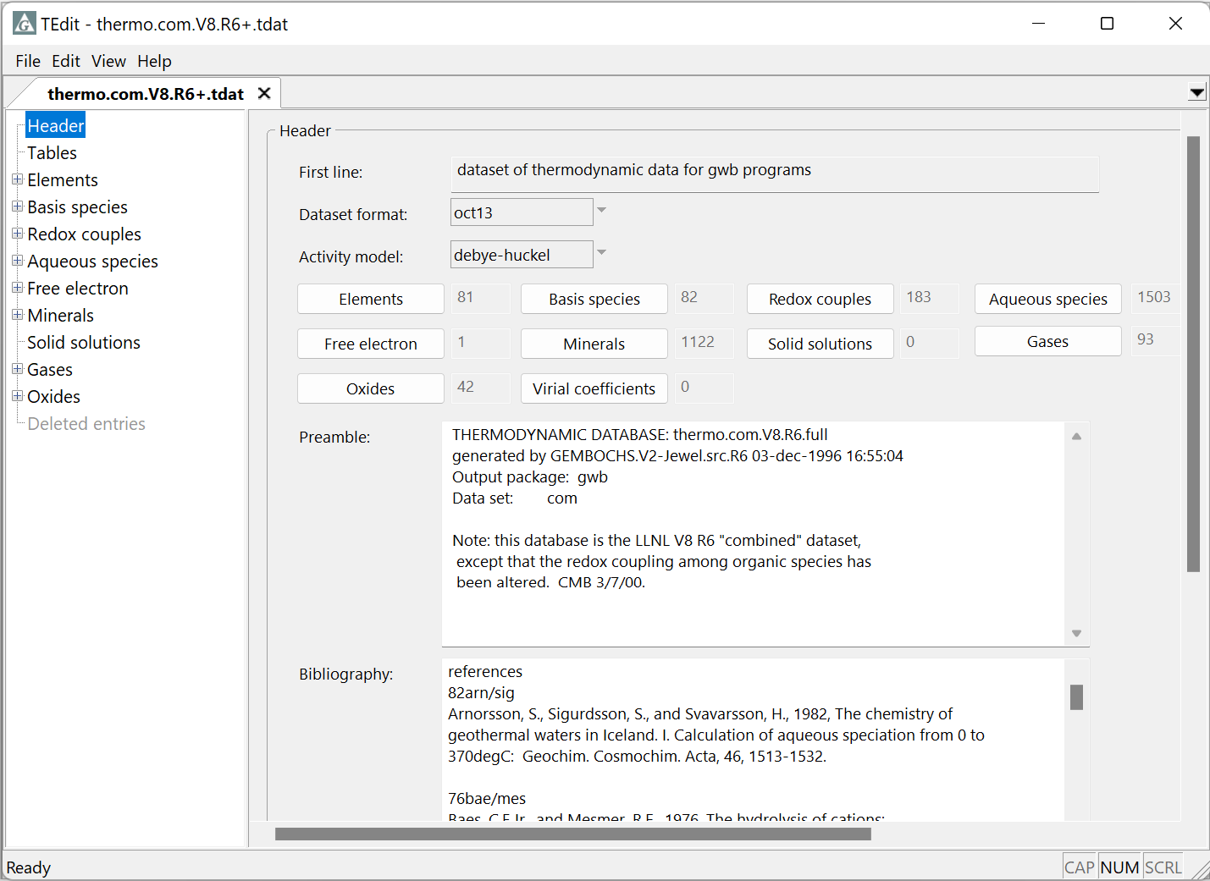
Updating datasets to the newest format

Slide 2
Update to the latest format to enable all new features
File → Save As…

Slide 3
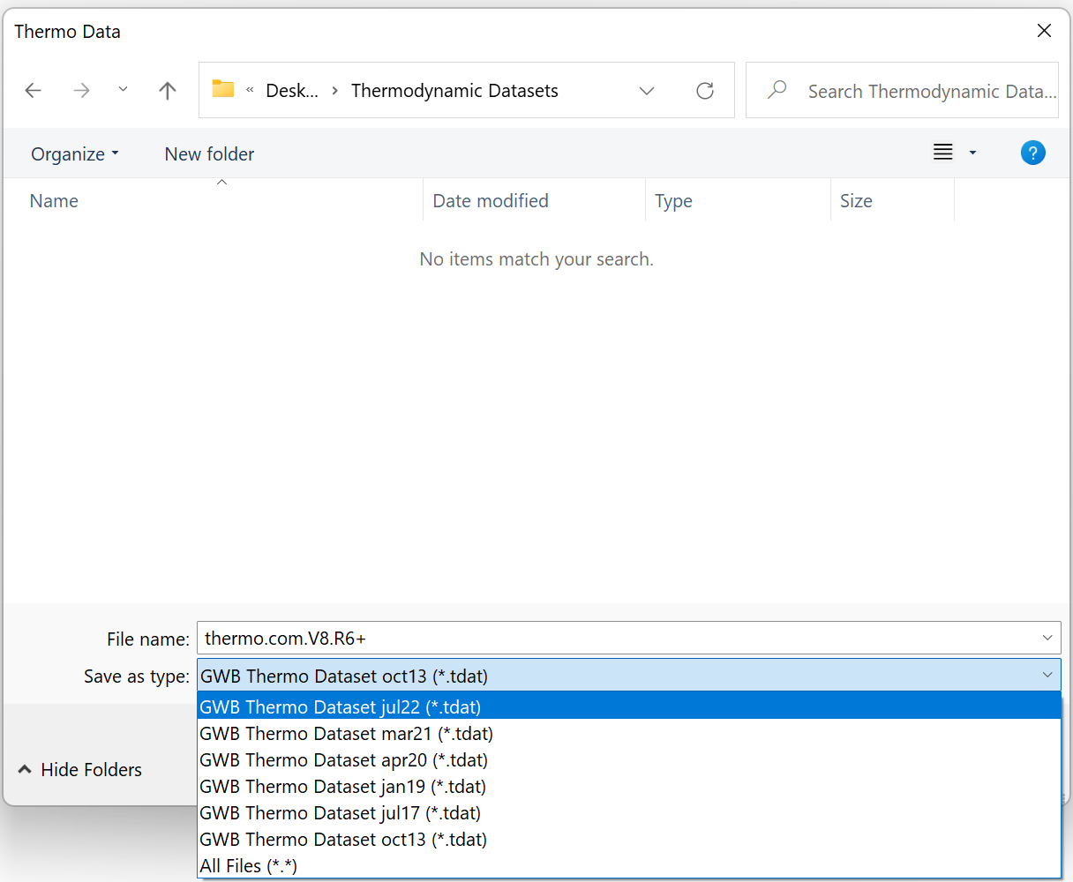
Change very old “.dat” files to “.tdat” (thermo data) or “.sdat” (surface data)
Choose latest format from
“Save as type:”

Slide 4
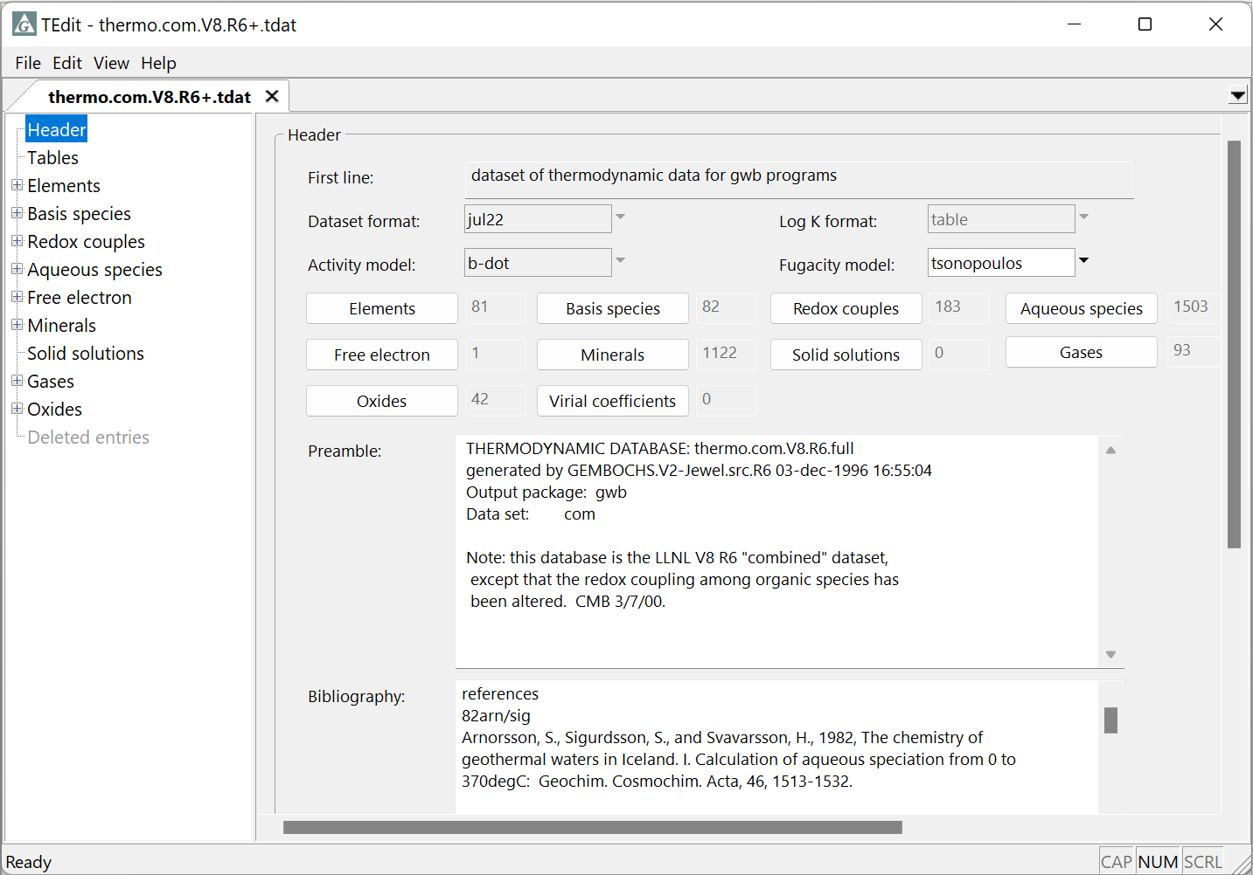
Updated to the newest format

