Slide 1
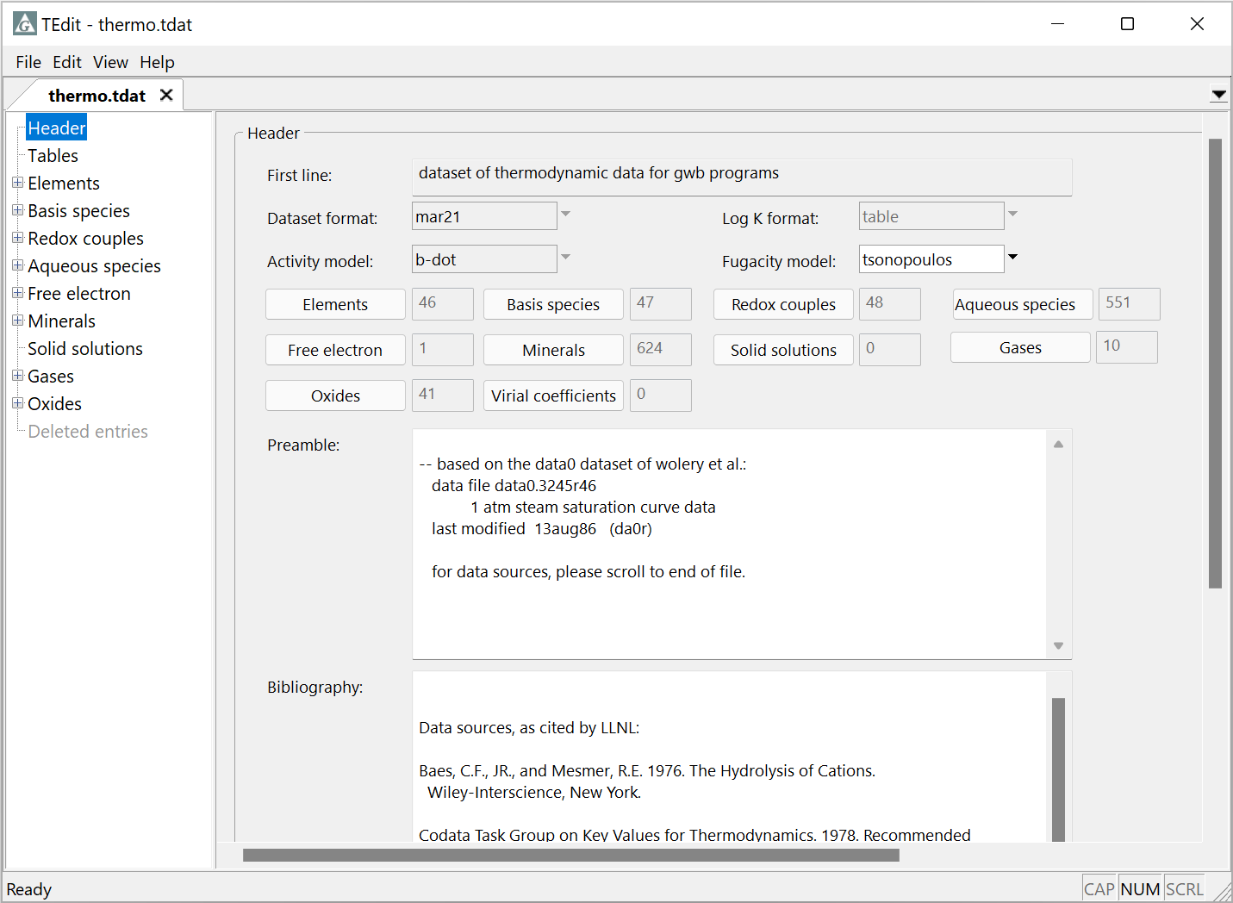
Viewing thermo datasets in TEdit

Slide 2
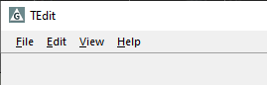
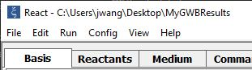
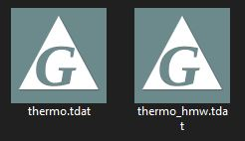
You can launch TEdit to view thermo datasets in several different ways.
From TEdit,
File → Open…
GWB’s default dataset
From GWB apps, File → View → …\thermo.tdat
From File Explorer,
double-click the file or drag into TEdit

Slide 3

The Header section contains a description of the thermo dataset’s content and bibliographic information
The “B-dot” Debye-Hückel equation is used for activity coefficients, and the Tsonopoulos method for fugacity coefficients
# of elements, species, etc. in the dataset
Literature sources for thermo data

Slide 4
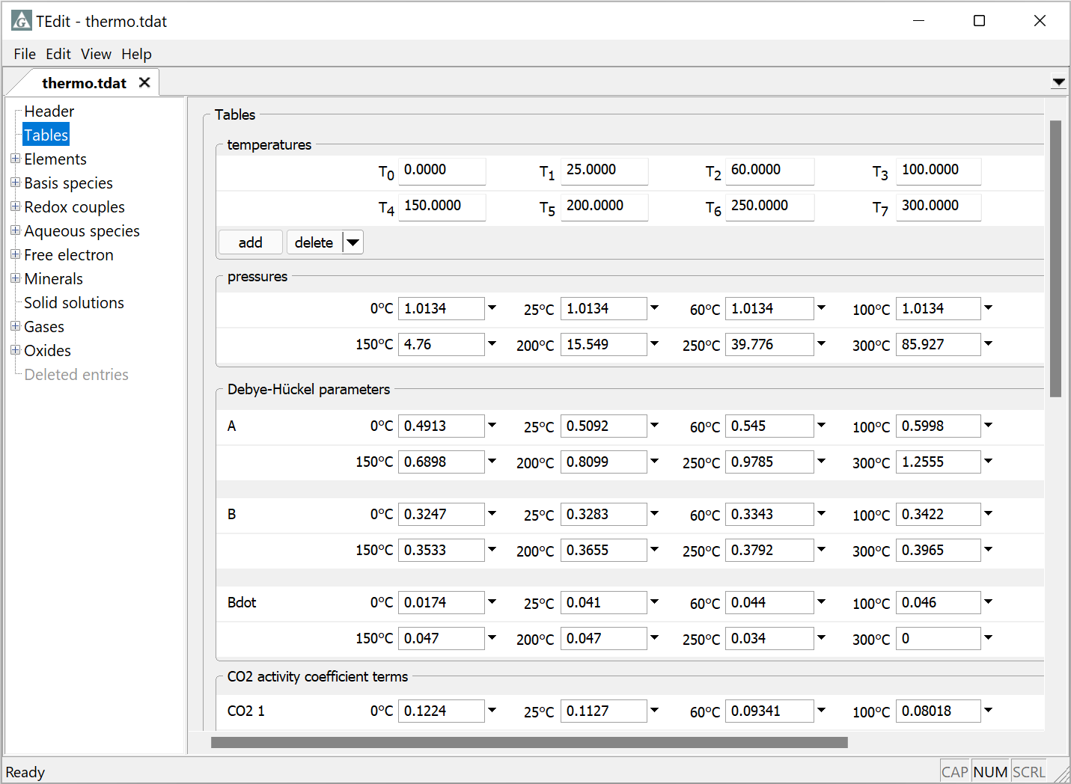
The Tables section contains the principal temperatures at which activity coefficient parameters and log Ks are compiled
Data compiled from 0 to 300°C
Pressure is by default 1 atm up to 100°C, then follows the steam saturation curve
Parameters for calculating activity coefficients

Slide 5
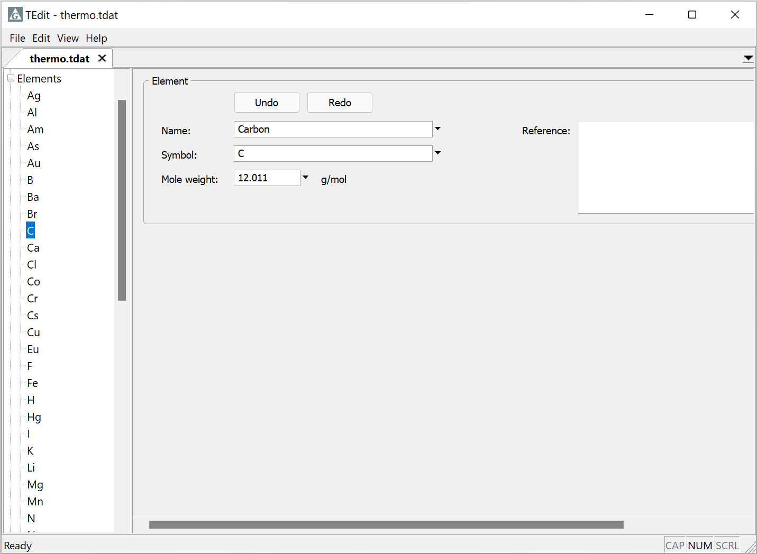
The Elements from which all species in the dataset are composed are defined here
Click “+” to expand list
Each entry includes a name, symbol, and molecular weight
Click to view the entry

Slide 6
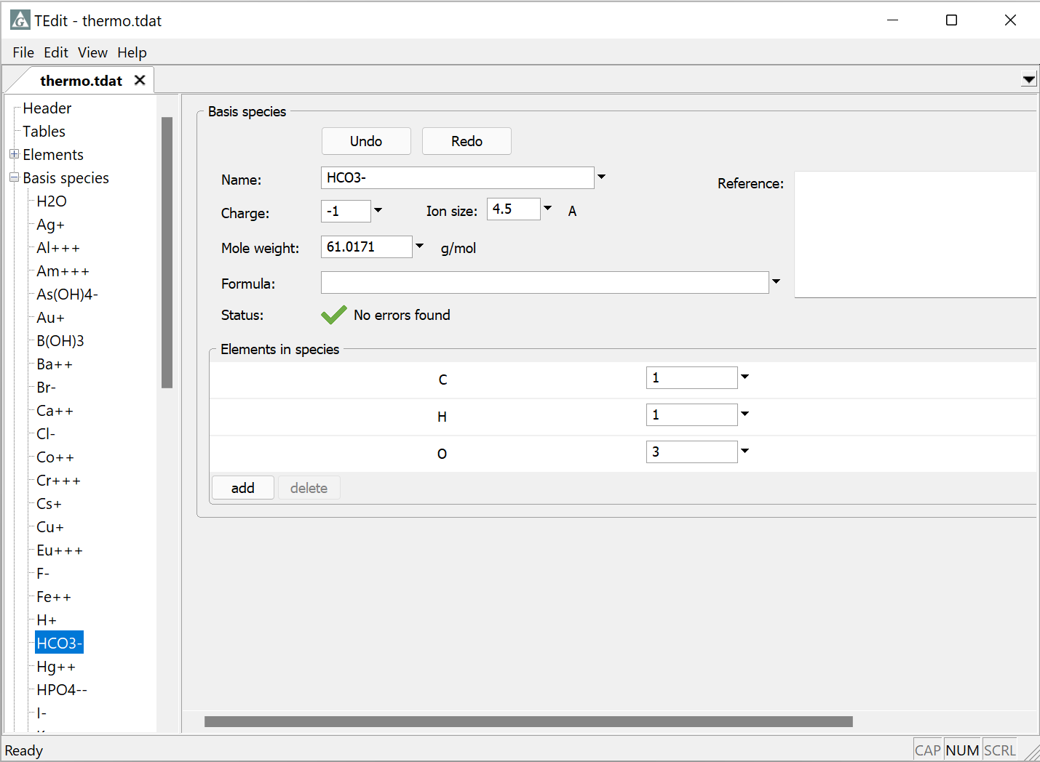
The Basis species from which all reactions are constructed are defined here
Each entry includes a name, charge, ion size parameter, and molecular weight
Basis species are composed of elements defined in the previous section
HCO₃⁻ is composed of 1 H, 1 C, and 3 O

Slide 7
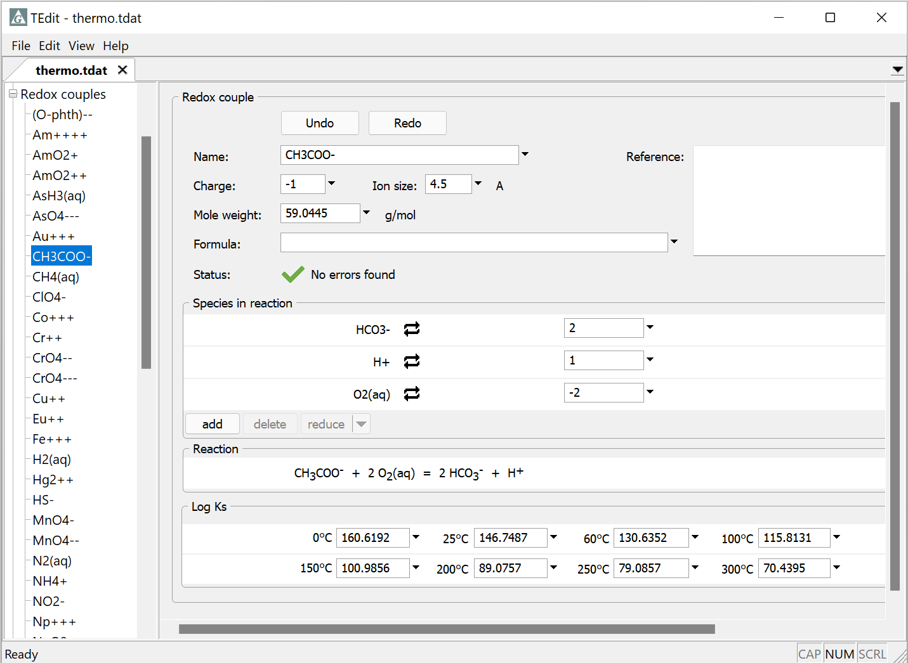
The Redox couples are Basis species in a different oxidation state. Entries include a reaction and log K.
Species defined in the dataset
Negative coefficient for species on the left side of the reaction
Reaction might use
e⁻, O₂(aq), O₂(g), H₂(aq), or H₂(g)
Log K for the reaction at the principal temperatures

Slide 8
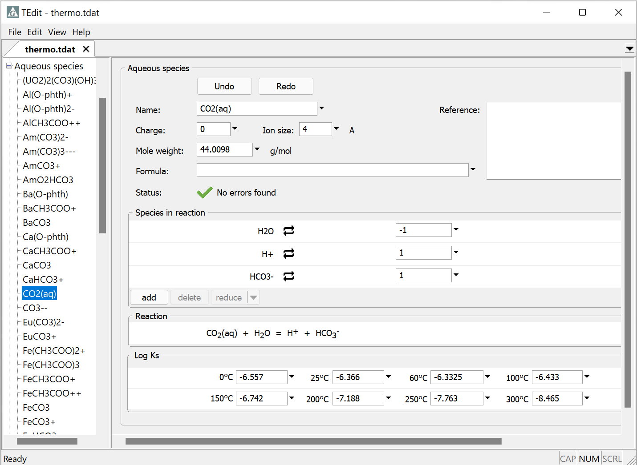
All other species to be considered are known as Aqueous species
In GWB 2021 and newer releases, reactions can be written in terms of any species in the database
The reaction should be written without change in oxidation state, if possible

Slide 9
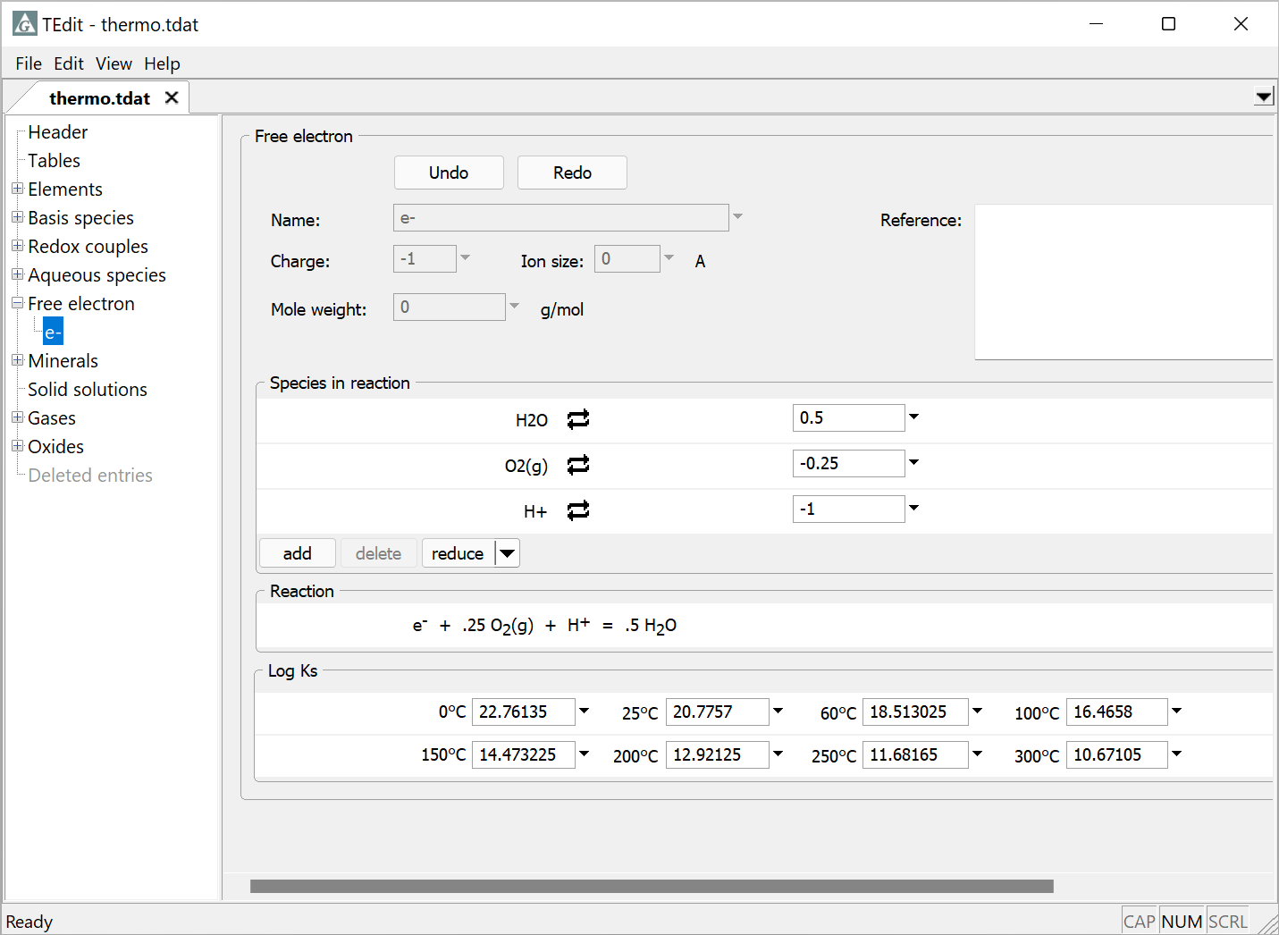
The Free electron is included in datasets considering redox reactions
Reaction is balanced in terms of O₂(aq), O₂(g), H₂(aq), or H₂(g)

Slide 10
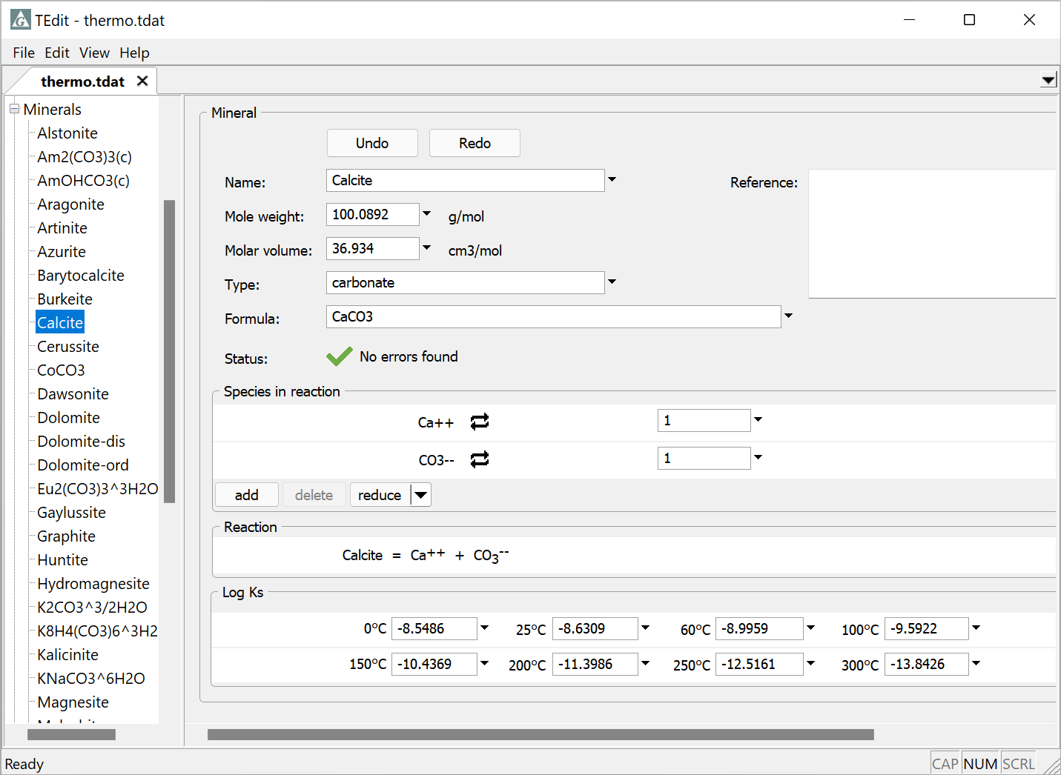
Mineral reactions are defined here
Optional information for minerals
In GWB 2021 and newer releases, reactions can be written in terms of any species in the database
Like the Aqueous species and later sections, reaction should be written without change in oxidation state, if possible

Slide 11
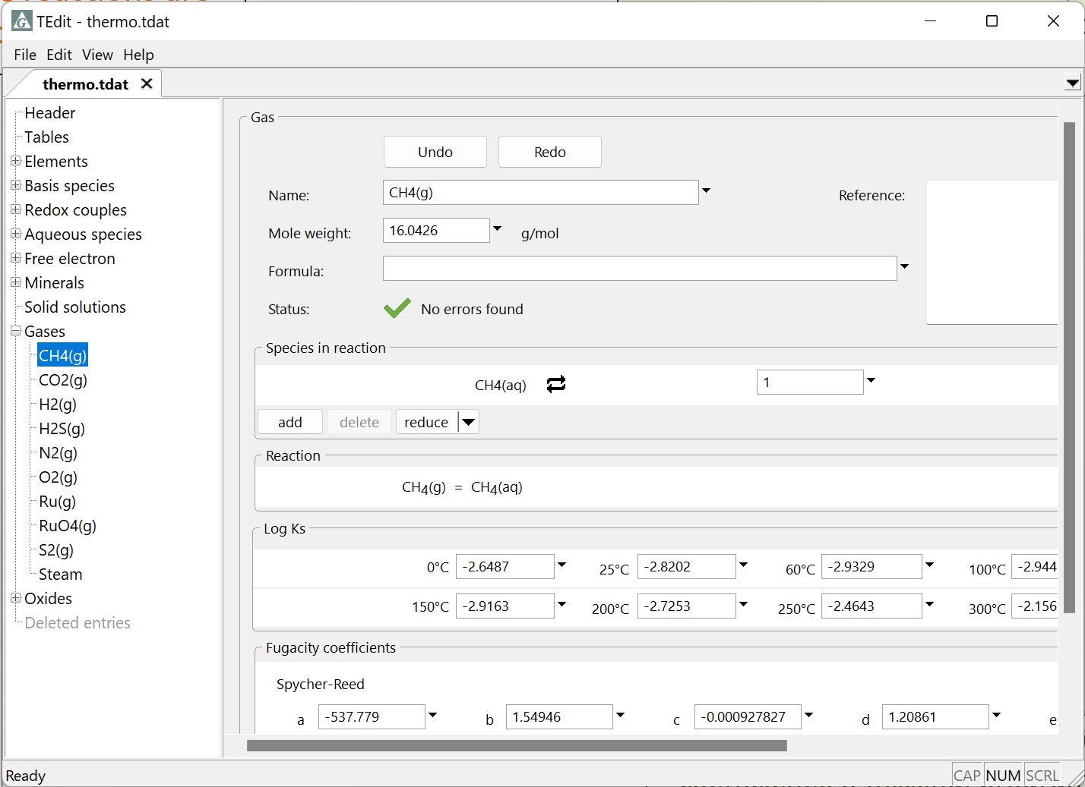
Gas reactions are defined here
In GWB 2021 and new releases, reactions can be written in terms of any species in the database
CH₄(g) is balanced in terms of the Redox species CH₄(aq)
Parameters for calculating fugacity coefficients. If missing, program assumes ideal behavior

Slide 12
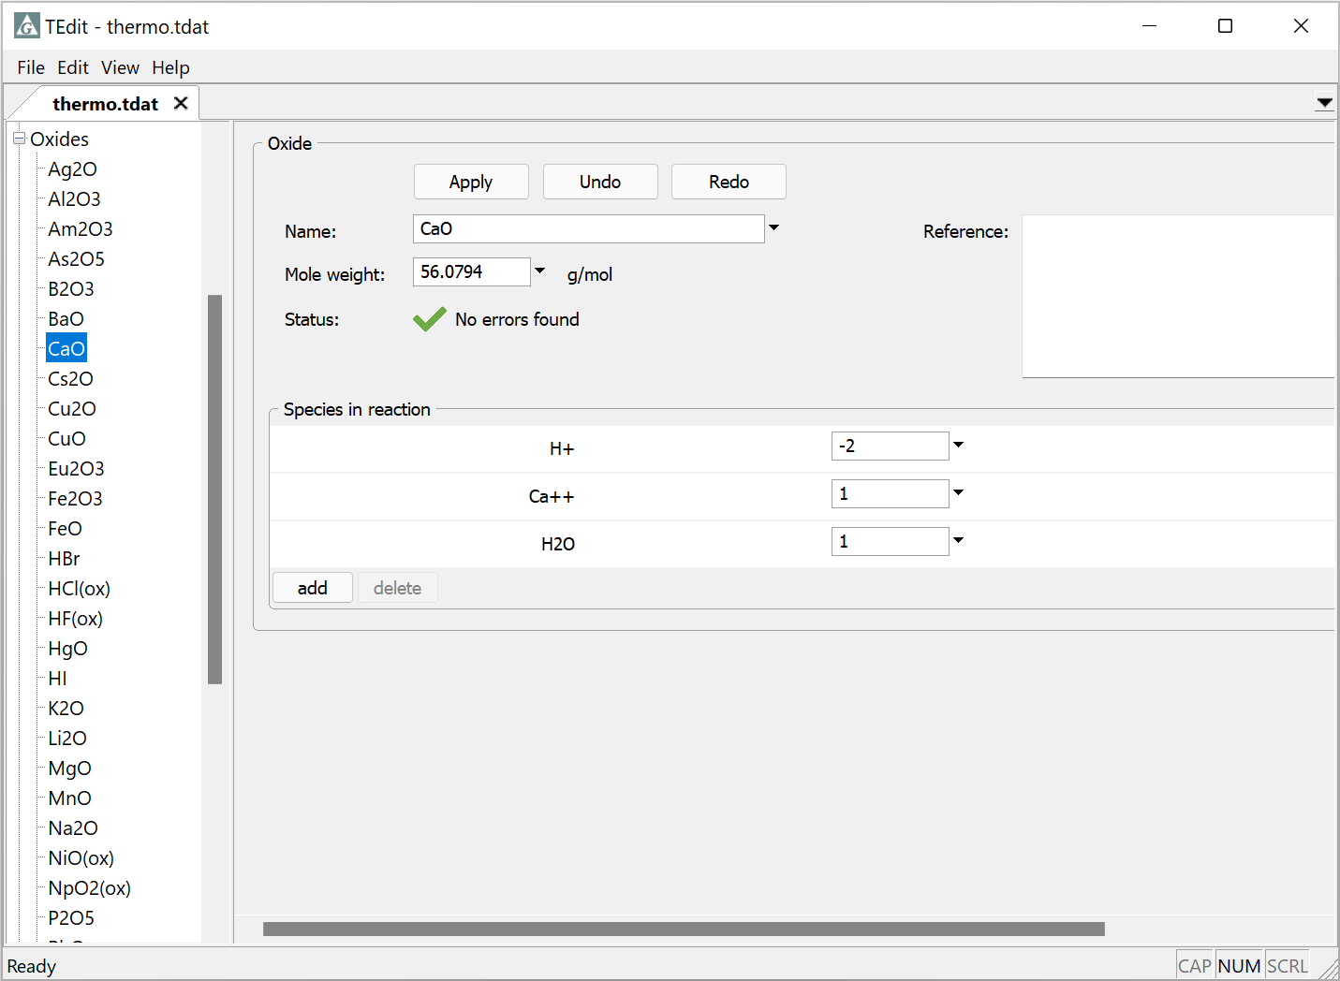
The Oxide components are fictive entries used to describe bulk composition
They have no thermodynamic stability and hence there are no entries for log K values

Slide 13
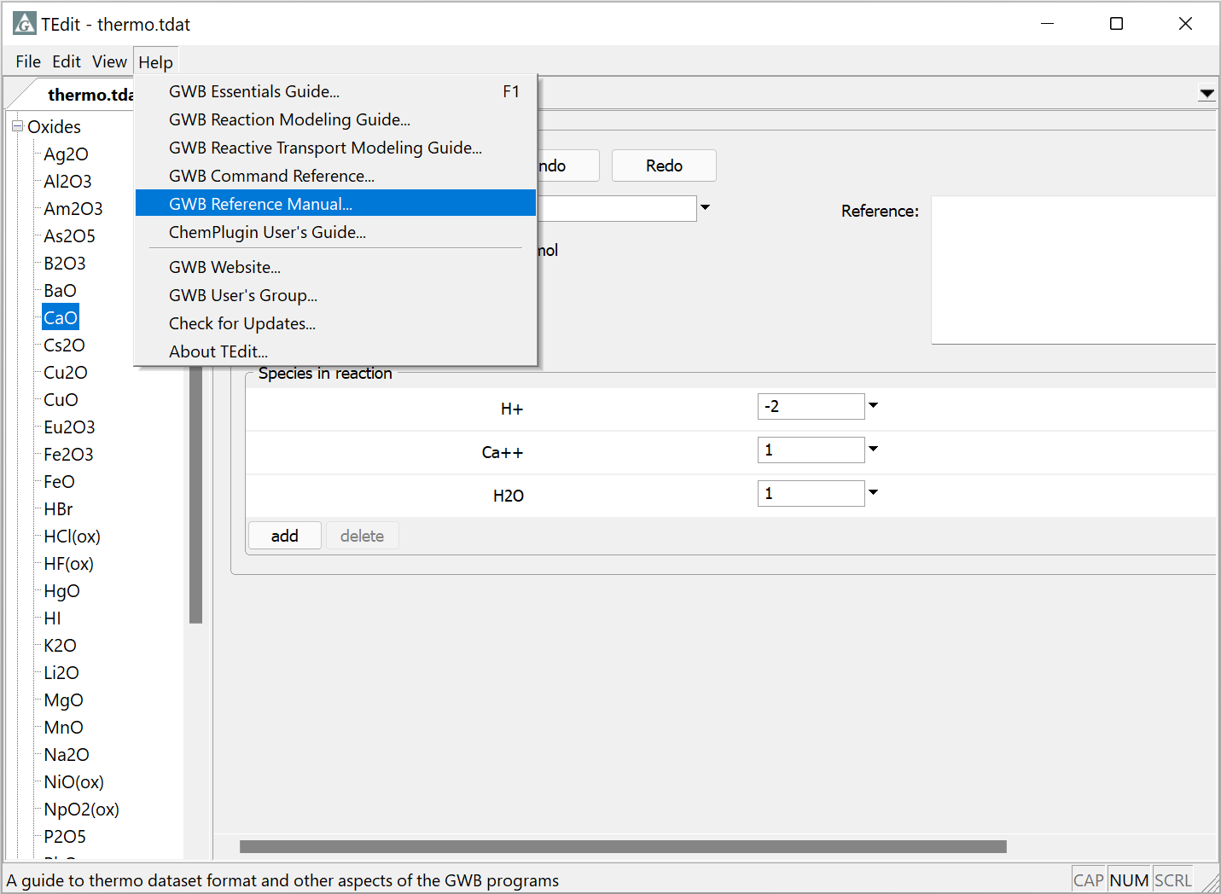
For more details, see the “Thermo Datasets” chapter in the GWB Reference Manual

