Slide 2
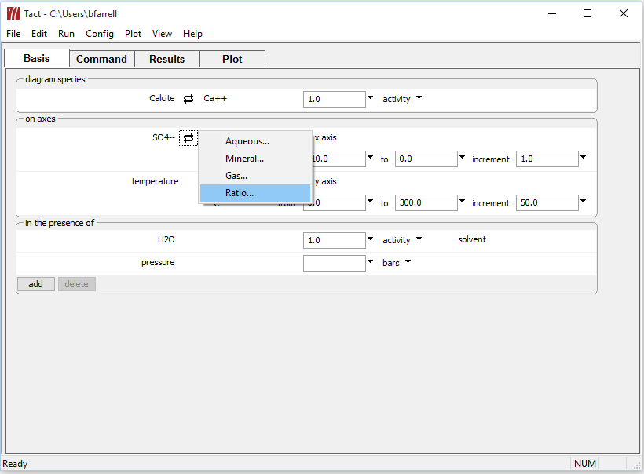
Choose Ca⁺⁺ as the main species to diagram, then swap in mineral Calcite.
Choose SO₄⁻⁻ for the x-axis, then swap in a fugacity ratio.

Slide 3
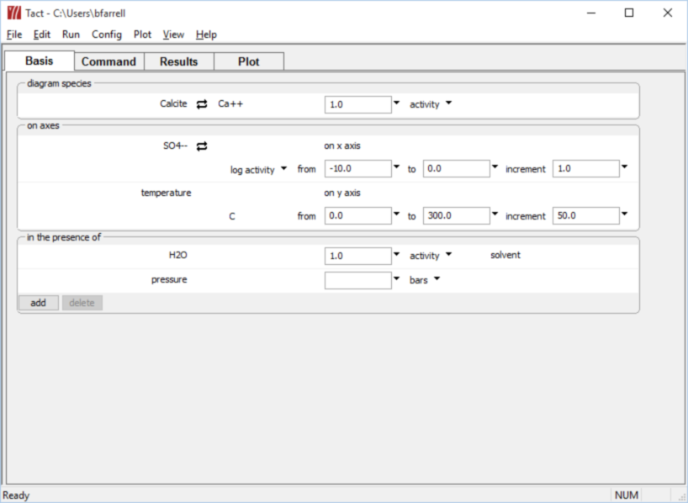
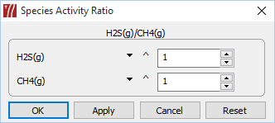
Choose H₂S(g) for the numerator, and CH₄(g) for the denominator.

Slide 4
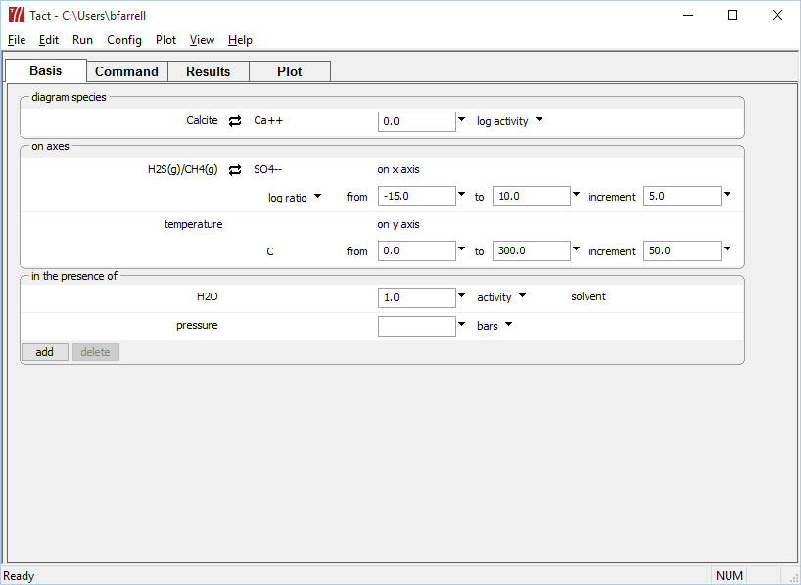
Choose an appropriate range of values for the H₂S(g)/CH₄(g) fugacity ratio.
Run → Go
draws the diagram

Slide 5
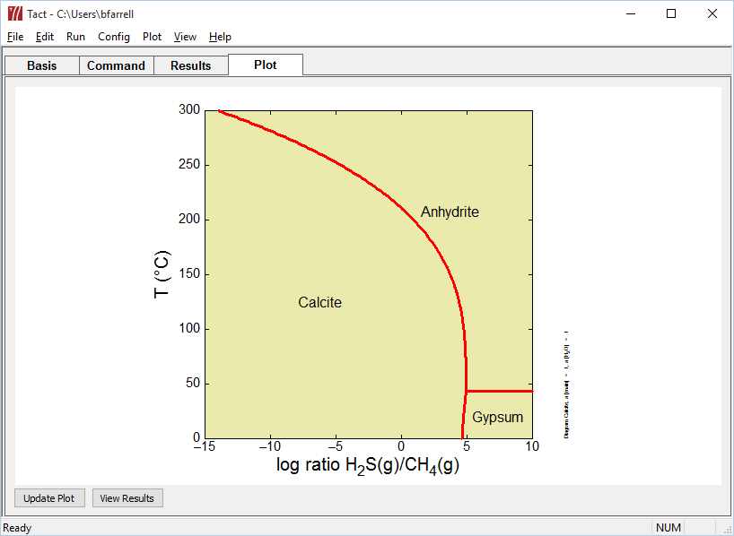
Equilibrium point of the methane souring reaction, calculated as a function of temperature.
CH₄(g) + Anhydrite ↔ Calcite + H₂O + H₂S(g)

