Slide 2
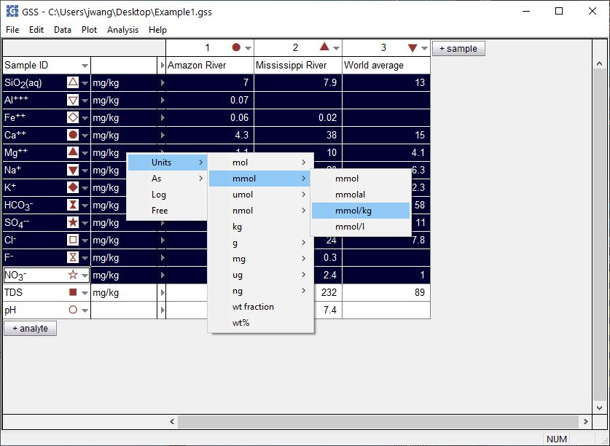
GSS is a spreadsheet for manipulating and plotting geochemical data
Right-click on unit field to convert units

Slide 3
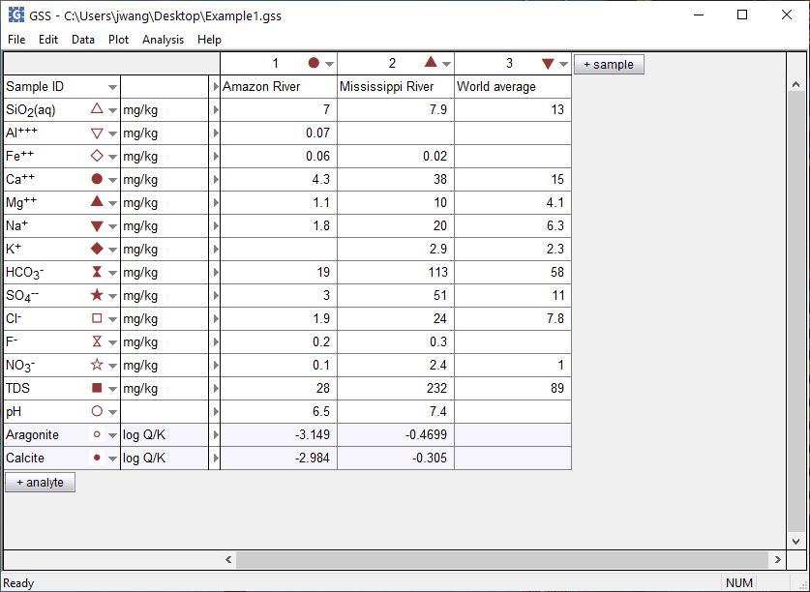
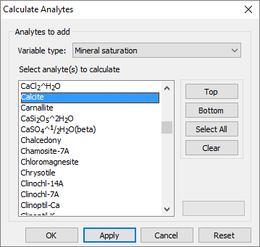
Enter chemical data for one or more samples in GSS, then perform geochemical calculations
Select a mineral then click Apply
Calculated saturation indices added to spreadsheet
+ analyte → Calculate with SpecE8…

Slide 4
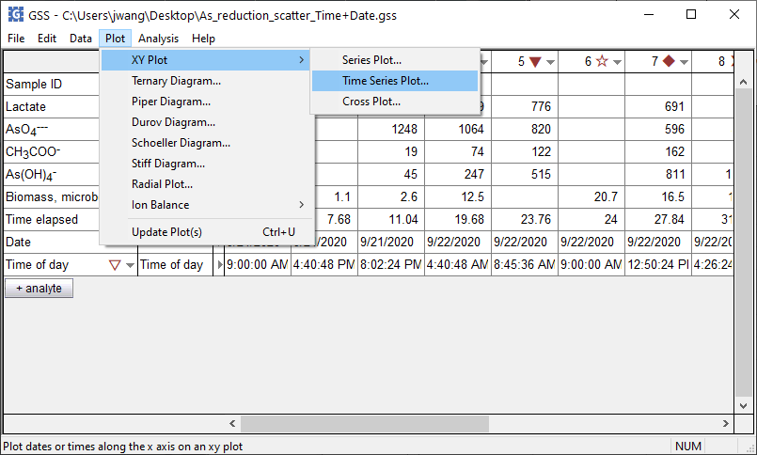
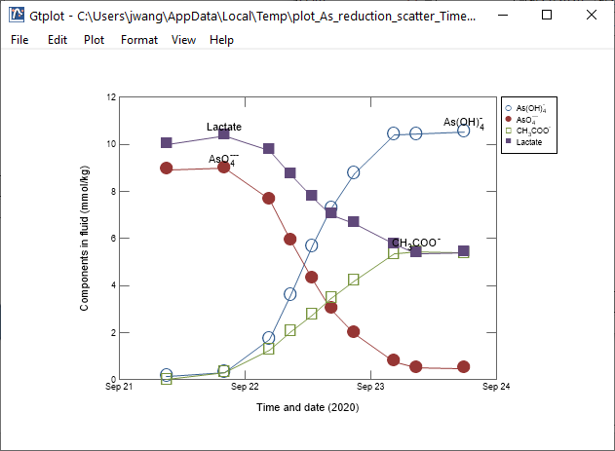
You can display your data in Time Series and XY plots
Plot → XY Plot → Time Series Plot → Time and date…

Slide 5
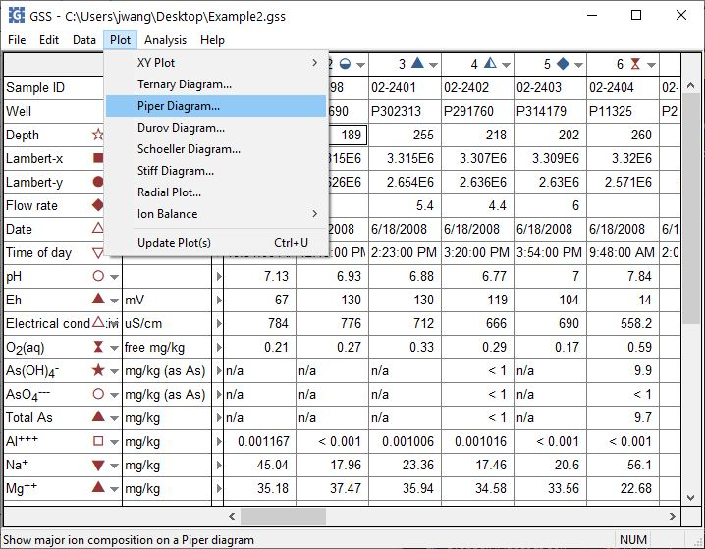
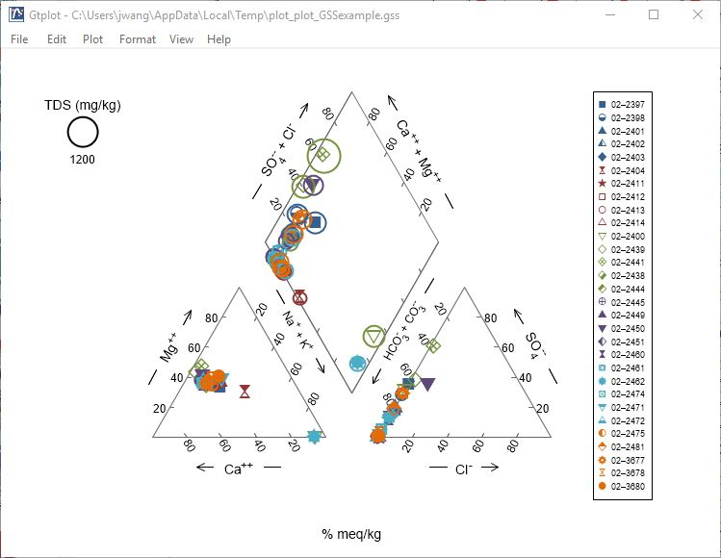
You can choose from a variety of water chemistry plots
Plot → Piper Diagram…

Slide 6
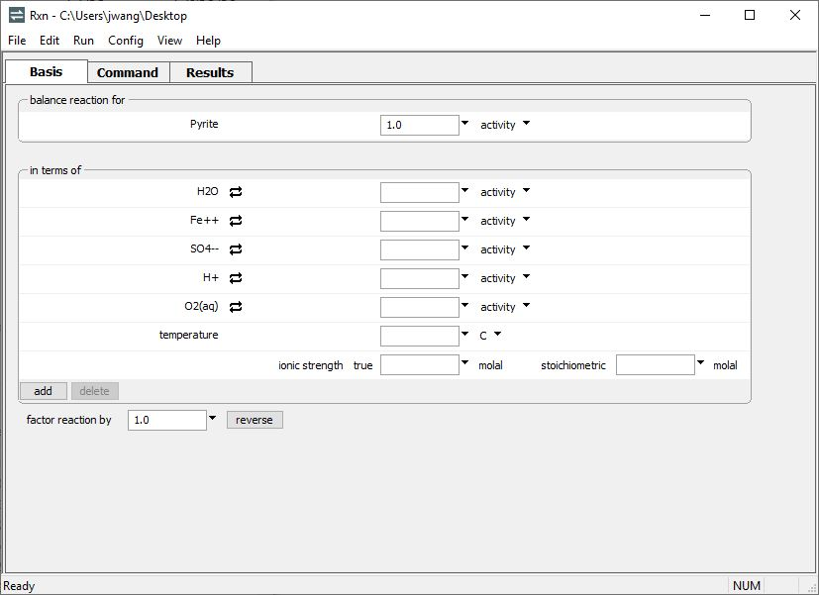
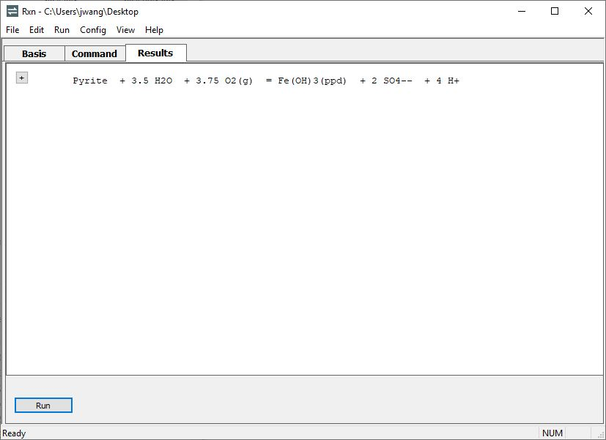
Rxn balances chemical reactions and calculates equilibrium constants, equilibrium equations, and more
Choose species to appear on left side of reaction.
Rxn will automatically add its default set of species.
Move to the Results pane.
Rxn writes a reaction with Pyrite on the left side, balanced by the default basis species

Slide 7
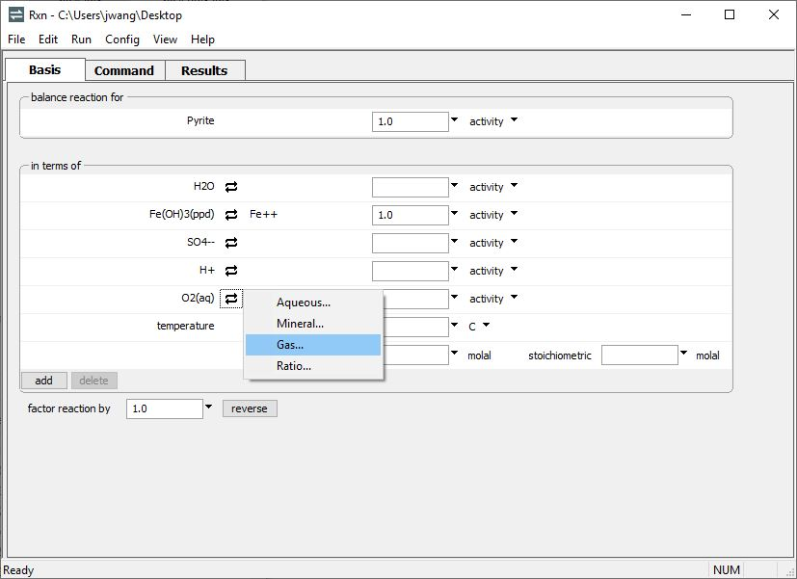
Recast the reaction by performing basis swaps. Click
to swap out an entry, then choose a species to replace it
Fe(OH)₃(ppd) has been swapped in for Fe⁺⁺
O₂(g) swapped in for O₂(aq)
The reaction is automatically rebalanced in terms of a ferric iron mineral and O₂(g).

Slide 8
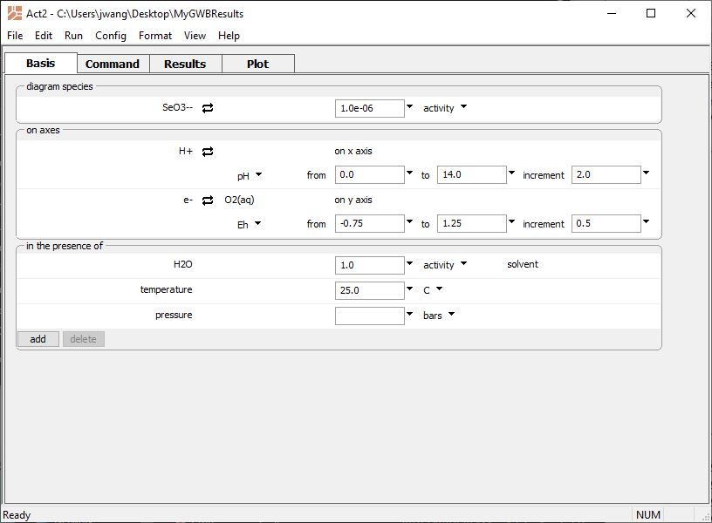
Act2 generates stability diagrams on activity, Eh, pe, pH, and fugacity axes
Select main species to diagram
Choose axes
Add any background ions
Run → Go
draws the diagram

Slide 9
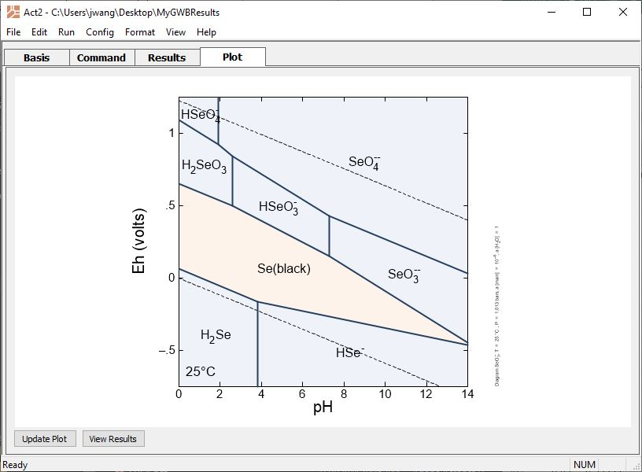
Move to the Plot pane
Minerals plot in orange, aqueous species in blue
Water stability limits
You can copy the diagram to the clipboard and paste into your documents

Slide 10
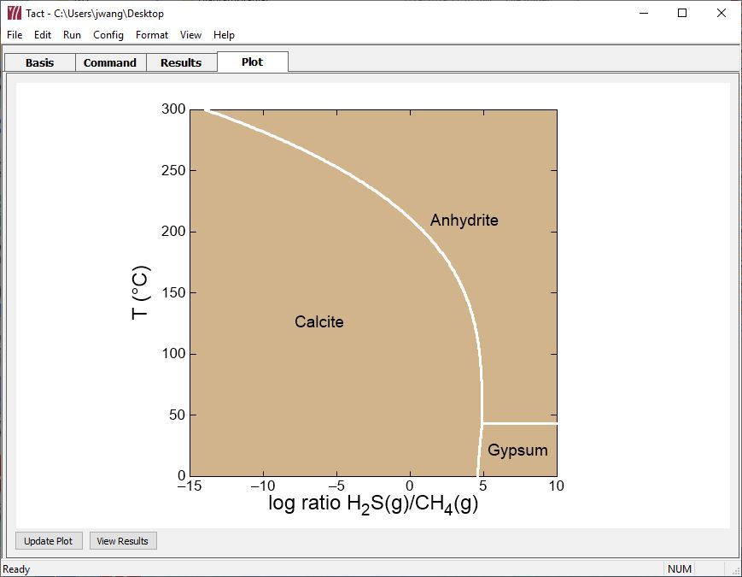
Tact makes temperature-activity and temperature-fugacity diagrams
Equilibrium point of the methane souring reaction, calculated as a function of temperature.
CH₄(g) + Anhydrite ↔ Calcite + H₂O + H₂S(g)

Slide 11
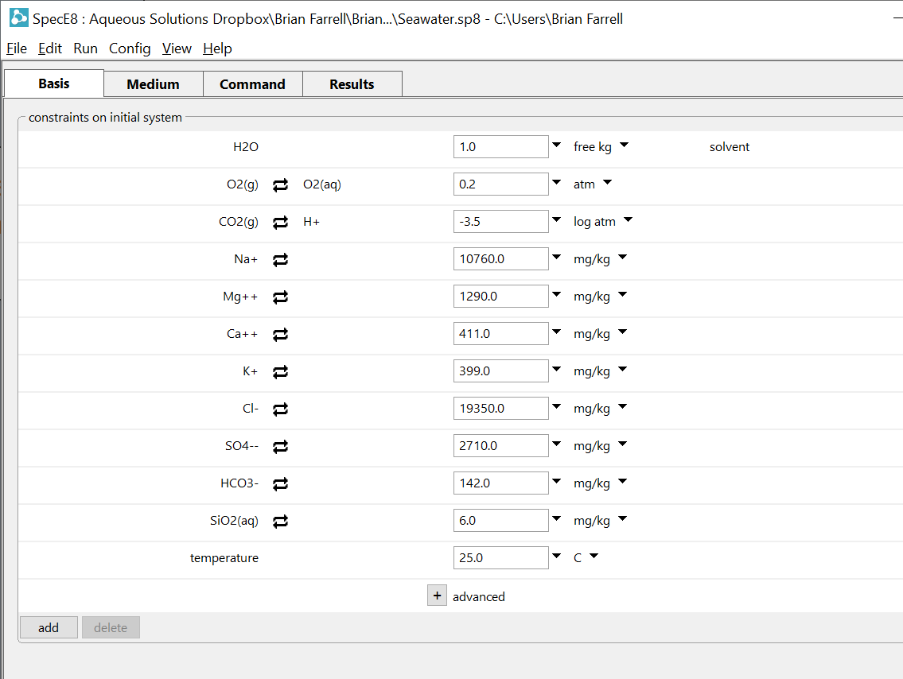
SpecE8 figures concentrations of aqueous and sorbed species, mineral saturation, gas partial pressure, and isotope fractionation
Enter your fluid composition on the Basis pane
Swap in gases of known partial pressure, or minerals at equilibrium
Set dissolved concentrations in units of your choice
Set temperature
Click to add new entries

Slide 12
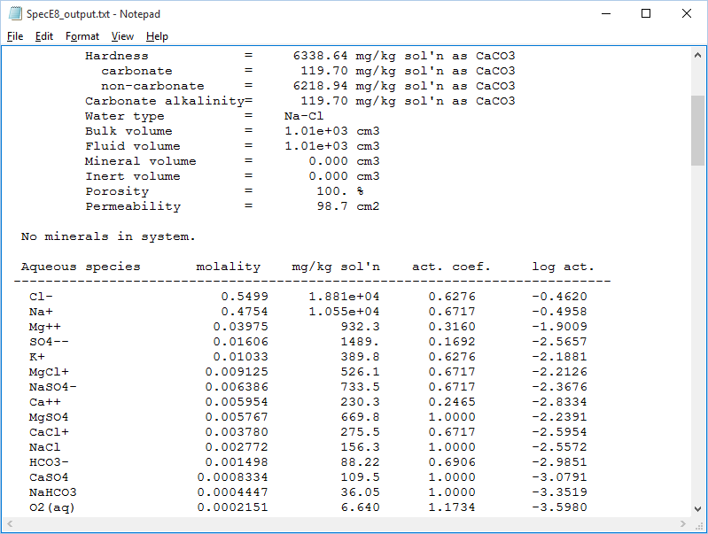
View results as a text file…
Species listed in order of molal concentration
Activity coefficients
Species activities

Slide 13
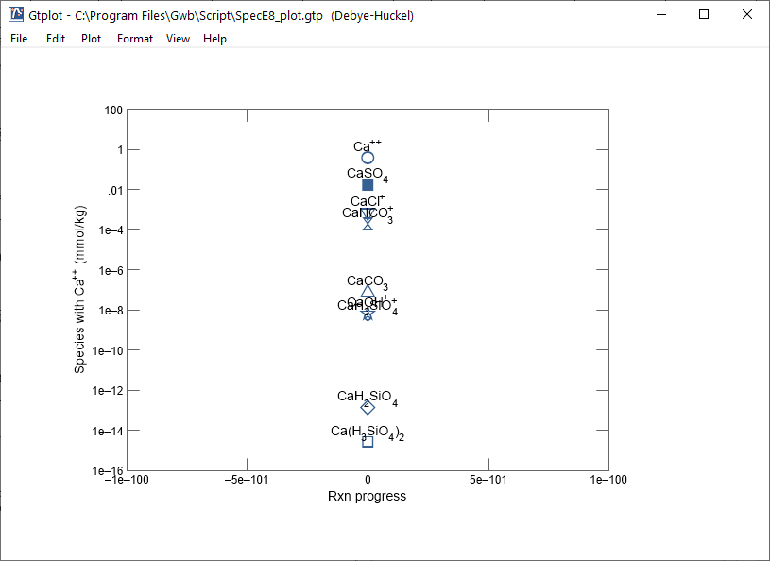
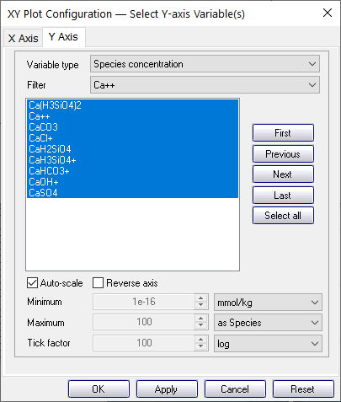
… or plot results in Gtplot
Set “Variable type”, then choose from the list of variables
Set X and Y axes

Slide 14
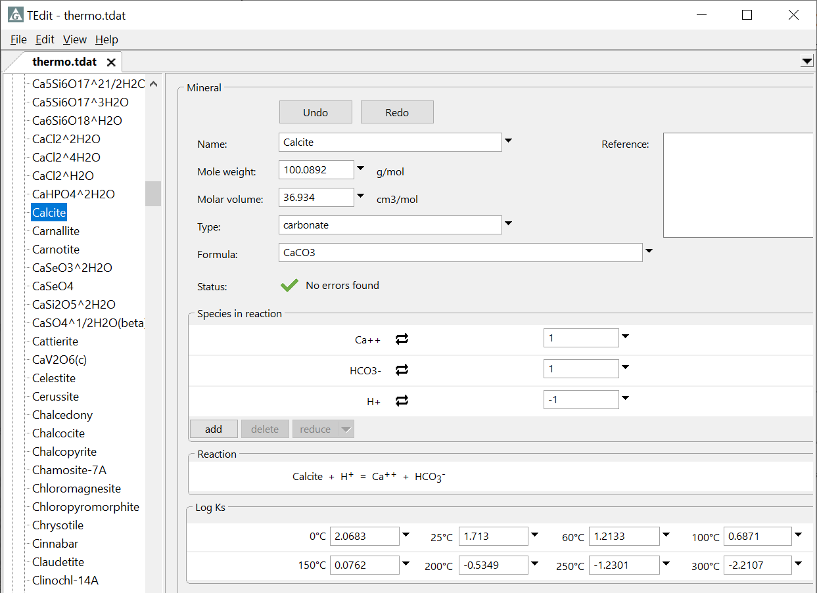
TEdit is a graphical application for quickly and accurately editing and combining thermodynamic datasets.
Entry for the mineral Calcite (CaCO₃)
Reaction, log Ks at the principal temperatures

