Slide 2
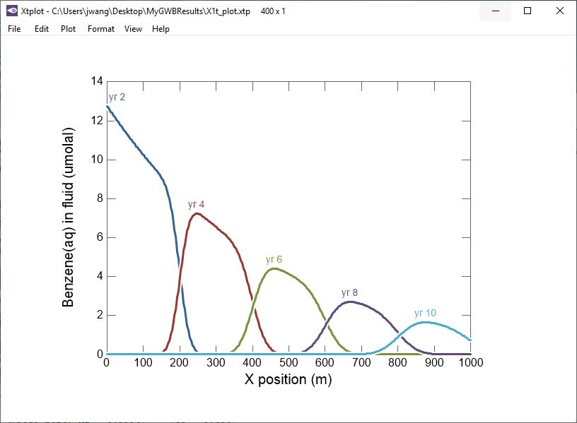
X1t models reactive transport in groundwater flows in one linear, radial, or spherical coordinate.
Pulse of Benzene contaminated
water is attenuated by biodegradation.

Slide 3
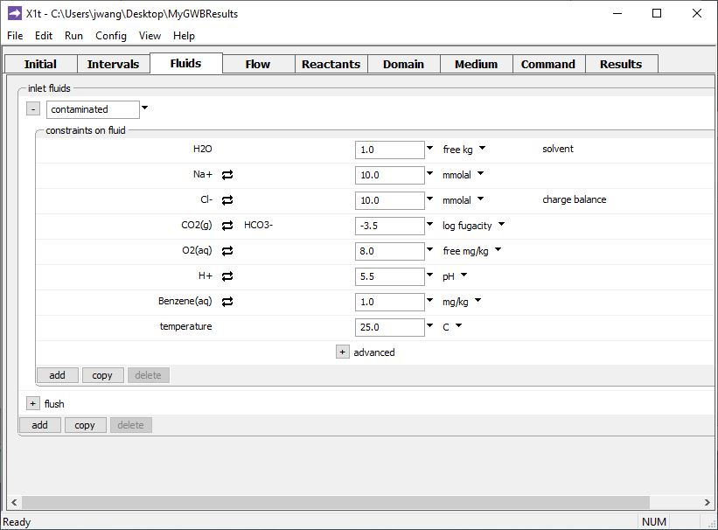
Specify domain’s starting fluid composition on the Initial pane, and any number of inlet or injected fluids on the Fluids pane
Benzene contaminated water
Clean water

Slide 4
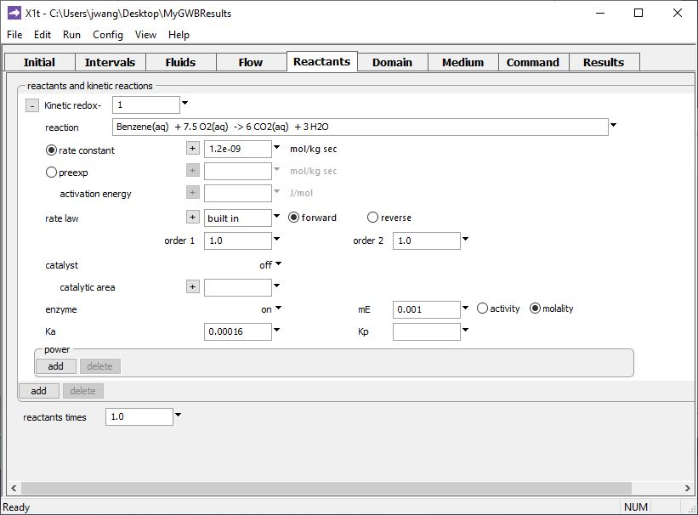
You can account for the kinetics of redox transformations, including effects of enzymes and catalysts.
Type out the redox reaction.
Set enzyme function to “on” and enter rate constant, half-saturation constant, and enzyme concentration.

Slide 5
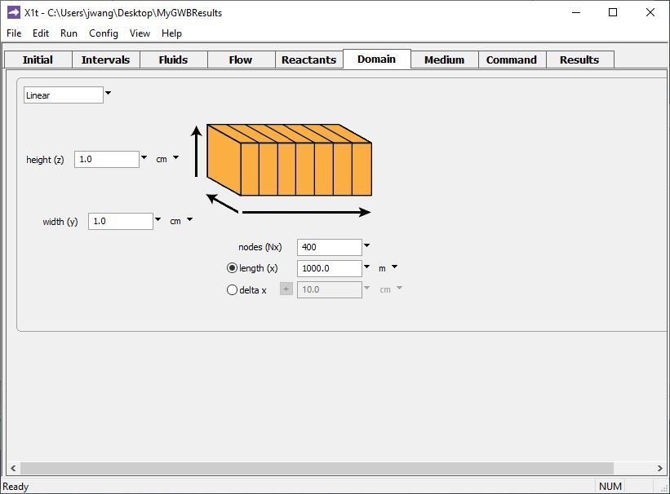
Specify domain size and gridding on the Domain pane.
Domain is 1 km long, divided into 400 nodal blocks
Set various mass transport and thermal properties on the Medium pane.
Specify flow rate on the Flow pane.

Slide 6
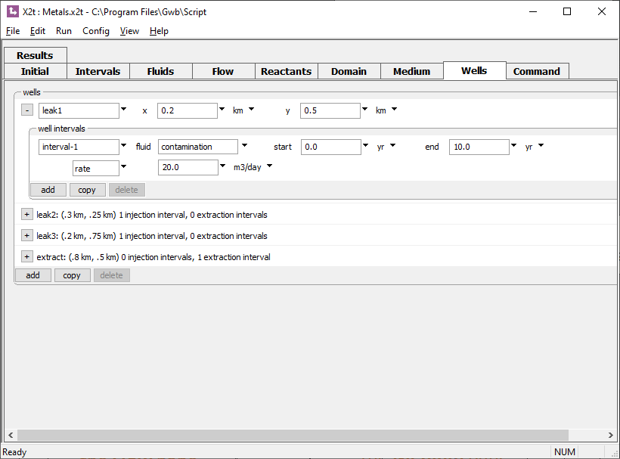
X2t simulates reactive transport in two dimensions, including injecting and producing wells.
Use the Wells pane to add any number of wells. You can adjust pumping rate, turn wells on or off, and change the injection fluid chemistry at any time.

Slide 7
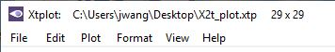
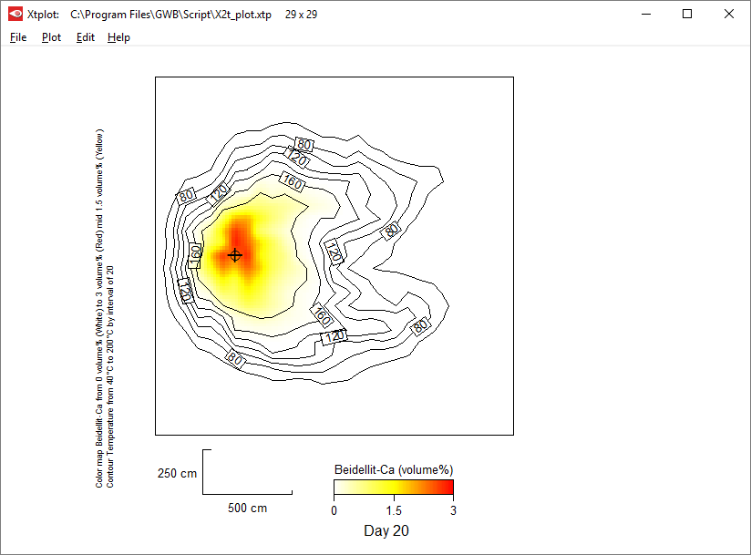
Account for evolving porosity and permeability in heterogeneous media.
Formation of clay mineral scale around the wellbore alters reservoir porosity and permeability.

Slide 8
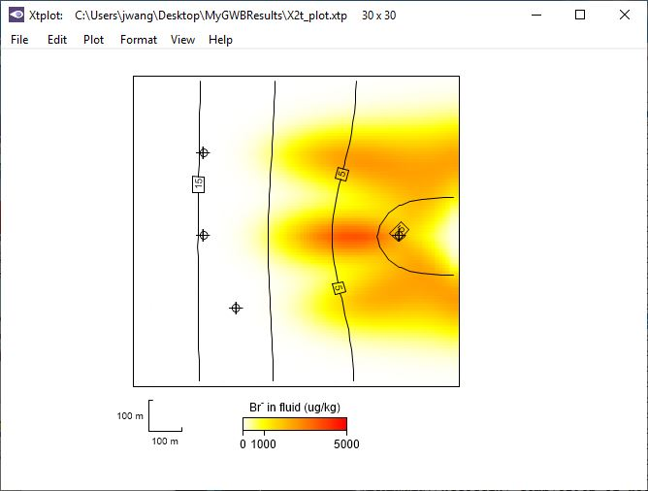
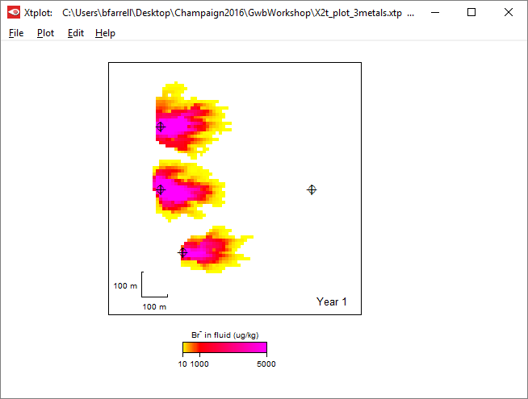
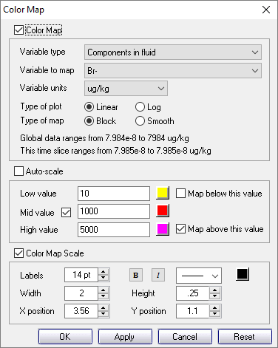
Render results of 2D reactive transport simulations in map view
Create map view plots using color maps
Choose variable to plot, units, scale.
Heavy metals leak into domain from 3 point sources, then pumping at extraction well begins.

Slide 9
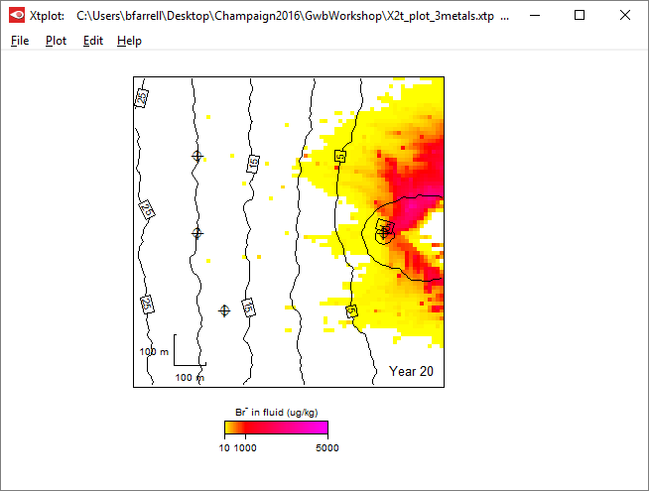
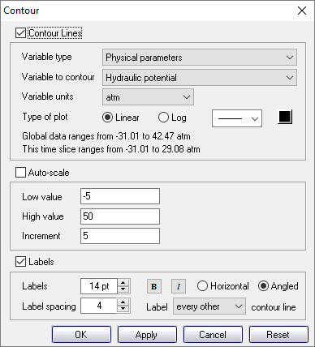
Include contour lines
You can show velocity arrows, color masks, the nodal grid, and more

Slide 10
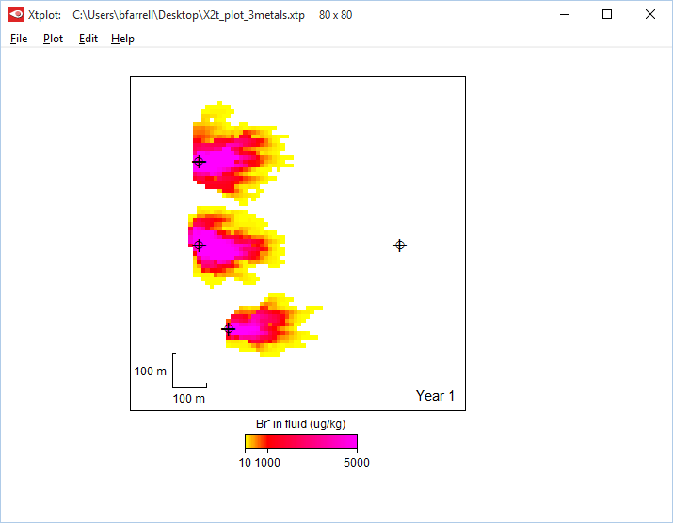
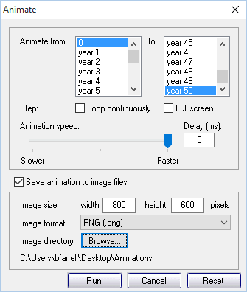
Watch simulations unfold with the animation feature.
Starting and ending times
Configure your plot, view animation, then export image files to make video clips

Slide 11
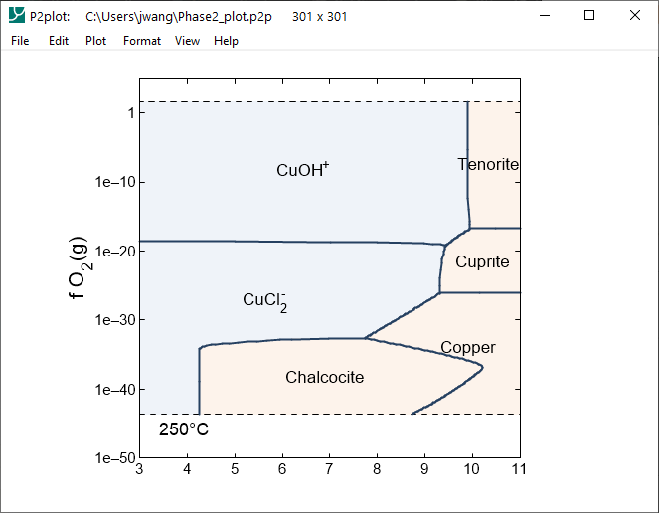
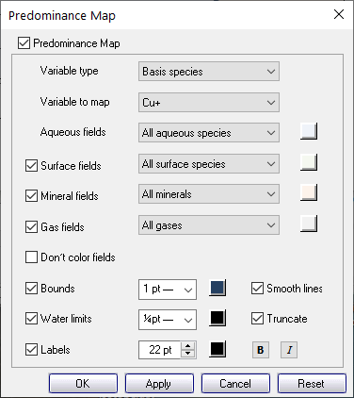
Use Phase2 to create true predominance diagrams.
Choose Cu, S, etc. – any element or basis species
pH

Slide 12
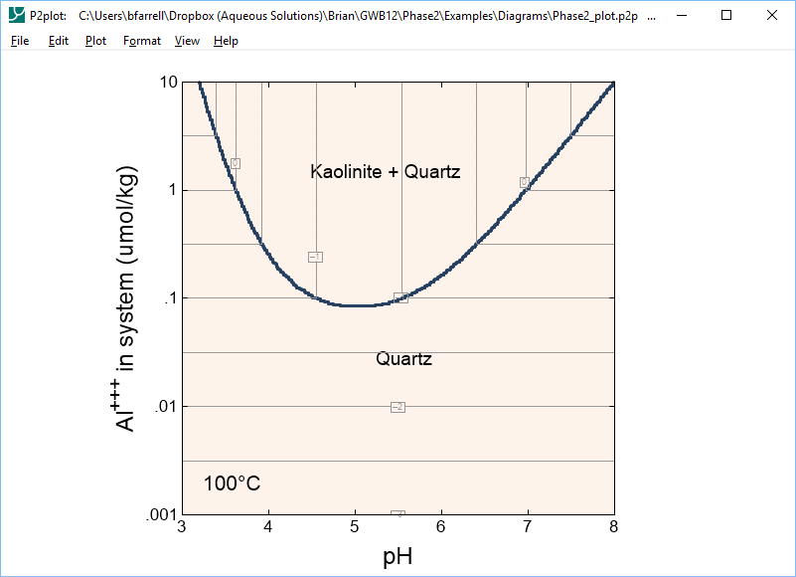
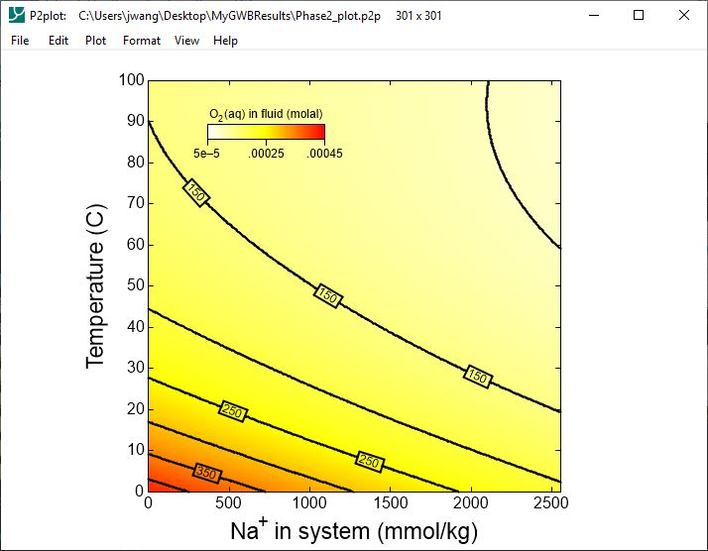
Draw mineral assemblage diagrams and color map or contour any variable
Plot solubility of O₂ gas
Map show stability of kaolinite in the presence of quartz

