Slide 1
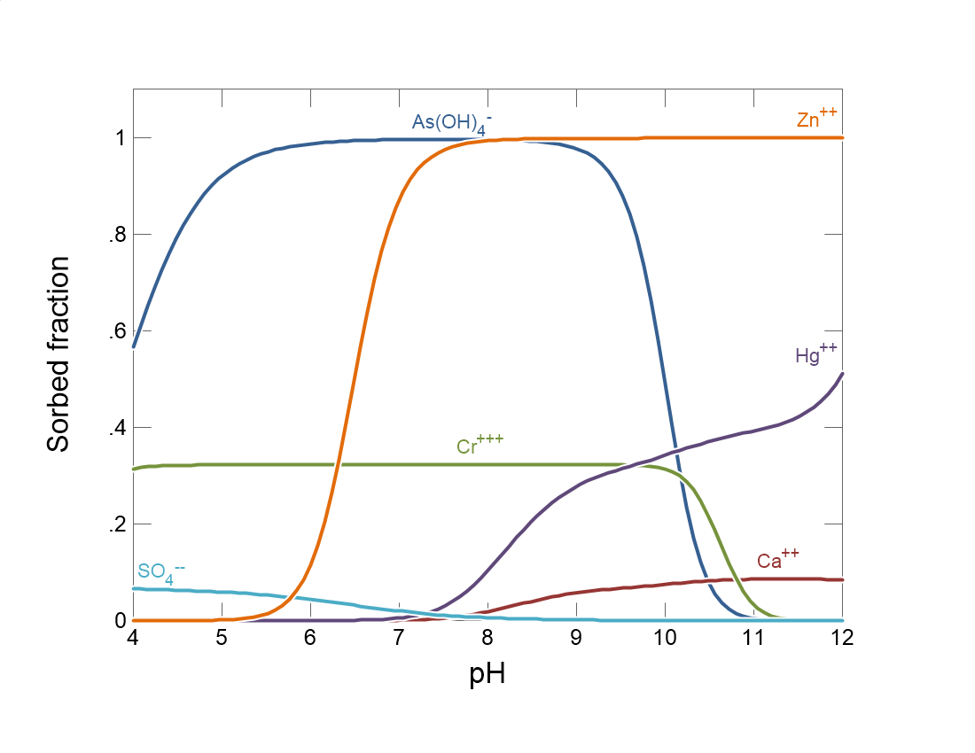

Slide 2
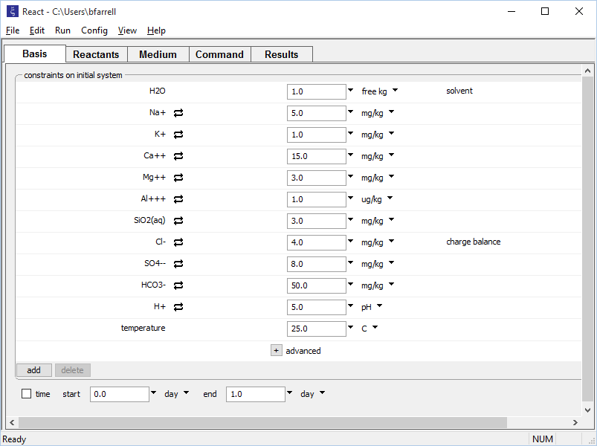
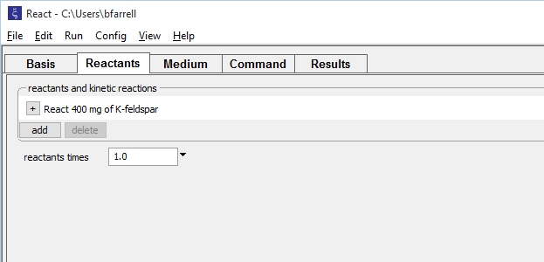
React traces reaction paths involving fluids, minerals, gases, and microbes.
Set the initial fluid composition on the Basis pane.
Set up a titration path on the Reactants pane.
400 mg of K-feldspar will gradually be added to the fluid.

Slide 3
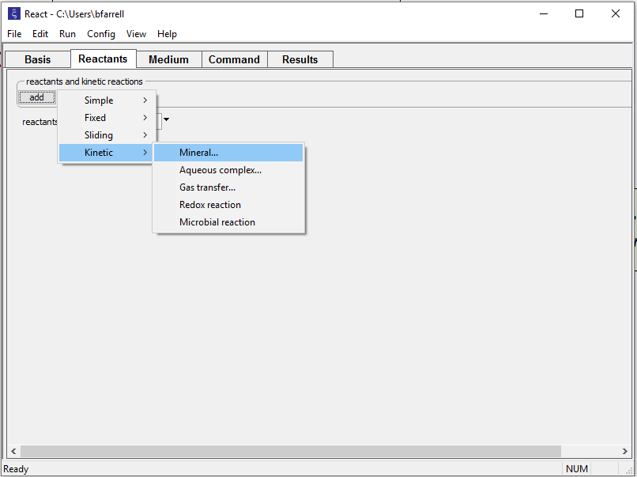
Titrate in aqueous species, minerals, gases, and oxides.
Hold fixed pH, Eh, activity, fugacity...
… or scan (slide) over a range of values.
Add kinetic reactants
React can simulate any combination of equilibrium and kinetic reactions.

Slide 4
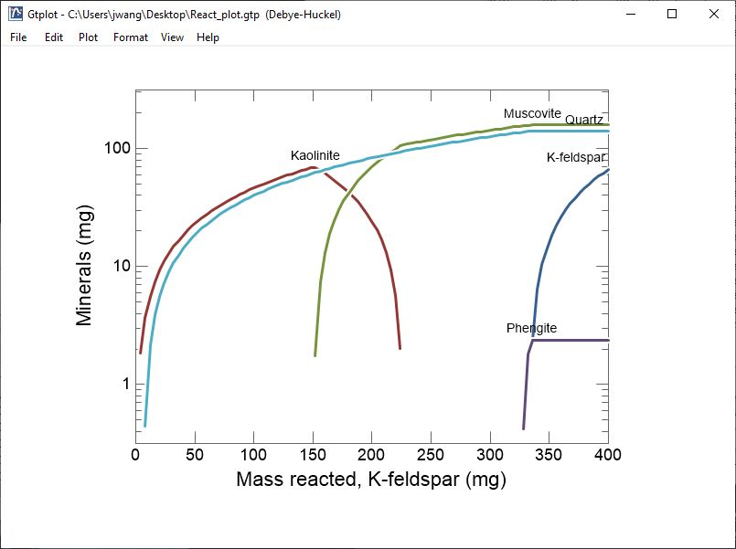
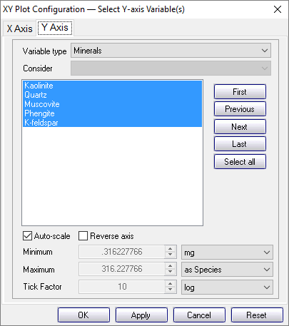
Gtplot displays data from GSS and the results of running SpecE8 and React.
Plot species concentrations, composition of system, mineral saturation, and more.
Choose units, linear or log scale, etc.

Slide 5
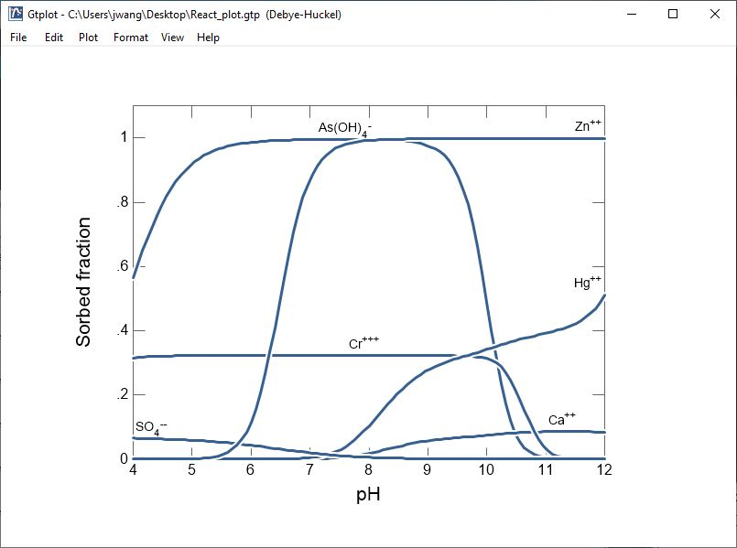
Model sorption using Distribution coefficients, Freundlich or Langmuir isotherms, ion exchange, two-layer, three-layer, or cd-music surface complexation models.
A sliding pH path is a fast way to show how sorption behavior changes with pH

Slide 6
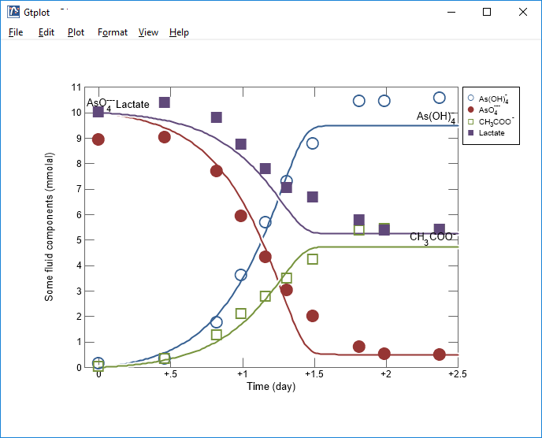
Model kinetics of microbial metabolism and growth.
Kinetics of microbial arsenate reduction, with scatter data added from GSS

Slide 7
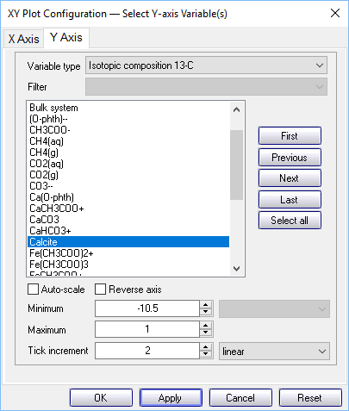
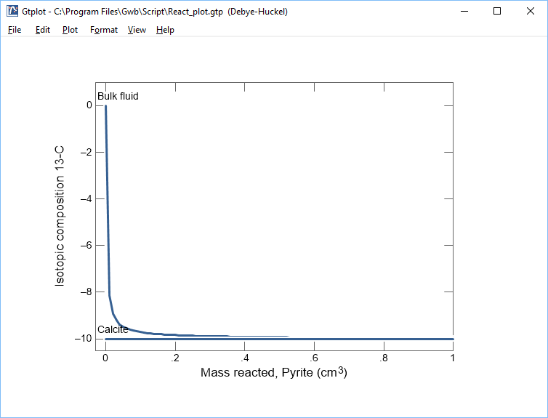
Model isotope fractionation of fluids and minerals.
Fluid’s ¹³C composition varies from initial value toward that of the dissolving calcite

