Slide 1
–
6
–
7
–
8
–
9
Uraninite
+
+
+
–
10
+
U
a
–
11
U
++++
g
Log K = -3.5
o
l
–
12
+++
UOH
Log K = -4.6383
-
U(OH)
–
13
5
U(OH)
++
2
–
14
+
U(OH)
3
U(OH)
–
15
4
25°C
–
16
0
2
4
6
8
10
12
14
pH

Slide 2
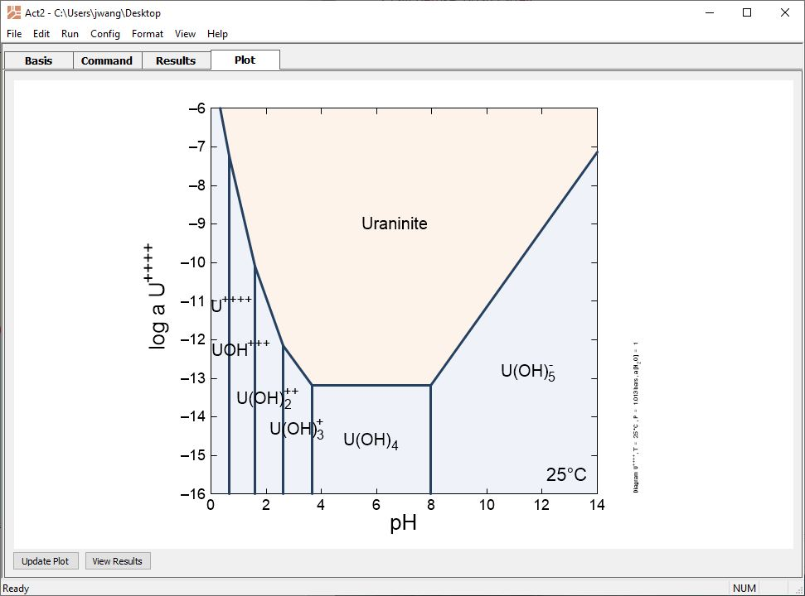
Use the “Alter log Ks” option to adjust the equilibrium constant for a reaction without permanently modifying a thermo dataset.

Slide 3
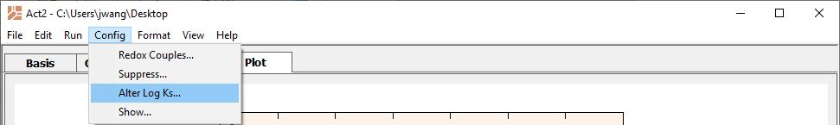
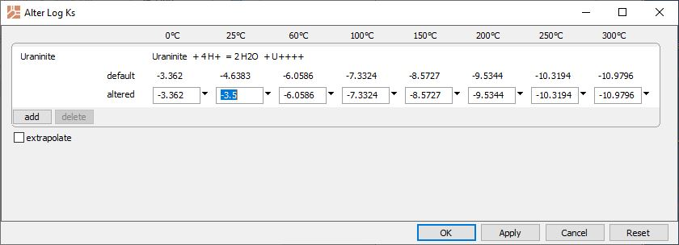
Config → Alter Log Ks…
Top row values are preserved in the dataset.
Temporarily adjust the reaction’s log K at any principal temperature, then click Apply.
add → Mineral… → Uraninite

Slide 4
–
6
–
7
–
8
The stability field for Uraninite has decreased.
–
9
Uraninite
+
+
+
–
10
+
U
a
–
11
U
++++
g
Log K = -3.5
o
Original diagram
l
–
12
+++
UOH
Log K = -4.6383
-
U(OH)
–
13
5
U(OH)
++
2
–
14
+
U(OH)
3
U(OH)
–
15
4
25°C
–
16
0
2
4
6
8
10
12
14
pH

