Slide 1
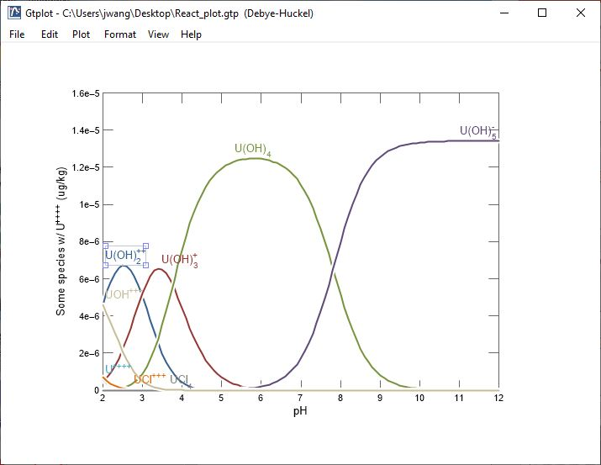
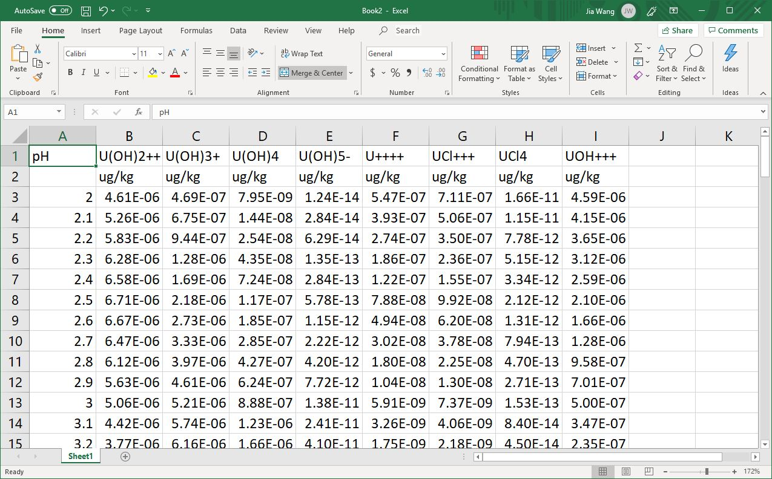
Retrieving
numerical values

Slide 2
You can export your raw data from Gtplot, P2plot, or Xtplot into Excel
Edit → Copy As → Spreadsheet (Tab delimited)

Slide 3
Ctrl + v pastes your data.
x axis variable in the first column
y axis variables in subsequent columns

Slide 4
You can also export your data to a text editor in a nicely aligned table
Edit → Copy As →
Text (Space delimited)

Slide 5
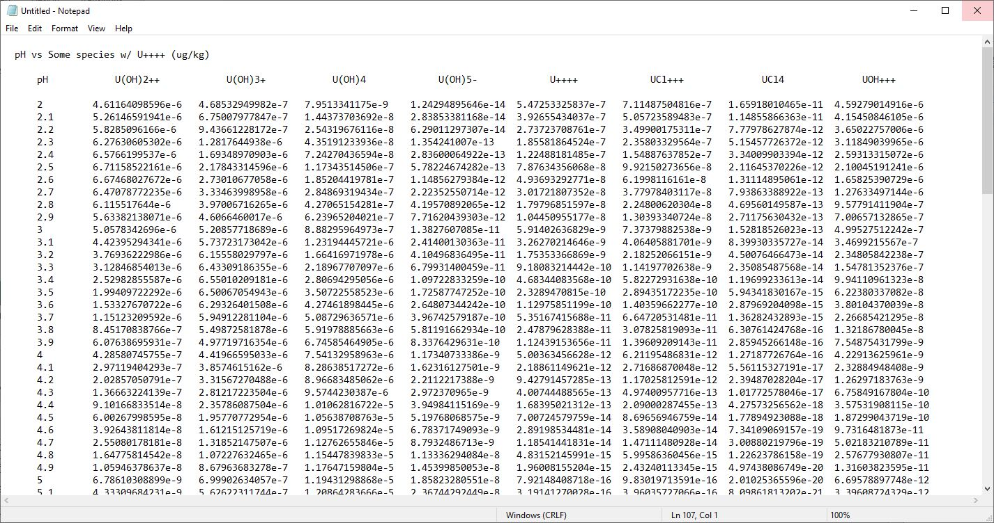
Ctrl + v pastes your data.
x axis variable in the first column
y axis variables in subsequent columns

