Slide 1
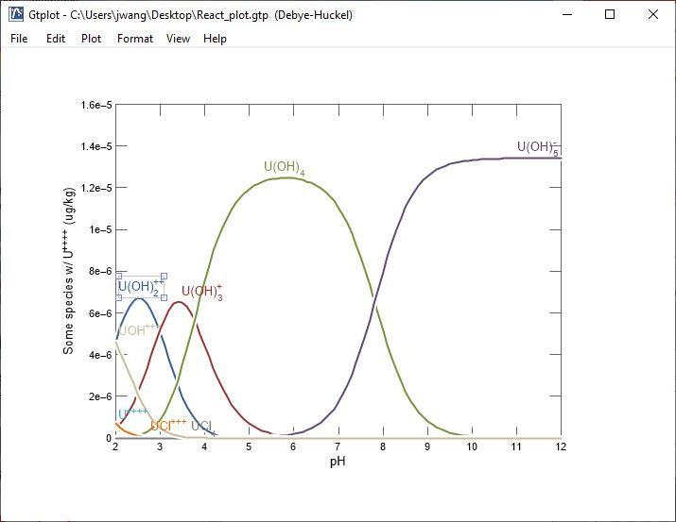
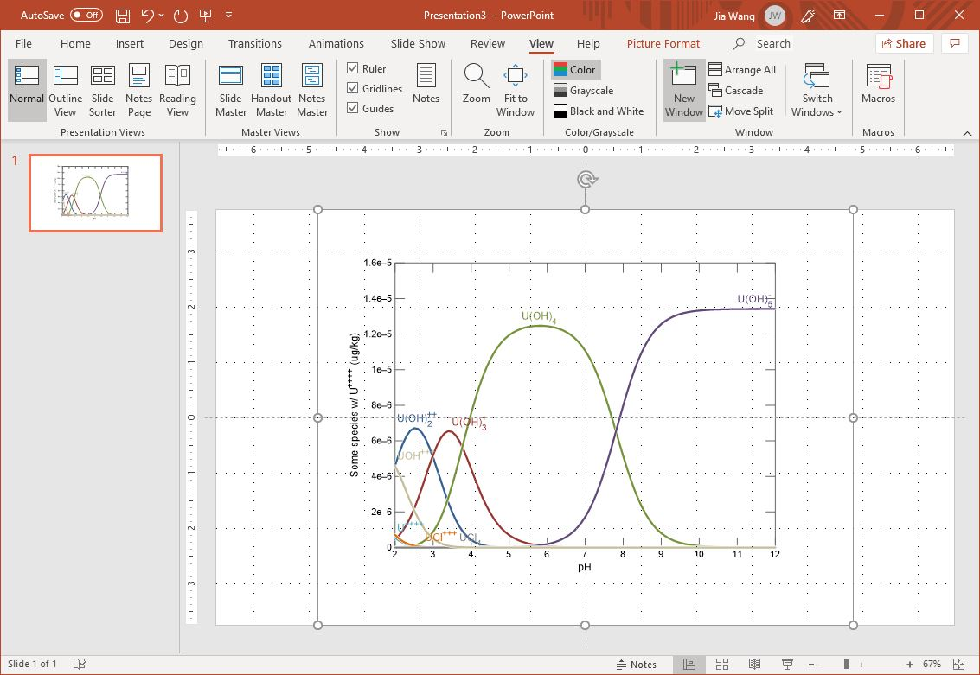
Exporting plots and Saving images

Slide 2
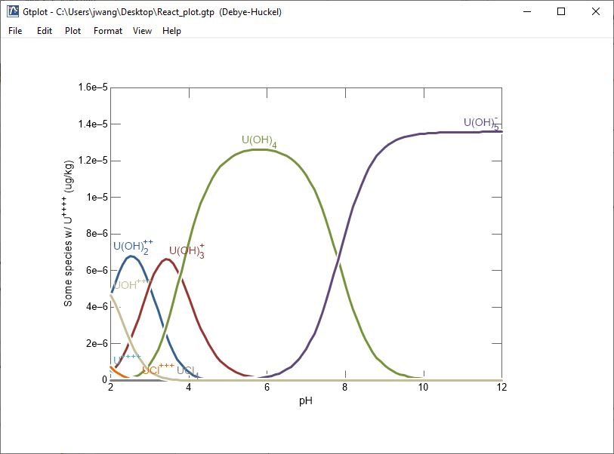
You can copy your current plot to the clipboard in a variety of formats…
Edit → Copy
(Ctrl + c)
Adobe Illustrator
Enhanced Metafile
Bitmap
Numerical values (tab or space delimited)

Slide 3
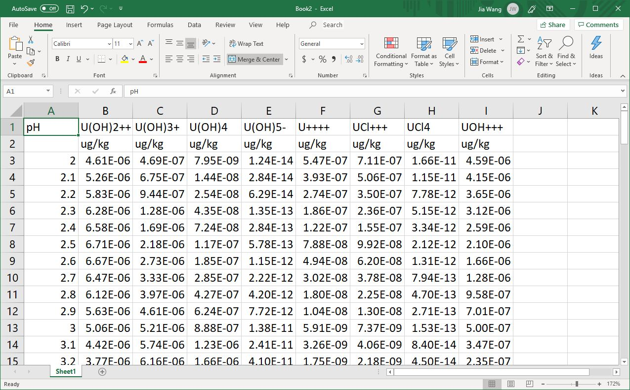
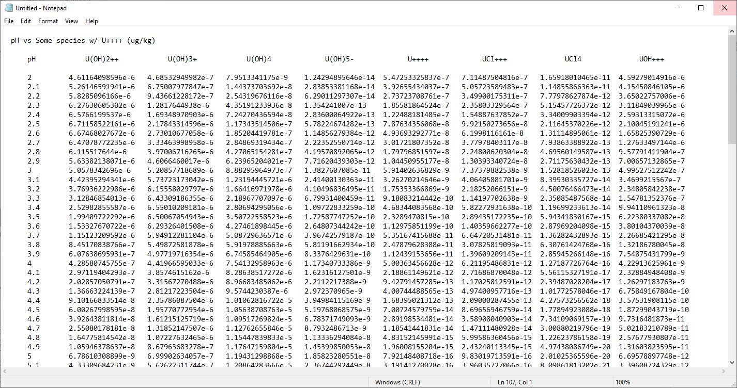
…then paste your plot in a format suitable for the application.
Use Paste (Ctrl + v) to add your data in the application’s default format.
Use Paste Special to select a different format.

Slide 4
You can also use Copy As to select the format of the plot to be copied.
Edit → Copy As →
Enhanced Metafile

Slide 5
Instead of copying and pasting, you can save the image as a file in a directory that you specify.
File → Save Image…
Enhanced Metafile
PostScript (Encapsulated, Color, Black and White)
Adobe Illustrator
Scalable Vector Graphics
Compressed SVG
PDF
PNG
TIFF
Bitmap
JPEG

