Slide 1
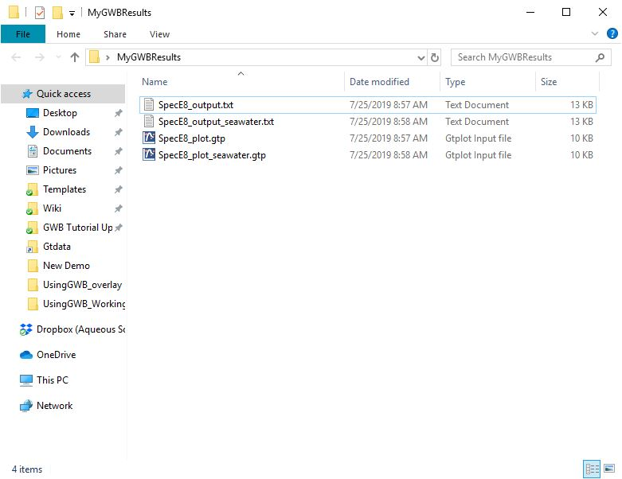
Managing results files

Slide 2
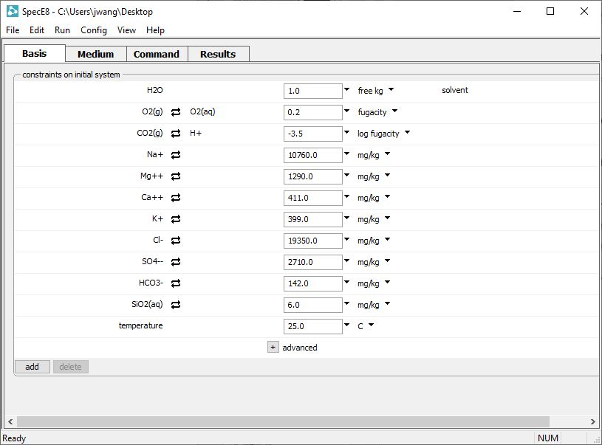
Path to your working directory
The results of your models will be saved in your current working directory

Slide 3
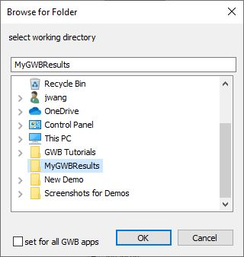
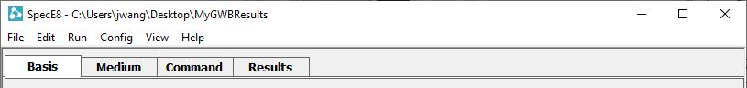
Go to File →
Working Directory…
… and choose a folder to store your results.
The GWB app will show your chosen working directory

Slide 4
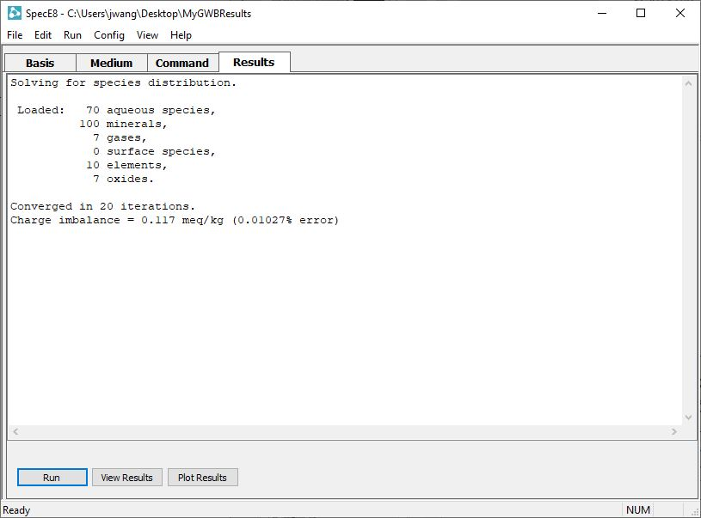
The GWB apps create results files after you run your models.
Click to view the text output file
Click to plot your results

Slide 5
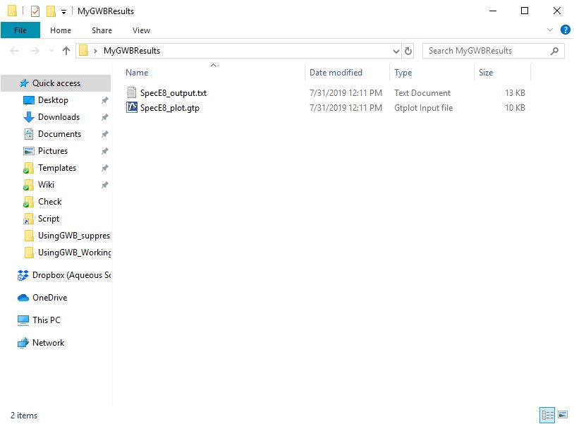
Your results files are saved in your current working directory
Default filenames. When you rerun a model, your results files will be overwritten.

Slide 6
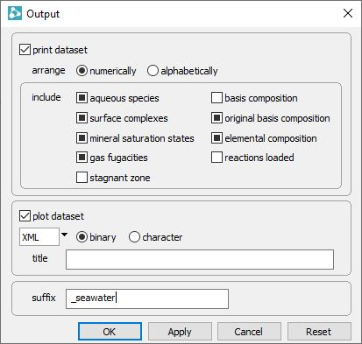
Go to
Config → Output…
… and set a suffix, then click Apply. The suffix will be appended to the name of the results file.

Slide 7
When you rerun your model, a new set of results files is created.

