Slide 1
0
FeOH
++
–
10
+++
Fe
–
20
)
q
a
Hematite
(
–
30
2
O
a
g
–
40
o
=
l
n
i
a
++
m
Fe
[
a
,
s
r
–
50
a
b
3
1
0
.
1
=
P
,
C
°
0
–
60
0
Magnetite
1
=
T
,
FeO(c)
+
+
e
100°C
F
m
a
r
g
a
i
–
70
D
0
2
4
6
8
10
12
14
pH

Slide 2
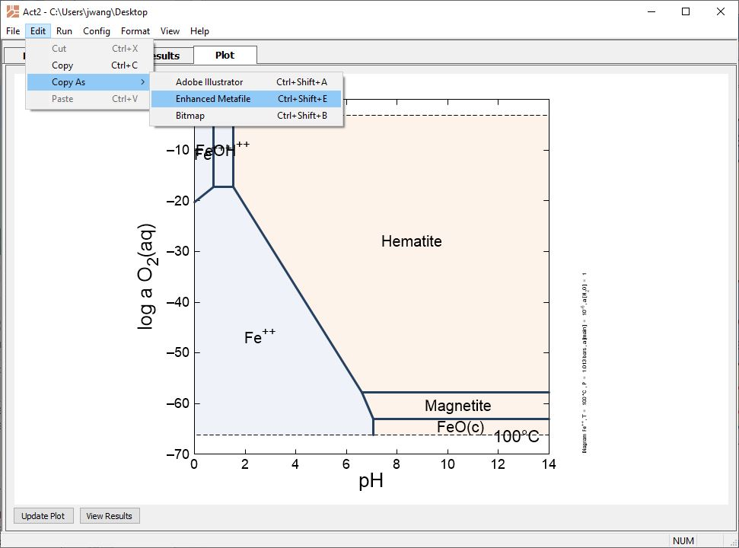
Create diagrams in Act2, Tact, Gtplot, P2plot, or Xtplot, then copy and paste into PowerPoint as enhanced metafiles.
Edit → Copy As → Enhanced Metafile
Each plot should have the same x- and y-ranges

Slide 3
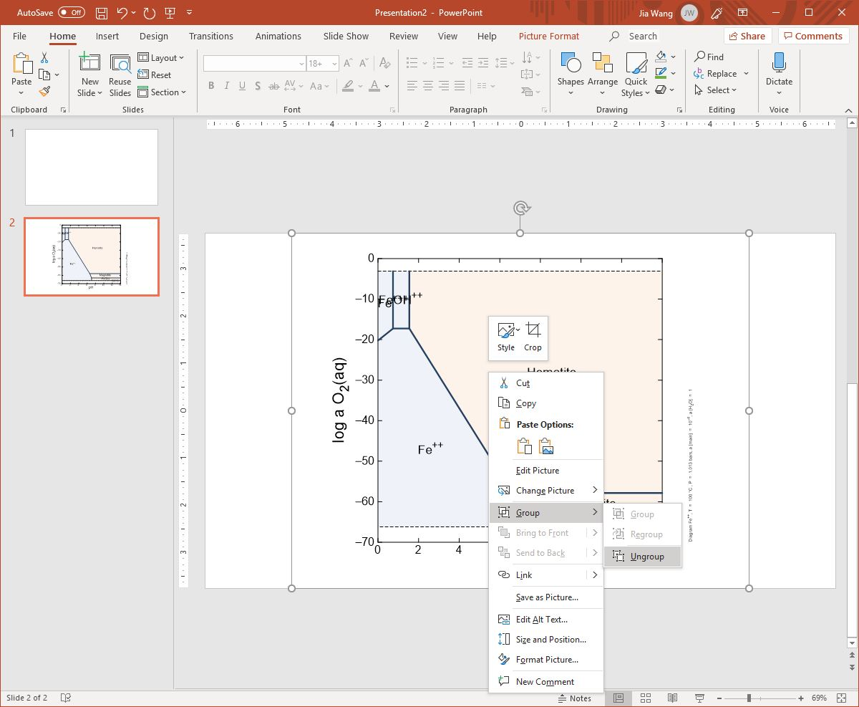
Paste each plot into a separate slide, then ungroup each image.
Right-click → Group → Ungroup. Choose Yes to convert to Microsoft Office drawing object

Slide 4
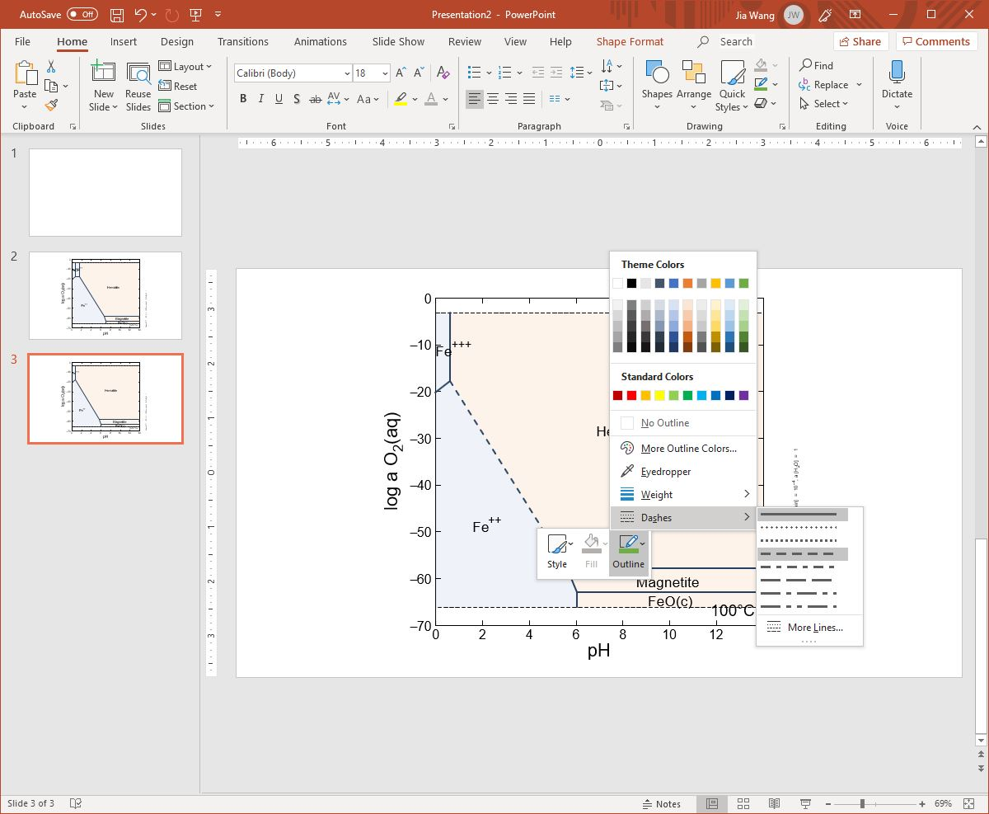
Select desired line segments, edit style if desired, then copy to clipboard (Ctrl+C)

Slide 5
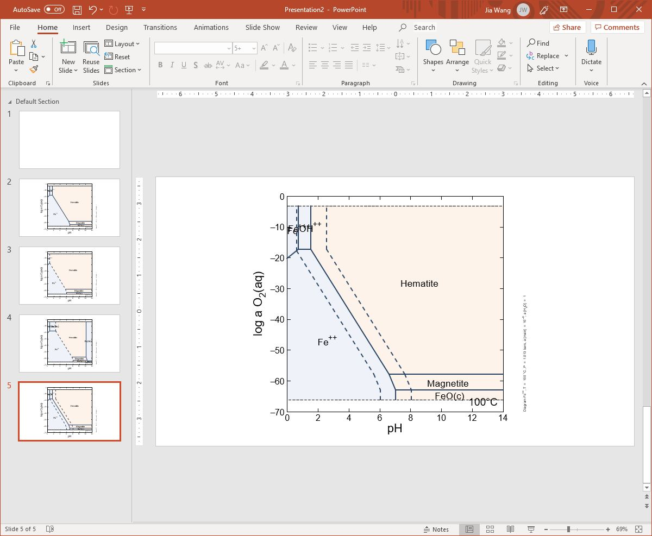
Paste lines from each plot into a single composite image

Slide 6
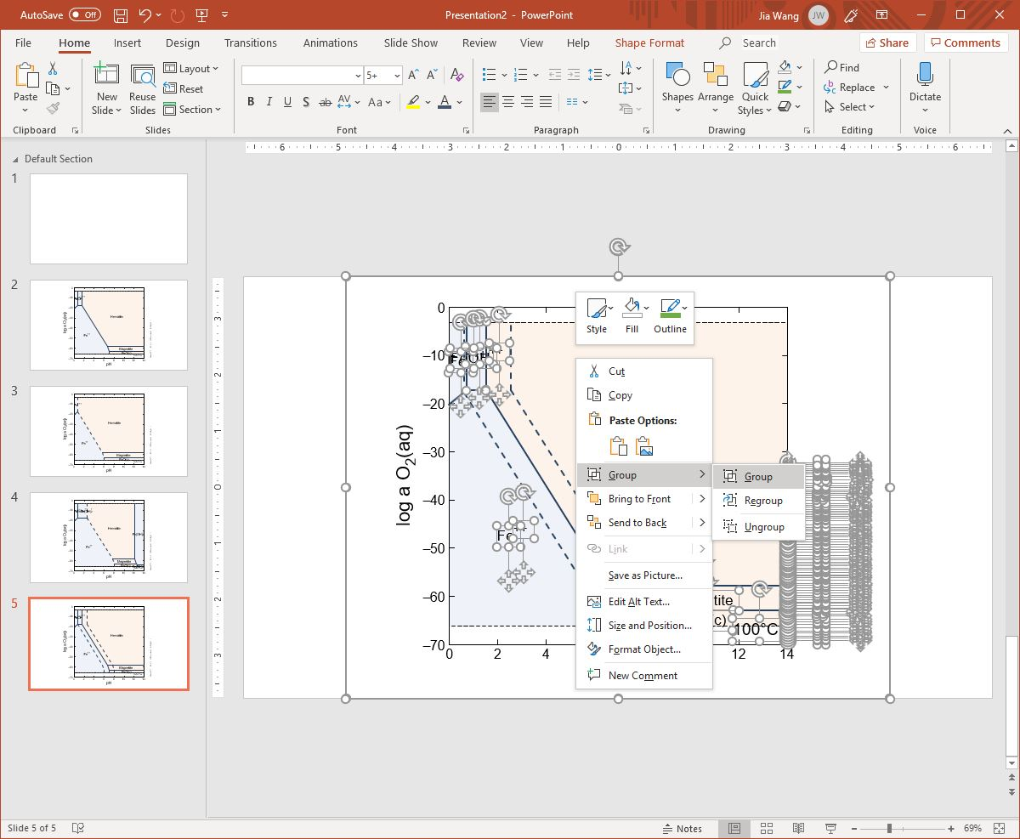
Select every element, then right-click and combine into a single group.

Slide 7
0
–
10
+++
++
Composite diagram shows the effect of Fe⁺⁺ activity on mineral stability fields
FeOH
Fe
–
20
)
-6
log a_{Fe} = -8
q
-4
a
Hematite
(
–
30
2
O
1
=
]
a
O
2
H
[
a
g
,
–
40
6
–
0
o
1
l
=
]
n
i
a
++
m
Fe
[
a
,
s
r
–
50
a
b
3
1
0
.
1
=
P
,
C
°
0
–
60
0
Magnetite
1
=
T
,
FeO(c)
+
+
e
100°C
F
m
a
r
g
a
i
–
70
D
0
2
4
6
8
10
12
14
pH

