Slide 1
Chalcedony
Cristobalite
Amrph^
silica
–
1

Slide 2
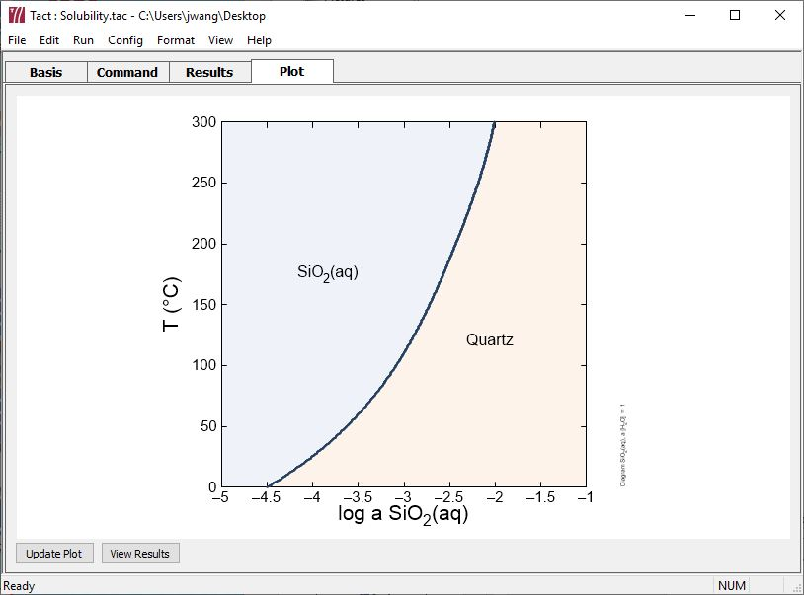
By default, all loaded species will be considered in a calculation
Solubility of Quartz, the most stable silica polymorph

Slide 3
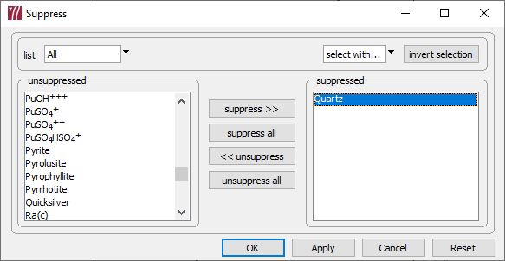
The “suppress” feature prevents a species from being considered
Config → Suppress…
Select species in the unsuppressed list, then hit “suppress >>”
Suppress Quartz to allow less stable silica minerals to form.

Slide 4
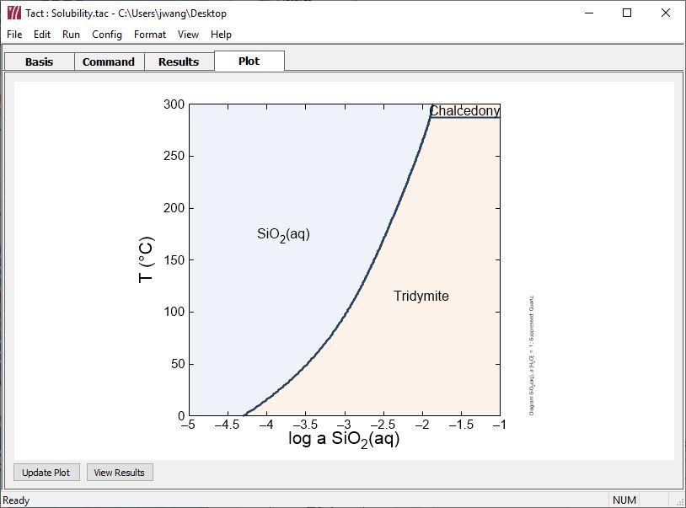
Suppressing Quartz allows Tridymite and Chalcedony to form.

Slide 5
Chalcedony
Cristobalite
Amrph^
silica
–
1

