Slide 1
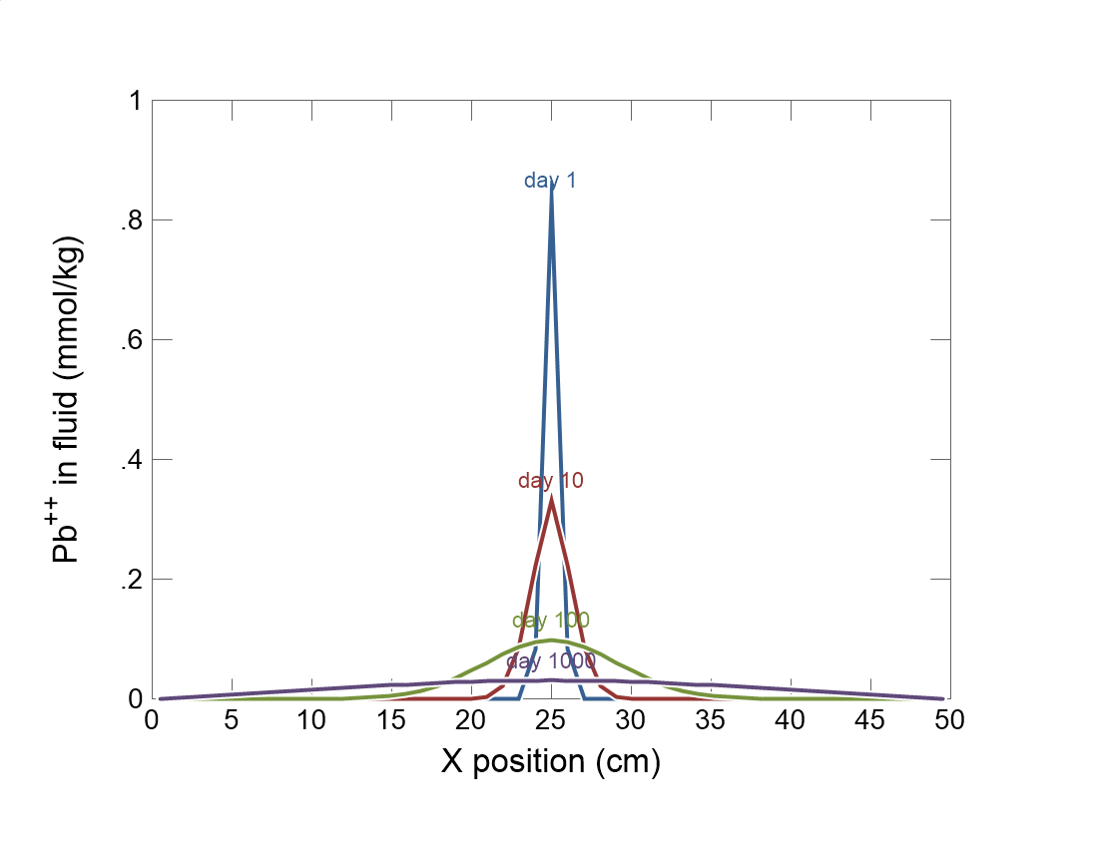

Slide 2
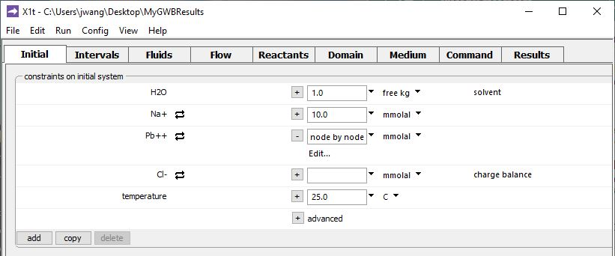
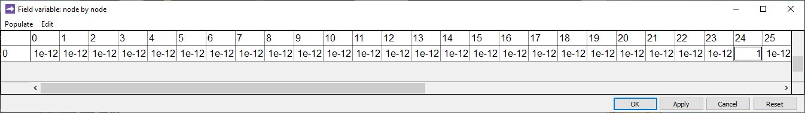
The Initial fluid has negligible Pb²⁺ everywhere but the central node
Click Edit…
Negligible Pb²⁺ concentration.
1 mmolal Pb²⁺ in the central node, #24.

Slide 3
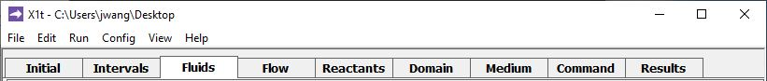
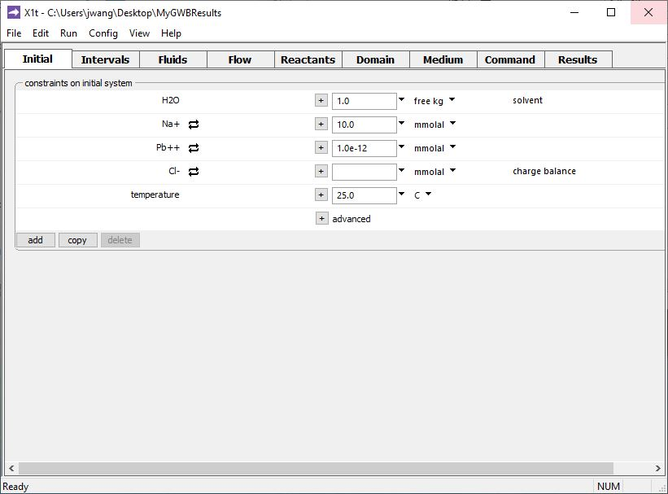
Set any boundary fluids in the Fluids pane

Slide 4
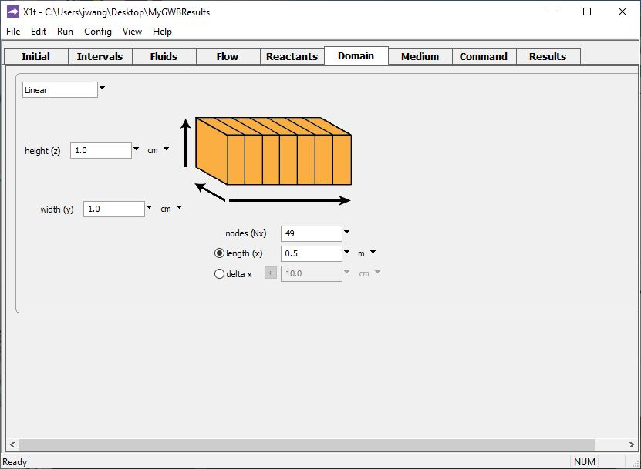
Specify domain size and gridding on the Domain pane.
Domain is 0.5 m long, divided into 49 nodal blocks (Node 24 is in the center)

Slide 5
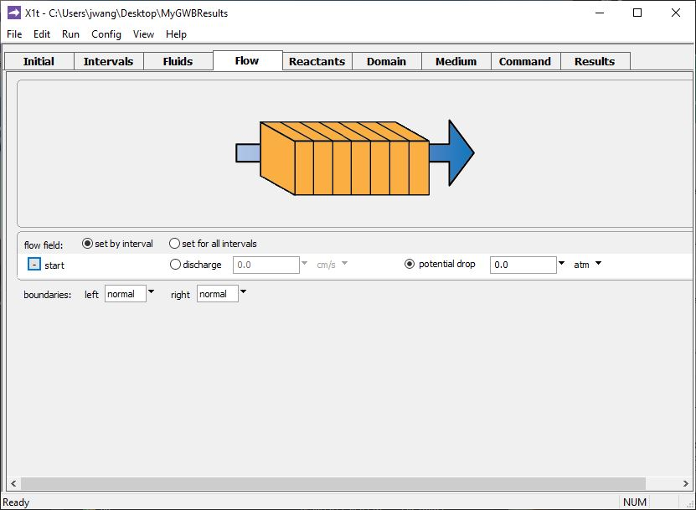
Set flow rate in the Flow pane.
No flow in the simulation →
diffusion is the only transport process.

Slide 6
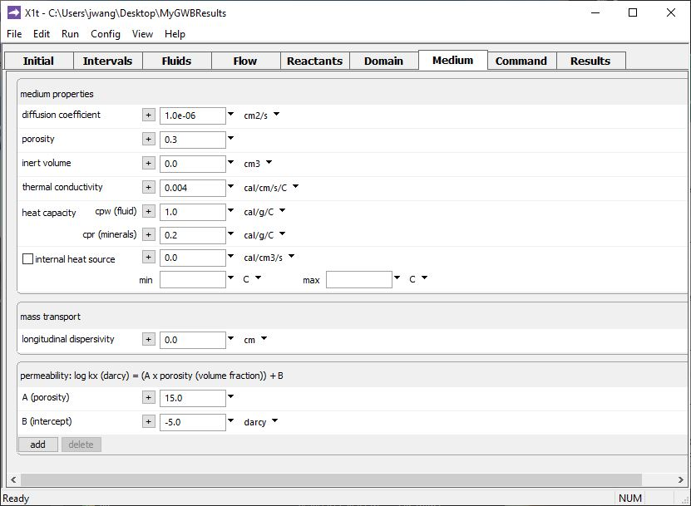
Set various mass transport properties on the Medium pane.
Set diffusion coefficient for the porous medium

Slide 7
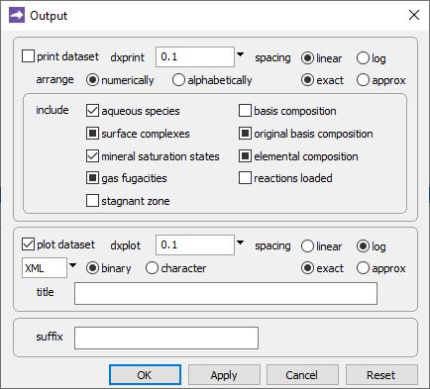
Config → Output…
Tip: Use logarithmic spacing for plotted results

Slide 8
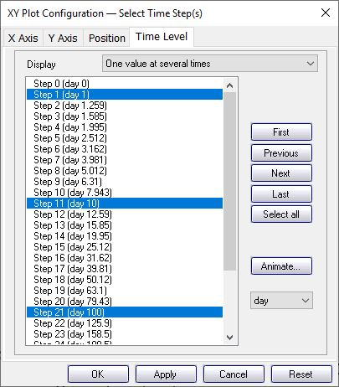
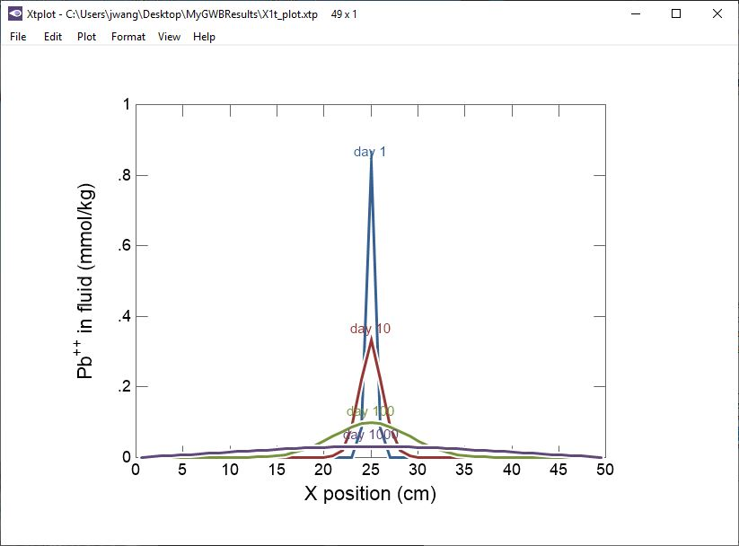
Plot Pb²⁺ concentratin after 1, 10, 100, 1000 days
Pb²⁺ diffuses outward from the center node over 1,000 days

