Slide 1
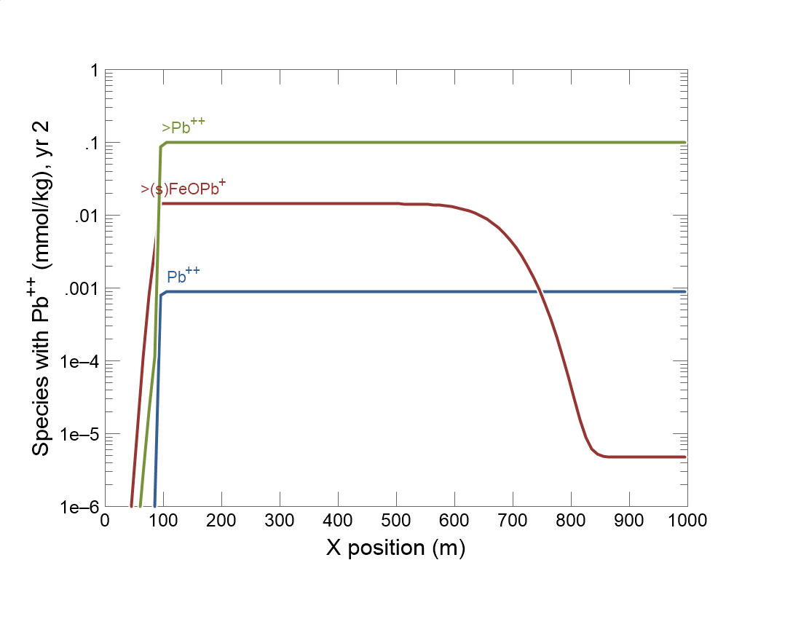

Slide 2
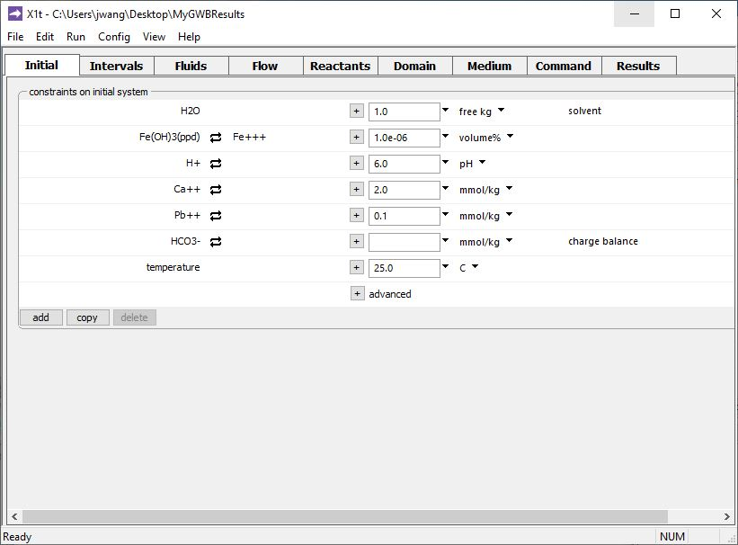
Specify domain’s starting fluid composition on the Initial pane
Negligible ferric iron (HFO) in initial system
Considerable Pb⁺⁺ in initial system

Slide 3
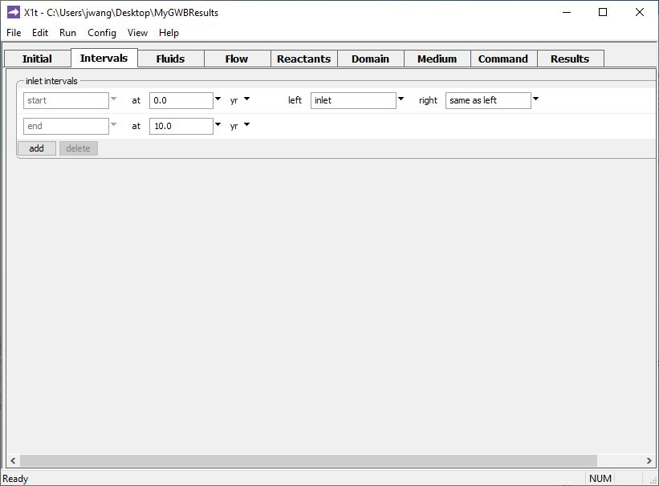
Define the reaction intervals. Specify what fluids flow into the domain, and when.
A single inlet fluid flows into the domain for 10 years.
Click to add a new reaction interval

Slide 4
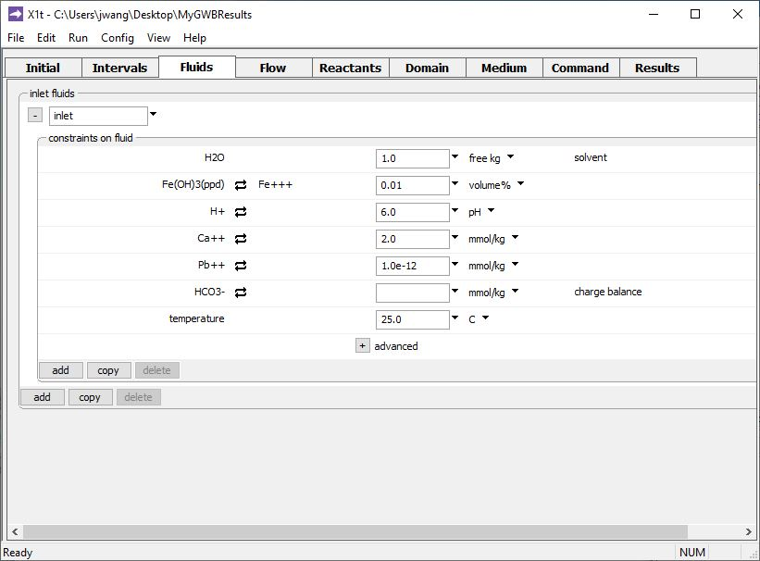
The inlet fluid is defined on the Fluids pane
Inlet fluid carries ferric hydroxide colloid into the domain
Negligible Pb⁺⁺ in inlet fluid

Slide 5
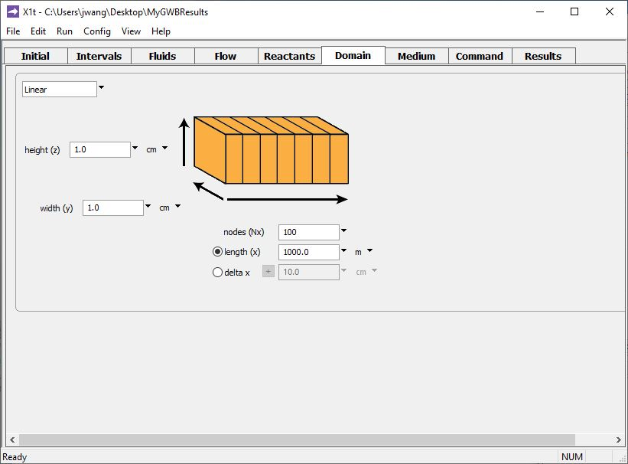
Specify domain size and gridding on the Domain pane.
Domain is 1 km long, divided into 100 nodal blocks

Slide 6
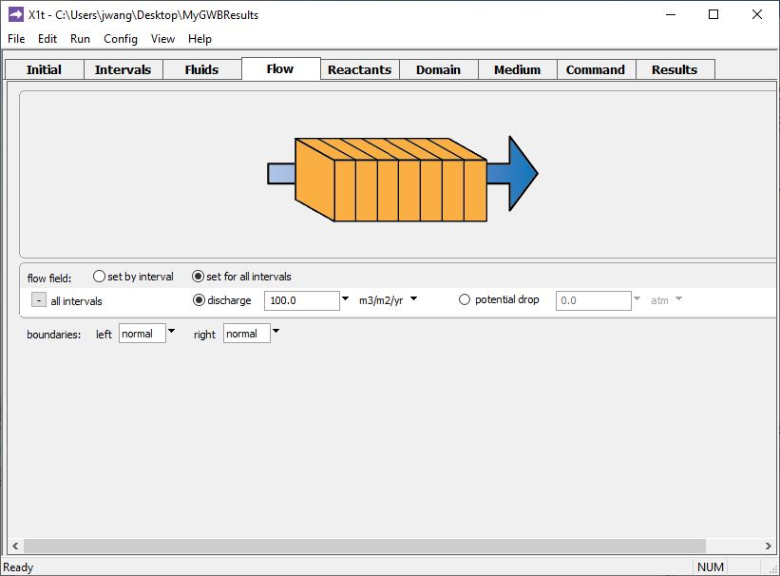
Specify flow rate on the Flow pane.
Set specific discharge or hydraulic head/ potential drop

Slide 7
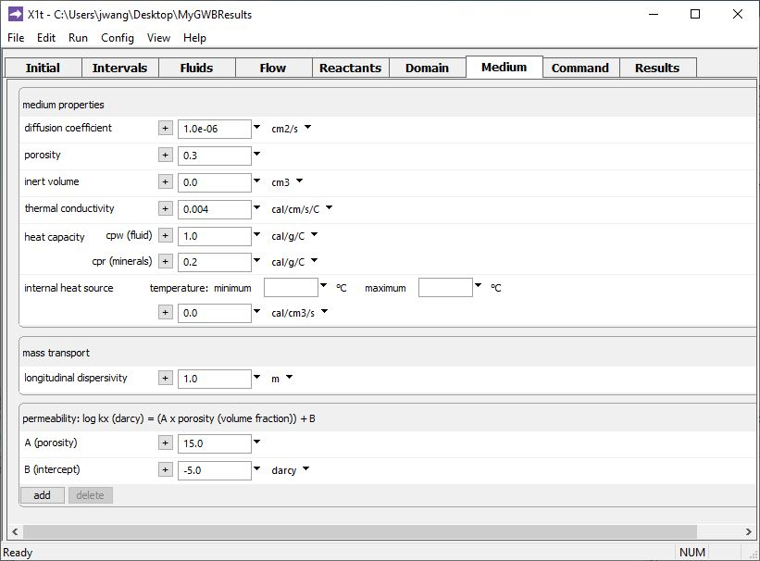
Set various mass transport properties on the Medium pane.
Colloid migrates by advection and dispersion

Slide 8
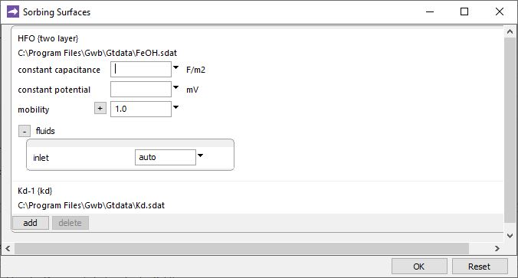
File → Open → Sorbing Surfaces…
Surface complexation dataset for hydrous ferric oxide.
Set mobility in the domain to 1 to make HFO and its sorbate a mobile colloid.
Kd describes distribution coefficient between Pb⁺⁺ and immobile aquifer sediments
You can add any number of sorbing surfaces.

Slide 9
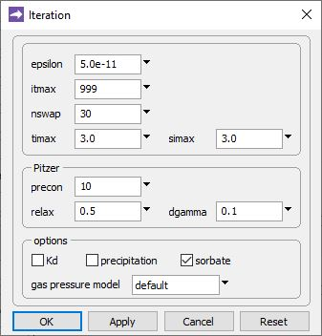
Config → Iteration
If you check to include “sorbate”, the total Pb⁺⁺ concentration defined for each fluid (Initial and Fluids panes) is distributed between solution and surfaces.
Run → Go
traces the model

Slide 10
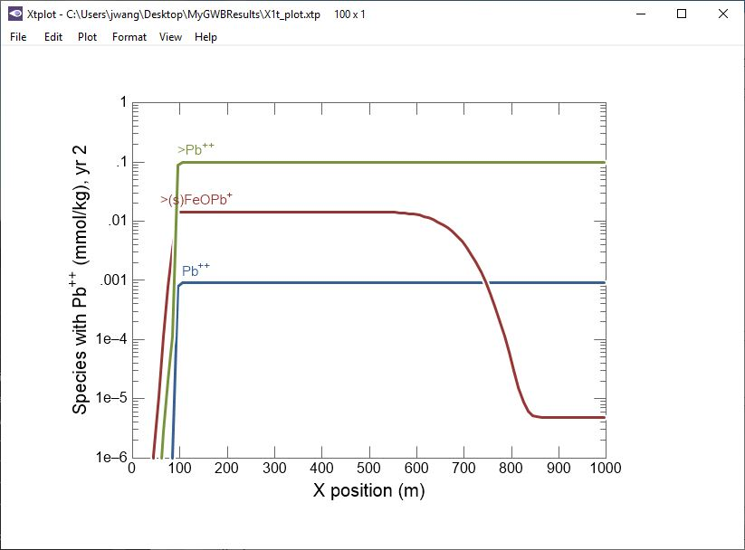
Initially Pb⁺⁺ almost entirely sorbed to immobile aquifer sediments (>Pb⁺⁺).
Pb⁺⁺ scavenged from aquifer sediments (>Pb⁺⁺) onto mobile colloid surface (>(s)FeOPb⁺).
Fluid transports ferric hydroxide colloid through aquifer.

