Slide 1
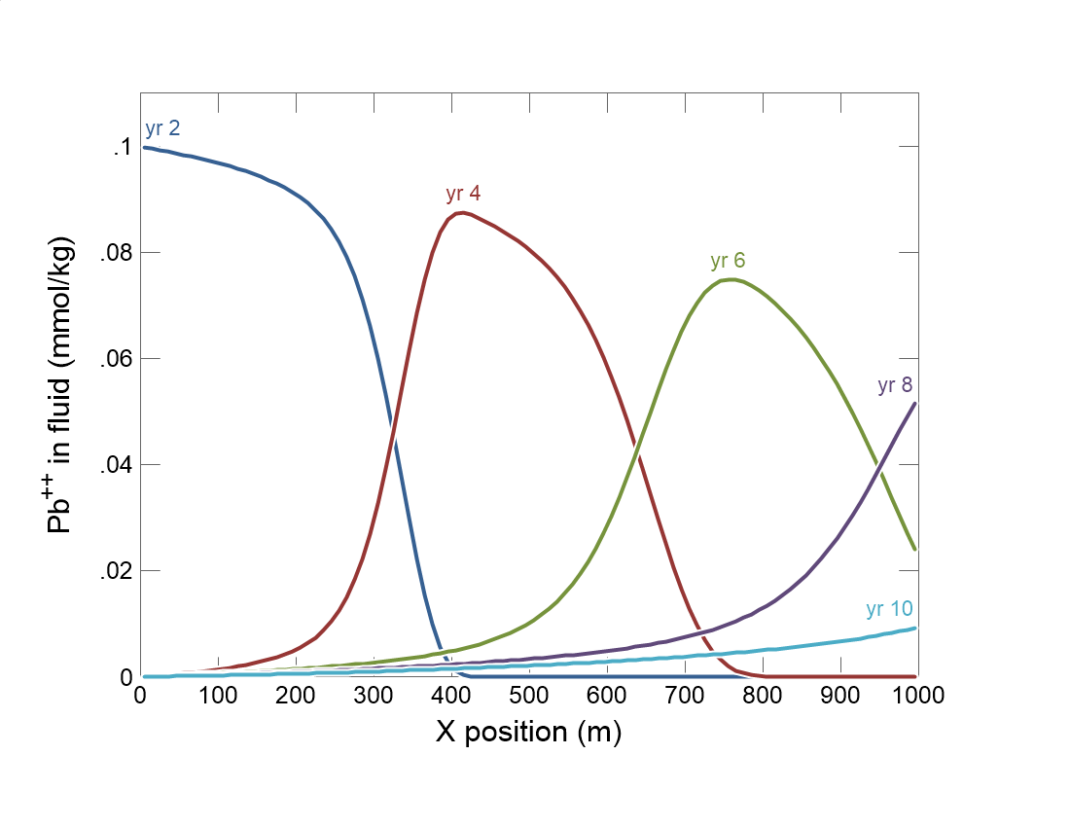

Slide 2
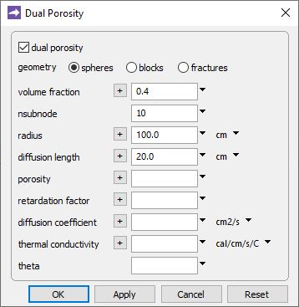
In a dual porosity model, each nodal block is divided into a free-flowing zone and a stagnant zone.
Config →
Dual Porosity…
On/off toggle
40% of the aquifer is stagnant.
Characteristic dimension of the stagnant zone
Diffusion coefficient, thermal conductivity, porosity of stagnant zone default to free-flowing values unless you set them here.

Slide 3
Specify domain’s starting fluid composition on the Initial pane
Clean water

Slide 4
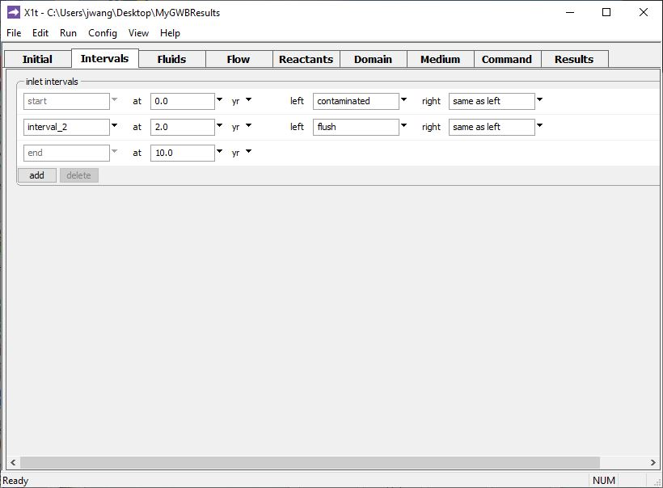
Define the reaction intervals. Specify what fluids flow into the domain, and when.
Inlet fluid “contaminated” enters the domain from t = 0 to 2 years
Inlet fluid “flush” enters the domain from t = 2 to 10 years
Click to add a new reaction interval

Slide 5
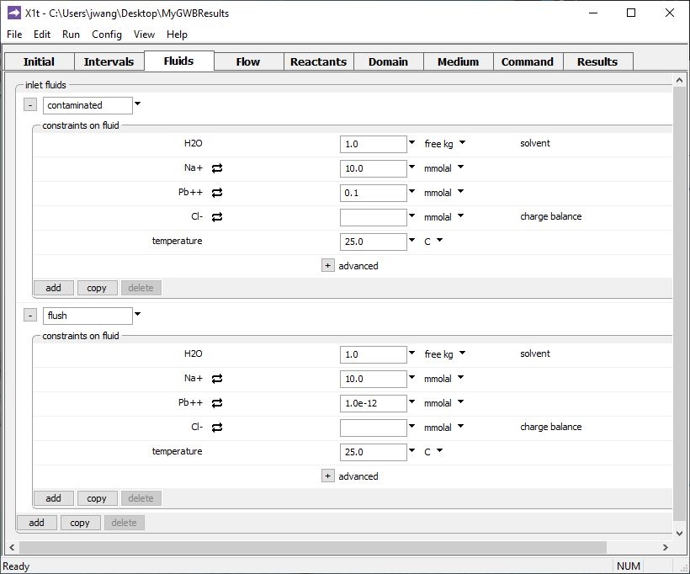
The various inlet fluids are defined on the Fluids pane
Inlet fluid named “contaminated” carries Pb⁺⁺ pulse into the domain
Clean rinse water: negligible Pb⁺⁺ in the “flush” inlet fluid
Click to add a new fluid

Slide 6
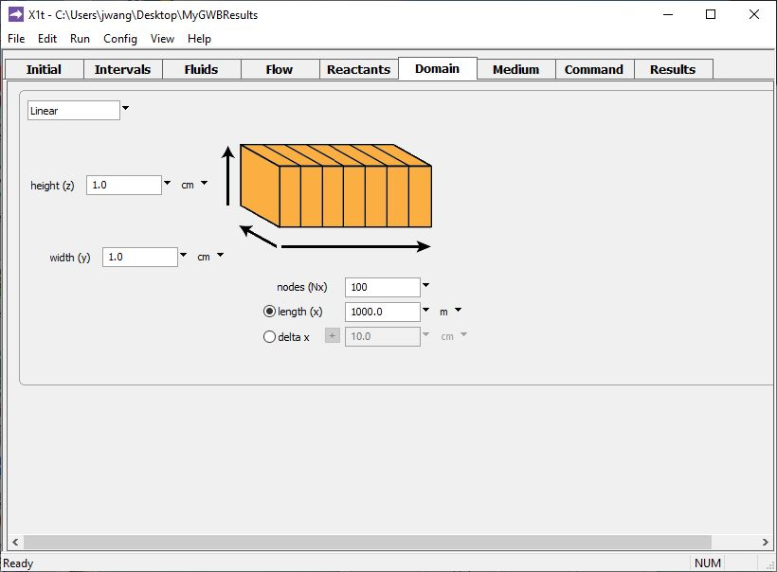
Specify domain size and gridding on the Domain pane.
Domain is 1 km long, divided into 100 nodal blocks

Slide 7
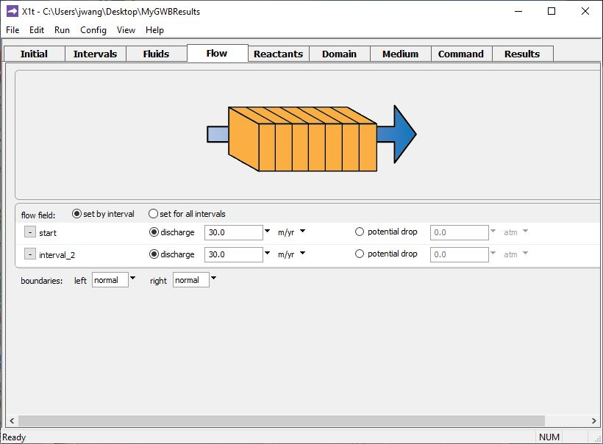
Specify flow rate on the Flow pane.
Set flowrate for 1st and 2nd reaction intervals individually, or set one flowrate for all intervals
Set specific discharge or hydraulic head/ potential drop

Slide 8
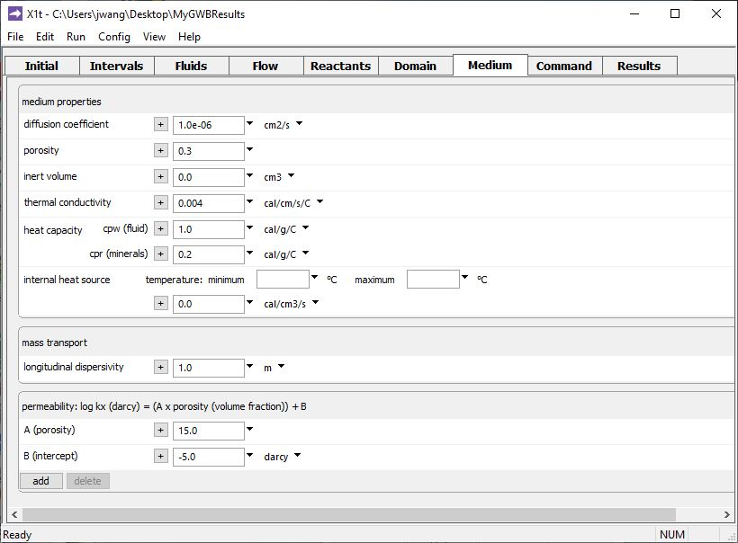
Set various mass transport properties on the Medium pane.
Porosity of the free-flowing zone.
Used to calculate coefficient of hydrodynamic dispersion.
Run → Go
traces the model

Slide 9
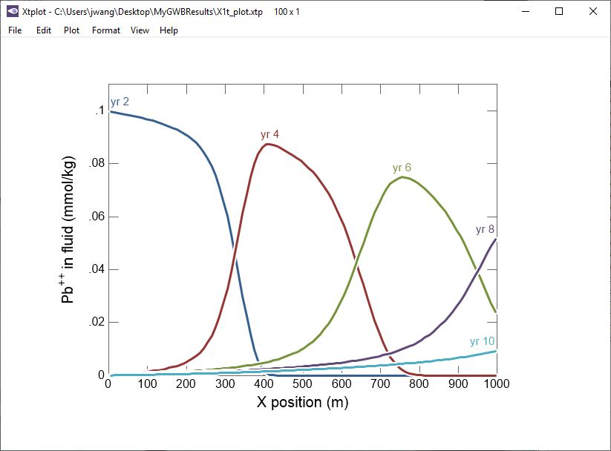
Pb⁺⁺ travels from one nodal block to another only through the free-flowing volume, but it can diffuse into and out of the stagnant zones.

