Slide 1
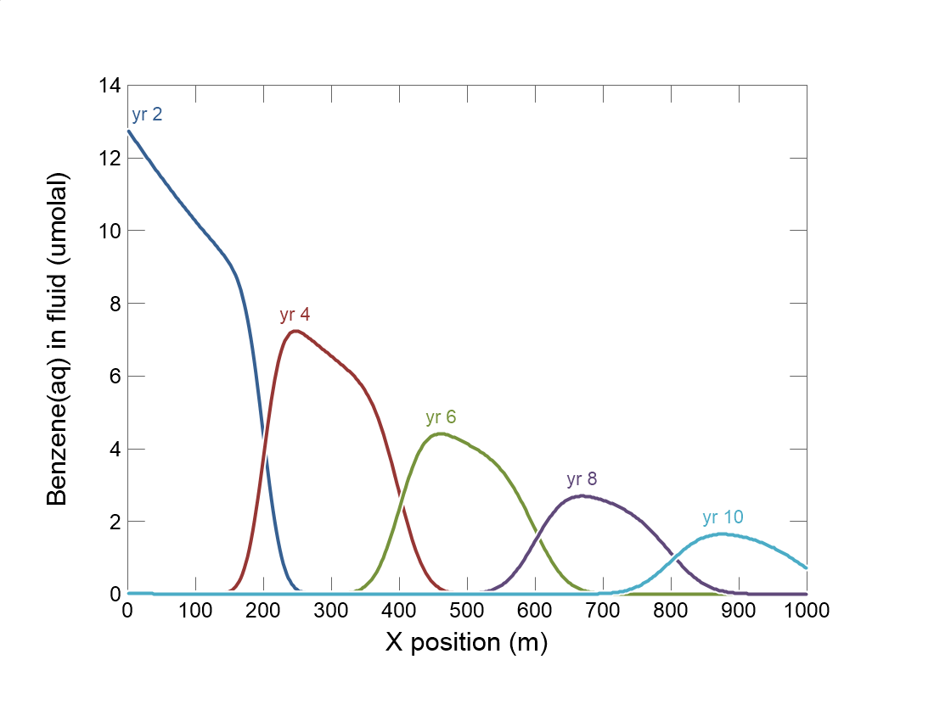

Slide 2
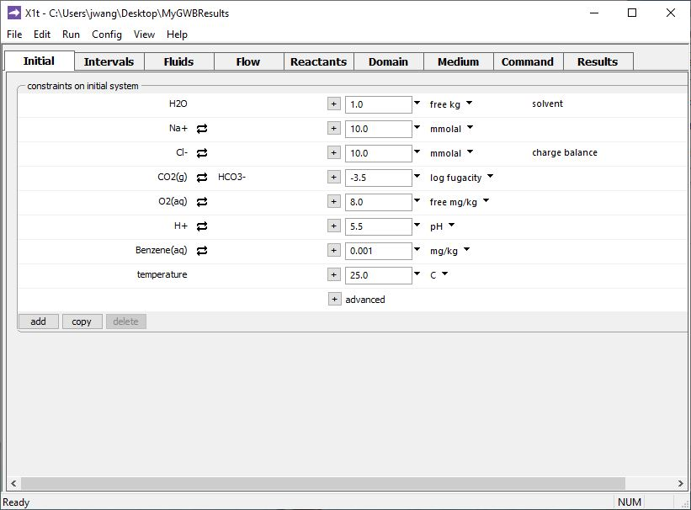
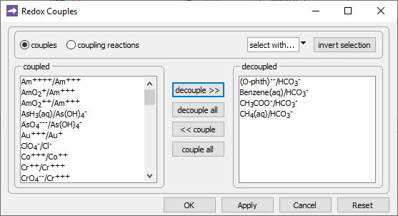
Config →
Redox Couples…
Decouple reaction between carbonate and Benzene(aq), other forms of carbon.
Default setting: all redox reactions are coupled.

Slide 3
Specify domain’s starting fluid composition on the Initial pane
Decoupled redox pairs (Benzene and carbonate) can be constrained independently.

Slide 4
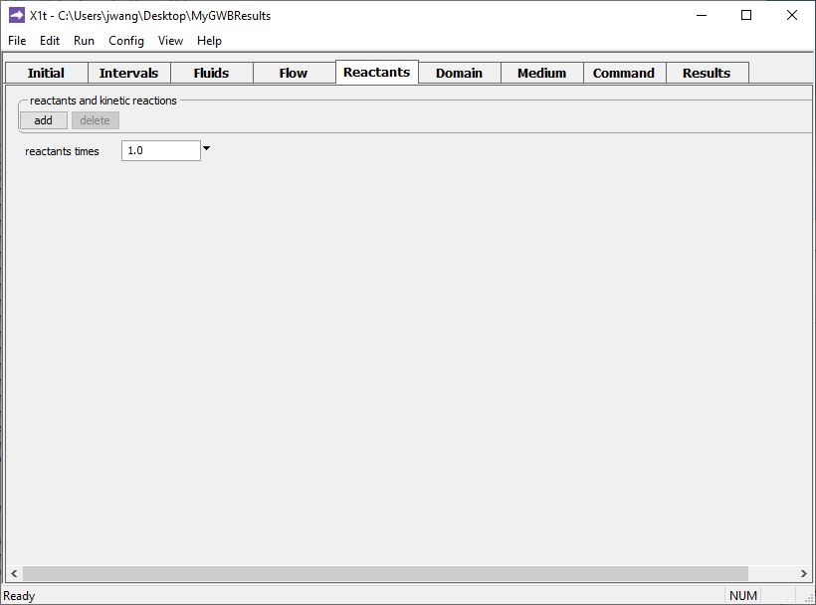
You enable redox kinetics on the Reactants pane.
add → Kinetic →
Redox reaction

Slide 5
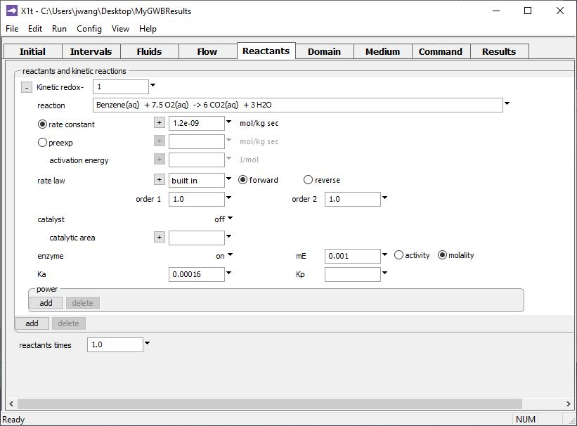
Type out the redox reaction.
Set enzyme function to “on” and enter rate constant, half-saturation constant, and enzyme concentration.

Slide 6
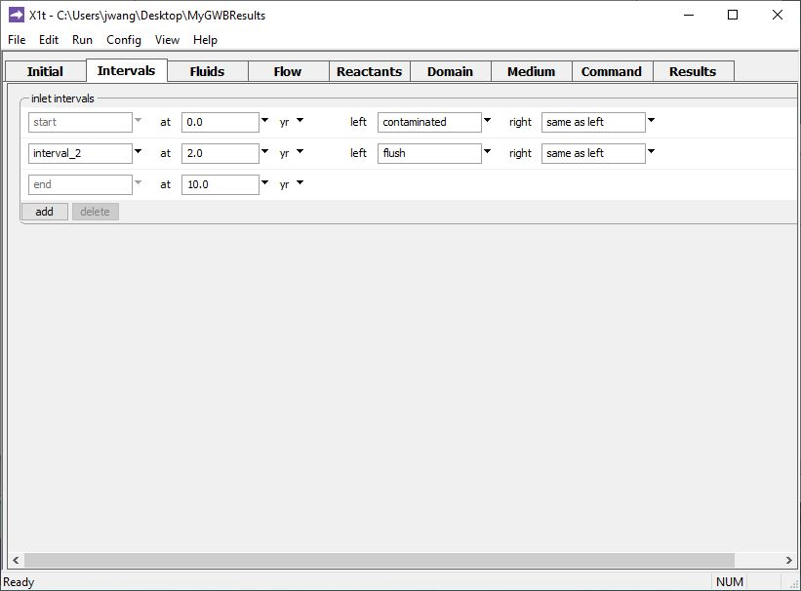
Define the reaction intervals. Specify what fluids flow into the domain, and when.
Inlet fluid “contaminated” enters the domain from t = 0 to 2 years
Inlet fluid “flush” enters the domain from t = 2 to 10 years
Click to add a new reaction interval

Slide 7
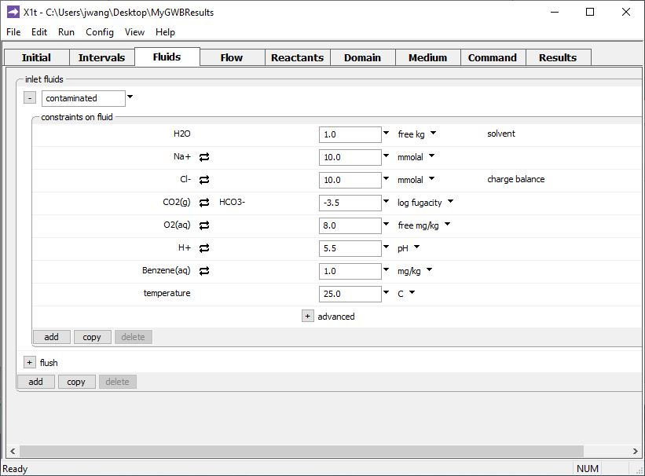
The various inlet fluids are defined on the Fluids pane
Click to expand or contract view
Inlet fluid named “contaminated” carries Benzene into the domain
Click to add a new fluid

Slide 8
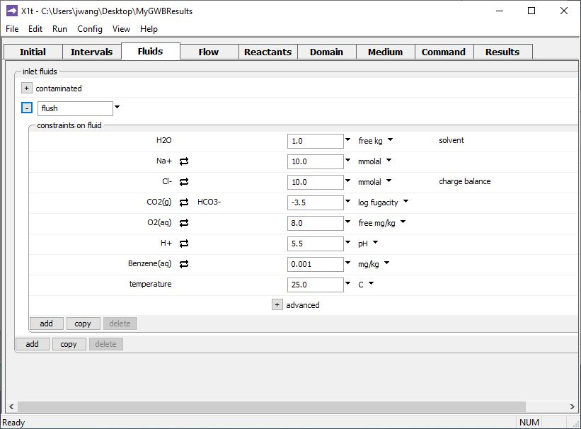
The various inlet fluids are defined on the Fluids pane
Clean rinse water: negligible Benzene in the “flush” inlet fluid

Slide 9
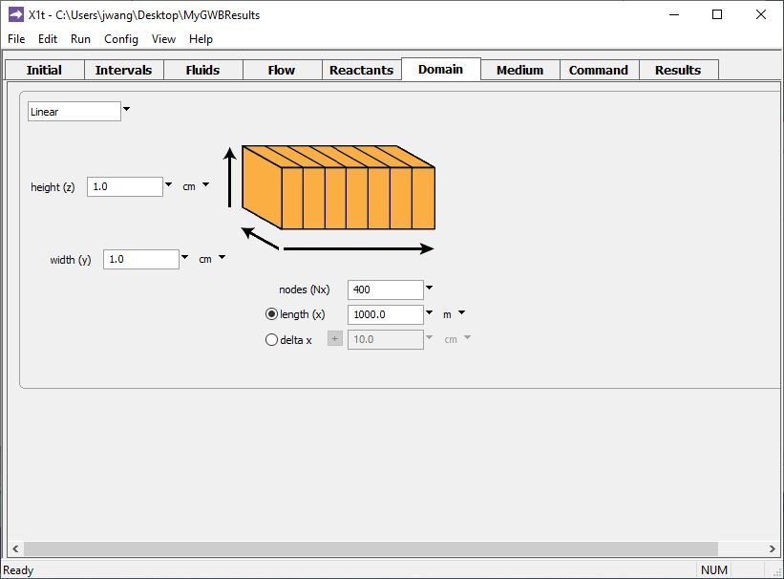
Specify domain size and gridding on the Domain pane.
Domain is 1 km long, divided into 400 nodal blocks

Slide 10
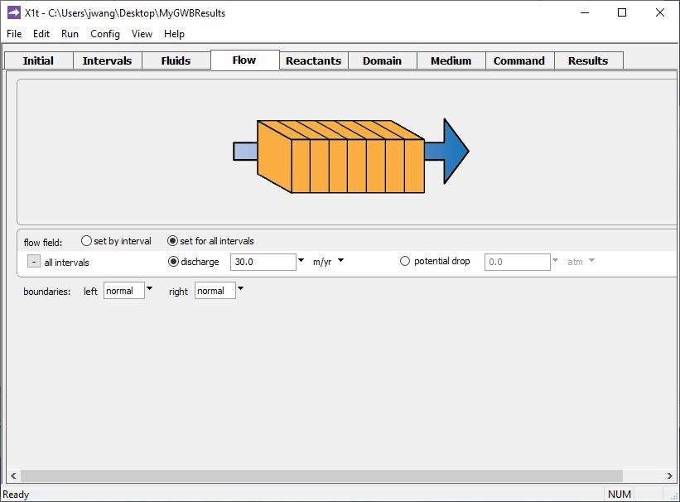
Specify flow rate on the Flow pane.
Set a single flowrate for all intervals
Set specific discharge or hydraulic head/ potential drop

Slide 11
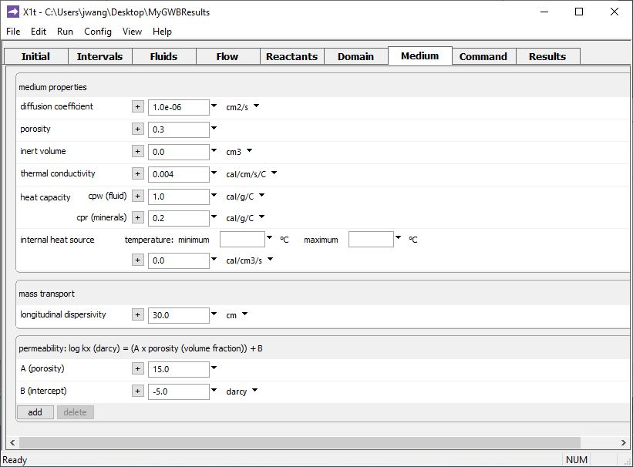
Set various mass transport properties on the Medium pane.
Porosity affects groundwater velocity.
Used to calculate coefficient of hydrodynamic dispersion.
Run → Go
traces the model

Slide 12
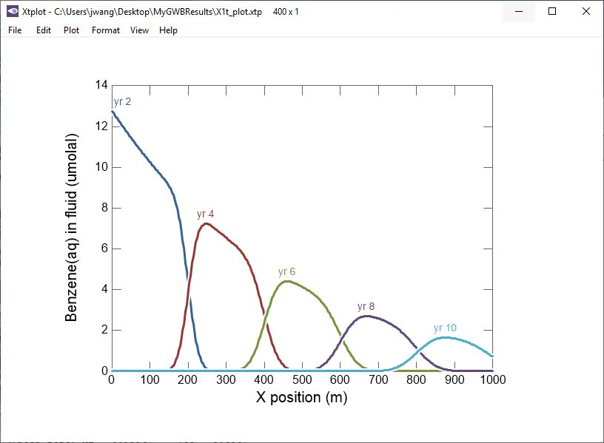
Initial pulse of Benzene contaminated
water is attenuated by biodegradation.

