Slide 2
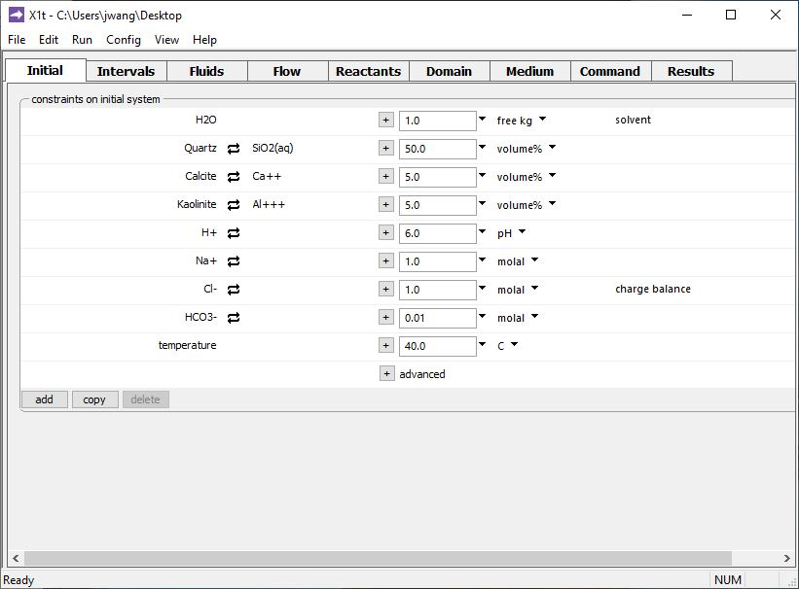
Specify domain’s starting fluid temperature on the Initial pane
Porewater temperature is 40°C

Slide 3
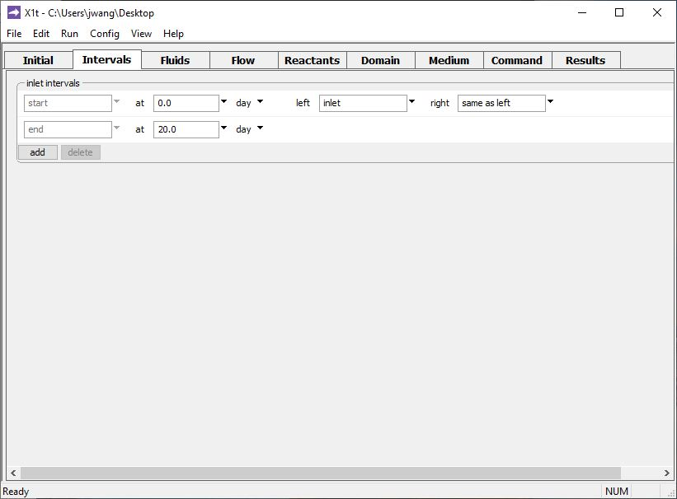
Define the reaction intervals. Specify what fluids flow into the domain, and when.
A single inlet fluid flows into the domain for 20 days.

Slide 4
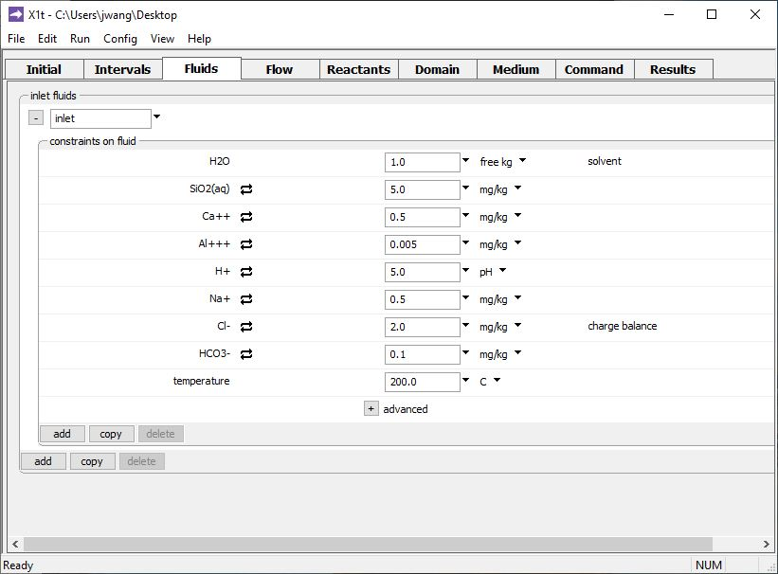
The inlet fluid is defined on the Fluids pane
A 200°C injectate will displace the initial fluid

Slide 5
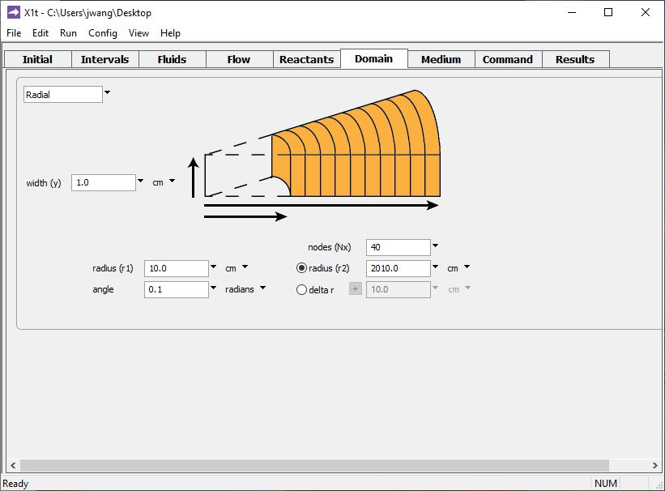
Specify domain size and gridding on the Domain pane.
Radial domain set in this example
Domain is 2000 cm long, divided into 40 nodal blocks

Slide 6
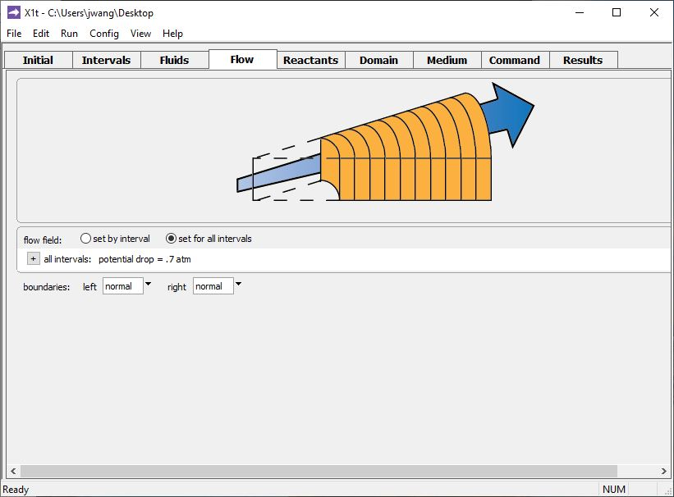
Specify flowrate on the Flow pane.
Injection pressure 0.7 atm greater than formation pressure

Slide 7
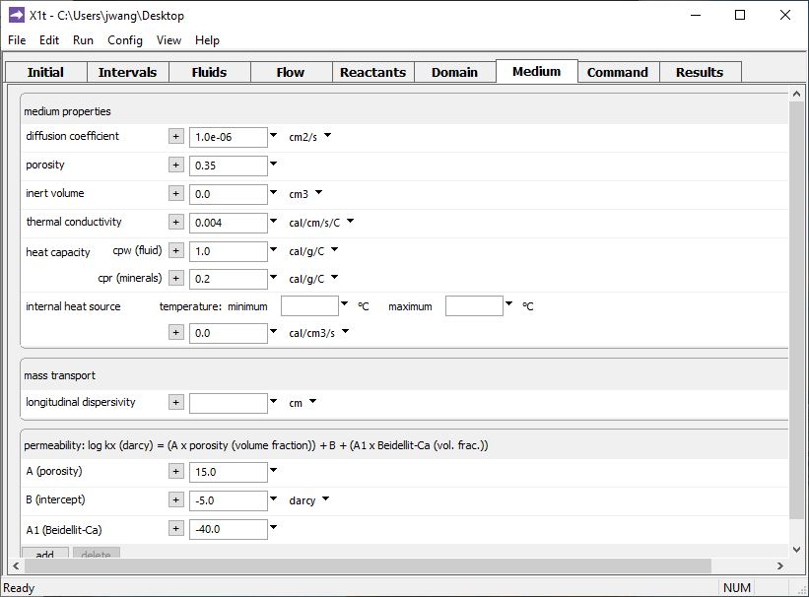
Set various thermal properties on the Medium pane.
Set thermal conductivity of porous medium to model heat conduction.
Set heat capacity of the fluid and rock to simulate heat transfer by advecting groundwater.
Can include transient heat sources or sinks within the domain.
Run → Go
traces the model

Slide 8
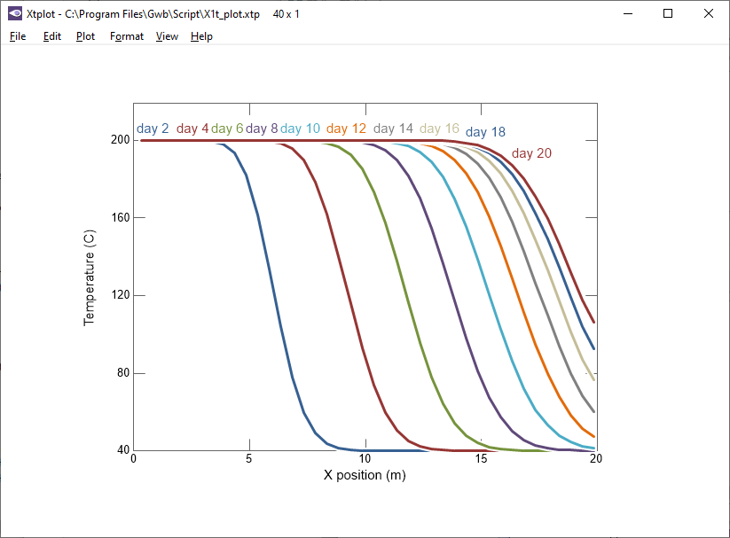
Hot water is injected into the domain’s inlet. Heat transported by advection and conduction.

