Slide 1
10
0
3
y
-
a
5
HCO
d
3
,
Calcite
C
-
3
0
1
Bulk fluid
n
o
i
t
i
–
5
s
CO
(aq)
o
p
2
m
o
c
–
10
c
i
p
o
t
o
–
15
s
I
–
20
0
2
4
6
8
10
X position (m)

Slide 2
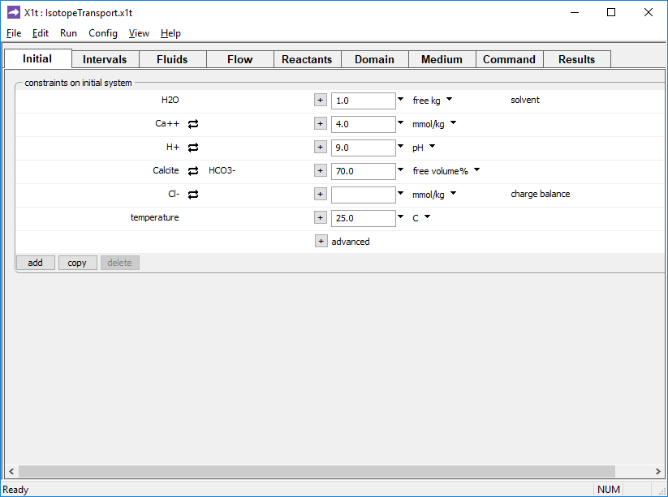
Specify domain’s starting fluid composition on the Initial pane
Alkaline fluid in equilibrium with calcite
Aquifer is 70% calcite by volume

Slide 3
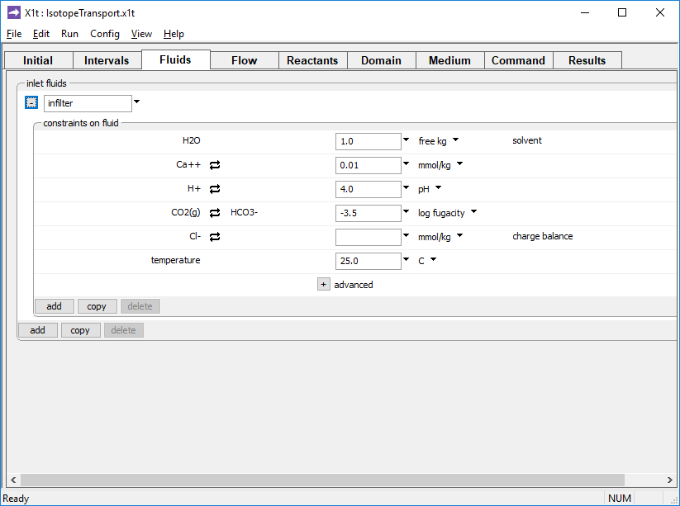
The inlet fluid is defined on the Fluids pane
Acidic inlet fluid “infilter”
Equilibrium with atmospheric CO₂

Slide 4
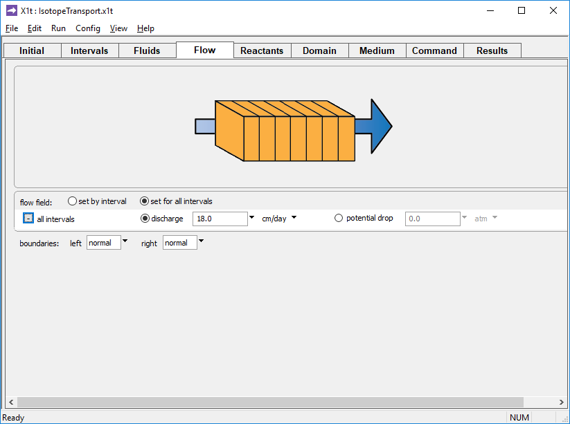
Specify flow rate on the Flow pane.
Set specific discharge or hydraulic head/ potential drop

Slide 5
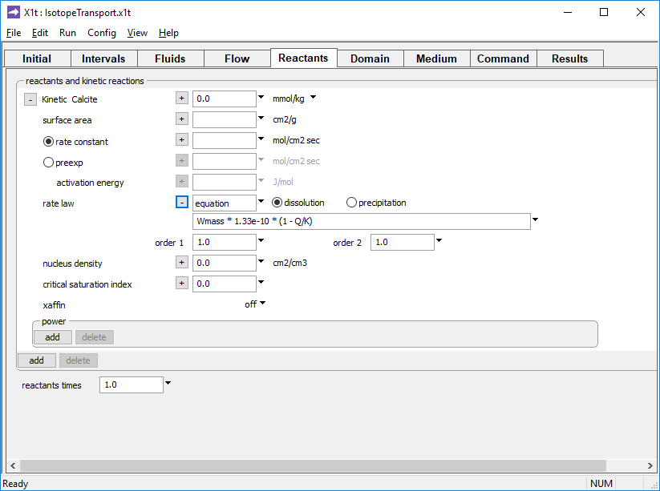
Define simple and buffered reactants and kinetic reactions on the Reactants pane
Simple kinetic rate law for calcite dissolution

Slide 6
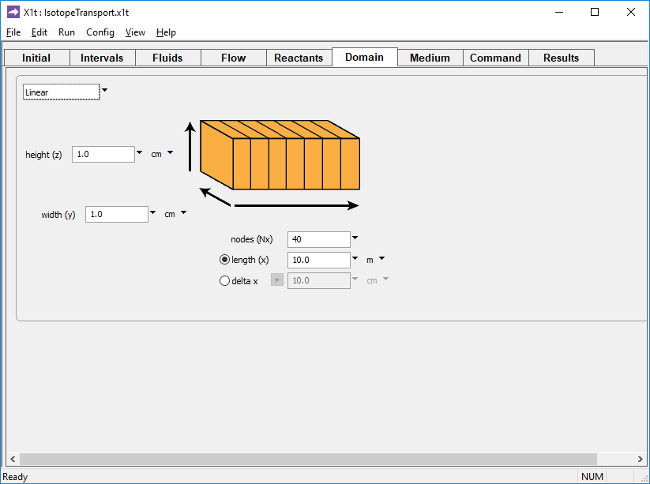
Specify domain size and gridding on the Domain pane.
Domain is 10 m long, divided into 40 nodal blocks

Slide 7
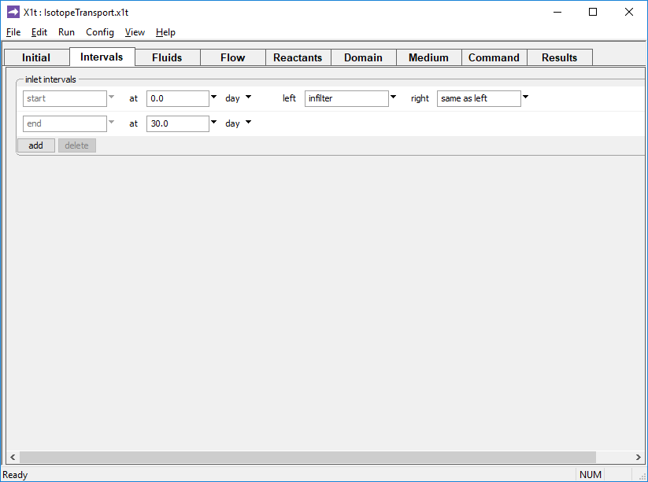
Define the reaction intervals. Specify what fluids flow into the domain, and when.
Inlet fluid “infilter” enters the domain from t = 0 to 30 days

Slide 8
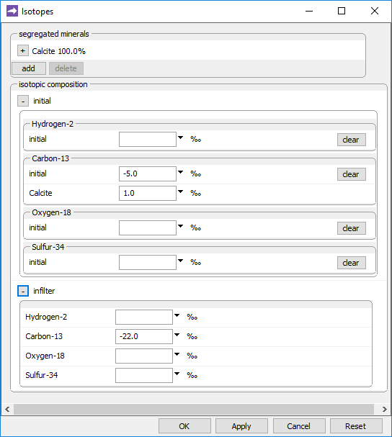
Config → Isotopes…
Calcite is segregated from isotopic exchange
Isotopic composition δ¹³C of the initial fluid
Initial δ¹³C of segregated mineral calcite
δ¹³C of the inlet fluid “infilter”
Run → Go
traces the model

Slide 9
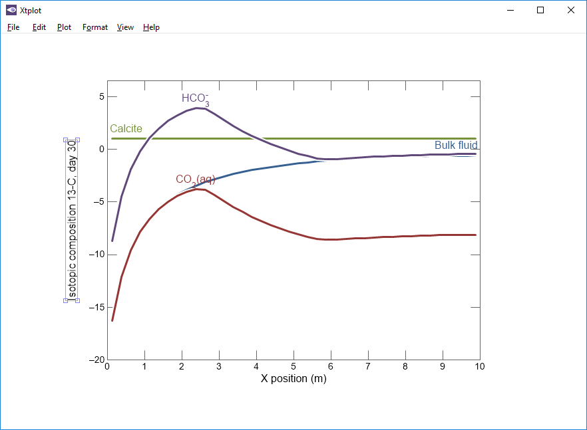
In absence of precipitation, composition of segregated calcite is unchanged
Calcite dissolution makes bulk fluid heavier as it moves through domain.
δ¹³C of fluid changes from composition of CO₂(aq), the predominant species at low pH near inlet, toward that of HCO₃⁻

