Slide 1
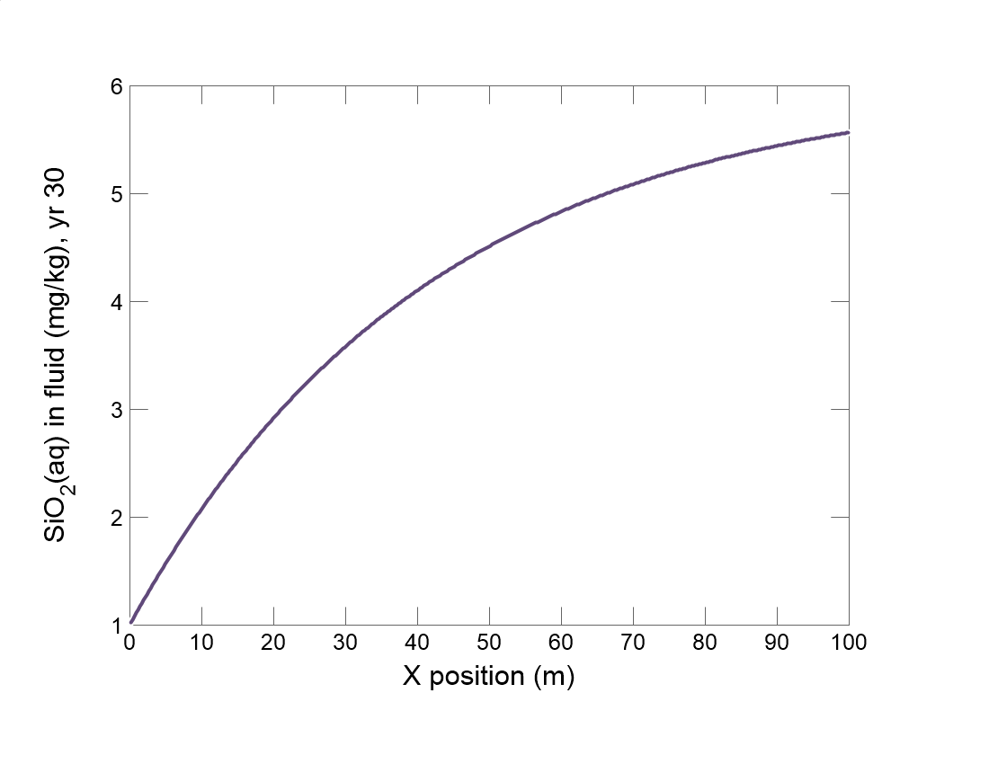

Slide 2
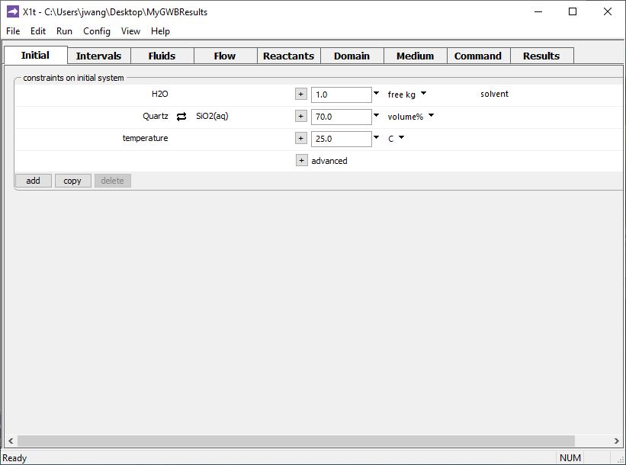
Specify domain’s starting fluid composition on the Initial pane
Initial fluid in equilibrium with Quartz
Aquifer is 70% Quartz

Slide 3
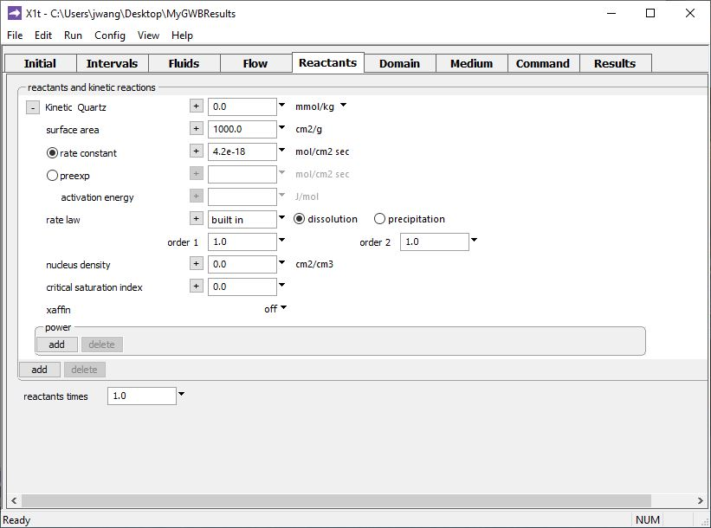
You enable kinetic reactions on the Reactants pane.
Mass already specified on Initial pane
Specific surface area
Rate constant
You can also…
Add promoting or inhibiting species
add → Kinetic →
Mineral…
Use Arrhenius equation for polythermal runs
Supply a nucleus density, critical S.I., cross-affinity terms, etc.

Slide 4
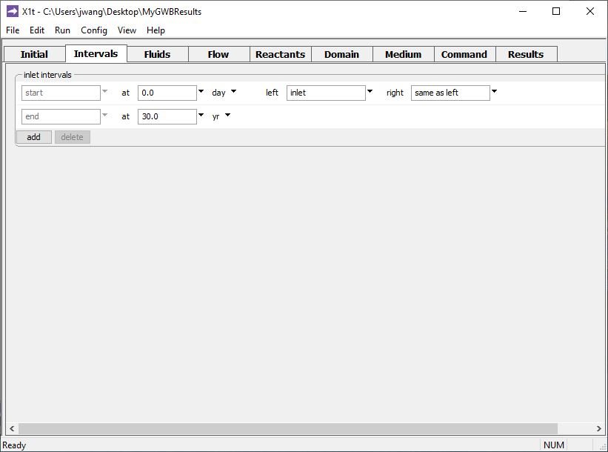
Define the reaction intervals. Specify what fluids flow into the domain, and when.
A single inlet fluid flows into the domain for 30 years.

Slide 5
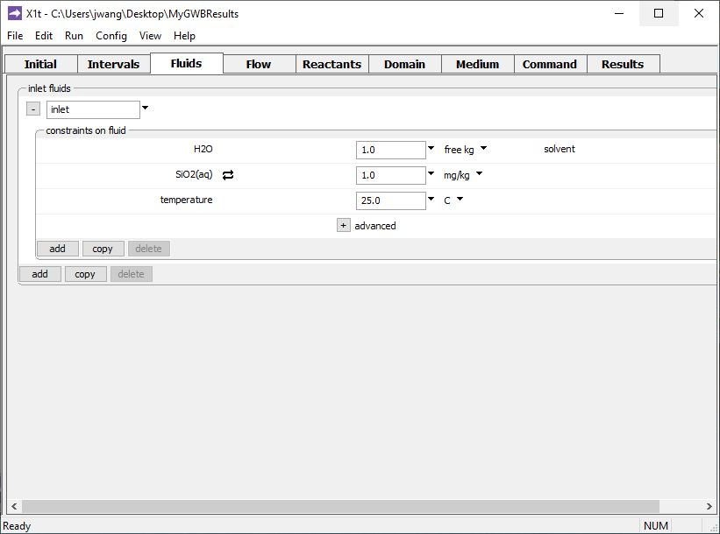
The inlet fluid is defined on the Fluids pane
SiO₂(aq) concentration sets the inlet fluid to be undersaturated with respect to Quartz

Slide 6
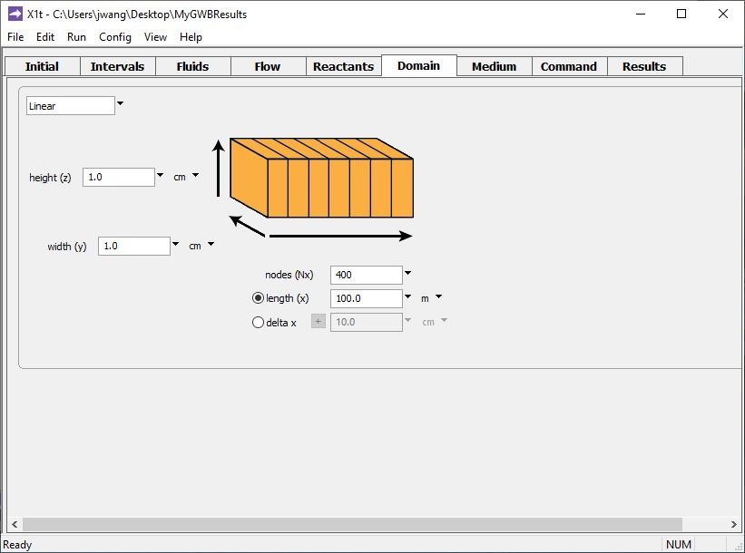
Specify domain size and gridding on the Domain pane.
Domain is 100 m long, divided into 400 nodal blocks

Slide 7
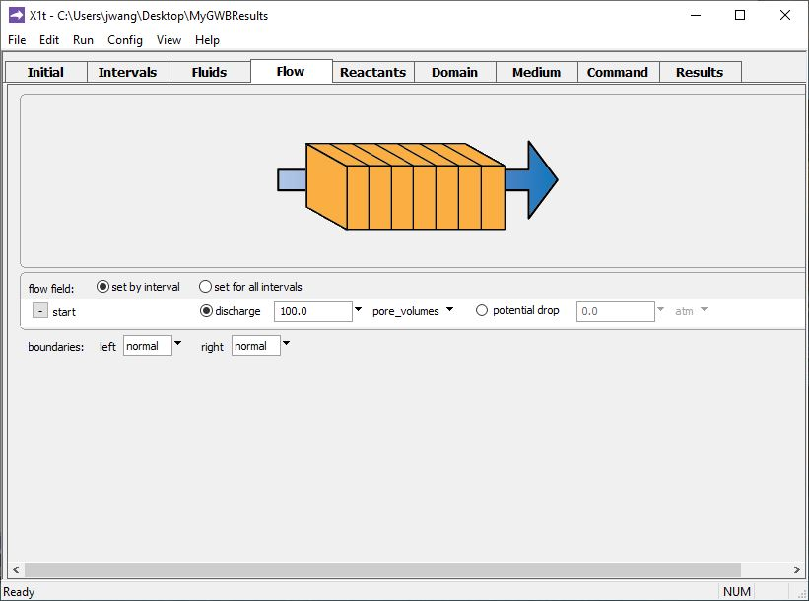
Specify flowrate on the Flow pane.
Pore fluid in aquifer displaced 100 times over the 30 year timespan we set on the Intervals pane

Slide 8
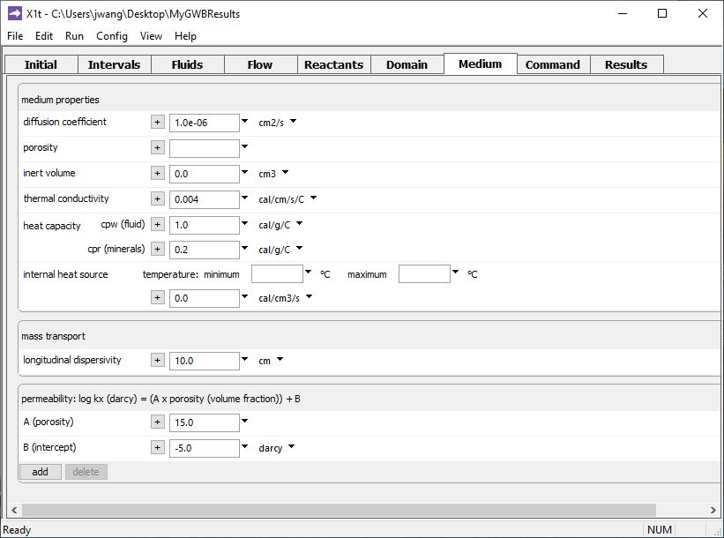
Set various mass transport properties on the Medium pane.
No value set, so porosity calculated from volume of equilibrium minerals: 70% Quartz → 30% pore space.
Run → Go
traces the model

Slide 9
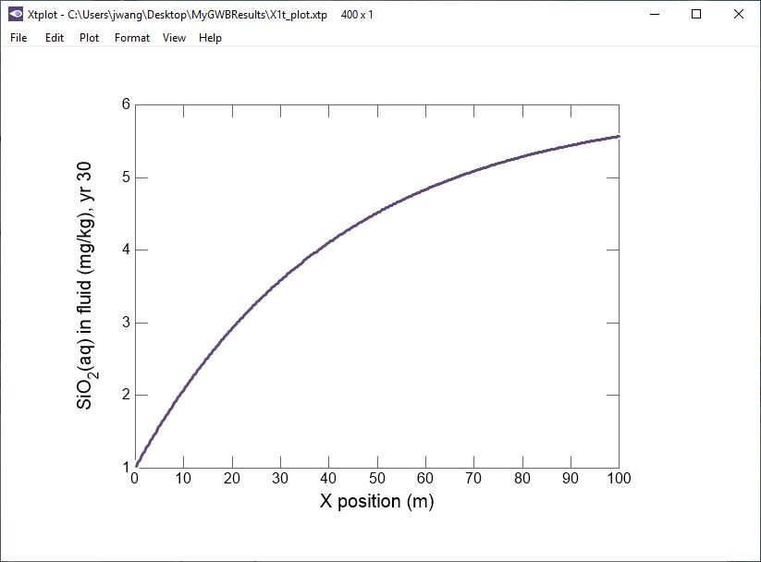
SiO₂(aq) concentration approaches Quartz equilibrium value.
Inlet fluid is undersaturated with respect to Quartz.

