Slide 2
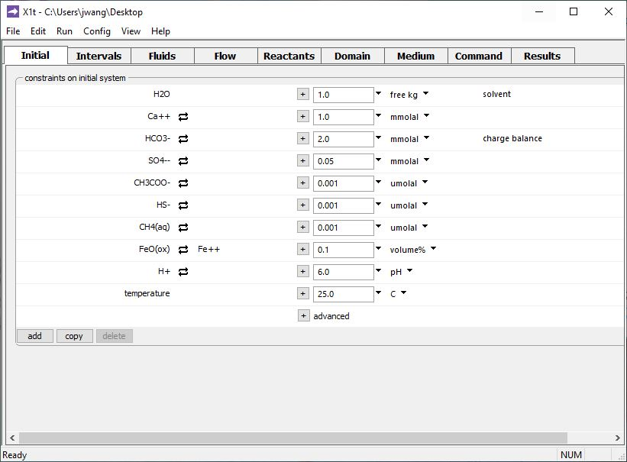
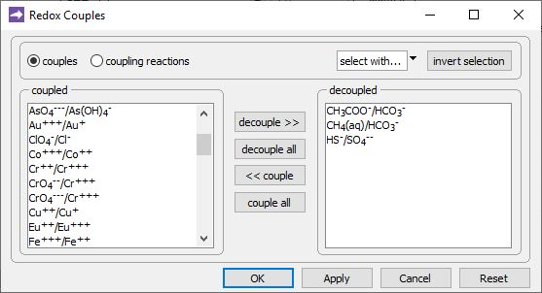
Config →
Redox Couples…
Decouple reaction between carbonate and acetate, carbonate and methane, and sulfate and sulfide.
Decoupling provides for the redox disequilibrium that supplies sulfate reducers and methanogens with energy.
Default setting: all redox reactions are coupled.

Slide 3
Specify domain’s starting fluid composition on the Initial pane
After decoupling redox pairs, you can add carbon and sulfur species in multiple redox states.
Ca-HCO₃ water containing SO₄²⁻, pH = 6

Slide 4
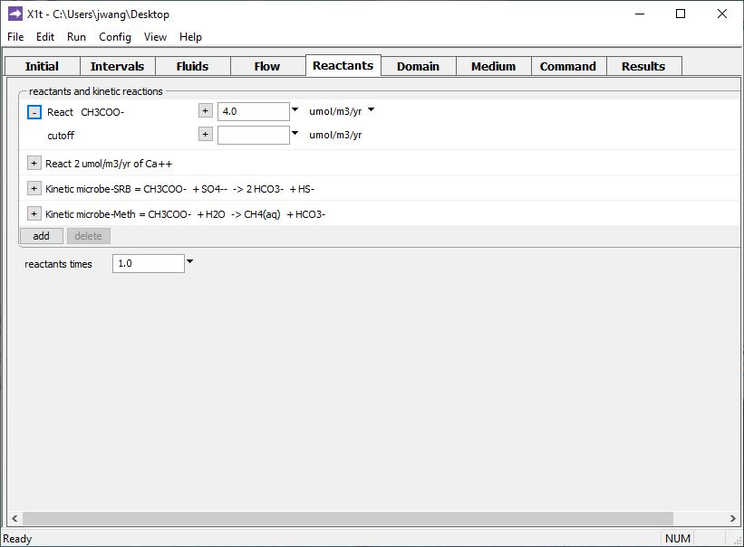
You add reactants and enable redox kinetics on the Reactants pane.
Click to expand
Rate of acetate addition to the aquifer
SO₄⁻⁻ reducers
Methanogens
add → Simple →
Aqueous… → CH3COO−
add → Simple →
Aqueous… → Ca++
add → Kinetic →
Microbial reaction (2X)

Slide 5
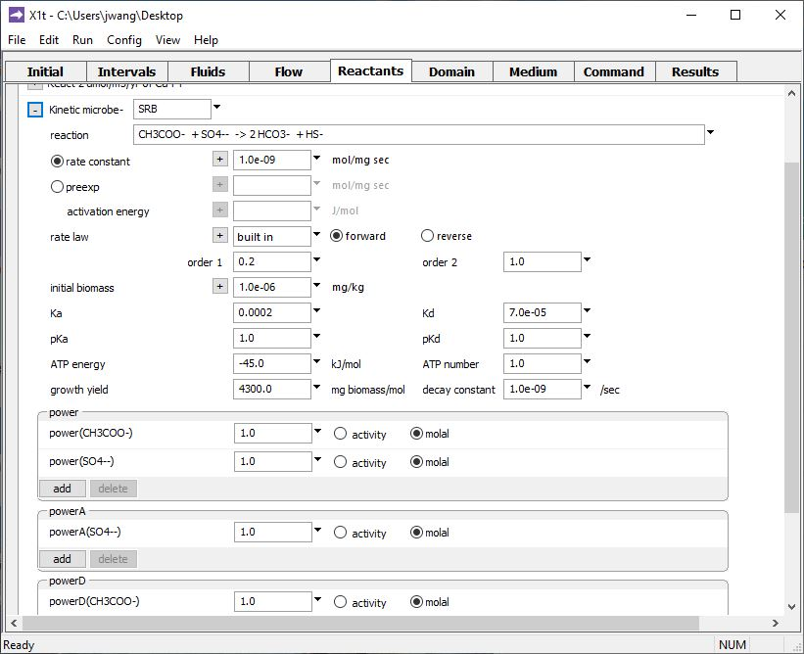
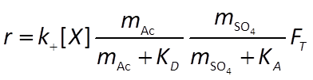
Identify each microbe with a label and reaction. Microbes can compete for common substrates or carry out separate reactions.
Specify kinetic, thermodynamic, and growth parameters for each microbe.
Initial biomass
Growth yield and decay constant
Rate constant, half-saturation constants
ATP energy, ATP number
Form of Monod terms for e⁻ donating (D) and accepting (A) half-reactions

Slide 6
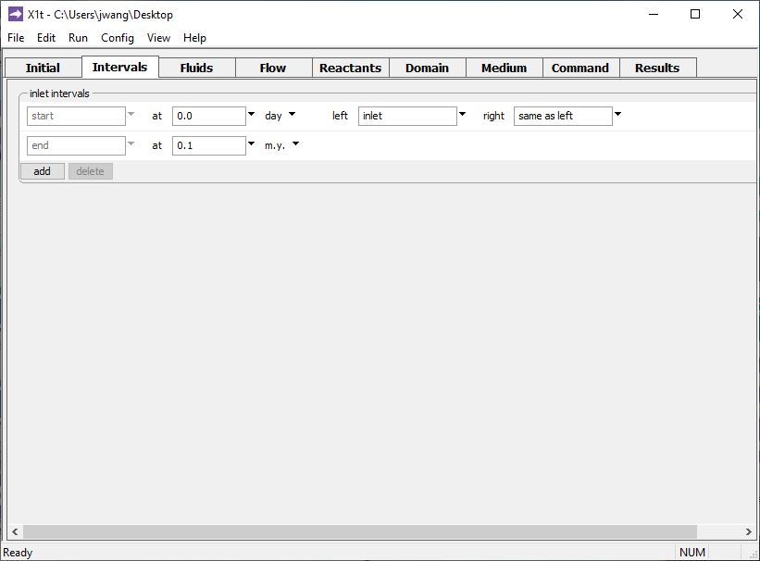
Define the reaction intervals. Specify what fluids flow into the domain, and when.
A single inlet fluid flows into the domain for 10⁵ years.

Slide 7
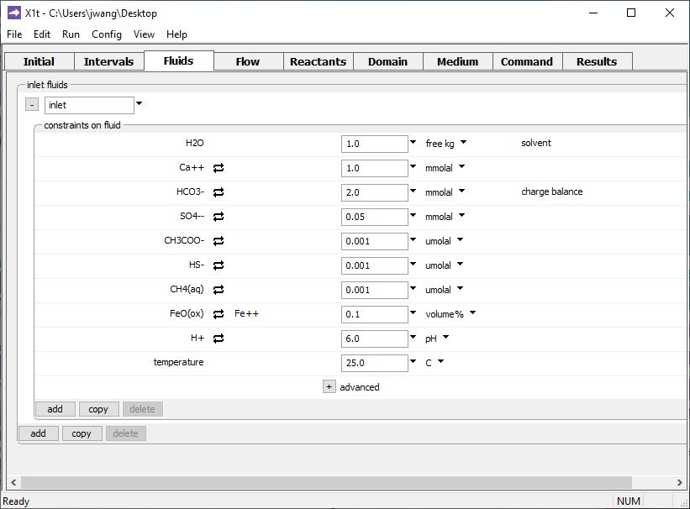
The inlet fluid is defined on the Fluids pane
The “inlet” fluid is identical to the Initial fluid

Slide 8
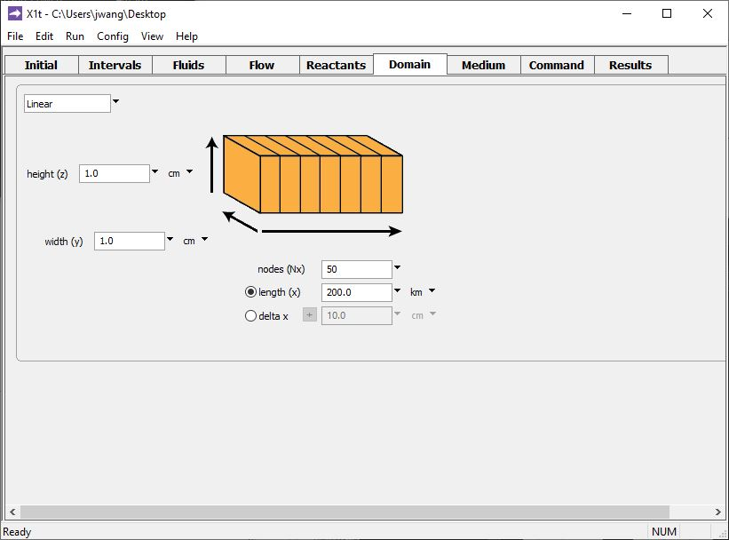
Specify domain size and gridding on the Domain pane.
Domain is 200 km long, divided into 50 nodal blocks

Slide 9
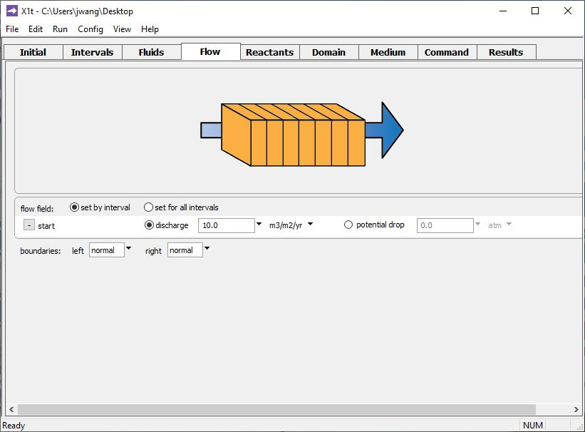
Specify flowrate on the Flow pane.
Set specific discharge or head drop

Slide 10
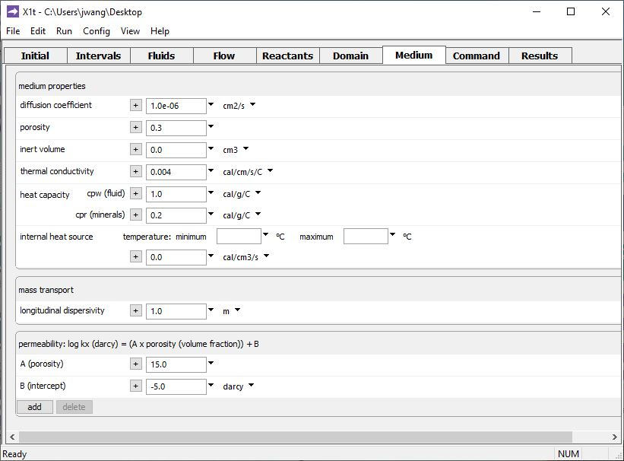
Set various mass transport properties on the Medium pane.
Run → Go
traces the model

Slide 11
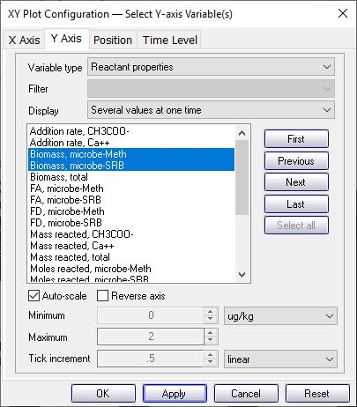
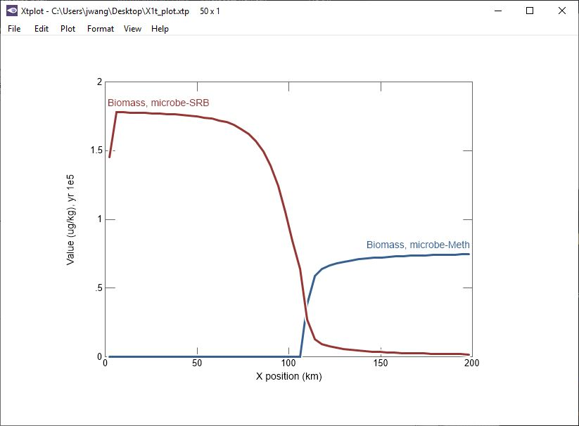
After 10⁵ years of metabolism, growth, and decay, two microbiological zones develop in the aquifer.

Slide 12
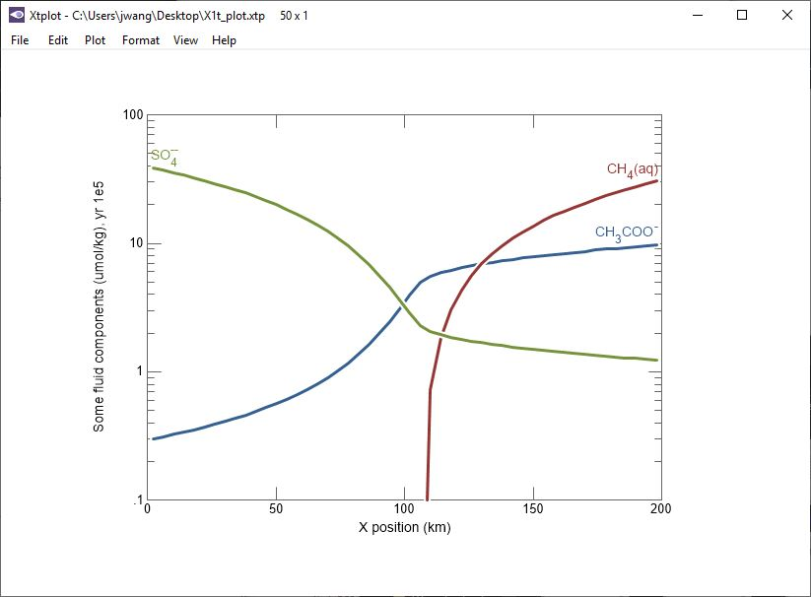
SRB dominate where sulfate is abundant.
Methane accumulates in second zone of the aquifer.

