Slide 1
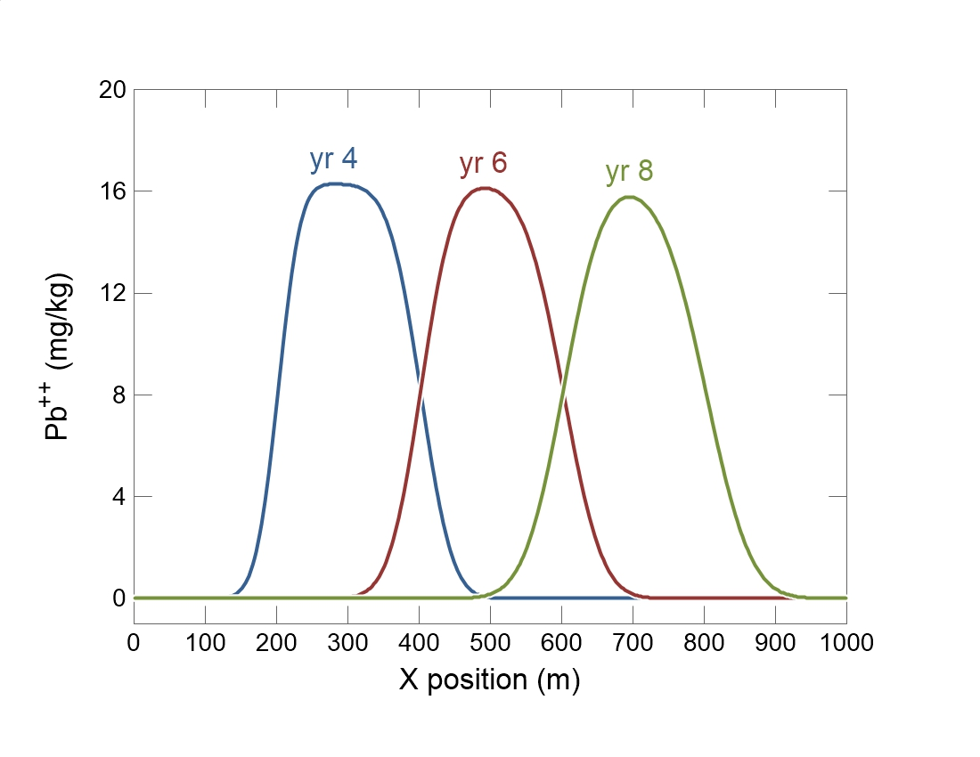

Slide 2
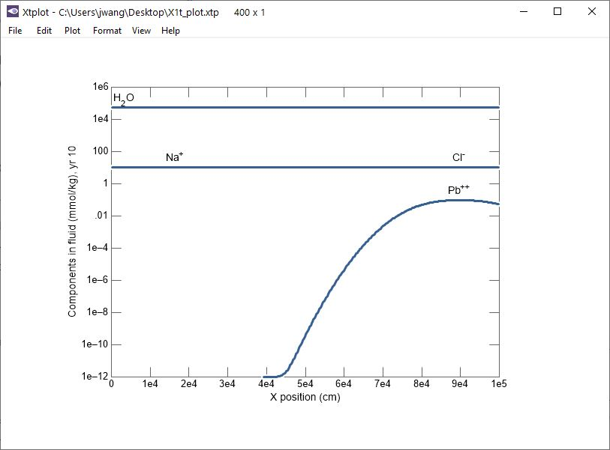
Use Xtplot to display species concentration along the profile.

Slide 3
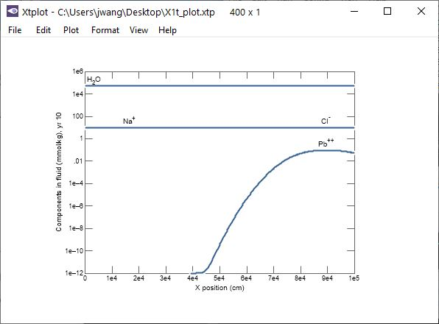
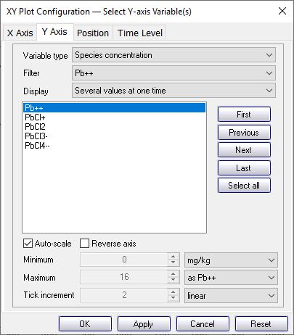
Plot → XY Plot
Move to the Y Axis pane.
Select Pb++ in filter to show only Pb species.
Variable type → Species concentration

Slide 4
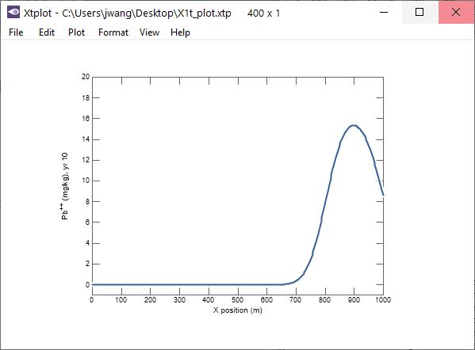
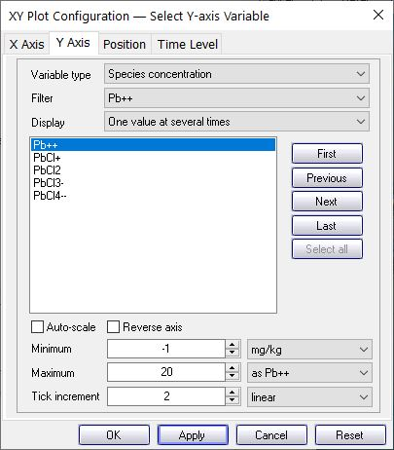
Select from linear, log, or delta plots
Quickly change units
Uncheck auto-scale to manually set the scale.

Slide 5
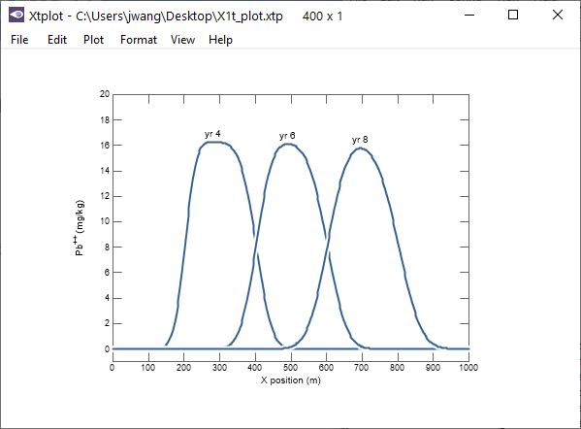
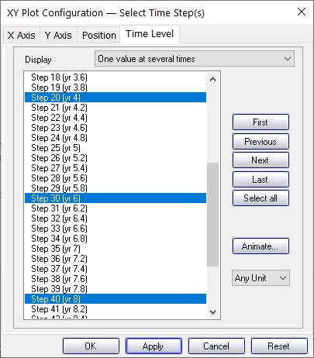
Select one value at several times to display Pb++ concentrations at various times.
Move to the Time Level pane.
Press Ctrl while clicking to select multiple times.

Slide 6
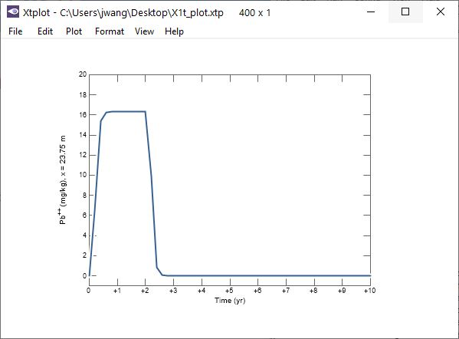
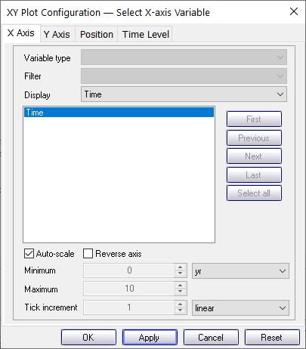
Move to the X Axis pane.
Display → Time
Use Xtplot to display species concentration through time.

Slide 7
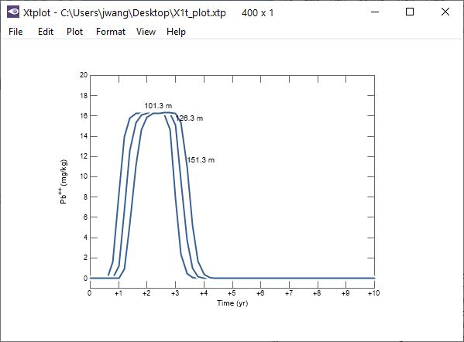
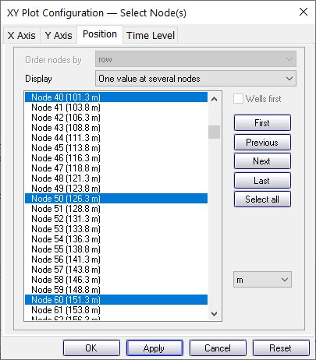
Move to the Position pane.
Press Ctrl to select multiple nodes to plot breakthrough curves.

