Slide 2
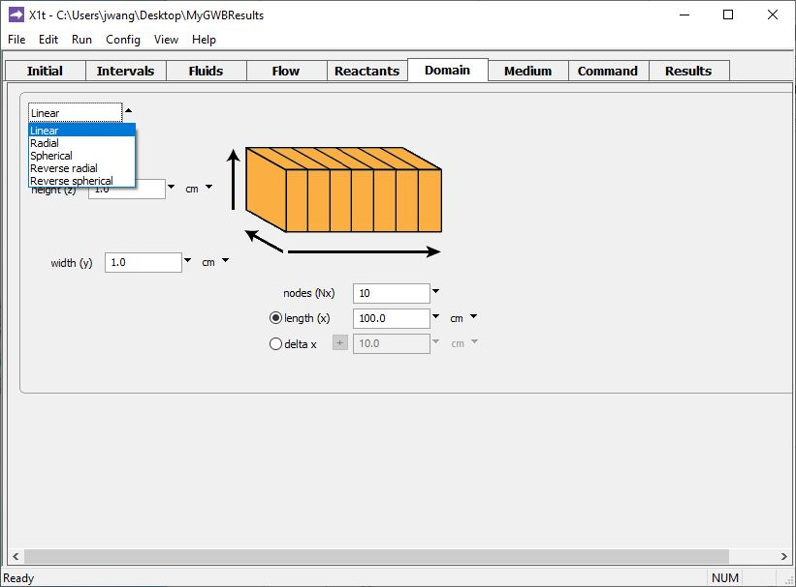
You can set up a model in linear, radial, or spherical coordinates in X1t.
Specify coordinate system on the Domain pane.
Set the number of nodes, Nx
Set either domain length, x, or grid spacing, ∆x

Slide 3
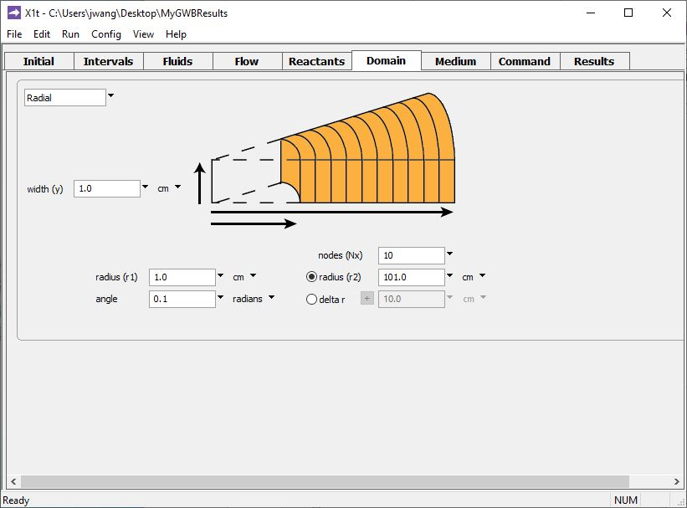
You can set up a model in linear, radial, or spherical coordinates in X1t.
Set the number of nodes, Nx
Set small-end radius, r1
Set either large-end radius, r2, or grid spacing, ∆r

Slide 4
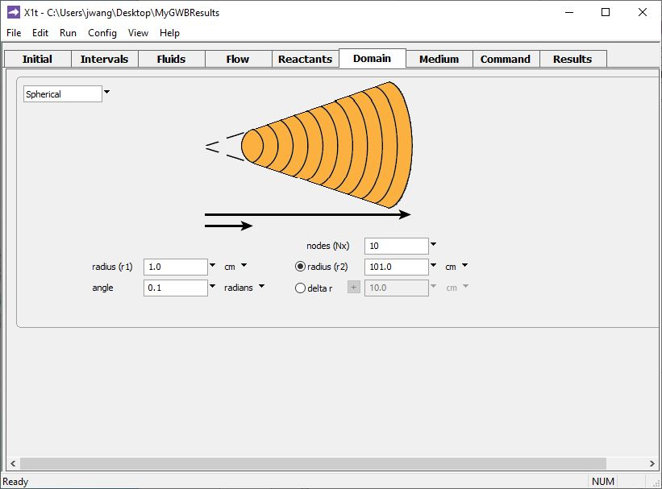
You can set up a model in linear, radial, or spherical coordinates in X1t.
Set the number of nodes, Nx
Set small-end radius, r1
Set either large-end radius, r2, or grid spacing, ∆r

Slide 5
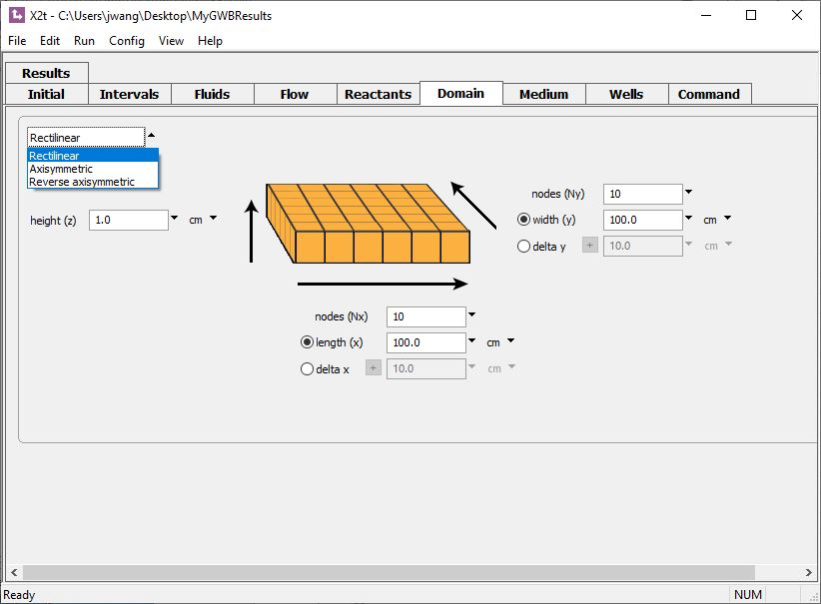
Set the number of nodes along y, Ny
Set either domain width, y, or grid spacing, ∆y
You can set up a model in rectilinear or axisymmetric coordinates in X2t.
Set the number of nodes along x, Nx
Set either domain length, x, or grid spacing, ∆x

Slide 6
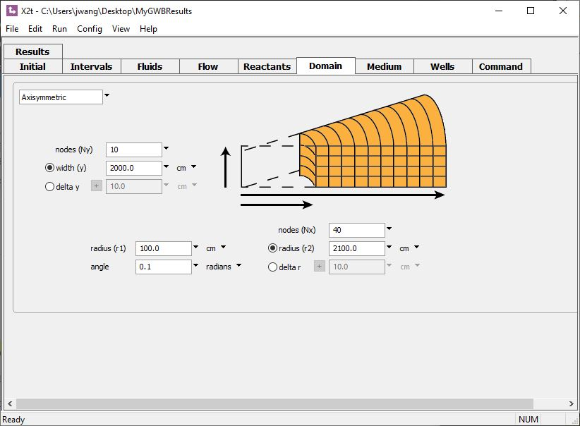
You can set up a model in rectilinear or axisymmetric coordinates in X2t.
Set the number of nodes along y, Ny
Set either domain width, y, or grid spacing, ∆y
Set the number of nodes, Nx
Set small-end radius, r1
Set either large-end radius, r2, or grid spacing, ∆r

Slide 7
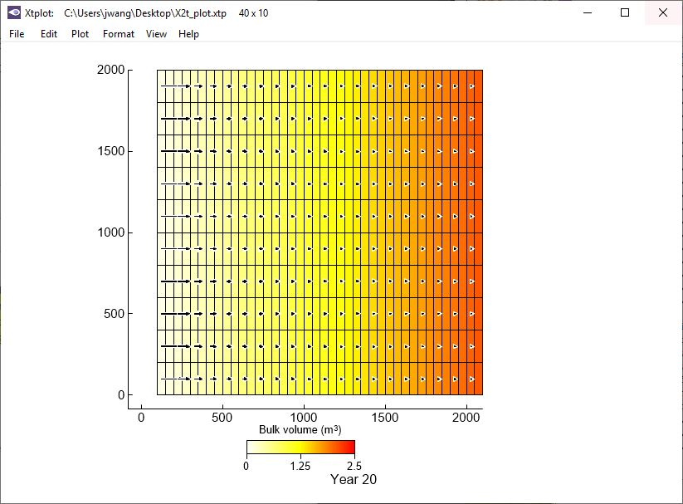
X1t and X2t will account for the domain’s coordinate system in calculating the flow field.
In an axisymmetric domain, fluid velocity decreases with distance from the wellbore.
Small-radius end.
Large-radius end.

